Slide 1
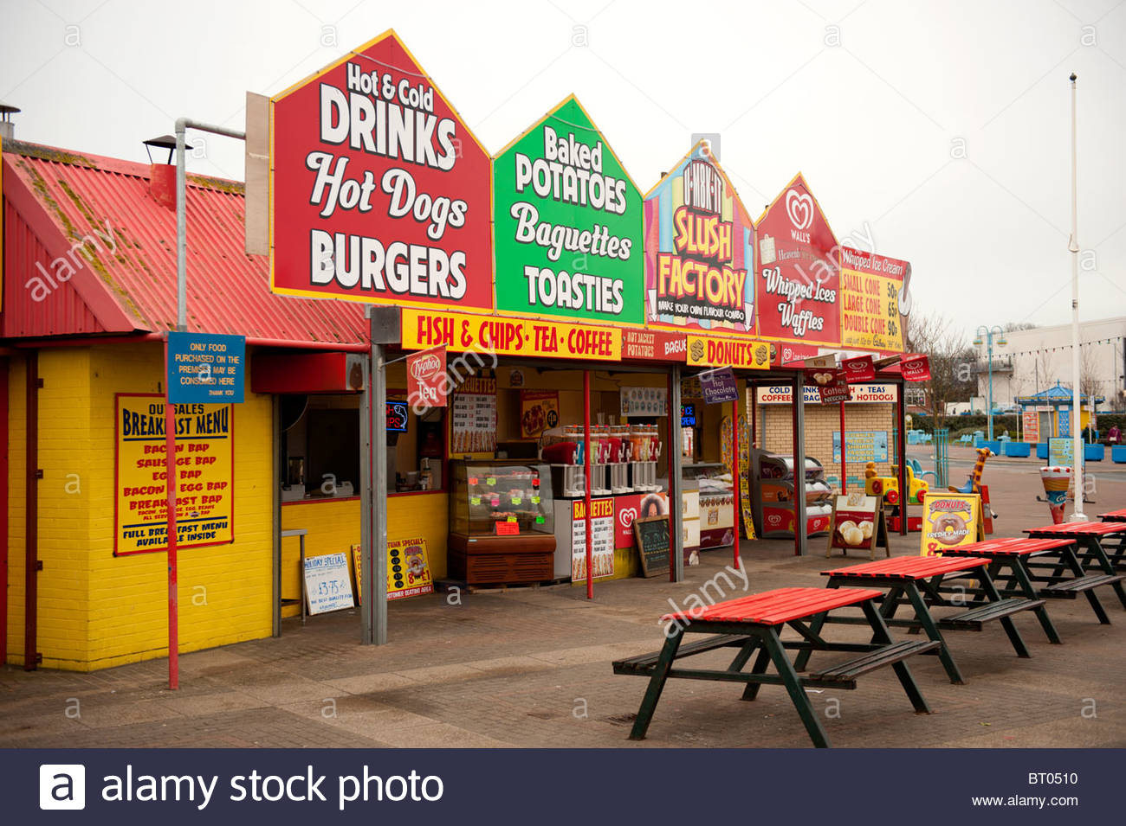
FAST FOOD BUSINESS MANAGEMENT

Slide 2
AGENDA
Introduction
Problem Statement and Data Source
Objective & Methodology
Solution Description
Business Impact

Slide 3
INTRODUCTION
Fast food is a term that is given to food that can be prepared and served quickly. These are the foods that can be sold in the restaurant and served to customers as a package to takeout or take away. Fast Food are in the process of making turnaround strategy that will help in transform the organization into more proficient and profitable.
Fast Food Business should be managed in such a way that it should result in making good Profits. It should Increase the customer number as well as the Sales and Profits.

Slide 4
PROBLEM STATEMENT AND DATA SOURCE
Understand the working process of the Restaurant to find out the positive and negative side where the client is making profits and loss and help him to reduce the losses and to create a sustainable business.
Data is Collected From the Client and some from the Research. The data is of 6-7 months.
Increase the Profit by more than 15% - 20% a month.
Finding out the Investment Source and manage the Investment

Slide 5
OBJECTIVE
Identifying the best Food Items to buy.
Identifying the Customers Choice.
To make Food Items Taste better.
Identifying the Seasonal based Food Items to buy.
Finding out the Investment Source and manage the Investment.
Increase the Profit by more than 15% - 20% a month.

Slide 6
METHODOLOGY
Using Microsoft Excel to store the collected data, to analyze and to visualize the business model.
 |  |  |  | MONTHS
SALES | FOOD ITEMS | M1 | M2 | M3 | M4 | M5 | M6 | M7
 | BIRYANI | 22474 | 26912 | 30350 | 19558 | 18319 | 6474 | 3639
 | MAGGIE | 13447 | 15243 | 24525 | 19749 | 15958 | 5004 | 1623
 | EGG BHUJIA | 11620 | 13281 | 15860 | 19846 | 18064 | 6753 | 1355
 | OMELETS | 12241 | 14667 | 16993 | 19855 | 19395 | 4108 | 2229
 | CHICKEN KABAB | 20324 | 25843 | 27754 | 18739 | 17853 | 4396 | 2713
 | VEG FOOD | 8466 | 0 | 0 | 0 | 0 | 0 | 0
TOTAL SALES |  | 88572 | 95946 | 115482 | 97747 | 89589 | 26735 | 11559
RENT |  | 14000 | 14000 | 14000 | 14000 | 14000 | 0 | 0
OTHER EXPENDITURES |  | 60000 | 48000 | 50000 | 50000 | 48000 | 45000 | 40000
PROFIT/LOSS |  | 14572 | 33946 | 51482 | 33747 | 27589 | -18265 | -28441

Slide 7
SOLUTION DESCRIPTION
Research and Analyze the Place weather good or bad for the business.
Analyzing every month sales and Profit Chart.
Conducting Free Survey from Customers to improve Customers experience.
Analyzing new food stalls or Hotels open nearby.
Analyzing the business of other fast food stalls or Hotels present nearby.
Getting connected with online platforms like Zomato and Swiggy.
Analyze the Food to sell on season basis.
special offers on weekends and Festivals.

Slide 8
BUSINESS IMPACT
Creating a Proper business model for decreasing losses and to gain more Profits.
Increasing the sales and Profits.
Increasing the number of Customers.
Creating a brand.

Slide 9
THANK YOU!

