Slide 1
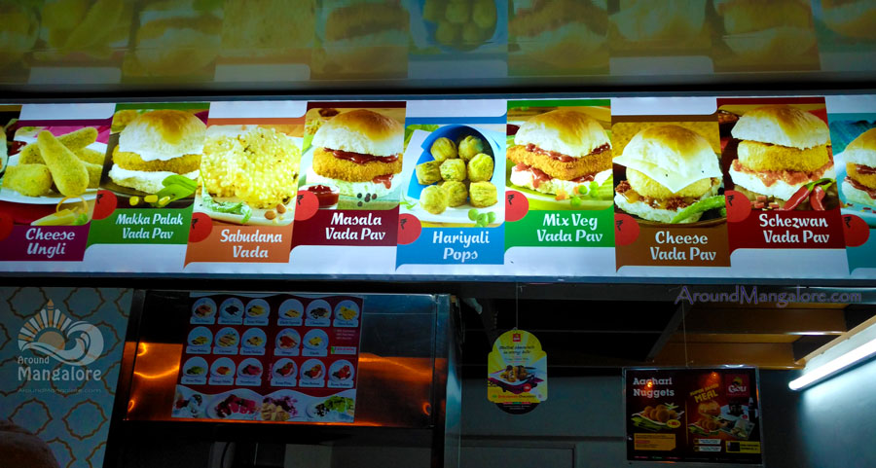
VADAPAV SHOP BUSINESS MODEL

Slide 2
AGENDA
Introduction
Problem Statement and Data Source
Objective & Methodology
Solution Description

Slide 3
INTRODUCTION
Here was a product available at almost every corner of Mumbai and Pune, hugely popular and selling for as little as Rs.5. But the popular selling it had absolutely no vision for putting any kind of consistency or expertise around it.
In many ways Vadapav resembled the burger sells in the United States for just 15 cents before McDonald’s made a grand appearance and decided to grow with this.
A Business model will help in growing the Business in well manner and try to lower the risk and losses. It results in making more profits, increasing number of Customers and help in making a sustainable Business.

Slide 4
PROBLEM STATEMENT AND DATA SOURCE
Understand the working of Vadapav shops present near Shivaji Nagar, Pune to find out the process, negative and positive side the Business.
Is it a good place to open a Vadapav shop where already the Competitors are present with good Customer support?
Attract Customers and Increase the number of Customers.
Find out the source for the materials we needed to open a Vadapav shops like bakeries for pav and patties.
Increase the quality, taste and Hygiene of the Vadapavs.
Data is being collected from the Research of the place we want to open the shops and the already presented shops.

Slide 5
DATA

Slide 6
OBJECTIVE
Best Price to offer for Vadapav.
How to be different from competitors?
Attract Customers and Customer Retention.
Quality, taste and Hygiene.
Regular increase in profit more than 10%-15%.

Slide 7
SOLUTION DESCRIPTION 1
Analyze the place and competitors for the Vadapav Business.
Analyze the working and Food of the 4 Shops present nearby.
Conducting a Free 1 hr sales during opening a Vadapav shop to attract the Customers.
Price of the Vadapav should be in between Rs.8 to Rs.15 to attract the middle and lower class customers.
Mainly we have to take care of quality, Taste and Hygiene.
Getting connected with online platforms like Zomato and Swiggy.
Special offers to regular customers and on weekends too.

Slide 8
SOLUTION DESCRIPTION 2(OPTIONAL)
We can Approach for a partnership with one of the four Vadapav Shops by investing in the shop.
If one of the shop agrees with the partnership we don’t have to attract customers.
We can Invest the money in advertisement like printing outlets and small billboards and placed in strategic locations(like buses, trains, ticket counters, petrol pumps etc.) and advertise digitally too.
We can invest the money to increase the space for more Customers to getin.
We can offer good price to the existing customer with better quality, taste and Hygiene.
We can experiment to increase the quality and taste of the vadapav.
Special offers to the regular customers and on weekends to.

Slide 9
THANK YOU!

