Slide 1
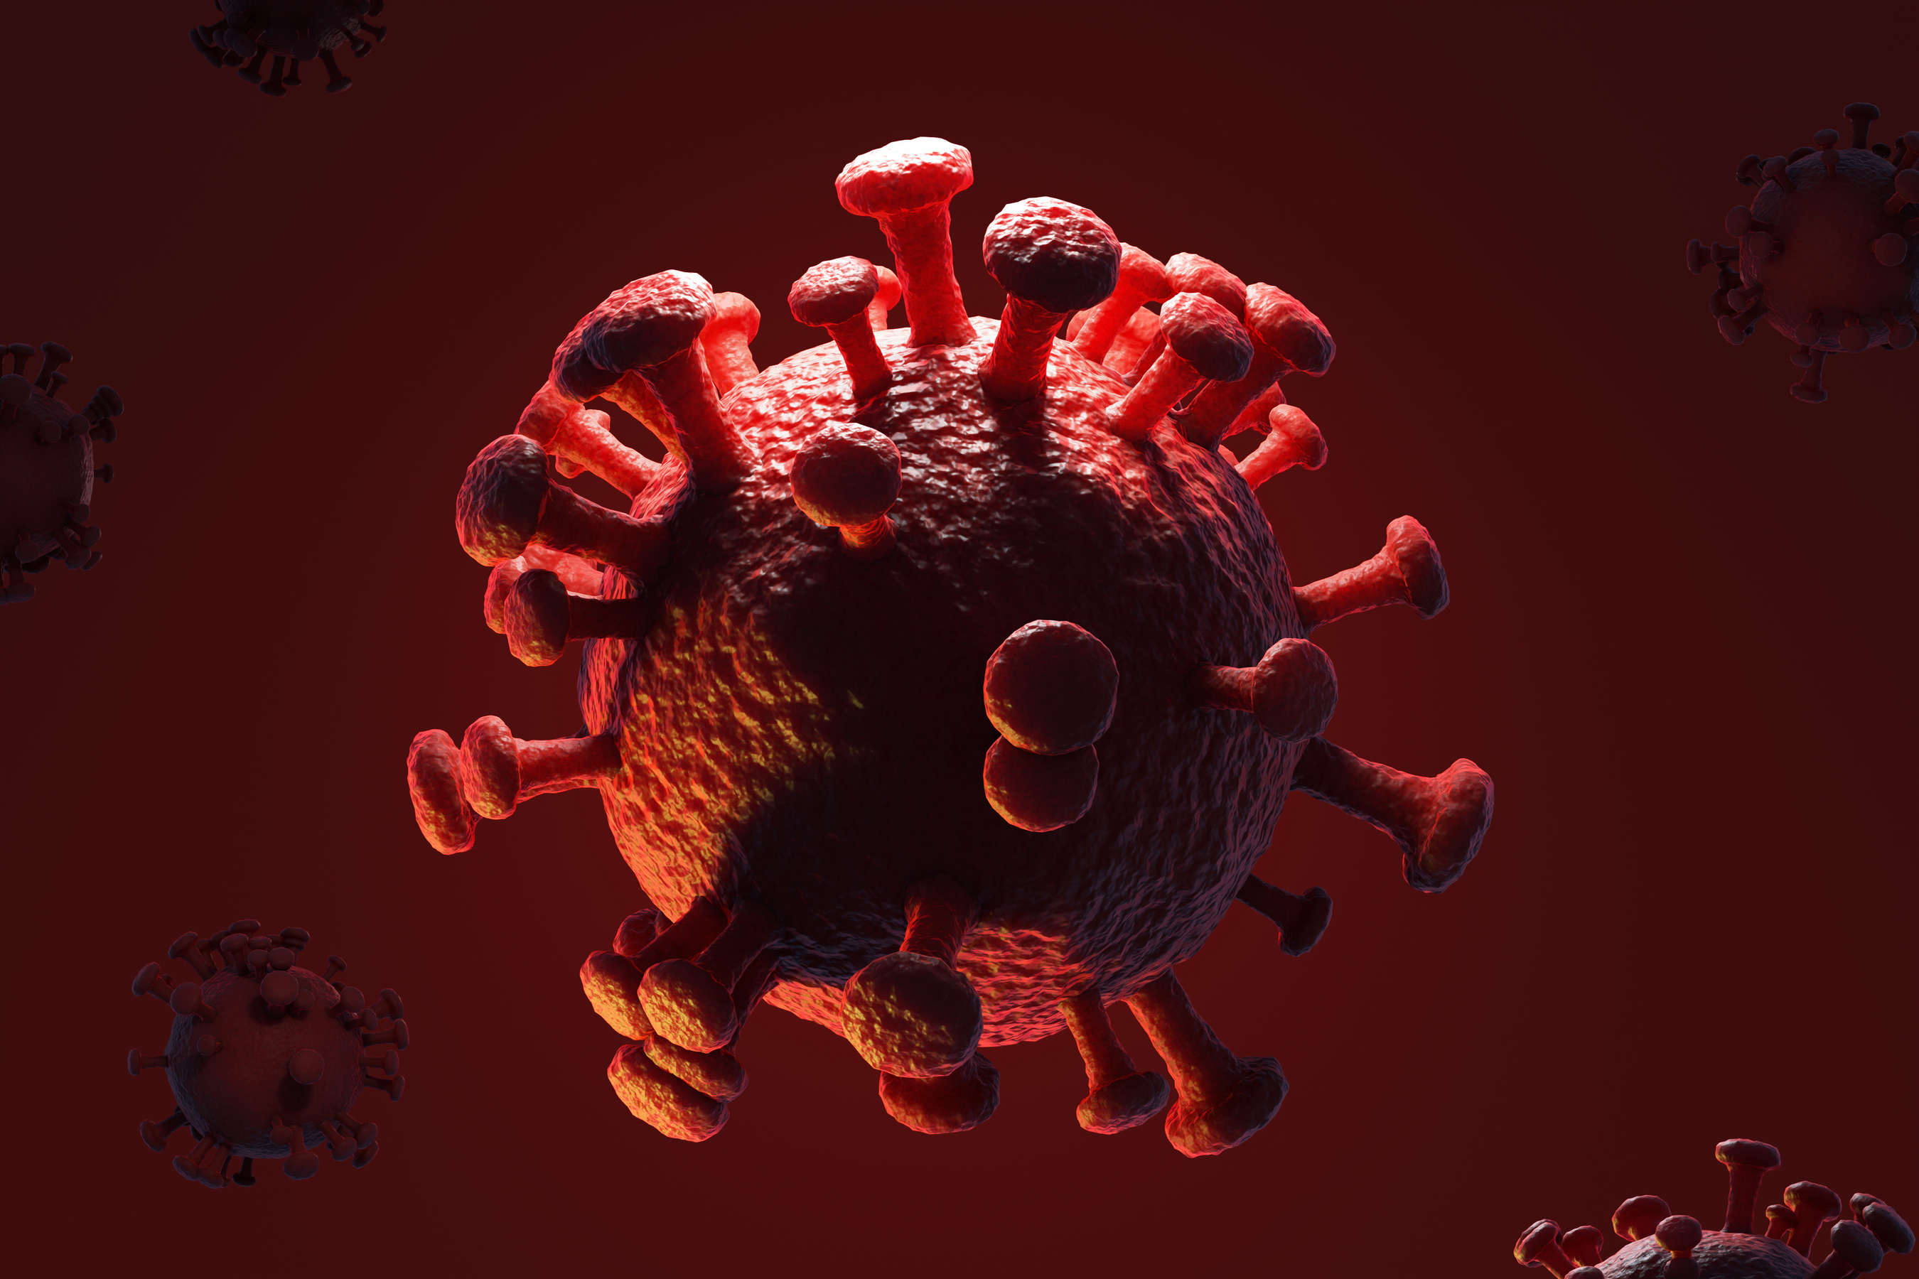
HEART
DISEASE PREDICTION

Slide 2
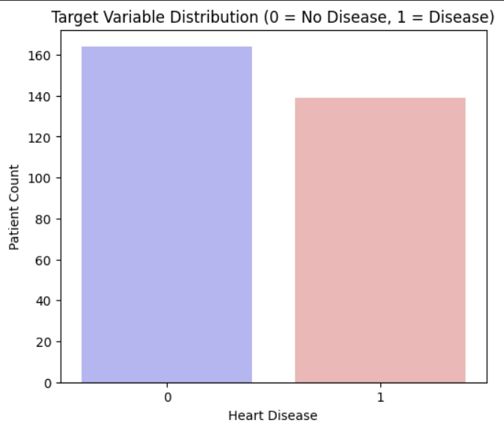
PROJECT OVERVIEW
Primary Objective:
  To predict the presence (1) or absence (0) of heart disease.
Dataset:
  Source: Cleveland Heart Disease (UCI)
  Size: 303 patient records, 14 features.
Data Preparation:
  Cleaning: Imputed 6 missing values (ca, thal) using the mode.
  Transformation: Converted the target (0-4) into a binary class (0 vs 1).
  Result: A clean, well-balanced dataset (164 vs 139 samples).

Slide 3
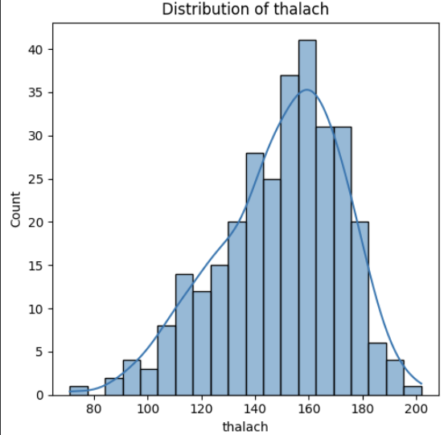
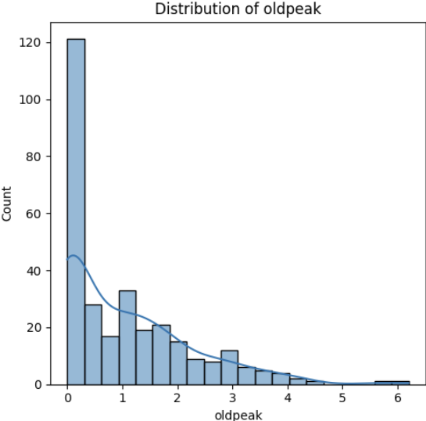
EDA - KEY NUMERICAL PREDICTORS
Key Insight
Patients with heart disease (1) show clear, measurable differences in key medical readings.
  They consistently demonstrate a lower thalach (max heart rate) during stress tests.
  They also show a higher oldpeak (ST depression), indicating stress-induced abnormalities.

Slide 4
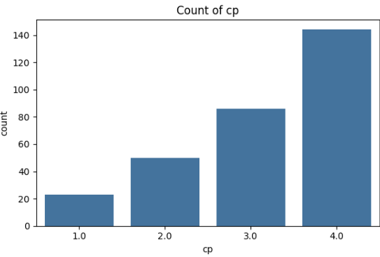
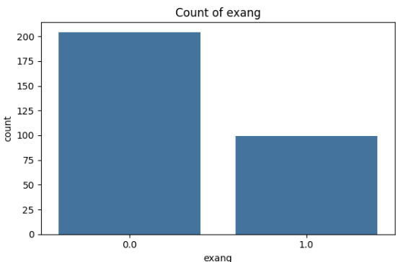
EDA - KEY CATEGORICAL PREDICTORS
Key Insight: Patient-reported symptoms and test results are highly predictive "risk factors".
  Chest Pain (cp): Type 0 (Typical Angina) is strongly linked to having heart disease.
  Exercise Angina (exang): Patients with exercise-induced angina (exang=1) are far more likely to have heart disease.

Slide 5
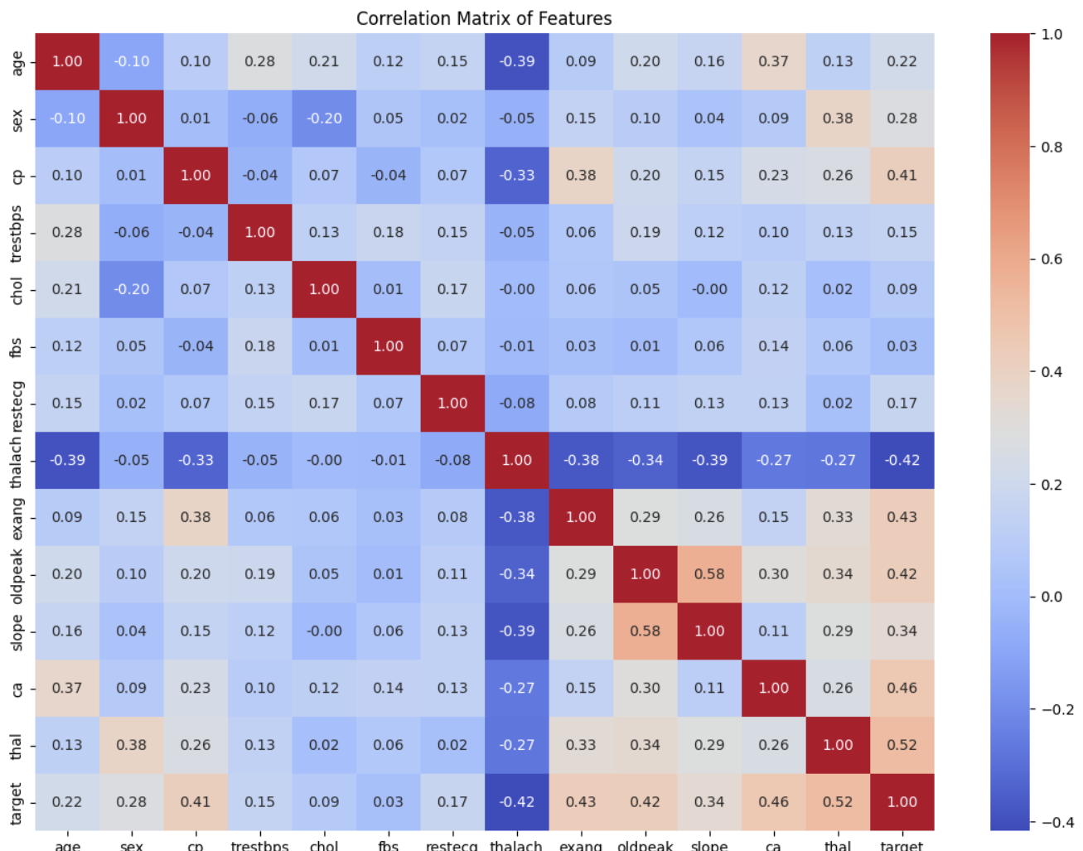
EDA - CORRELATION HEATMAP
Key Insight: The heatmap confirms our findings and reveals which features are most important for modeling.
  Strongest Negative Correlation: target vs. thalach (Max Heart Rate).
  Strongest Positive Correlations: target vs. oldpeak (ST Depression) and target vs. ca (Number of Major Vessels).

Slide 6
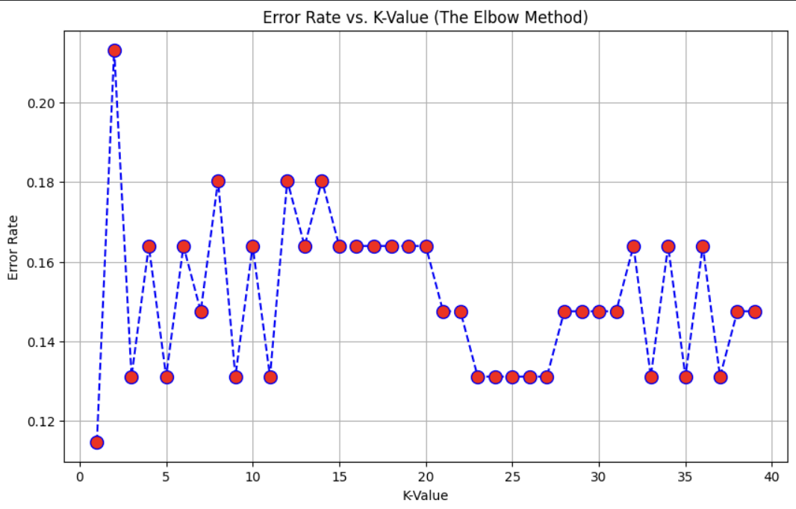
MODELING PIPELINE & HYPERPARAMETER TUNING
One-Hot Encoding:
Converted 8 categorical features (e.g., cp, thal) into 22 total features.
Train-Test Split:
Split data 80% (242 samples) for training and 20% (61 samples) for testing.
Feature Scaling:
Applied StandardScaler to all features, vital for models like SVM and KNN.
Tuning:
For models like KNN, we used the "Elbow Method" to find the optimal 'k' to minimize error.

Slide 7
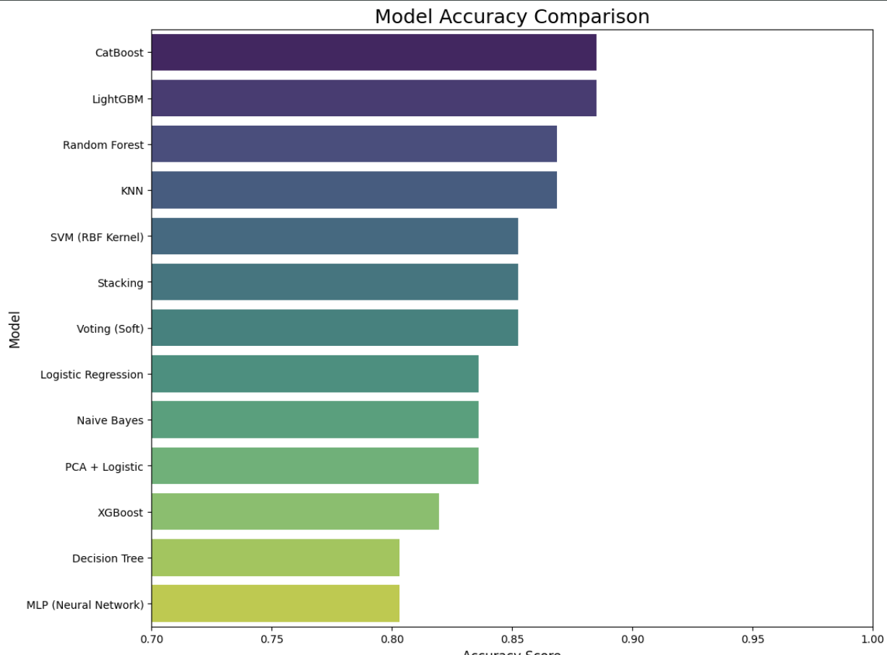
MODEL PERFORMANCE COMPARISON (ACCURACY)
Results: All 13 models were trained and tested. The results show a clear winner in terms of overall accuracy.
Top Tier: Boosting and Ensemble methods provided the highest accuracy.
Mid Tier: Tree-based and distance-based models were strong
performers.
Baseline: Simple models provided a good starting point but were outperformed.

Slide 8
MODEL PERFORMANCE DEEP DIVE (TABLE)
Model | Accuracy | Precision | Recall | F1-Score
CatBoost | 0.8852 | 0.8858 | 0.8852 | 0.8853
LightGBM | 0.8852 | 0.8858 | 0.8852 | 0.8853
Random Forest | 0.8689 | 0.8709 | 0.8689 | 0.8689
KNN (K=23) | 0.8689 | 0.8761 | 0.8689 | 0.8687
SVM (RBF Kernel) | 0.8525 | 0.8531 | 0.8525 | 0.8525
Key Insight: The F1-Score (a balance of Precision and Recall) is often the best metric for medical data.
Best F1-Score: CatBoost and LightGBM (~0.885)
Best Recall: Naive Bayes (Warning: low precision)
Best Overall: CatBoost, LightGBM, and Random Forest show the most balanced and highest-performing metrics.

Slide 9
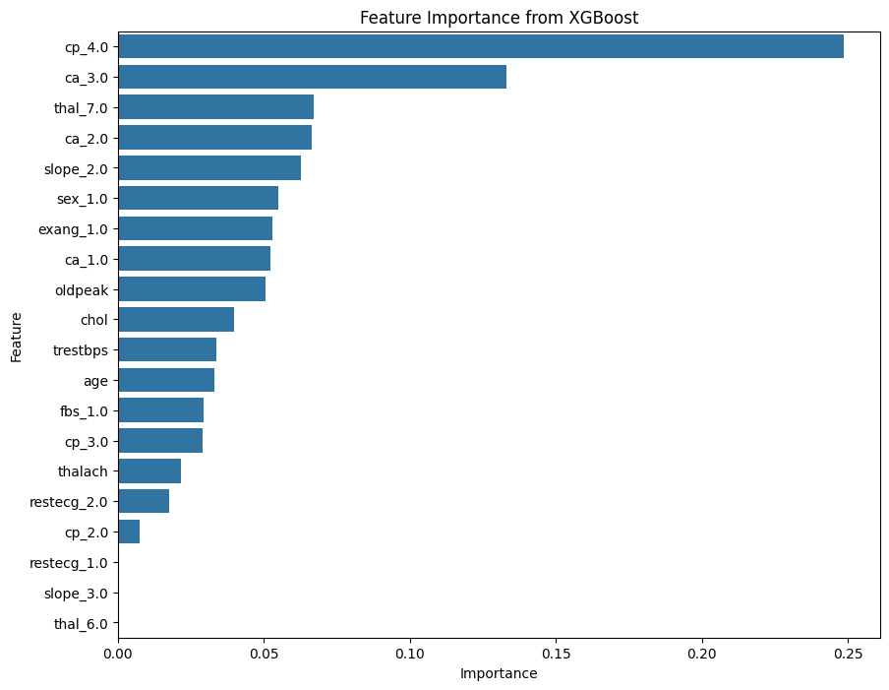
BEST MODEL : FEATURE IMPORTANCE
Insight: We can look inside our best models to see why they make their predictions.
The feature importance plot from XGBoost (similar to CatBoost/RF) confirms our EDA.
The most important features are thal_2, ca_0, cp_0, and oldpeak.
This gives us confidence in the model's decisions, as it aligns with medical knowledge.

Slide 10
CONCLUSION & RECOMMENDATIONS
Conclusion:
Heart disease is highly predictable from this data, with top models achieving ~88.5% accuracy.
Ensemble & Boosting models (CatBoost, LightGBM) are the clear winners.
Feature Engineering (one-hot encoding) was critical for this success.
Key Insight (PCA):
The PCA + Logistic model performed worse than the standard Logistic Regression (as seen in your notebook).
This proves that all 22 features were valuable and dimensionality reduction was not helpful for this dataset.
Future Work:
Use GridSearchCV to fine-tune the top 3 models (CatBoost, LightGBM, Random Forest) for even better performance.
Deploy the final model as a web application for practical use.

Slide 11
THANK YOU
NAME: Aman Tiwari
PRN: 22070521141
SEM: 7th, ‘C’

