Slide 1




IMAGE-BASED WASTE CLASSIFICATION SYSTEM
TEAM MEMBERS
KHUSHI DEKATE
AMAN TIWARI
ARNAV KALAMBE
RAJ LANDE

Slide 2

Learning Objectives
To understand the environmental impact of improper waste segregation and how AI can contribute to sustainability.
To learn how to apply Convolutional Neural Networks (CNNs) and Transfer Learning for image classification tasks.
To gain hands-on experience in preprocessing image datasets, including resizing, normalization, and augmentation techniques.
To learn how to handle class imbalance using class weighting during model training.
To build a binary classification model that distinguishes between biodegradable and non-biodegradable waste images.
GOAL

Slide 3
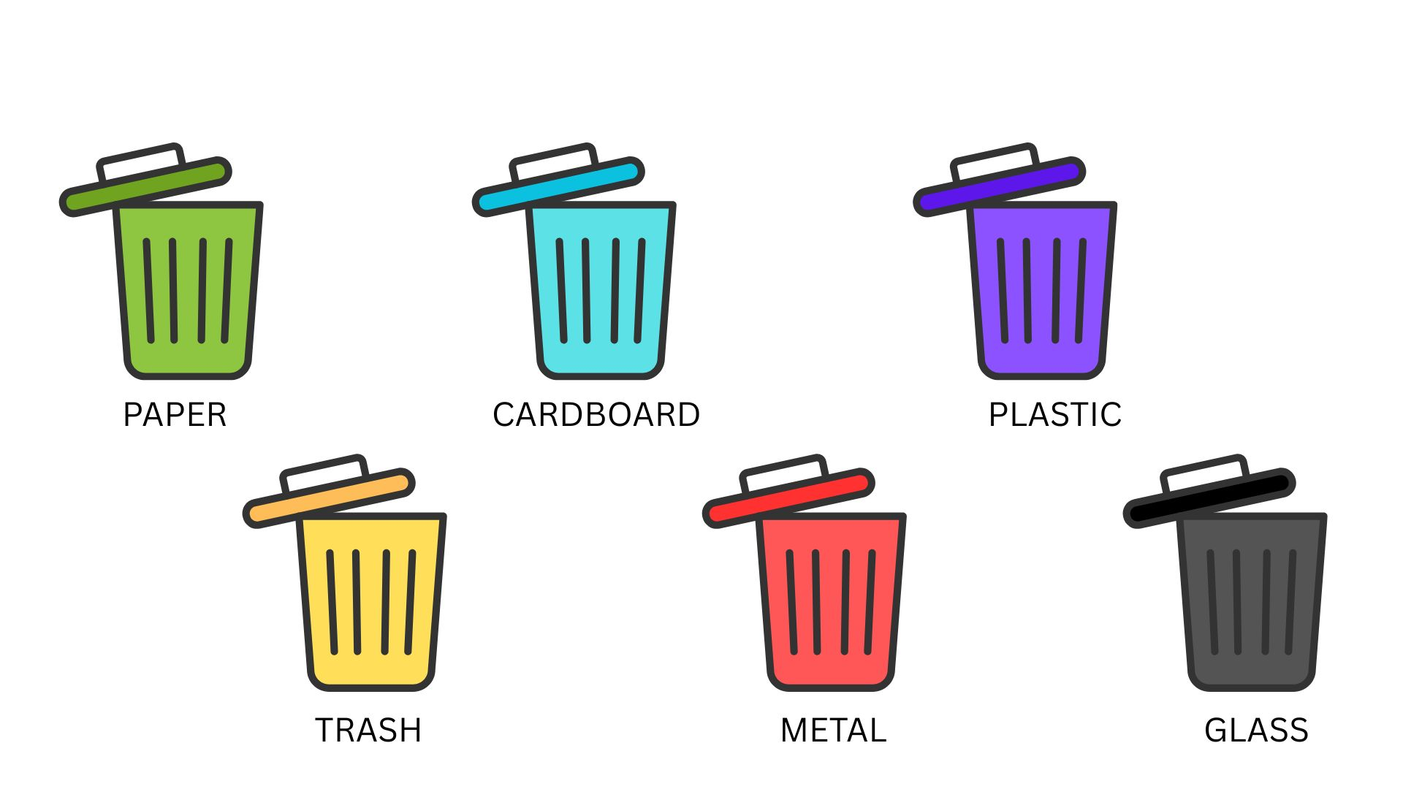
Problem Statement:
Manual waste segregation is time-consuming and error-prone. There is a need for an automated solution to classify waste items into biodegradable and non-biodegradable categories using images.

Slide 4
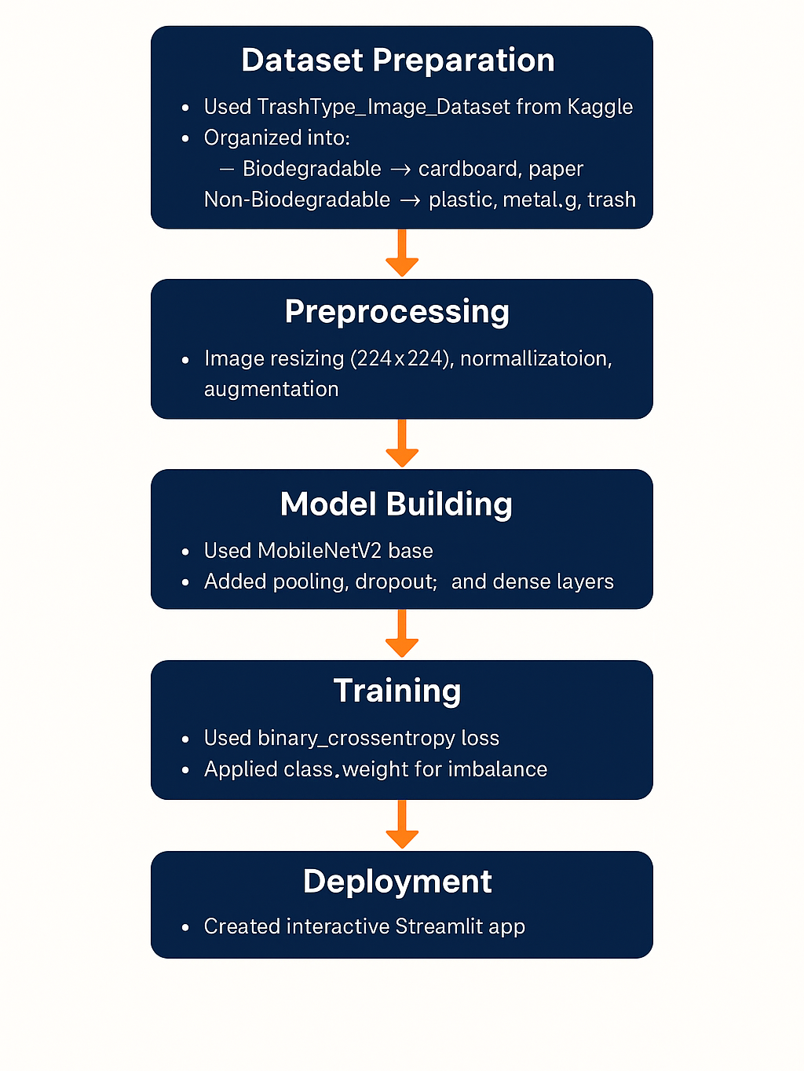
Methodology
1. Dataset Preparation:
Used Dataset from Kaggle.
Organized
2. Preprocessing:
Image resizing , normalization, augmentation
3. Model Building:
Used MobileNetV2 bas
4. Training:
Used binary_crossentropy loss
5. Deployment:
Created interactive Streamlit app

Slide 5





Tools and Technology
1. Python
2. TensorFlow & Keras
3. Matplotlib
4.Streamlit
5.Jupyter Notebook

Slide 6
Solution:
Used transfer learning (MobileNetV2) to classify images.
Model trained to distinguish between waste categories based on image features.
After training, the model achieved high validation accuracy and was saved for real-time use.
A user-friendly web interface was created using Streamlit, allowing users.

Slide 7
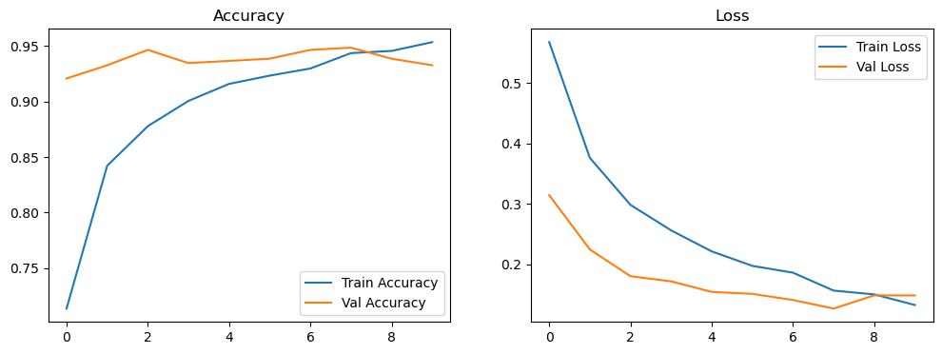
Screenshot of Output:

Slide 8
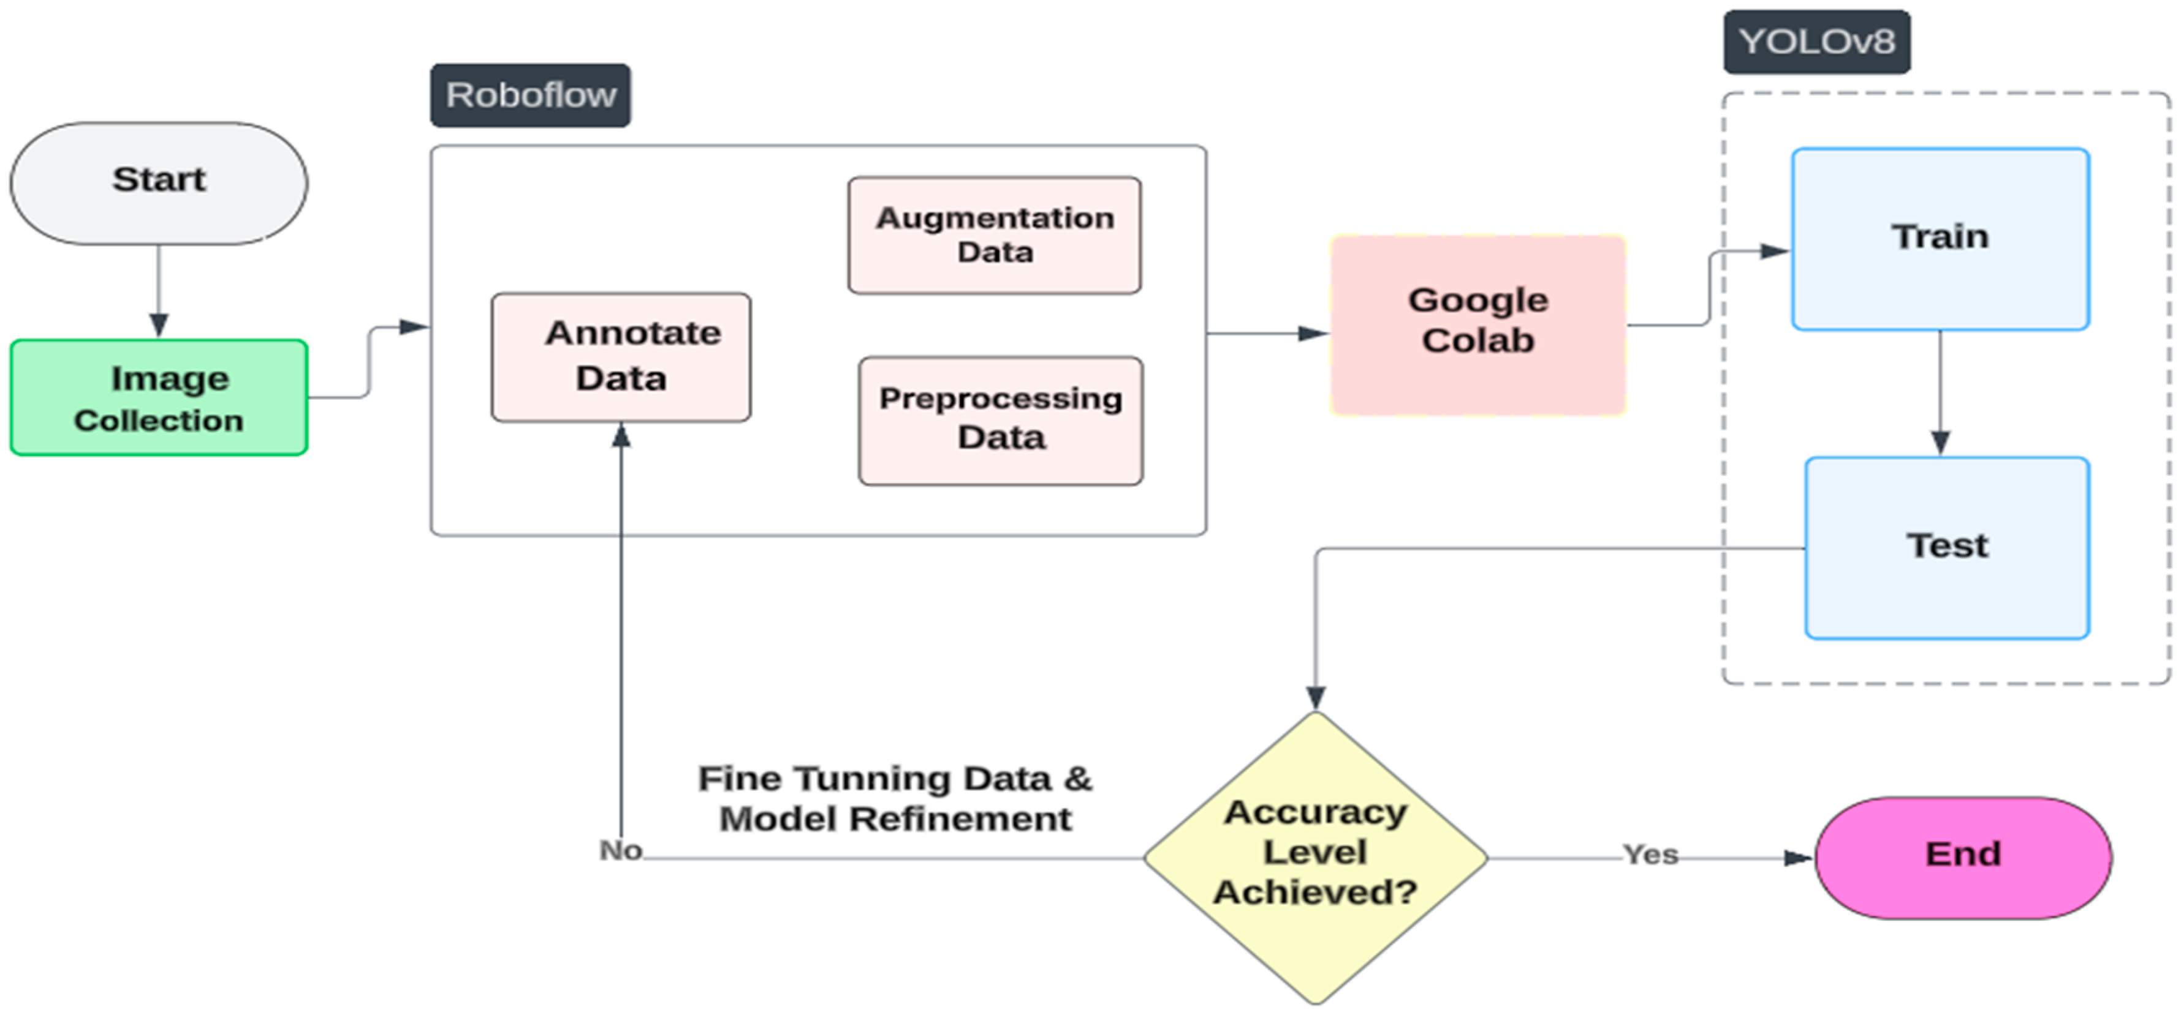
Conclusion:
Achieved 95% accuracy on validation data.
Real-time image prediction works reliably via the web interface.
Project demonstrates the practical application of deep learning in smart waste management systems.
Future scope: deploy on smart bins, extend to recyclable and hazardous categories.

