Slide 1
Objectives
In this session, you will learn to:
  Describe web applications
  Describe Java Platform, Enterprise Edition 5 (Java EE 5)
  Describe web application program execution methods and the advantages and disadvantages of each
  Describe Java servlet technology
  Describe JavaServer Pages technology
  Define three-tier architecture
  Define Model-View-Controller (MVC) architecture
Notes:
Start the session by explaining the objectives listed in Slide 1.

Slide 2

Web Application Technologies
HTML over HTTP
Common Gateway Interface (CGI)
Servlets
JavaServer Pages (JSP) technology
JSP Standard Tag Library (JSTL)
XML
Struts
JavaServer Faces
Notes:
In this slide, tell the students about the Web application technologies. Start by describing the HTTP. Tell that the HTTP is a request/response protocol between clients and servers. Tell the students that the Servlets, JSP, and Struts will be covered in the later part of this module.

Slide 3
Java™ EE 5
Java EE is the industry standard for developing portable, robust, scalable and secure server-side Java applications. Java EE is built on the solid foundation of Java Platform, Standard Edition (Java SE).
Java EE is a set of coordinated technologies which includes the following web application technologies:
  Java Servlet 2.5 (Java Specification Requests [JSR] 154)
  JavaServer Pages 2.1 (JSR 245)
  JavaServer Pages Standard Tag Library (JSR 52)
  JavaServer Faces 1.2 (JSR 252)
Notes:
In this slide, explain to the students about the Java Platform, Enterprise Edition 5 as given in SG.

Slide 4
Java™ EE 5 (Contd.)
For a complete list of Java technologies, go to:
  http://java.sun.com/javaee/technologies/
  http://java.sun.com/javase/technologies/
Notes:
Open the hyperlink given in this slide to show to the students the complete list of Java technologies.

Slide 5
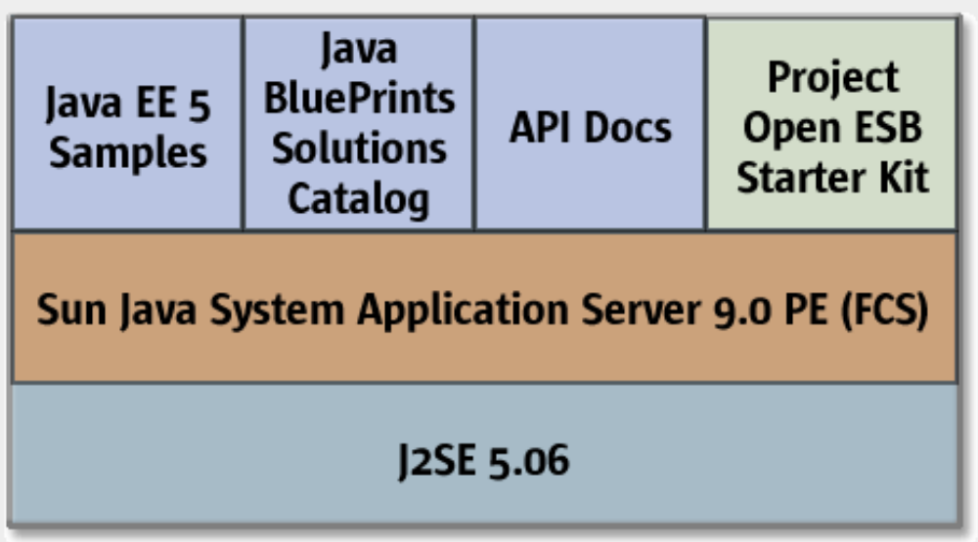
Java EE 5 SDK
Notes:
Use this slide to explain to the students about the Java EE 5 SDK.

Slide 6
Web Sites and Web Applications
A web site is a collection of static files, HTML pages, graphics, and various other files.
A web application is a web site with dynamic functionality on the server.
A web application run programs on the server, for example:
  A browser makes a request, to the server, for an HTML form.
  The server responds by sending the HTML form back to the browser in an HTTP request stream.
  Next, the browser sends another request, with data from the HTML form, to the server.
  The server passes the request and data to a program that responds by sending data back to the browser.
Notes:
Use this slide to explain to the students about the Web sites and Web applications.

Slide 7
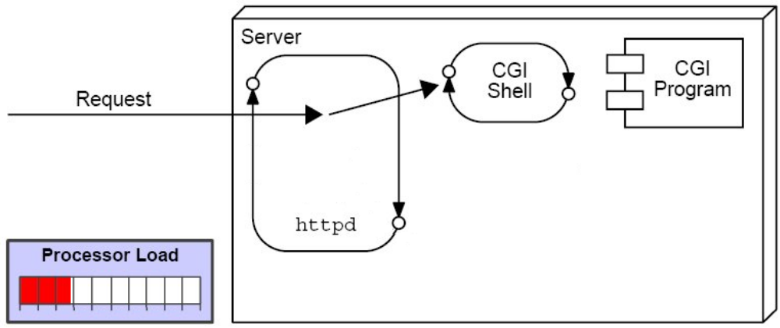
Execution of CGI Programs
A CGI program handling a single request:
Notes:
Use Slides 7 and 8 to explain the execution of the CGI programs. Explain about the CGI programs and their advantages and disadvantages, as given in pages 1-9 to 1-12 of the SG.

Slide 8
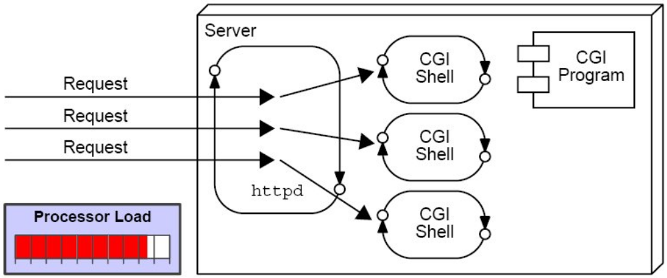
Execution of CGI Programs (Contd.)
A CGI program handling multiple requests:

Slide 9
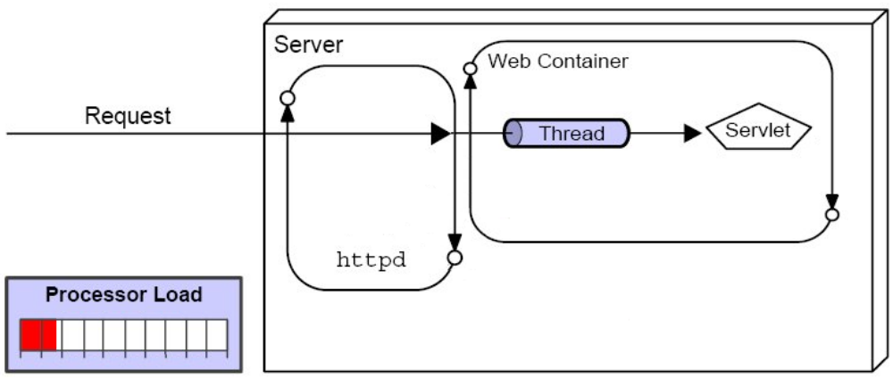
Execution of Java Servlets
A servlet program handling a single request:
Notes:
Use Slides 9 and 10 to explain the execution of the Java Servlets.

Slide 10
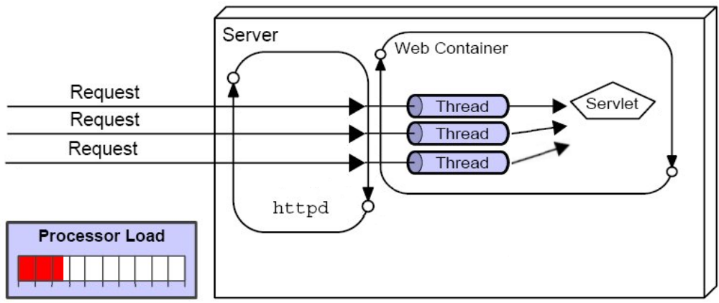
Execution of Java Servlets (Contd.)
A servlet program handling multiple requests:

Slide 11
Using Separate Processes or Using Threads
Advantages of running programs in separate processes over threads:
  Programs can be written in a variety of languages
  Web designers can easily reference programs that run in separate processes.
Advantages of running servlet programs in threads compared with other languages not in threads:
  The CPU requirements are lower.
  Java technologies separate processing code (business logic) from the HTML (presentation logic).
  The Java language is robust and object-oriented.
  The Java language is platform-independent.
Notes:
Use this slide to explain about the advantages and disadvantages of using Servlets over the CGI programs.

Slide 12
Java Servlets
A servlet is a Java technology component that executes on the server.
Servlet programs perform the following:
  Process HTTP requests
  Generate dynamic HTTP responses
A web container is a special Java Virtual Machine (JVM™) tool interface that manages the servlets and a thread pool.
Notes:
In this slide, explain to the students about the Java Servlets. Tell the students that the Servlets allow you to add dynamic content to a Web server using the Java platform.

Slide 13
JavaServer Pages™ Technology
JSP pages are translated into Java servlet classes that are compiled and execute as servlets in the web container.
JSP pages should focus on the presentation logic, not on the business logic. This makes for a good design.
In JSP pages, custom tags and JSP Expression Language provide for reusable code and separation of concerns.
Java code can be embedded into JSP pages.
In a Java technology web application, JSP pages are often used in conjunction with servlets and business objects in a Model-View-Controller pattern.
Notes:
Use this slide to explain about the JavaServerPages technology.

Slide 14
Demo: JavaServer Pages™ Technology
Demo: JavaServerPages Technology
Notes:
Use this slide to demonstrate the comparison of JSP and servlet coding to the students. You can run the project, SquaresServlet stored at Datafiles For Faculty\Session01\Demo1\SquaresServlet.zip file in the TIRM CD. This project contains a JSP file, index.jsp, which displays the squares of numbers 0 through 9 in an HTML table.
You can show the students the equivalent servlet, SquaresServlet.java, which can be found at
Datafiles For Faculty\Session01\Demo1 in the TIRM CD.

Slide 15
Concerns When Using Servlets and JSP™ Technology
Advantages of JSP technology:
  Provides high performance and scalability because threads are used
  Is built on Java technology, so it is platform-independent.
  Can take advantage of the object-oriented language and its APIs
Notes:
Use Slides 14 and 15 to explain to the students about the advantages and disadvantages of JSP technology. Also, tell the students about when to use Servlets and JSP technology in the Web application.

Slide 16
Concerns When Using Servlets and JSP™ Technology (Contd.)
Disadvantages of JSP technology:
  If JSP pages are used in isolation, then the scripting code that performs business and control logic can become cumbersome in the JSP pages. JSP pages are also difficult to debug.
  There is separation of concerns into business logic and presentation logic.
  There are concurrency issues.

Slide 17
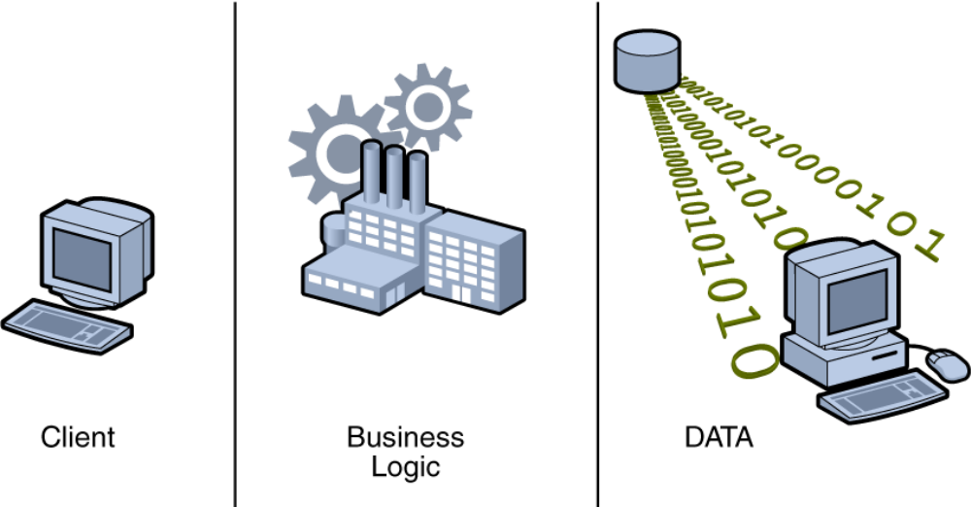
Web Application – Three-Tier Architecture
Notes:
Use this slide to explain to the students about the three-tier architecture for Web applications.

Slide 18
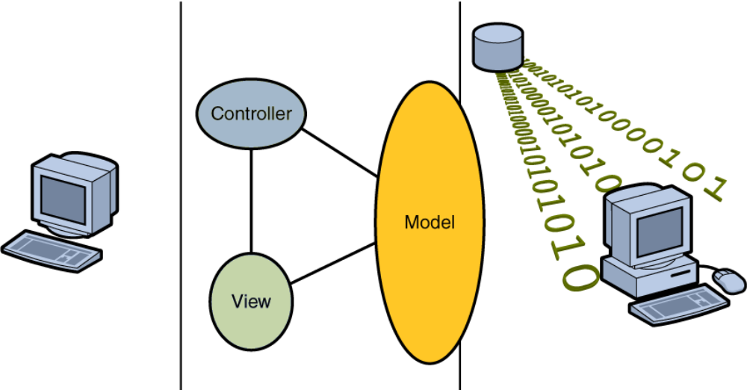
Model-View-Controller (MVC) Architecture in a Web Application
Notes:
Use this slide to explain about the Model-View-Controller (MVC) architecture in Web application.

Slide 19
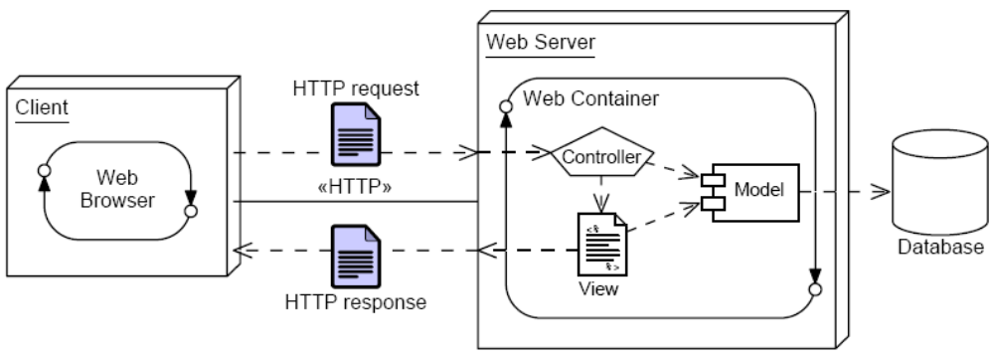
Model 2 Architecture
Deployment diagram of a web container using Model 2 architecture:
Notes:
Use this slide to explain about the Model 2 architecture. In the Model 2 architecture, Servlets control the flow of the web application and delegate the business logic to external components, such as JavaBeans or EJBs, while JSP pages generate the HTML for web browsers.

Slide 20
Model 2 Frameworks
Frameworks are partial implementations on which you can build your components.
There are several Model 2 frameworks available:
  Struts from the Jakarta group
  JavaServer Faces technology from Sun
  Velocity from Apache
Notes:
Use this slide to explain about the Model 2 frameworks.

Slide 21
Java EE Containers
Modular design allows for easier modification of the business logic.
Enterprise components can use container-provided services such as presentation, security, transaction, persistence, and life cycle management.
Notes:
Use this slide to explain about the Java EE containers. Explain that the containers are the interface between a component and the low-level platform-specific functionality that supports the component. Before the execution of a web application, it must be assembled into a Java EE module and deployed into its container.

Slide 22
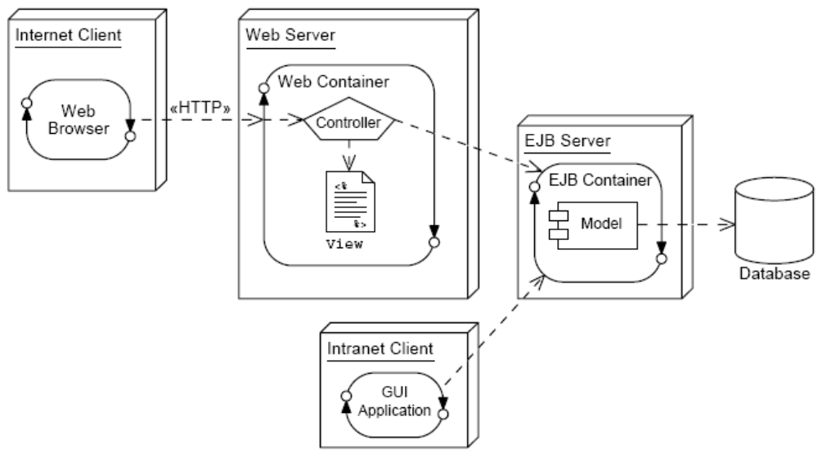
Java EE Architecture Example
Notes:
In this slide, explain to the students about the Java EE architecture. Also, discuss about its features such as scalability, extensibility, and maintainability.

Slide 23
Job Roles
The modularity of Java EE architecture clearly distinguishes several job roles:
  Web Designer – Creates View elements
  Web Component Developer – Creates Controller elements
  Business Component Developer – Creates Model elements
  Data Access Developer – Creates database access elements
Notes:
Use this slide to discuss about the Job roles.

Slide 24
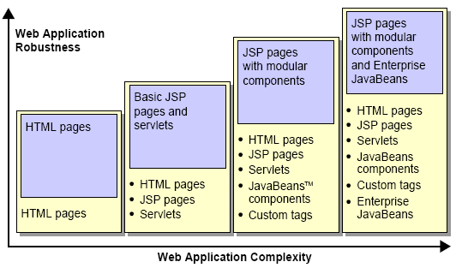
Web Application Migration
A matrix showing the relationship between an architecture’s complexity and robustness, based on the technologies used:
Notes:
Use this slide to explain a matrix of the relationship between an architecture’s complexity and robustness, based on technologies used.

Slide 25
Summary
In this session, you learned:
  CGI provided hooks for web servers to execute application programs.
  Java servlets are similar to CGI, but they execute in a JVM using threading.
  JSP pages are similar to servlets, but they are better suited for generating HTML content.
  The Model 2 architecture uses servlets in conjunction with JSP pages to build web applications.
  Well designed web applications using Model 2 can be easily migrated to more complex Java EE architectures.
Notes:
End the session by discussing the summary points as given in Slide 25.

