Slide 1

Objectives
In this session, you will learn to:
  Design a controller component
  Create an HTML form
  Describe how HTML form data is sent in the HTTP request
  Develop a controller servlet
  Dispatch from a controller servlet to a view servlet
Notes:
Start the session by explaining the objectives listed in Slide 1. Students should understand how a controller servlet processes a web form. The other key point is how to keep view and controller servlets separated, and how servlets communicate using the request scope attributes and using a request dispatcher.
Use the following flow:
● Design a controller component
Exercise 1: Design the Add a DVD to list use case
● Create an HTML form
Exercise 2: Develop the Add DVD form
● Describe how HTML form data is sent in the HTTP request
● Develop a controller servlet
Exercise 3: Develop the AddDVD Controller
● Dispatch from a controller servlet to a view servlet
Exercise 4: Develop the Success view
Exercise 5: Develop the Error view

Slide 2
Types of Controller Components
Process input from a user
Support screen navigation
Prepare data for view components
Notes:
Use this slide to explain about the types of Controller components.

Slide 3
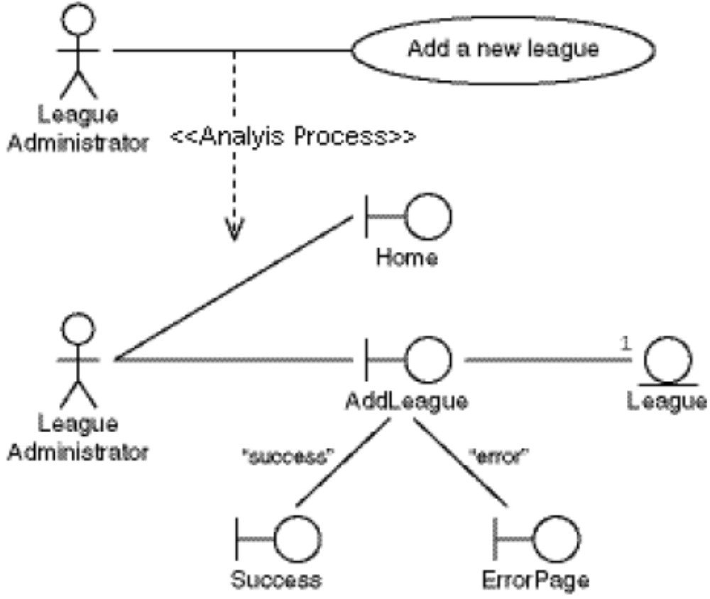
Add a New League Analysis Model
Notes:
Use this slide to explain about the Add a New League Analysis model, as given in page 3-5 of the SG.

Slide 4
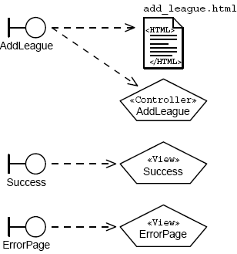
Add League Boundary Components
Notes:
Use this slide to explain about the Add League Boundary components.

Slide 5
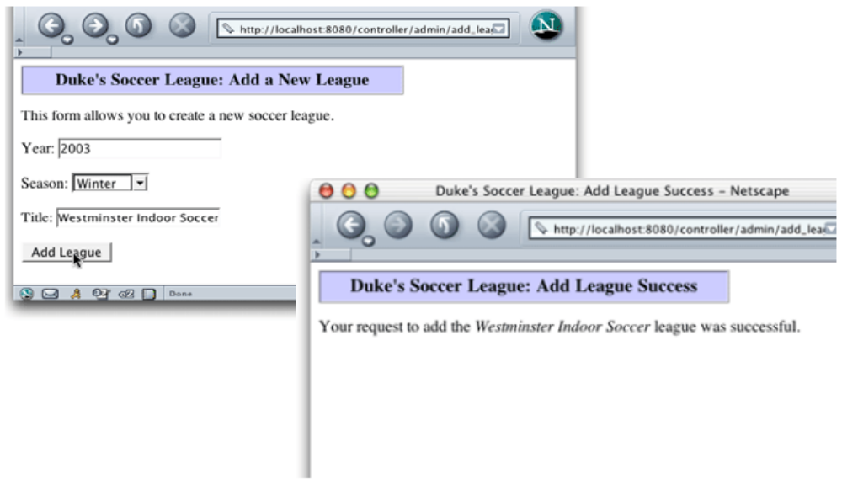
Add a New League Page Flow
Success path:
Notes:
Use slides 5 and 6 to explain about the Add a New League Page flow, as given in page 3-7 of the SG.

Slide 6
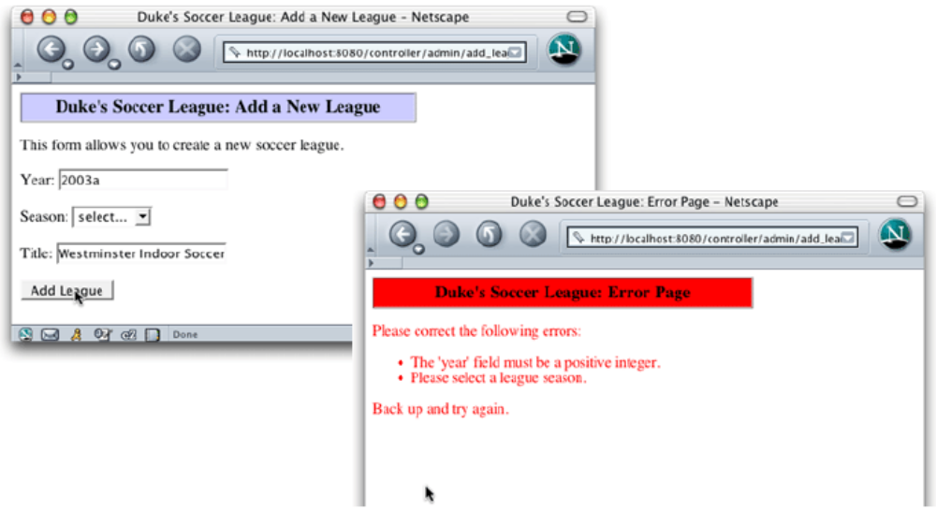
Add a New League Page Flow (Contd.)
Error path:

Slide 7
Form Verification
What are the drawbacks of using server-side verification?
What is an alternative to server-side verification?
What are the drawbacks of using client-side verification?
What is the solution?
Notes:
Use this slide to discuss about the form verification.
What are the drawbacks of using server-side verification?
Ans: Server-side verification requires a round-trip HTTP request, which is often unnecessary. This is an application responsiveness issue as well. It is better for the browser to pop-up an alert dialog with the verification errors immediately, rather than waiting for the server to respond with the same errors.
What is an alternative to server-side verification?
Ans: Client-side verification using JavaScript™ technology.
What are the drawbacks of using client-side verification?
Ans: JavaScript technology can be turned-off in the web browser. Also, some verification checks can only be performed by analysing data on the server to which the browser does not have access.
What is the solution?
Ans: Use both client-side and server-side verification.

Slide 8
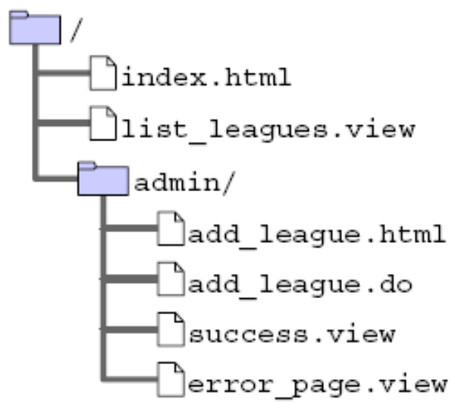
Soccer League Web Structure
Notes:
Use this slide to explain the logical structure of the Soccer League Web application.

Slide 9
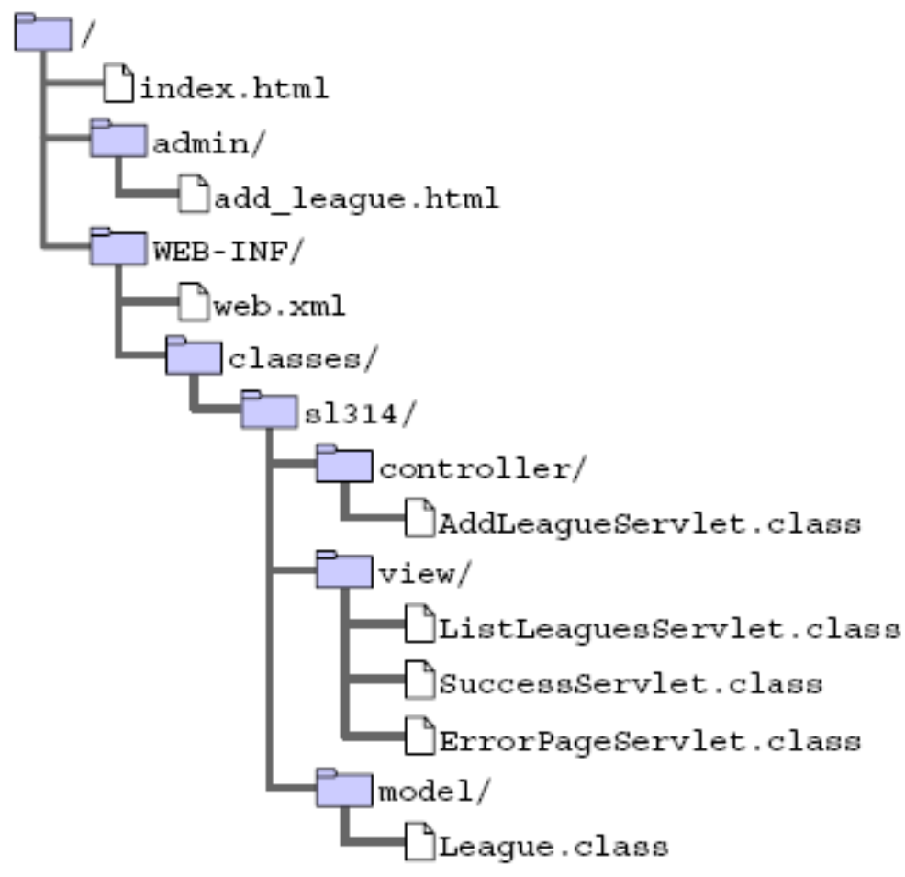
Soccer League Web Structure (Contd.)
Notes:
Use this slide to explain the physical structure of the Soccer League Web application.

Slide 10
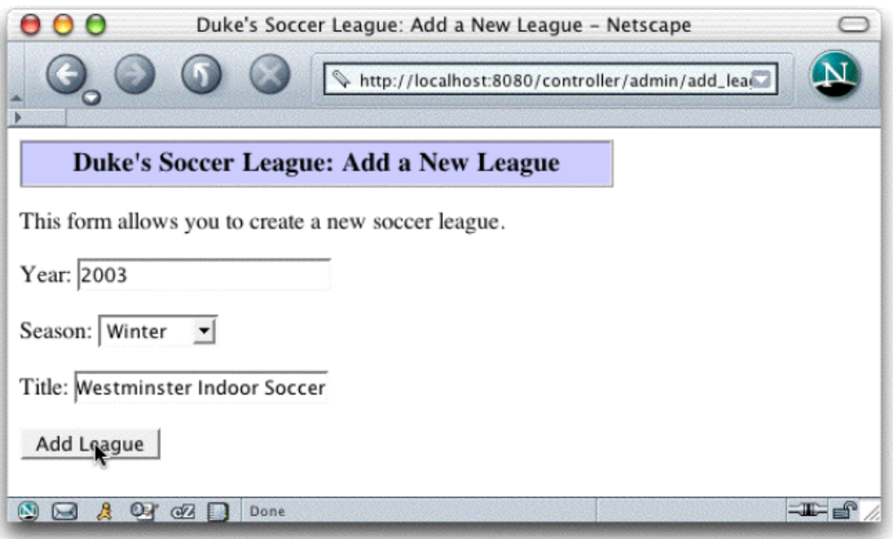
Creating an HTML Form
Notes:
Use this slide to explain about creating an HTML form. Demonstrate the creation of an Add a League form to the students.

Slide 11
The form Tag
The following is a partial structure of an HTML form:
  <form action='URL TO CONTROLLER' method='GET or POST'>
  <!-- PUT FORM COMPONENT TAGS HERE -->
  </form>
For example:
  <form action=’add_league.do’ method=’POST’>
  Year: [textfield tag]
  Season: [drop-down list tag]
  Title: [textfield tag]
  [submit button tag]
  </form>
A single web page can contain many forms.
Notes:
Use this slide to explain about the form tag. Tell the students that the form tag creates a form for user input. A form can contain textfields, checkboxes, radio-buttons and more. Forms are used to pass user-data to a specified URL.

Slide 12

Textfield Component
In Netscape™, a textfield component looks like this:
The HTML content for this component is:
  16 <p>
  17 This form allows you to create a new soccer league.
  18 </p>
  19
  20 <form action=’add_league.do’ method=’POST’>
  21 Year: <input type=’text’ name=’year’ /> <br/><br/>
Notes:
Use this slide to explain about creating the textfield component.

Slide 13
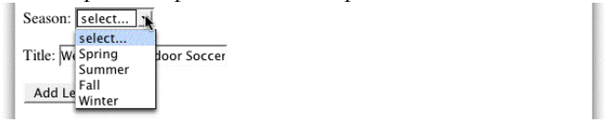
Drop-Down List Component
In Netscape, a drop-down list component looks like this:
The HTML content for this component is:
  22 Season: <select name=’season’>
  23 <option value=’UNKNOWN’>select...</option>
  24 <option value=’Spring’>Spring</option>
  25 <option value=’Summer’>Summer</option>
  26 <option value=’Fall’>Fall</option>
  27 <option value=’Winter’>Winter</option>
  28 </select> <br/><br/>
Notes:
Use this slide to explain about creating the drop-down list component. Select tag is used to create the drop-down list component and the option tag is used to specify the values in the drop-down list.

Slide 14
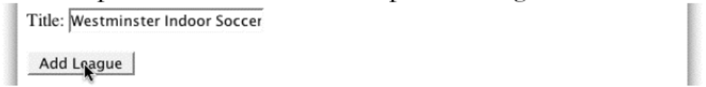
Submit Button
In Netscape, a submit button component might look like this:
The HTML content for this component is:
  29 Title: <input type=’text’ name=’title’ /> <br/><br/>
  30 <input type=’submit’ value=’Add League’ />
  31 </form>
Notes:
Use this slide to explain about creating the Submit button. Tell the students the same input that is used to create the textfield, is used to create the Submit button. You just need to specify value of the type attribute as submit to create the Submit button.

Slide 15
Complete Add a New League Form
16 <p>
17 This form allows you to create a new soccer league.
18 </p>
19
20 <form action=’add_league.do’ method=’POST’>
21 Year: <input type=’text’ name=’year’ /> <br/><br/>
22 Season: <select name=’season’>
23 <option value=’UNKNOWN’>select...</option>
24 <option value=’Spring’>Spring</option>
25 <option value=’Summer’>Summer</option>
26 <option value=’Fall’>Fall</option>
27 <option value=’Winter’>Winter</option>
28 </select> <br/><br/>
29 Title: <input type=’text’ name=’title’ /> <br/><br/>
30 <input type=’submit’ value=’Add League’ />
31 </form>
Notes:
Use this slide to explain the coding for the complete Add a New League form.

Slide 16
Form Data in the HTTP Request
HTTP includes a specification for data transmission used to send HTML form data from the web browser to the web server.
Syntax:
  fieldName1=fieldValue1&fieldName2=fieldValue2&...
Examples:
  username=Fred&password=C1r5z
  season=Winter&year=2004&title=Westminster+Indoor+Soccer+(2004)
Notes:
Use this slide to explain how form data is sent in an HTTP Request.

Slide 17
HTTP GET Method Request
Form data is contained in the URL of the HTTP request:
  GET /admin/add_league.do?year=2003&season= Winter&title=Westminster+Indoor+HTTP/1.1
  Host: localhost:8080
  User-Agent: Mozilla/5.0 (Macintosh; U; PPC Mac OS X Mach-O; en-US; rv:1.4)
  20030624 Netscape/7.1
  Accept: text/xml,application/xml,application/ xhtml+xml,text/html;q=0.9,tex
  plain;q=0.8,video/x-mng,image/png,image/jpeg,image/gif;q=0.2,*/*;q=0.1
  Accept-Language: en-us,en;q=0.5
  Accept-Encoding: gzip,deflate
  Accept-Charset: ISO-8859-1,utf-8;q=0.7,*;q=0.7
  Keep-Alive: 300
  Connection: keep-alive
Notes:
Use this slide to explain about the HTTP GET method request.

Slide 18
HTTP POST Method Request
Form data is contained in the body of the HTTP request:
  POST /admin/add_league.do HTTP/1.1
  Host: localhost:8080
  User-Agent: Mozilla/5.0 (Macintosh; U; PPC Mac OS X Mach-O; en-US; rv:1.4)20030624 Netscape/7.1
  Accept: text/xml,application/xml,application/ xhtml+xml,text/html;q=0.9,tex plain;q=0.8,video/x-mng,image/png,image/jpeg,image/gif;q=0.2,*/*;q=0.1
  Accept-Language: en-us,en;q=0.5
  Accept-Encoding: gzip,deflate
  Accept-Charset: ISO-8859-1,utf-8;q=0.7,*;q=0.7
  Keep-Alive: 300
  Connection: keep-alive
  Referer: http://localhost:8080/controller/ admin/add_league.html
  Content-Type: application/x-www-form-urlencoded
  Content-Length: 55
  year=2003&season=Winter&title=Westminster+Indoor+Soccer
Notes:
Use this slide to explain about the HTTP POST method request.

Slide 19
HTTP GET and POST Methods
The HTTP GET method is used when:
  The processing of the request is idempotent.
  The amount of form data is small.
  You want to allow the request to be bookmarked.
The HTTP POST method is used when:
  The processing of the request changes the state of the server, such as storing data in a database.
  The amount of form data is large.
  The contents of the data should not be visible in the URL (for example, passwords).
Notes:
Use this slide to explain the difference between the HTTP GET and HTTP POST methods.

Slide 20
Developing a Controller Servlet
A form-processing (controller) servlet needs to:
  Retrieve form parameters from the HTTP request.
  Perform any data conversion on the form parameters.
  Verify the form parameters.
  Execute the business logic.
  Dispatch to the next view component based on the results of the previous steps.
Notes:
Use this slide to explain about developing the Controller Servlet. Explain the steps performed by the form-processing servlet.

Slide 21
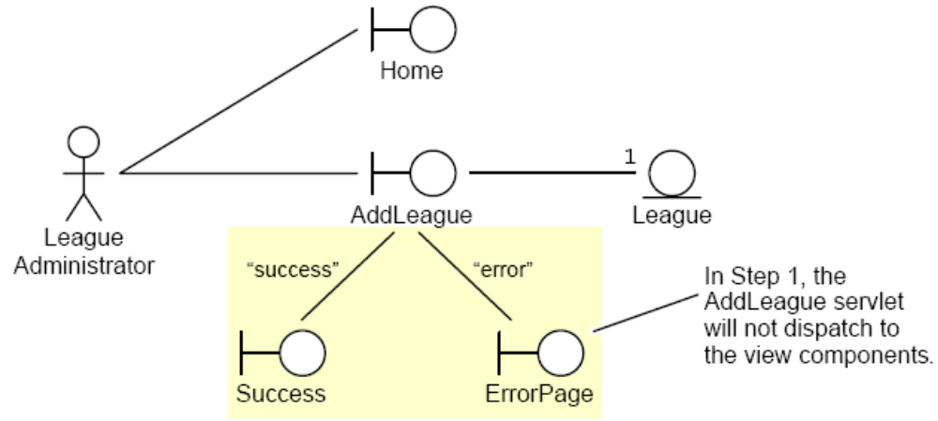
Add League Analysis Model (Stage 1)
Notes:
Use Slides 21 and 22 to explain the Add League Analysis Model (Stage 1), as given in pages 3-24 to 3-25 of the SG.

Slide 22
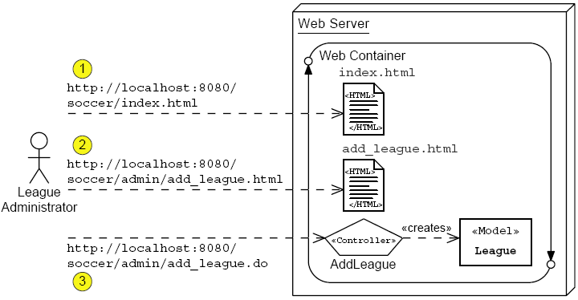
Add League Analysis Model (Stage 1) (Contd.)

Slide 23
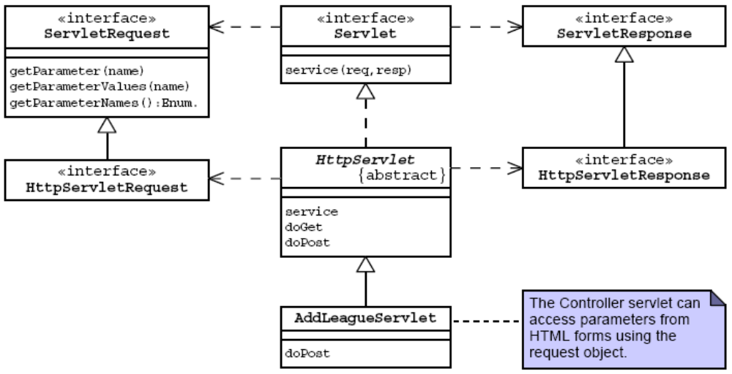
Servlet API to Retrieve Form Parameters
Notes:
Use this slide to explain about the Servlet API to retrieve form parameters. Explain the methods of the ServletRequest interface, as given in page 3-36 of the SG.

Slide 24
The AddLeagueServlet Class Declaration
1 package sl314.controller;
2
3 import javax.servlet.http.HttpServlet;
4 import javax.servlet.http.HttpServletRequest;
5 import javax.servlet.http.HttpServletResponse;
6 import javax.servlet.ServletException;
7 // Support classes
8 import java.io.IOException;
9 import java.io.PrintWriter;
10 // Model classes
11 import sl314.model.League;
12 import java.util.List;
13 import java.util.LinkedList;
14
15 public class AddLeagueServlet extends HttpServlet {
16 public void doPost(HttpServletRequest request,
17 HttpServletResponse response)
18 throws IOException, ServletException {
19
20 // Keep a set of strings to record form processing
errors.
21 List errorMsgs = new LinkedList();
Notes:
Use this slide to explain the declaration of the AddLeagueServlet class. Tell the students that you need to extend the HttpServlet class to create the controller servlet.

Slide 25
Retrieving Form Parameters and Data Conversion
22
23 try {
24
25 // Retrieve form parameters.
26 String yearStr = request.getParameter(“year”).trim();
27 String season = request.getParameter(“season”).trim();
28 String title = request.getParameter(“title”).trim();
29
30 // Perform data conversions.
31 int year = -1;
32 try {
33 year = Integer.parseInt(yearStr);
34 } catch (NumberFormatException nfe) {
35 errorMsgs.add(“The ‘year’ field must be a positive
integer.”);
36 }
37
Notes:
Use this slide to explain how to retrieve form parameters and perform their data conversion. You can retrieve form parameters by using the getParameter() method on the request object. After the form data has retrieved, you need to convert the data of the form parameter to the proper data type required by the application.

Slide 26
Performing Form Validations
37
38 // Verify form parameters
39 if((year != -1)&&((year < 2000) || (year > 2010))){
40 errorMsgs.add(“The ‘year’ field must within 2000 to
2010.”);
41 }
42 if ( season.equals(“UNKNOWN”) ) {
43 errorMsgs.add(“Please select a league season.”);
44 }
45 if ( title.length() == 0 ) {
46 errorMsgs.add(“Please enter the title of the
league.”);
47 }
48
49 // Send the ErrorPage view if there were errors
50 if ( ! errorMsgs.isEmpty() ) {
51 // dispatch to the ErrorPage
52 PrintWriter out = response.getWriter();
53 out.println(“ERROR PAGE”);
54 return;
55 }
56
Notes:
Use this slide to explain about the third task of the controller, which is to perform the form data verification.

Slide 27
Performing the Business Logic
57
58 // Perform business logic
59 League league = new League(year, season, title);
60
61 // Send the Success view
62 PrintWriter out = response.getWriter();
63 out.println(“SUCCESS”);
64 return;
65
Notes:
Use this slide to explain about performing the business logic.

Slide 28
Handling an Exception
65
66 // Handle any unexpected exceptions
67 } catch (RuntimeException e) {
68 errorMsgs.add(e.getMessage());
69 // dispatch to the ErrorPage
70 PrintWriter out = response.getWriter();
71 out.println(“ERROR PAGE”);
72
73 // Log stack trace
74 e.printStackTrace(System.err);
75
76 } // END of try-catch block
77 } // END of doPost method
78 } // END of AddLeagueServlet class
Notes:
Use this slide to explain about handling an exception.

Slide 29
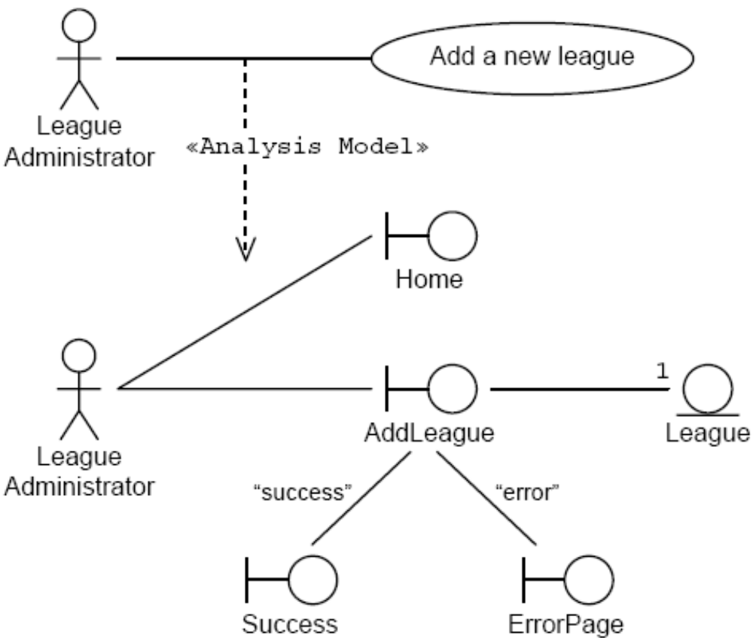
Add League Analysis Model (Stage 2)
Notes:
Use this slide to explain about the Add League Analysis Model (Stage 2).

Slide 30
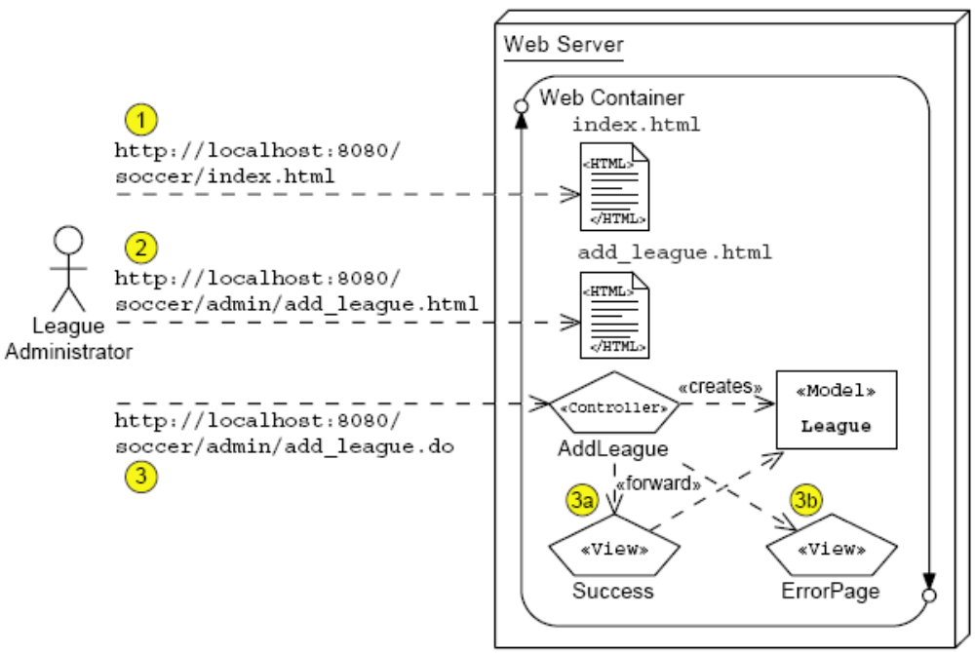
Add League Architecture Model (Stage 2)
Notes:
Use this slide to explain the architecture model (Stage 2) for the Add a New League use case.

Slide 31
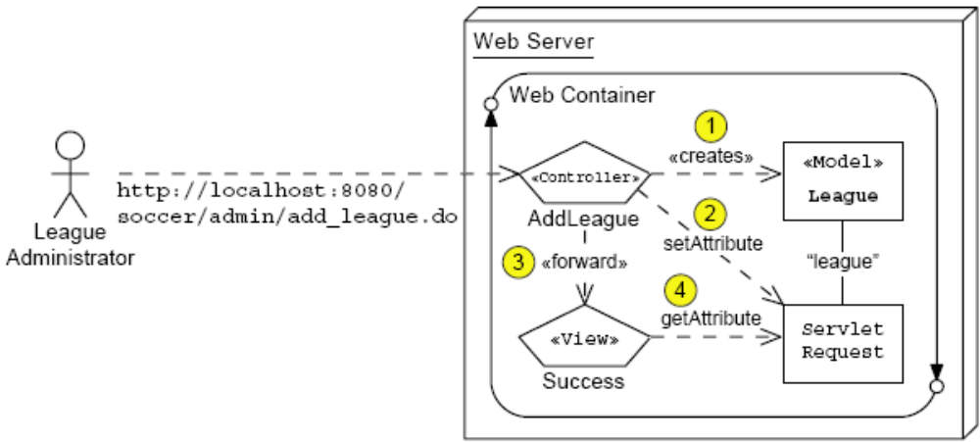
Request Scope
Notes:
Use this slide to explain about the request scope. Data saved in the request is destroyed when the request is completed.

Slide 32
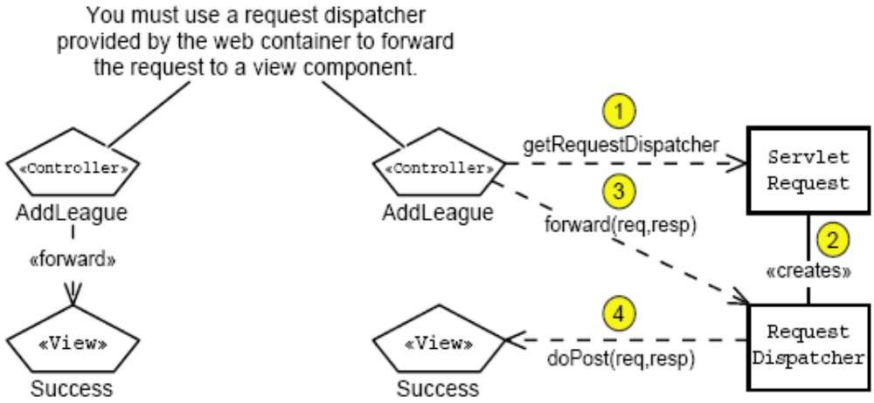
Using a Request Dispatcher
Notes:
Use this slide to explain about using a Request Dispatcher. The Web container forwards the request from one Servlet to another by using the RequestDispatcher. The RequestDispatcher object contains the following two methods:
forward - It forwards a request from a servlet to another on the server. This method should be called before the response has been committed to the client.
include - It includes the content of a servlet in the response.

Slide 33
Developing the AddLeagueServlet Code
6 import javax.servlet.RequestDispatcher;
7 import javax.servlet.ServletException;
8 // Support classes
9 import java.io.IOException;
10 import java.io.PrintWriter;
11 // Model classes
12 import sl314.model.League;
13 import java.util.List;
14 import java.util.LinkedList;
15
16 public class AddLeagueServlet extends HttpServlet {
17 public void doPost(HttpServletRequest request,
18 HttpServletResponse response)
19 throws IOException, ServletException {
20
21 // Keep a set of strings to record form processing
errors.
22 List errorMsgs = new LinkedList();
23 // Store this set in the request scope, in case we
24 // need to send the ErrorPage view.
Notes:
Use Slides 33, 34, 35, and 36 to explain to the students about applying the concepts of request-scope and using a request dispatcher in the AddLeagueServlet code.

Slide 34
Developing the AddLeagueServlet Code (Contd.)
25 request.setAttribute(“errorMsgs”, errorMsgs);
26
27 try {
28
29 // Retrieve form parameters.
30 String yearStr = request.getParameter(“year”).trim();
31 String season = request.getParameter(“season”).trim();
32 String title = request.getParameter(“title”).trim();
33
34 // Perform data conversions.
35 int year = -1;
36 try {
37 year = Integer.parseInt(yearStr);
38 } catch (NumberFormatException nfe) {
39 errorMsgs.add(“The ‘year’ field must be a positive
integer.”)
40 }
41

Slide 35
Developing the AddLeagueServlet Code (Contd.)
42 // Verify form parameters
43 if((year != -1)&&((year < 2000) || (year > 2010))){
44 errorMsgs.add(“The ‘year’ field must within 2000
to 2010.”);
45 }
46 if ( season.equals(“UNKNOWN”) ) {
47 errorMsgs.add(“Please select a league season.”);
48 }
49 if ( title.length() == 0 ) {
50 errorMsgs.add(“Please enter the title of the
league.”);
51 }
52
53 // Send the ErrorPage view if there were errors
54 if ( ! errorMsgs.isEmpty() ) {
55 RequestDispatcher view
56 = request.getRequestDispatcher(“error_page.view”);
57 view.forward(request, response);
58 return;
59 }
60

Slide 36
Developing the AddLeagueServlet Code (Contd.)
61 // Perform business logic
62 League league = new League(year, season, title);
63 // Store the new league in the request-scope
64 request.setAttribute(“league”, league);
65
66 // Send the Success view
67 RequestDispatcher view
68 = request.getRequestDispatcher(“success.view”);
69 view.forward(request, response);
70 return;
71
72 // Handle any unexpected exceptions
73 } catch (RuntimeException e) {
74 errorMsgs.add(e.getMessage());
75 RequestDispatcher view
76 = request.getRequestDispatcher(“error_page.view”);
77 view.forward(request, response);
78
79 // Log stack trace
80 e.printStackTrace(System.err);

Slide 37
The SuccessServlet Code
11
12 public class SuccessServlet extends HttpServlet {
13
14 public void doGet(HttpServletRequest request,
15 HttpServletResponse response)
16 throws IOException {
17 generateView(request, response);
18 }
19
20 public void doPost(HttpServletRequest request,
21 HttpServletResponse response)
22 throws IOException {
23 generateView(request, response);
24 }
25
26 public void generateView(HttpServletRequest request,
27 HttpServletResponse response)
28 throws IOException {
29
Notes:
Use Slides 37, 38, and 39 to explain about the SuccessServlet code.

Slide 38
The SuccessServlet Code (Contd.)
30 // Set page title
31 String pageTitle = “Duke’s Soccer League: Add League
Success”;
32
33 // Retrieve the ‘league’ from the request-scope
34 League league = (League)request.getAttribute(“league”);
35
36 // Specify the content type is HTML
37 response.setContentType(“text/html”);
38 PrintWriter out = response.getWriter();
39
40 // Generate the HTML response
41 out.println(“<html>”);

Slide 39
The SuccessServlet Code (Contd.)
54
55 // Generate main body
56 out.println(“<p>”);
57 out.print(“Your request to add the “);
58 out.print(“<i>” + league.getTitle() + “</i>”);
59 out.println(“ league was successful.”);
60 out.println(“</p>”);
61
62 out.println(“</body>”);
63 out.println(“</html>”);
64
65 } // END of generateResponse method
66
67 } // END of SuccessServlet class

Slide 40
Demo: Add a New League Page Flow
Demo: Add a New League Page Flow
Notes:
Use this slide to demonstrate the flow of the Add a New League Page. You can run the project, ControllerDemo stored at Datafiles For Faculty\Session04\Demo1\mod03_controller.zip file in the TIRM CD.
To demonstrate the flow of the Add a New League Page, you need to perform the following tasks:
1. Create the add_league.html to demonstrate the creation of the HTML form.
2. Create the AddLeagueServlet.java file in the sl314.controller package.
3. Create the SuccessServlet.java file in the sl314.view package.
4. Create the ErrorPageServlet.java file in the sl314.view package.
5. Create the League.java file in the sl314.model package.
6. Configure the web.xml file.

Slide 41
Summary
In this session, you learned:
  You can use a controller component to process forms, manage screen navigation, prepare data for views, and so on.
  You can create web forms using the HTML form tags.
  Usually, you should use the POST HTTP method to send form data to your servlets.
  You can access form data on the request stream using the getParameter method on the request object.
  You can use the request scope to communicate from a controller to a view component.
  You can use a RequestDispatcher object to forward the request from the controller to the view component.
Notes:
End the session by discussing the summary points as given in Slide 40.

