Slide 1
Objectives
In this session, you will learn to:
  Describe the servlet life cycle
  Customize a servlet with initialization parameters
  Explain error reporting within the web form
  Repopulating the web form
Notes:
Start the session by explaining the objectives listed in Slide 1. Students should understand what aspects of a web form can be dynamic. These include: customized form fields (such as drop-down lists), error reporting, and form repopulation. Other aspects that are not described in this module include layout configuration and internationalization.
Use the following flow for this module:
● Describe the servlet life cycle
● Customize a servlet with initialization parameters
Exercise 1: Customize the AddDVD form
● Error reporting within the web form
Exercise 2: Introduce error reporting in the AddDVD form
● Repopulating the web form
Exercise 3: Repopulate the AddDVD form

Slide 2
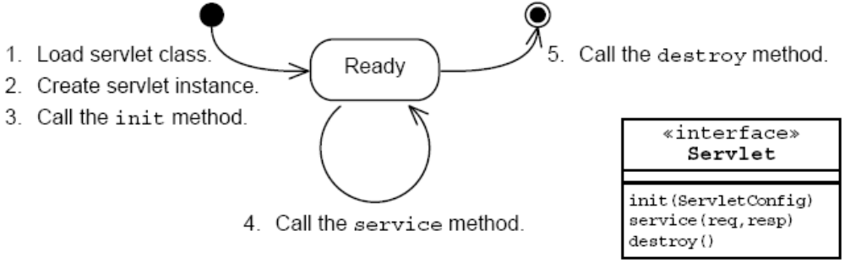
Servlet Life Cycle Overview
The web container manages the life cycle of a servlet instance. These methods should not be called by your code.
Notes:
Use this slide to explain about the Servlet Life Cycle.

Slide 3
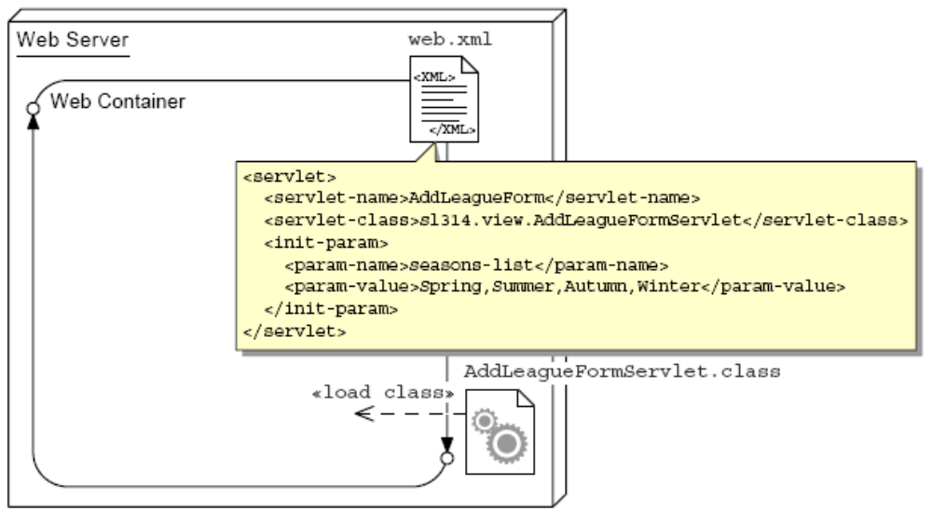
Servlet Class Loading
Classes can be in: WEB-INF/classes/,
WEB-INF/lib/*.jar, plus Java SE classes, and container classes.
Notes:
Use this slide to explain about the loading the servlet class file into the Web container’s JVM. This is the first step in the creation of a servlet component.

Slide 4
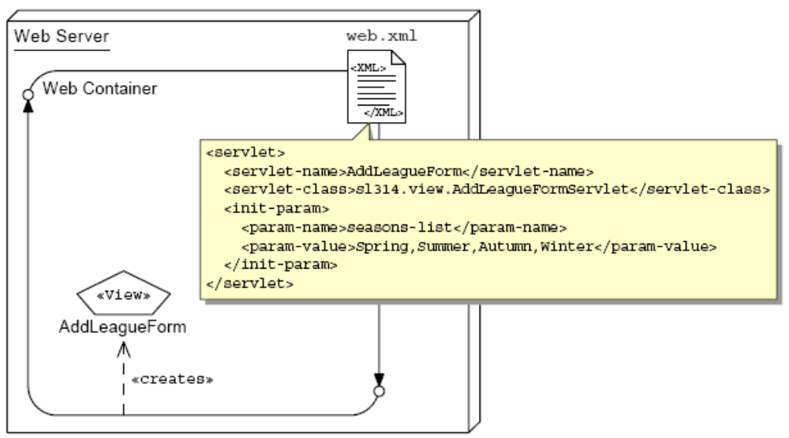
One Instance Per Servlet Definition
Notes:
Use this slide to explain about creating an instance of the servlet class that has been loaded into the JVM.

Slide 5
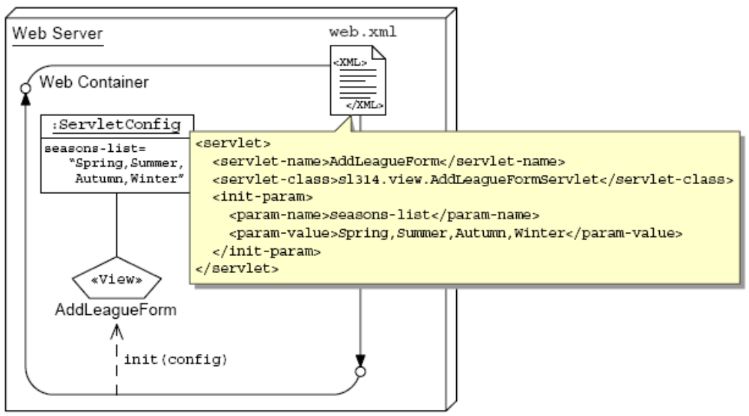
The init Life Cycle Method
Notes:
Use this slide to explain about the init life cycle method. The init method is called when the servlet is first requested by a browser and is used for one-time initialization. It is not called again for any subsequent request. This method is a good place to put any initialization variables.

Slide 6
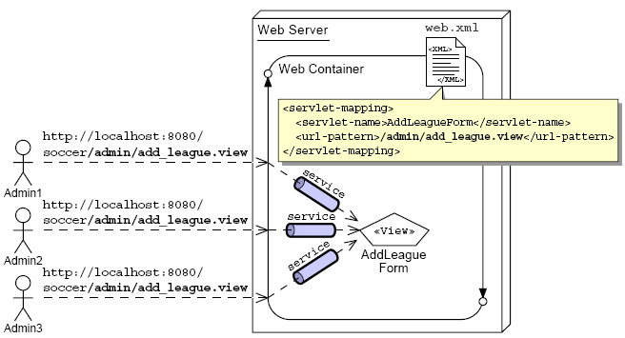
The service Life Cycle Method
Notes:
Use this slide to explain about the service life cycle method. Each time, the server receives a request for a servlet, the server spawns a new thread and calls the servlet’s service () method. By default, the service() method checks the HTTP Header and based on the header, either doPost() or doGet() method is called.

Slide 7

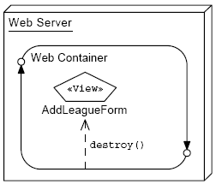
The destroy Life Cycle Method
Notes:
Use this slide to explain about the destroy life cycle method. Before a server shuts down, it calls the destroy() method.
You can handle the following clean up tasks in the destroy method:
Updating log files.
Closing database connections.
Closing any socket connections.

Slide 8
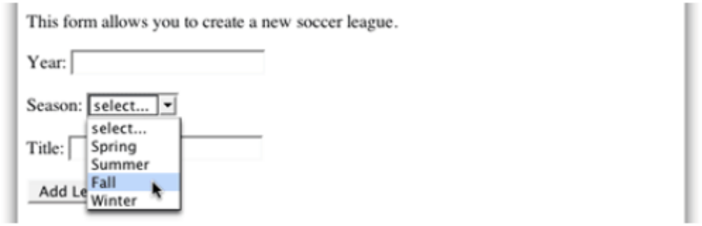
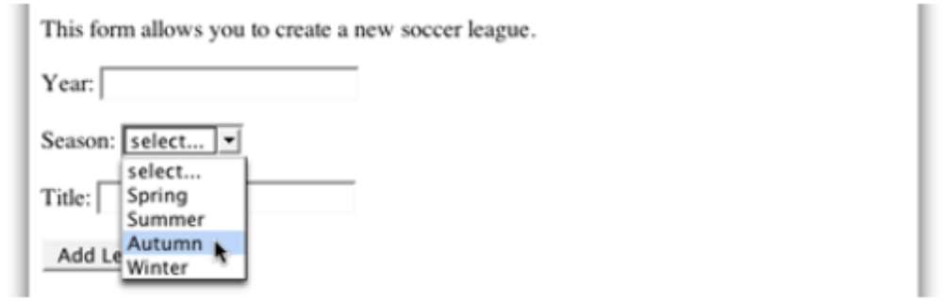
Customizing the Add a New League Form
US-centric season names:
Customized season names:
Notes:
Use this slide to explain about using the initialization parameter to customize the Add a New League form.

Slide 9
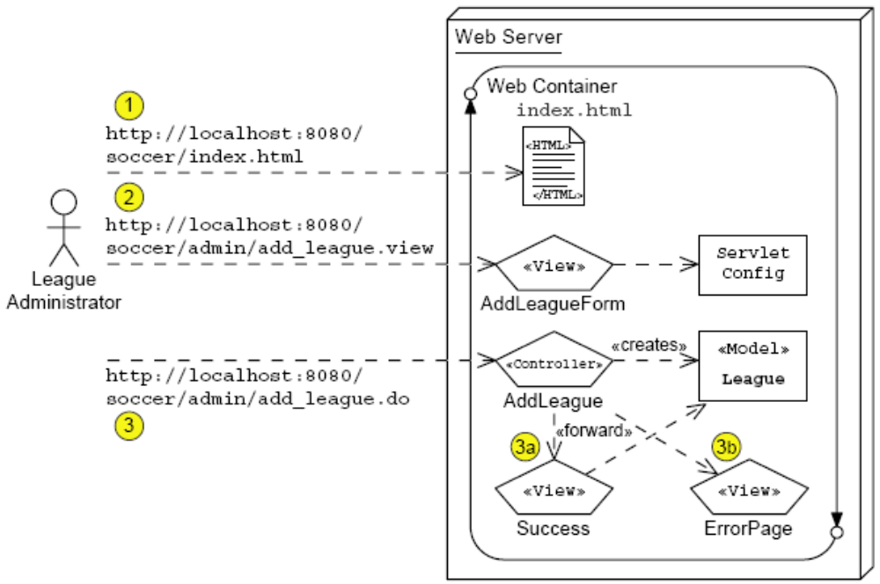
Add League Architecture Model (Step 1)
Notes:
Use this slide to explain about the architecture model for the Soccer League application.

Slide 10
The AddLeagueFormServlet Code
74 out.println(“</p>”);
75 out.println(“<form action=’add_league.do’ method=’POST’>”);
76
77 // Display the year field
78 out.println(“Year: <input type=’text’ name=’year’ /> <br/><br/>”);
79
80 // Customize the season drop-down menu
81 out.println(“Season: <select name=’season’>”);
82 out.println(“ <option value=’UNKNOWN’>select...</option>”);
83 for ( int i = 0; i < SEASONS.length; i++ ) {
84 out.print(“ <option value=’” + SEASONS[i] + “‘”);
85 out.println(“>” + SEASONS[i] + “</option>”);
86 }
87 out.println(“ </select> <br/><br/>”);
88
89 // Display the title field
90 out.println(“Title: <input type=’text’ name=’title’ /> <br/><br/>”);
91
92 out.println(“<input type=’Submit’ value=’Add League’ />”);
93 out.println(“</form>”);
Notes:
Use this slide to explain about the AddLeagueFormServlet code.

Slide 11
Configuring Initialization Parameters
Deployment descriptor for a servlet initialization parameter:
  20 <servlet>
  21 <servlet-name>AddLeagueForm</servlet-name>
  22 <servlet-class>sl314.view.AddLeagueFormServlet
  </servlet-class>
  23 <init-param>
  24 <param-name>seasons-list</param-name>
  25 <param-value>Spring,Summer,Autumn,Winter
  </param-value>
  26 </init-param>
  27 </servlet>
A servlet can have any number of initialization parameters.
Notes:
Use this slide to explain about configuring the initialization parameters in the deployment descriptor.

Slide 12
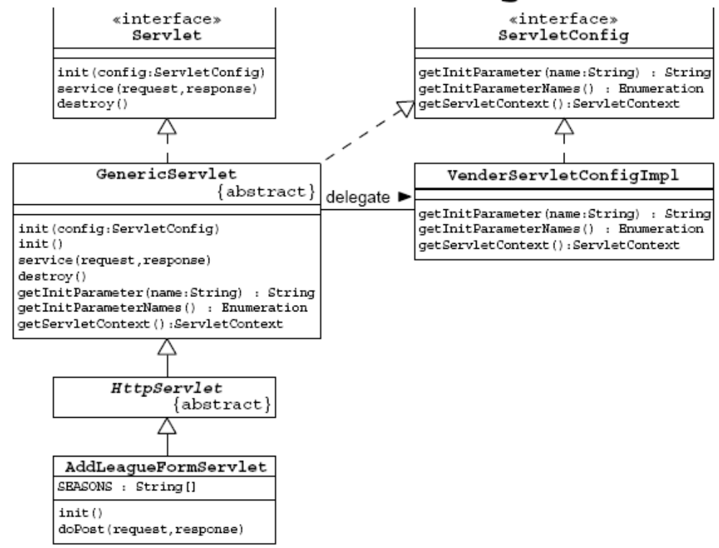
The ServletConfig API
Notes:
Use this slide to explain about the ServletConfig API. Servlet Container uses the ServletConfig object to pass information to the Servlet during its initialization. Following are the methods of the ServletConfig interface:
getInitParameter() method returns a value of given initialization parameter.
getInitParameterNames() method returns an Enumeration object containing names of all initialization parameters provided.
getServletContext() method returns reference to the ServletContext object for this Servlet.
Also, tell the students about the GenericServlet class. The GenericServlet class makes writing servlets easier. It provides simple versions of the life-cycle methods, init and destroy, and of the methods in the ServletConfig interface.

Slide 13
The AddLeagueFormServlet Code
11
12 public class AddLeagueFormServlet extends HttpServlet {
13
14 /** There are the default seasons for the US. */
15 private static final String DEFAULT_SEASONS
16 = “Spring,Summer,Fall,Winter”;
17
18 /** This variable holds the set of seasons. */
19 private String[] SEASONS;
20
21 /** The init method configures the set of seasons. */
22 public void init() {
23 String seasons_list = getInitParameter
(“seasons-list”);
24 if ( seasons_list == null ) {
25 seasons_list = DEFAULT_SEASONS;
26 }
27 SEASONS = seasons_list.split(“,”);
28 }
29
Notes:
Use this slide to explain about the AddLeagueFormServlet code.

Slide 14
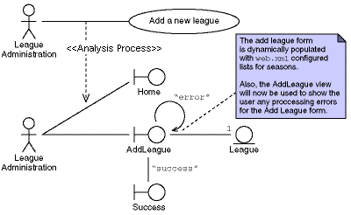
Add League Analysis Model (Stage 2)
Notes:
Use this slide to explain about the modified Analysis model of the Add a New League use case.

Slide 15
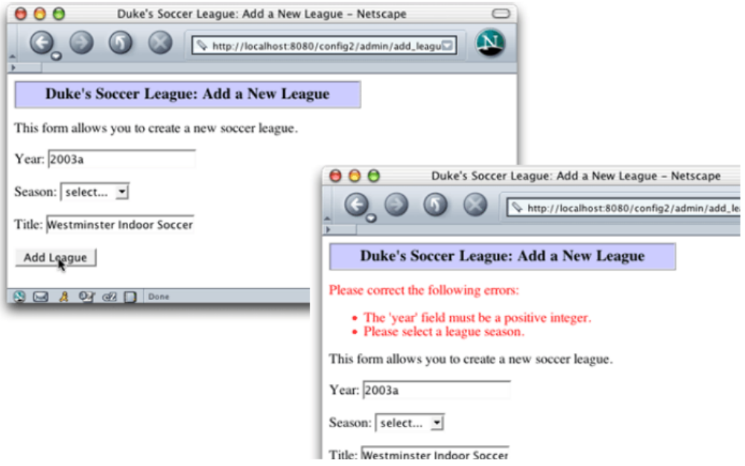
Error Handling Screen Shots
Notes:
Use this slide to explain the Add a New League form with some bad data in the form fields.

Slide 16
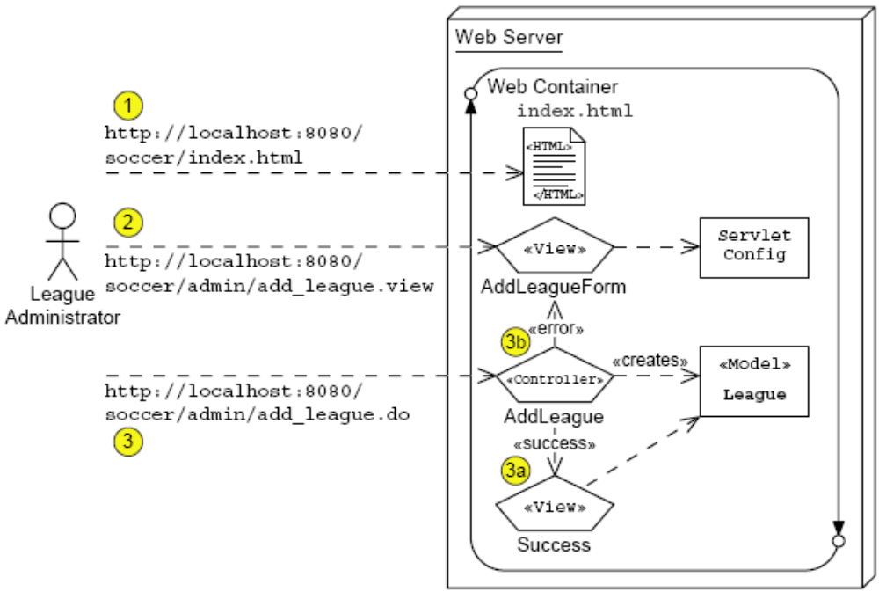
Add League Architecture Model (Stage 2)
Notes:
Use this slide to explain about the Add League Architecture Model (Stage 2).

Slide 17
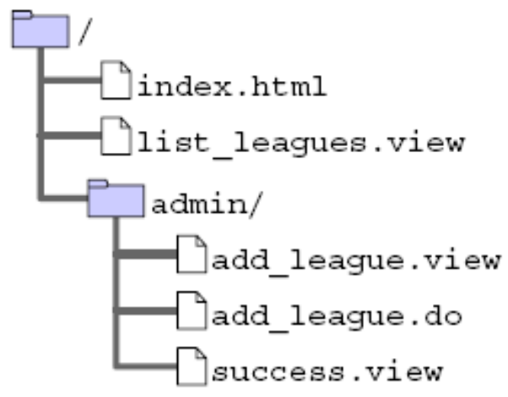
Soccer League Web Application Structure
Notes:
Use this slide to explain about the logical structure of the Soccer League Web application.

Slide 18
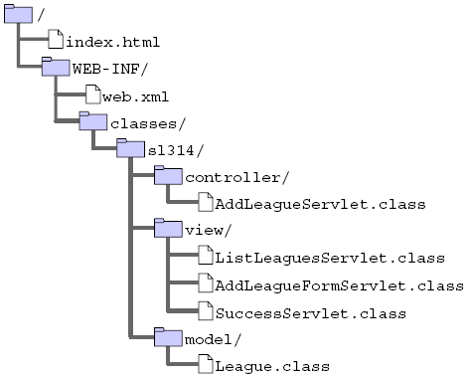
Soccer League Web Application Structure (Contd.)
Notes:
Use this slide to explain about the physical structure of the Soccer League Web application.

Slide 19
The AddLeagueServlet Code
43
44 // Verify form parameters
45 if((year != -1)&&((year < 2000) || (year > 2010))){
46 errorMsgs.add(“The ‘year’ field must within 2000 to
2010.”);
47 }
48 if ( season.equals(“UNKNOWN”) ) {
49 errorMsgs.add(“Please select a league season.”);
50 }
51 if ( title.length() == 0 ) {
52 errorMsgs.add(“Please enter the title of the
league.”);
53 }
54
55 // Send the user back to the AddDVD form, if there
were errors
56 if ( ! errorMsgs.isEmpty() ) {
57 RequestDispatcher view
58 = request.getRequestDispatcher(“add_league.view”);
59 view.forward(request, response);
60 return;
61 }
Notes:
Use this slide to explain about the AddLeagueServlet code.

Slide 20
The AddLeagueFormServlet Code
28
29 public void doGet(HttpServletRequest request,
30 HttpServletResponse response)
31 throws IOException {
32 generateView(request, response);
33 }
34
35 public void doPost(HttpServletRequest request,
36 HttpServletResponse response)
37 throws IOException {
38 generateView(request, response);
39 }
40
41 public void generateView(HttpServletRequest request,
42 HttpServletResponse response)
43 throws IOException {
Notes:
Use Slides 20, 21, and 22 to explain about the AddLeagueFormServlet code.

Slide 21
The AddLeagueFormServlet Code (Contd.)
41 public void generateView(HttpServletRequest request,
42 HttpServletResponse response)
43 throws IOException {
44
45 // Set page title
46 String pageTitle = “Duke’s Soccer League: Add a New
League”;
47
48 // Retrieve the errorMsgs from the request-scope
49 List errorMsgs = (List)
request.getAttribute(“errorMsgs”);
50
51 // Specify the content type is HTML
52 response.setContentType(“text/html”);
53 PrintWriter out = response.getWriter();
54
55 // Generate the HTML response
56 out.println(“<html>”);
57 out.println(“<head>”);
58 out.println(“ <title>” + pageTitle + “</title>”);
59 out.println(“</head>”);
60 out.println(“<body bgcolor=’white’>”);
61

Slide 22
The AddLeagueFormServlet Code (Contd.)
69
70 // Report any errors (if any)
71 if ( errorMsgs != null ) {
72 out.println(“<p>”);
73 out.println(“<font color=’red’>Please correct the
following errors:”);
74 out.println(“<ul>”);
75 Iterator items = errorMsgs.iterator();
76 while ( items.hasNext() ) {
77 String message = (String) items.next();
78 out.println(“ <li>” + message + “</li>”);
79 }
80 out.println(“</ul>”);
81 out.println(“</font>”);
82 out.println(“</p>”);
83 }
84

Slide 23
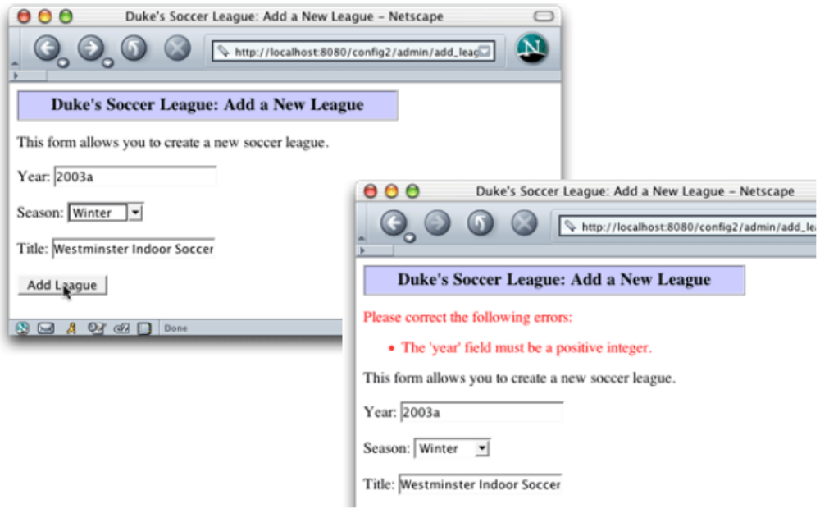
Repopulating Web Forms
Notes:
Use this slide to explain about repopulating Web forms.

Slide 24
Repopulating a Text Field
84
85 // Generate main body
86 out.println(“<p>”);
87 out.println(“This form allows you to create a new
soccer league.”);
88 out.println(“</p>”);
89 out.println(“<form action=’add_league.do’
method=’POST’>”);
90
91 // Repopulate the year field
92 String year = request.getParameter(“year”);
93 if ( year == null ) {
94 year = ““;
95 }
96 out.println(“Year: <input type=’text’ name=’year’
value=’”
97 + year + “‘ /> <br/><br/>”);
98
Notes:
Use this slide to explain about repopulating a text field component.

Slide 25
Repopulating a Drop-Down List
98
99 // Repopulate the season drop-down menu
100 String season = request.getParameter(“season”);
101 out.println(“Season: <select name=’season’>”);
102 if ( (season == null) || season.equals(“UNKNOWN”) ) {
103 out.println(“ <option
value=’UNKNOWN’>select...</option>”);
104 }
105 for ( int i = 0; i < SEASONS.length; i++ ) {
106 out.print(“ <option value=’” + SEASONS[i] + “‘”);
107 if ( SEASONS[i].equals(season) ) {
108 out.print(“ selected”);
109 }
110 out.println(“>” + SEASONS[i] + “</option>”);
111 }
112 out.println(“ </select> <br/><br/>”);
113
Notes:
Use this slide to explain about repopulating a drop-down list.

Slide 26
Demo: Developing Dynamic Forms
Demo: Developing Dynamic Forms
Notes:
Use this slide to demonstrate about developing dynamic forms. You can run the project, ConfigDemo stored at Datafiles For Faculty\Session05\Demo1\mod04_config.zip file in the TIRM CD for demonstration.
To demonstrate how to develop dynamic forms, you need to perform the following tasks:
1. Create the index.html to demonstrate how the admin/add_league.view link points to the servlet generated form.
2. Create the AddLeagueServlet.java file in the sl314.controller package.
3. Create the AddLeagueFormServlet.java file in the sl314.view package.
4. Create the SuccessServlet.java file in the sl314.view package.
5. Create the ListLeaguesServlet.java file in the sl314.view package.
6. Create the League.java file in the sl314.model package.
7. Configure the web.xml file.

Slide 27
Summary
In this session, you learned:
  Usually, web forms should be dynamic to allow for customization, error reporting, and repopulating fields after an error.
  You can use servlet initialization parameters to help customize forms, but init parameters can be used for many more purposes.
  You can use the init() method to read the init parameters and perform servlet configuration.
Notes:
End the session by discussing the summary points as given in this slide.

