Slide 1
Objectives
In this session, you will learn to:
  Design a web application using the Struts MVC framework
  Develop a Struts action class
  Configure the Struts action mappings
Notes:
Start the session by explaining the objectives listed in Slide 1. Students should understand how to develop a Struts action class for their controller components, and they need to be able to configure the action mappings.
The concept of a controller should not be foreign to the student by this module, so the transition from a
servlet controller to a Struts action class is very straightforward.
Use the following flow for this module:
● Design a web application using the Struts MVC framework
● Develop a Struts action class
● Configure the Struts action mappings
Exercise 1: Refactor the DVD application to use Struts action classes

Slide 2
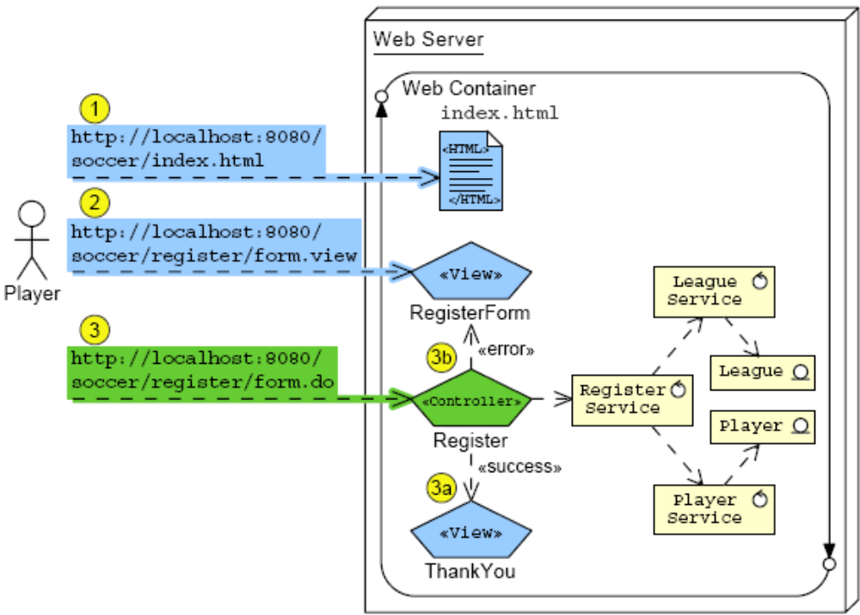
Model-View-Controller Pattern
Notes:
Use this slide to explain about the Model-View-Controller pattern. Model-View-Controller (MVC) design pattern is often used by applications that require to maintain multiple views of the same data. The MVC pattern separates the objects into the following three categories:
Models for maintaining data
Views for displaying all or a portion of the data
Controllers for handling events that affect the model or view(s)

Slide 3
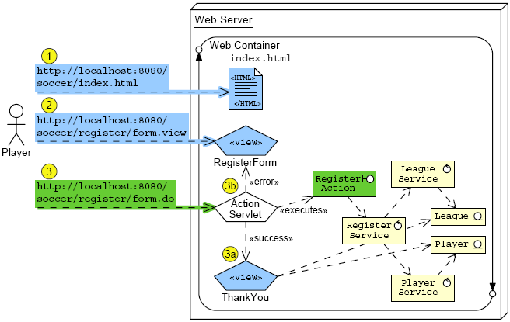
Struts MVC Framework
Notes:
Use this slide to explain about the Struts MVC Framework. The Struts framework helps create web applications that utilize a MVC architecture. The framework has three key components:
A request handler
A response handler
A tag library

Slide 4

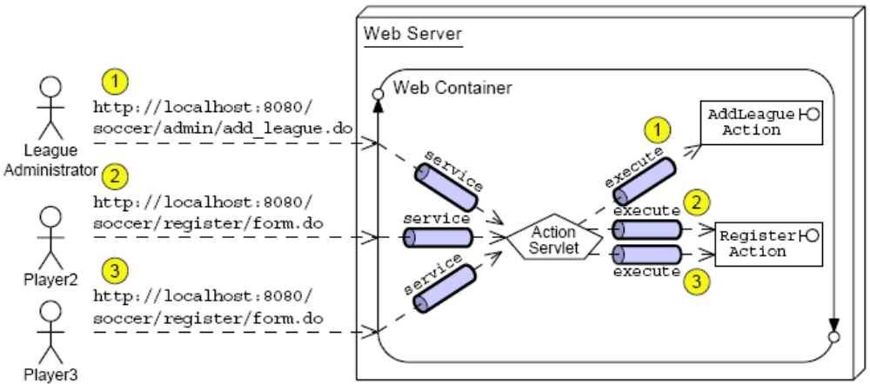
Front Controller Pattern
Controller requests are handled by the Struts ActionServlet, which acts as an infrastructure controller to dispatch to the application controller actions.
Notes:
Use this slide to explain about the Front Controller Pattern.

Slide 5
Struts MVC Framework
Framework provides the following elements:
  Infrastructure servlet controller
  Base classes
  Configuration files
Why use a framework like Struts?
  Provides flexible, extensible infrastructure for MVC
  Lets you focus on what is important to your application, such as:
    Application controllers
    Model components
    Views
Notes:
Use this slide to explain about the Struts MVC Framework. The Front Controller manages the handling of all incoming request, including invoking security services and delegating business processing. It defines a single component that is responsible for processing application requests, and invoking the appropriate business logic. The Front Controller pattern typically consists of two parts:
Handler
Command hierarchy
The handler receives incoming requests and determines the action to be performed. It then dispatches the request to the appropriate command, which actually carries out that action.

Slide 6
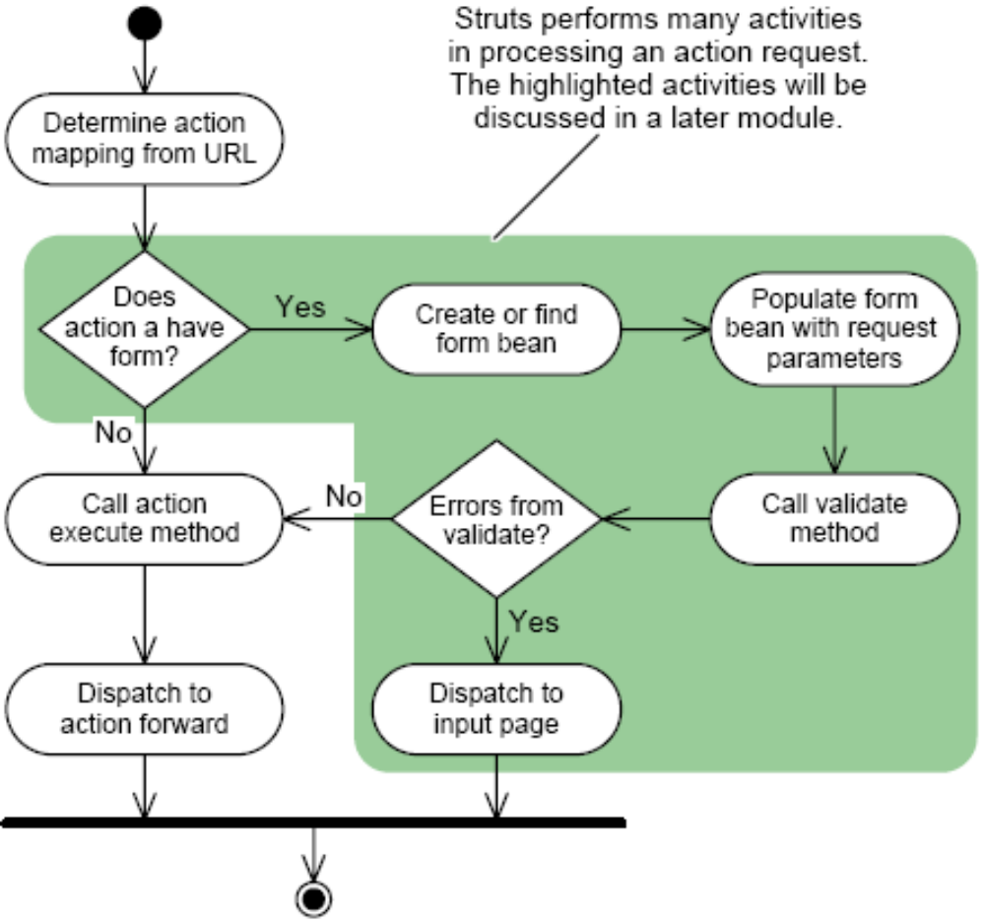
Struts Activity Diagram
Notes:
Use this slide to explain about the Struts request processing by using the Struts Activity diagram.

Slide 7
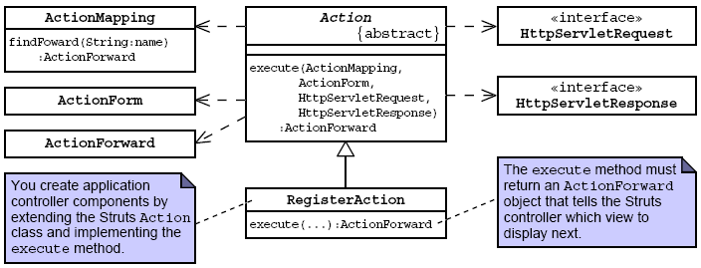
Struts Action Class
Notes:
Use this slide to explain about the Struts Action class. Explain the methods of the Action class, as given in page 7-10 of the SG.

Slide 8
The AddLeagueAction Code
1 package sl314.controller;
2
3 import javax.servlet.http.HttpServletRequest;
4 import javax.servlet.http.HttpServletResponse;
5 // Struts classes
6 import org.apache.struts.action.Action;
7 import org.apache.struts.action.ActionForward;
8 import org.apache.struts.action.ActionMapping;
9 import org.apache.struts.action.ActionForm;
10 // Model classes
11 import sl314.model.LeagueService;
12 import sl314.model.League;
13 import java.util.List;
14 import java.util.LinkedList;
15 import javax.servlet.ServletContext;
16
17
18 public class AddLeagueAction extends Action {
19
Notes:
Use Slides 8, 9, 10, and 11 to explain about creating an AddLeagueAction class by extending the Action class.

Slide 9
The AddLeagueAction Code (Contd.)
20 public ActionForward execute(ActionMapping mapping,
21 ActionForm form,
22 HttpServletRequest request,
23 HttpServletResponse response) {
24
25 // Keep a set of strings to record form processing
errors.
26 List errorMsgs = new LinkedList();
27 // Store this set in the request scope, in case we
28 // need to send the ErrorPage view.
29 request.setAttribute(“errorMsgs”, errorMsgs);
30
31 try {
32
33 // Retrieve form parameters.
34 String yearStr =
request.getParameter(“year”).trim();
35 String season =
request.getParameter(“season”).trim();
36 String title =
request.getParameter(“title”).trim();
37

Slide 10
The AddLeagueAction Code (Contd.)
38 // Perform data conversions.
39 int year = -1;
40 try {
41 year = Integer.parseInt(yearStr);
42 } catch (NumberFormatException nfe) {
43 errorMsgs.add(“The ‘year’ field must be a
positive integer.”);
44 }
45
46 // Verify form parameters
47 if((year != -1)&&((year < 2000)||(year > 2010))){
48 errorMsgs.add(“The ‘year’ field must within
2000 to 2010.”)
49 }
50 if ( season.equals(“UNKNOWN”) ) {
51 errorMsgs.add(“Please select a league season.”);
52 }
53 if ( title.length() == 0 ) {
54 errorMsgs.add(“Please enter the title of the
league.”)
55 }
56
57 // Send the ErrorPage view if there were errors
58 if ( ! errorMsgs.isEmpty() ) {
59 return mapping.findForward(“error”);

Slide 11
The AddLeagueAction Code (Contd.)
60 }
61
62 // Perform business logic
63 // Perform business logic
64 ServletContext context =
getServlet().getServletContext();
65 String dataDirectory = (String)context.getAttribute
(“sl314.model.dataDirectory”);
66 LeagueService leagueSvc = new
LeagueService(dataDirectory);
67 League league = leagueSvc.createLeague(year,
season, title);
68 // Store the new league in the request-scope
69 request.setAttribute(“league”, league);
70
71 // Send the Success view
72 return mapping.findForward(“success”);
73
74 // Handle any unusual exceptions
75 } catch (RuntimeException e) {
76
77 // Log stack trace
78 e.printStackTrace(System.err);

Slide 12
Configuring the Struts Action Mappings
You need to do the following:
  1 Configure the Struts infrastructure controller.
  2 Configure a servlet mapping for the Struts controller.
  3 Configure the action mappings.
  4 Install the Struts library files.
Notes:
Use this slide to explain about configuring the Struts Action Mappings.

Slide 13
Configuring the Infrastructure Controller
Configured in the web.xml deployment descriptor:
  25 <!-- Declare the Struts ActionServlet (Front
  Controller) -->
  26 <servlet>
  27 <servlet-name>FrontController</servlet-name>
  28 <servlet-class>
  29 org.apache.struts.action.ActionServlet
  30 </servlet-class>
  31 <!-- Path of the struts configuration file -->
  32 <init-param>
  33 <param-name>config</param-name>
  34 <param-value>/WEB-INF/struts-config.xml
  </param-value>
  35 </init-param>
  36 <!-- Load the servlet on startup -->
  37 <load-on-startup>1</load-on-startup>
  38 </servlet>
Notes:
Use this slide to explain about configuring the Infrastructure Controller in the web.xml deployment descriptor.

Slide 14
Front Controller Servlet Mapping
Also, configured in the web.xml deployment descriptor:
  79
  80 <!-- Standard Front Controller Mapping -->
  81 <servlet-mapping>
  82 <servlet-name>FrontController</servlet-name>
  83 <url-pattern>*.do</url-pattern>
  84 </servlet-mapping>
  85
This servlet mapping ensures that all *.do requests go to
the Struts infrastructure controller.
Notes:
Use this slide to explain about mapping the Front Controller Servlet in the web.xml deployment descriptor.

Slide 15
Configuring Action Mappings
Configured in the struts-config.xml file:
  8
  9 <action-mappings>
  10
  11 <!-- Declare the /register/form.do action -->
  12 <action path=”/register/form”
  13 type=”sl314.controller.RegisterAction”>
  14 <forward name=”success” path=”/register/thank_you.view”/>
  15 <forward name=”error” path=”/register/form.view”/>
  16 </action>
  17
  18 <!-- Declare the /admin/add_league.do action -->
  19 <action path=”/admin/add_league”
  20 type=”sl314.controller.AddLeagueAction”>
  21 <forward name=”success” path=”/admin/success.view”/>
  22 <forward name=”error” path=”/admin/add_league.view”/>
  23 </action>
  24
  25 </action-mappings>
  26
  27 </struts-config>
Notes:
Use this slide to explain about configuring the application-specific classes in the struts-config.xml file. The controller uses the Struts Configuration file, struts-config.xml, to determine the routing and configuration information for the Struts application. This file needs to be in the WEB-INF directory of the application.

Slide 16
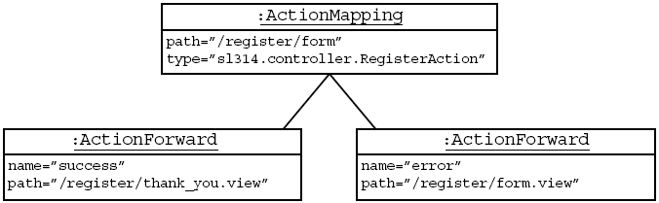
Action Mapping Object Representation
Notes:
Use this slide to explain about representing the Action Mapping object.

Slide 17
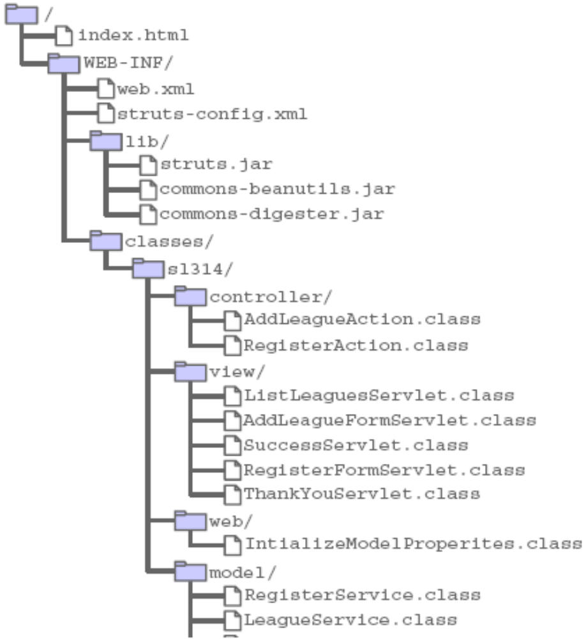
Installing the Struts Library Files
Notes:
Use this slide to explain about installing the Struts Library files.

Slide 18
Demo: Developing Web Applications Using Struts
Demo: Developing Web Applications Using Struts
Notes:
In this demo, you demonstrate how to add the Struts framework to the web application project, and make necessary changes to use the Struts framework.
Two projects, PreStrutsDemo and PostStrutsDemo are provided at
Datafiles For Faculty\Session08\Demo1\mod07_struts.zip file in the TIRM CD.
You can open the PreStrutsDemo project, and add the Struts framework to the project, and show students how the project properties and libraries are affected.
When you add the Struts framework, you follow the default settings for the Struts framework, and select Add Struts TLDs for future use.
The PostStrutsDemo project is a working project that has been modified to use Struts and action classes to implement the project. Before running the PostStrutsDemo project in NetBeans IDE 5.5.1, you need to set the Param Value of the data-directory context parameter by following the steps given below:
Open the web.xml file in the WEB-INF directory of the PostStrutsDemo project.
Select the General tab.
Expand the Context Parameters node.
Select the data-directory under the Param Name attribute.
Select the Edit button. The Edit Context Parameter dialog box is displayed.
Change the path of the data directory of the PostStrutsDemo project in the Param Value text box.
Click the OK button.
You can compare the AddLeagueAction class in the PostStrutsDemo project and the AddLeagueServlet class in the PreStrutsDemo project to explain,and the web.xml descriptors in these two projects to explain the necessary changes you should make for the Struts based project.
You should also demonstrate the struts-config.xml descriptor to explain the struts configuration, especially the action-mapping element.

Slide 19
Summary
In this session, you learned:
  Struts is a framework that provides an implementation of the Front Controller pattern and supports the development of MVC-based web applications.
  Using Struts, you create a subclass of Action for each application controller.
  You can then configure the set of actions and their forwards in the struts-config.xml file.
  You also need to configure the Struts infrastructure controller servlet in the web.xml file.
  Finally, Struts is a big framework. In this module, you were introduced only to the essential aspects of Struts.
Notes:
End the session by discussing the summary points as given in this slide.

