Slide 1
Objectives
In this session, you will learn to:
  Describe the web container request cycle
  Describe the Filter API
  Develop a filter class
  Configure a filter in the web.xml file
Notes:
Start the session by explaining the objectives listed in Slide 1. Because students might be unfamiliar with filters, it is important to stress to students how filters can be used in applications. Ask them to think of some examples of pre-processing and post-processing that they might need in their application, and how they would accomplish these actions. Based on the examples, filters can be an elegant solution to their problems.
Use the following flow in this module:
● Describe the web container request cycle
● Describe the Filter API
● Develop a filter class
● Configure a filter in the web.xml file
Exercise 1: Create an authentication filter to identify the user-specific library
Advanced Exercise 2: Create a response compression filter

Slide 2
Web Container Request Cycle
Request processing by the web container
Applying filters to an incoming request
Applying filters to a dispatched request
Notes:
Use this slide to explain about the Web container request cycle.

Slide 3

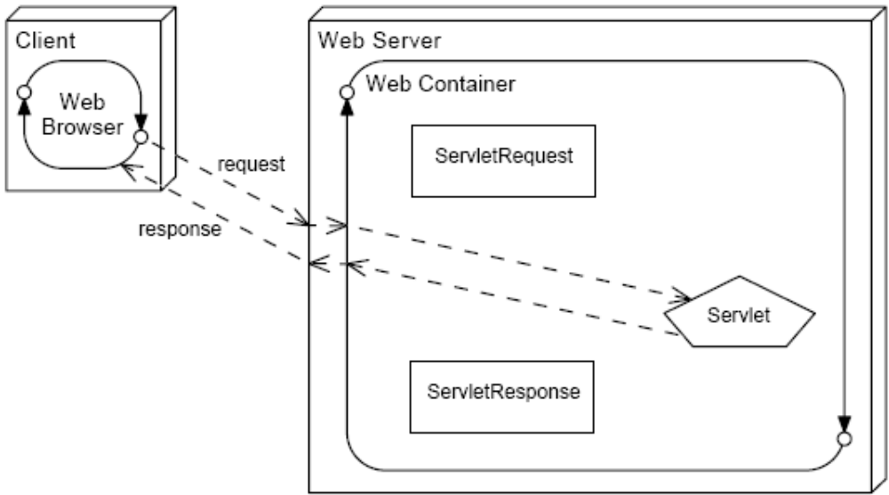
Web Container Request Processing
Request and response objects are created for each incoming request.
Notes:
Use this slide to explain about the processing of the Web container request.

Slide 4
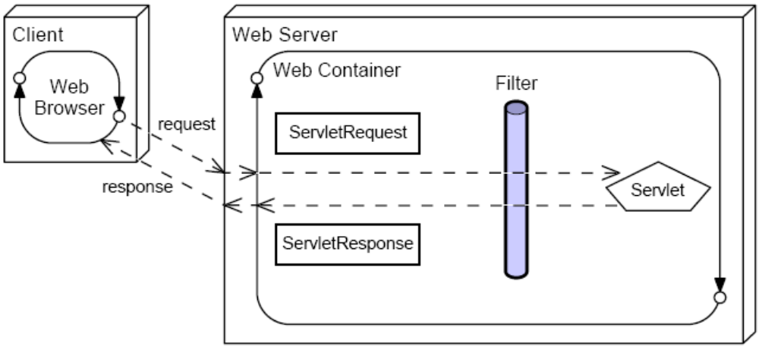
Applying Filters to an Incoming Request
A filter intercepts the request before it gets to the requested resource.
A response is returned to the client through the filter.
Notes:
Use Slides 4, 5, 6, and 7 to explain about applying filters to an incoming request.

Slide 5
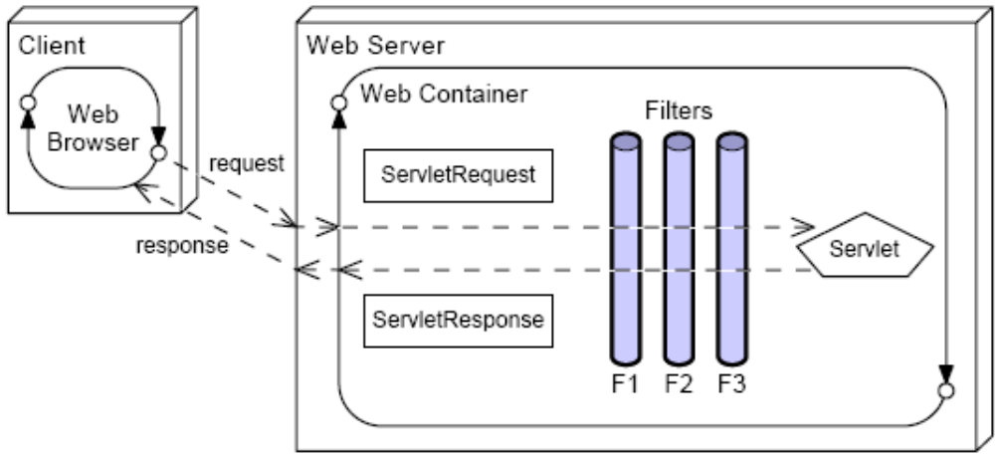
Applying Filters to an Incoming Request (Contd.)
Multiple filters can intercept a given request.
This provides for modularity and reuse of code.

Slide 6
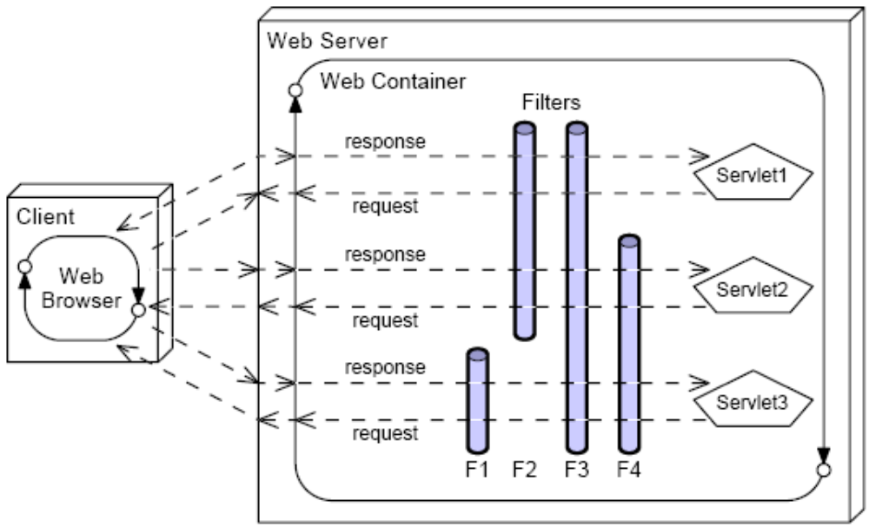
Applying Filters to an Incoming Request (Contd.)
Filters can be applied to different requests in different combinations.

Slide 7
Applying Filters to an Incoming Request (Contd.)
Filters can be used for many activities in a web application, such as:
  Blocking access to a resource based on user identity or role membership
  Auditing incoming requests
  Compressing the response data stream
  Transforming the response
  Measuring and logging servlet performance

Slide 8
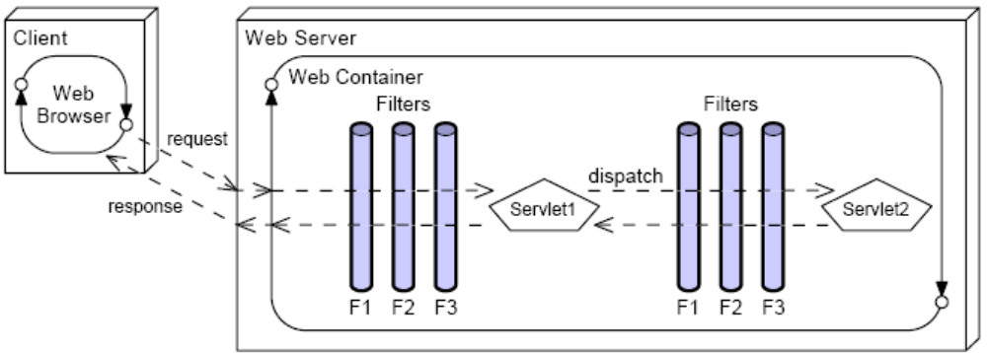
Filters Applied to a Dispatch
Filters can be applied to an internal dispatch, such as a request forward or include.
This behavior is determined by the information in the deployment descriptor.
Notes:
Use this slide to explain about applying filters to a dispatched request.

Slide 9
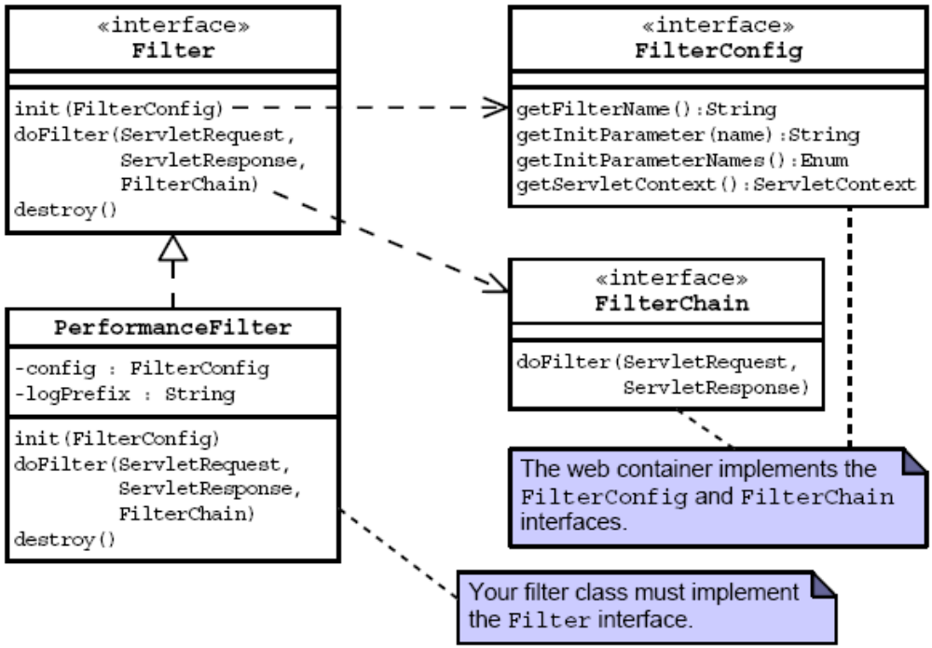
Filter API
Notes:
Use this slide to explain about the Filter API. Filters perform filtering in the doFilter method. The Filter interface contains the following methods:
void destroy()
void doFilter(ServletRequest, ServletResponse, FilterChain)
void init(FilterConfig filterConfig)

Slide 10
The PerformanceFilter Class
1 package sl314.web;
2
3 import java.io.IOException;
4
5 import javax.servlet.ServletRequest;
6 import javax.servlet.ServletResponse;
7 import javax.servlet.ServletException;
8 import javax.servlet.http.HttpServletRequest;
9
10 import javax.servlet.Filter;
11 import javax.servlet.FilterChain;
12 import javax.servlet.FilterConfig;
13
14 public class PerformanceFilter implements Filter {
15
16 private FilterConfig config;
17 private String logPrefix;
18
Notes:
Use this slide to explain about the PerformanceFilter class.

Slide 11
The init Method
The init method is called once when the filter instance is first created.
Use the init method to:
  Perform one-time initialization of resources the filter uses over its lifetime
  Retrieve the initialization parameters configured in the deployment descriptor
    19 public void init(FilterConfig config)
    20 throws ServletException {
    21 this.config = config;
    22 logPrefix = config.getInitParameter(“Log Entry
    Prefix”);
    23 }
Notes:
Use this slide to explain about the init method. This method is called by the web container to indicate to a filter that it is being placed into service.

Slide 12
The doFilter Method
The doFilter method is the filter equivalent of a servlet’s service method.
As a developer, you implement the doFilter method to do the following:
  Perform the operations you want to occur every time the filter is invoked.
  Decide whether to pass the request to the next component in the filter chain or halt the request entirely.
  To pass on the request, call the doFilter method on the FilterChain reference.
Notes:
Use Slides 12 and 13 to explain about the doFilter method. The doFilter is called by the container each time a request/response pair is passed through the chain.

Slide 13
The doFilter Method (Contd.)
25 public void doFilter(ServletRequest request,
26 ServletResponse response, FilterChain chain)
27 throws ServletException, IOException {
28
29 long begin = System.currentTimeMillis();
30 chain.doFilter(request, response);
31 long end = System.currentTimeMillis();
32
33 StringBuffer logMessage = new StringBuffer();
34 if (request instanceof HttpServletRequest) {
35 logMessage =
((HttpServletRequest)request).getRequestURL();
36 }
37 logMessage.append(“: “);
38 logMessage.append(end - begin);
39 logMessage.append(“ ms”);
40
41 if(logPrefix != null) {
42 logMessage.insert(0,logPrefix);
43 }
44
45 config.getServletContext().log(logMessage.toString());
46 }

Slide 14
The destroy Method
The destroy method is the last method called in the life cycle of a filter instance.
Use the destroy method to clean up any resources allocated in the init method.
  48 public void destroy() {
  49 config = null;
  50 logPrefix = null;
  51 }
Notes:
Use this slide to explain about the destroy method. This method is called by the web container to indicate to a filter that it is being taken out of service.

Slide 15
Configuring the Filter
You declare the filter in the deployment descriptor.
You can supply initialization parameters in the declaration.
  25 <filter>
  26 <filter-name>perfFilter</filter-name>
  27 <filter-class>sl314.web.PerformanceFilter
  </filter-class>
  28 <init-param>
  29 <param-name>Log Entry Prefix</param-name>
  30 <param-value>Performance: </param-value>
  31 </init-param>
  32 </filter>
Notes:
Use Slides 15, 16, 17, 18, and 19 to explain about configuring the filter. You can map a filter to a servlet by:
Using the <filter> element to declare the filter in the deployment descriptor file. This element creates a name for the filter and declares the implementation and initialization parameters of the filter class.
Defining a <filter-mapping> element to map the filter to a servlet in the deployment descriptor file. This element maps a filter name to a servlet by name or URL pattern.

Slide 16
Configuring the Filter (Contd.)
Mappings can be:
  URL based – Use the exact URL or a wildcard (*)
  Servlet name-based – Specify the name of the servlet to which the filter is applied
    34 <filter-mapping>
    35 <filter-name>perfFilter</filter-name>
    36 <url-pattern>*.do</url-pattern>
    37 </filter-mapping>
For a given request, if multiple filter mappings match:
  URL-based filters applied before servlet name-based filters
  Filters applied in the order in which the mappings occur in the deployment descriptor

Slide 17
Configuring the Filter (Contd.)
Given these servlet mappings, what happens if the client requests /admin/add_league.do?
  <servlet-mapping>
  <servlet-name>FrontController</servlet-name>
  </url-pattern>*.do</url-pattern>
  </servlet-mapping>
  <filter-mapping>
  <filter-name>perfFilter</filter-name>
  <servlet-name>FrontController</servlet-name>
  </filter-mapping>
  <filter-mapping>
  <filter-name>auditFilter</filter-name>
  <url-pattern>*.do</url-pattern>
  </filter-mapping>
  <filter-mapping>
  <filter-name>transformFilter</filter-name>
  <url-pattern>*.do</url-pattern>
  </filter-mapping>

Slide 18
Configuring the Filter (Contd.)
Typically, filters are applied to requests from a client. You can specify the dispatcher element in a filter mapping. This determines what type (or types) of requests invoke the filter. Valid values are:
  REQUEST – The filter is applied if the request is from a client.
  INCLUDE – The filter is applied if the request is from a request dispatcher include.
  FORWARD – The filter is applied if the request is from a request dispatcher forward.
  ERROR – The filter is applied if the request is a result of an error condition.

Slide 19
Configuring the Filter (Contd.)
You can use a combination of dispatcher elements to specify when filters should be applied.
Given:
  <filter-mapping>
  <filter-name>auditFilter</filter-name>
  <url-pattern>*.do</url-pattern>
  <dispatcher>INCLUDE</dispatcher>
  <dispatcher>FORWARD</dispatcher>
  </filter-mapping>
When would the auditFilter be applied?

Slide 20
Demo: Using Filters in Web Applications
Demo: Using Filters in Web applications
To demostrate the use of filtes in Web application, you need to perform the following tasks:
  Create the FilterDemo project in NetBeans IDE
  Build the project.
  Run the project.
Notes:
In this demo, you demonstrate the use of filters in a Web application. You can run the project, FilterDemo, stored at Datafiles For Faculty\Session11\Demo1\mod09_filters.zip file in the TIRM CD for demonstration.
Before running the FilterDemo project in NetBeans IDE 5.5.1, you need to set the Param Value of the data-directory context parameter by following the steps as given in the previous session.

Slide 21
Summary
In this session, you learned:
  Filters permit you to augment the default request processing model.
  You can create a filter as follows:
    Implementing the javax.servlet.Filter interface
    Configuring a filter instance in the deployment descriptor
    Configuring one or more filter mappings
  Filters can also be applied to dispatched requests.
Notes:
End the session by discussing the summary points as given in Slide 20.

