Slide 1

Objectives
In this session, you will learn to:
  Describe JSP technology
  Write JSP code using scripting elements
  Write JSP code using the page directive
  Write JSP code using standard tags
  Write JSP code using the Expression Language (EL)
  Implement EL
  Configure the JSP environment in the web.xml file
Notes:
Start the session by explaining the objectives listed in Slide 1. This module introduces the students to JSP technology. The most important thing for students to understand is that JSP pages become servlets. They do not replace servlet technology, but rather provide a different approach (embedding Java technology code in an HTML file). Everything that the students have learned about servlets (access to HTML form parameters, attribute scopes, session management, separation of presentation and business logic, access to the servlet configuration and context objects, security, concurrency, and so on) is the same for JSP pages. The notable exception is error handling.
Use the following flow for this module:
● Describe JSP technology
● Write JSP code using scripting elements
● Write JSP code using the page directive
Exercise 1: Convert the ListLibrary servlet into a JSP page
● Write JSP code using standard tags
Exercise 2: Convert the Success servlet using standard actions
● Write JSP code using the Expression Language (EL)
● Configure the JSP environment in the web.xml file
Exercise 3: Refactor the Success JSP page using EL
Advanced Exercise 4: Convert the AddDVDForm servlet to a JSP page

Slide 2
JavaServer Pages Technology
JavaServer Pages technology enables you to write standard HTML pages containing tags that run powerful programs based on Java technology.
The goal of JSP technology is to support separation of presentation and business logic:
  Web designers can design and update pages without learning the Java programming language.
  Programmers for Java platform can write code without dealing with web page design.
Notes:
This module begins with an introduction to raw JSP technology. The module then presents methods of reducing scripting in JSP pages using EL and standard tags. The goal is to show how to create JSP pages with few scripting elements, mainly by using JavaBeans components, JSTL, and custom tag libraries. Scripting elements are types of JSP technology tags: directive, declaration, scriptlet, comment, and expression tags. JSP pages with scripting elements can be difficult for web designers to understand. This is because the web designers who create HTML pages might not be savvy with Java technology. JSP technology is a critical piece of the web application puzzle, because it is the standard solution for creating the views in an MVC web application design.

Slide 3
Hello World Servlet
11 public class HelloServlet extends HttpServlet {
12
13 private static final String DEFAULT_NAME = “World”;
14
15 public void doGet(HttpServletRequest request,
16 HttpServletResponse response)
17 throws IOException {
18 generateResponse(request, response);
19 }
20
21 public void doPost(HttpServletRequest request,
22 HttpServletResponse response)
23 throws IOException {
24 generateResponse(request, response);
25 }
26
27 public void generateResponse(HttpServletRequest request,
28 HttpServletResponse response)
29 throws IOException {
30
Notes:
Use Slides 3 and 4 to explain about the coding for the Hello World Servlet.

Slide 4
Hello World Servlet (Contd.)
31 String name = request.getParameter(“name”);
32 if ( (name == null) || (name.length() == 0) ) {
33 name = DEFAULT_NAME;
34 }
35
36 response.setContentType(“text/html”);
37 PrintWriter out = response.getWriter();
38
39 out.println(“<HTML>”);
40 out.println(“<HEAD>”);
41 out.println(“<TITLE>Hello Servlet</TITLE>”);
42 out.println(“</HEAD>”);
43 out.println(“<BODY BGCOLOR=’white’>”);
44 out.println(“<B>Hello, “ + name + “</B>”);
45 out.println(“</BODY>”);
46 out.println(“</HTML>”);
47
48 out.close();
49 }

Slide 5
The hello.jsp Page
1 <%! private static final String DEFAULT_NAME = “World”; %>
2
3 <html>
4
5 <head>
6 <title>Hello JavaServer Page</title>
7 </head>
8
9 <%-- Determine the specified name (or use default) --%>
10 <%
11 String name = request.getParameter(“name”);
12 if ( (name == null) || (name.length() == 0) ) {
13 name = DEFAULT_NAME;
14 }
15 %>
16
17 <body bgcolor=’white’>
18
19 <b>Hello, <%= name %></b>
20
21 </body>
22
23 </html>
Notes:
Use this slide to explain about the coding for the hello.jsp page.

Slide 6
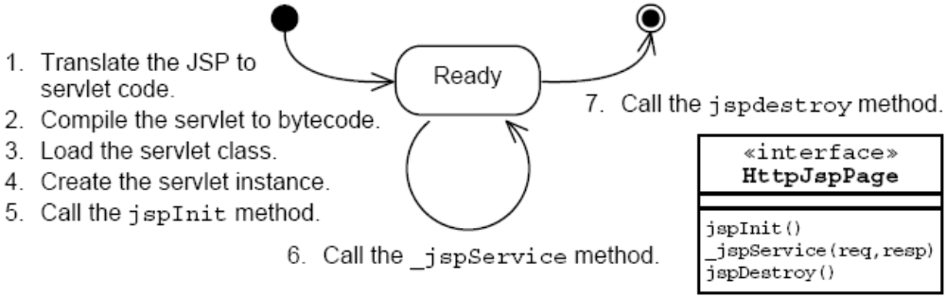
Steps of JSP Page Processing
Notes:
Use this slide to explain about the steps of JSP page processing.

Slide 7
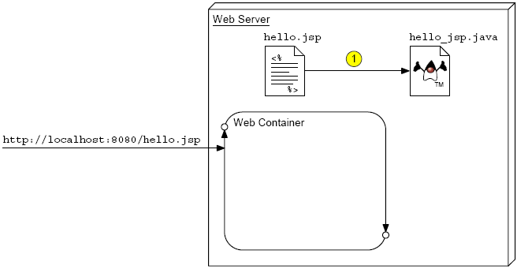
JSP Page Translation
Notes:
Use this slide to explain about the Translation phase of the JSP Page. During the translation phase, a JSP page is translated to a servlet and it is a servlet that actually runs when a browser makes a request. Much of the JSP life cycle is similar to that of a servlet.

Slide 8
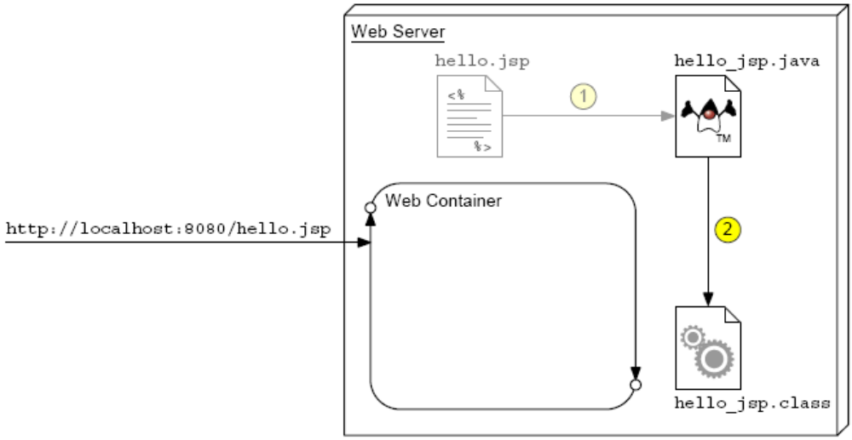
JSP Page Compilation
Notes:
Use this slide to explain about the Compilation phase of the JSP Page.

Slide 9
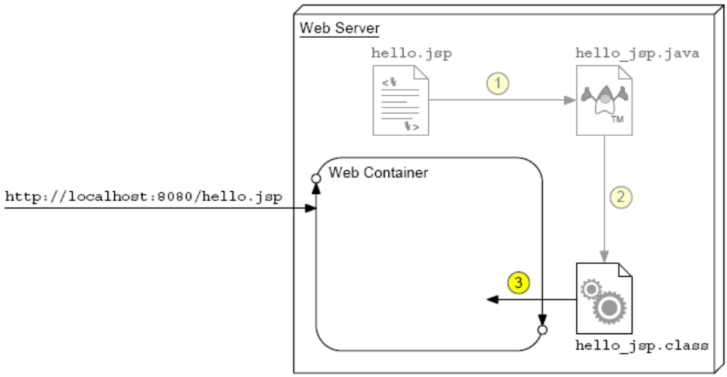
JSP Page Class Loading
Notes:
Use this slide to explain about the loading the servlet class into the Web container.

Slide 10
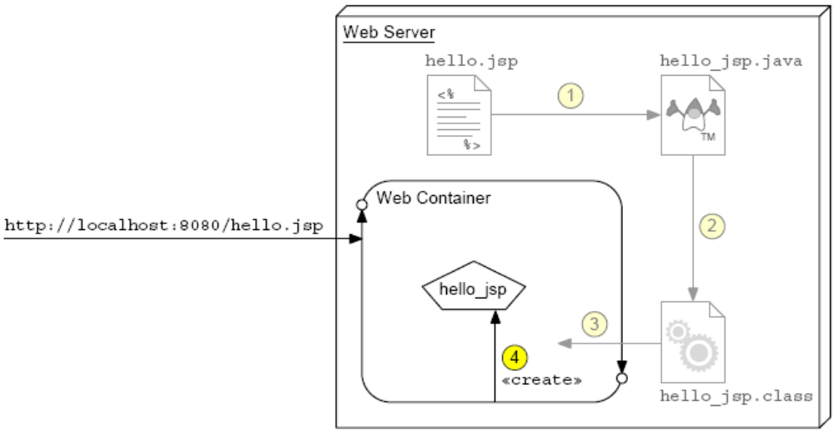
JSP Page Servlet Instance
Notes:
Use this slide to explain about the creating an instance of the servlet class.

Slide 11
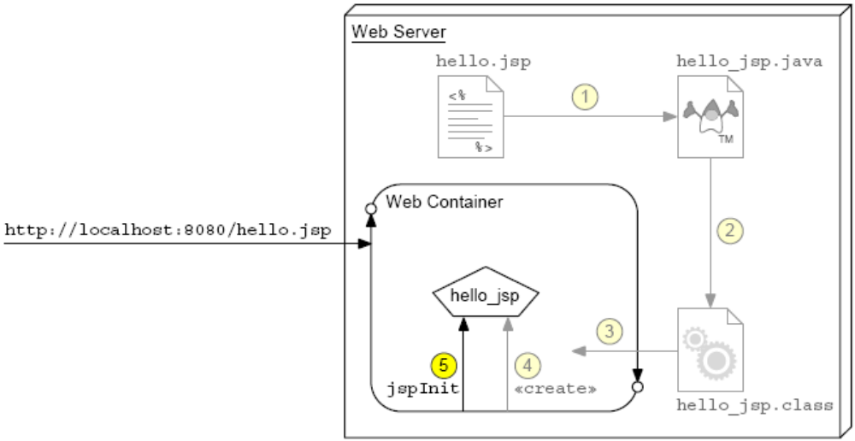
JSP Page Initialization
Notes:
Use this slide to explain about initializing the JSP Page by calling the jspInit method. The jspInit method is called by the Web container once and only once for a servlet instance.

Slide 12
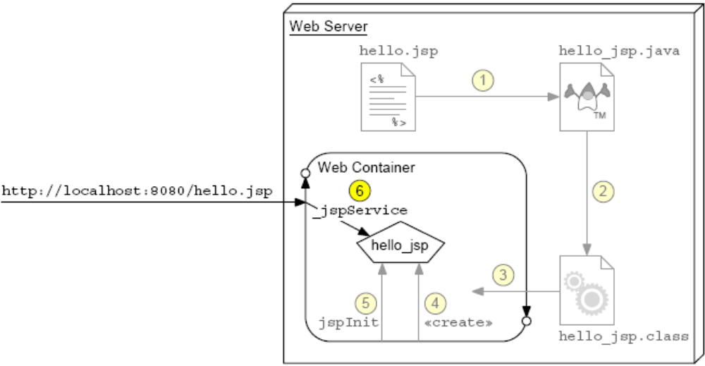
JSP Page Service
Notes:
Use this slide to explain about the _jspService method. This method is equivalent to the service() method for a servlet. This method is called for each request and takes the request and response objects as parameters.

Slide 13
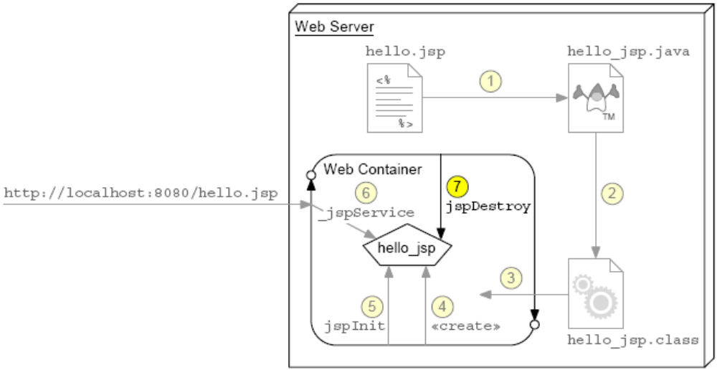
JSP Page Destroyed
Notes:
Use this slide to explain about cleaning up the resources used by the JSP page. The jspDestroy method is used to release the resources used by a JSP page.

Slide 14
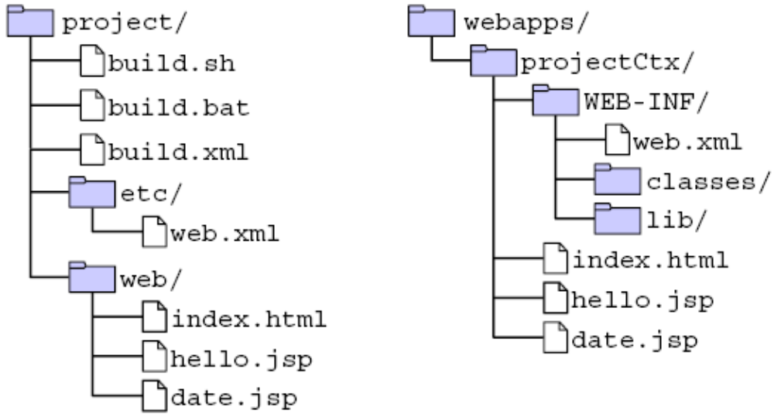
Developing and Deploying JSP Pages
Place your JSP files in the web directory during development. They are copied to the main HTML hierarchy at deployment:
Notes:
Use this slide to explain about developing and deploying JSP pages.

Slide 15
Writing JSP Scripting Elements
JSP scripting elements <% %> are processed by the JSP engine.
  <html>
  <%-- scripting element --%>
  </html>
There are five types of scripting elements:
Scripting Element | Scripting Syntax
Comment | <%-- comment --%>
Directive | <%@ directive %>
Declaration | <%! decl %>
Scriplet | <% code %>
Expression | <%= expr %>
Notes:
Use this slide to explain about writing JSP scripting elements. JSP documents are created using an XML syntax. Creating an XML version of a JSP page is non-trivial because you must wrap all of the template text in a jsp:text tag. Furthermore, any text that might include special XML symbols, such as the less-than character (<), must be wrapped within a CDATA construct. All of these constraints makes editing XML-based JSP pages almost impossible by a human. This syntax was added to the JSP specification to support XML-based JSP page editors.

Slide 16
Comments
There are three types of comments permitted in a JSP page:
  HTML comments
    <!-- This is an HTML comment. It will show up in the response. -->
  JSP page comments
    <%-- This is a JSP comment. It will only be seen in
    the JSP code. It will not show up in either
    the servlet code or the response.
    --%>
  Java technology comments
    <%
    /* This is a Java comment. It will show up in the
    servlet code. It will not show up in the
    response. */
    %>
Notes:
Use this slide to explain about the comments permitted in a JSP page.

Slide 17
Directive Tag
A directive tag affects the JSP page translation phase.
  Syntax:
    <%@ DirectiveName [attr=”value”]* %>
  Examples:
    <%@ page session=”false” %>
    <%@ include file=”incl/copyright.html” %>
Notes:
Use this slide to explain about the Directive tag.

Slide 18
Declaration Tag
A declaration tag lets the JSP page developer include
declarations at the class-level.
  Syntax:
    <%! JavaClassDeclaration %>
  Examples:
    <%! public static final String DEFAULT_NAME = “World”; %>
    <%! public String getName(HttpServletRequest request) {
    return request.getParameter(“name”);
    }
    %>
    <%! int counter = 0; %>
Notes:
Use this slide to explain about the Declaration tag.

Slide 19
Scriptlet Tag
A scriptlet tag lets the JSP page developer include arbitrary Java technology code in the _jspService method.
  Syntax:
    <% JavaCode %>
  Examples:
    <% int i = 0; %>
    <% if ( i > 10 ) { %>
    I am a big number.
    <% } else { %>
    I am a small number
    <% } %>
Notes:
Use this slide to explain about the Scriptlet tag.

Slide 20
Expression Tag
An expression tag encapsulates a Java technology runtime expression, the value of which is sent to the HTTP response stream.
  Syntax:
    <%= JavaExpression %>
  Examples:
    <B>Ten is <%= (2 * 5) %></B>
    Thank you, <I><%= name %></I>, for registering for the soccer league.
    The current day and time is: <%= new java.util.Date() %>
Notes:
Use this slide to explain about the Expression tag.

Slide 21
Implicit Variables
These variables are predefined in the _jspService method.
Variable Name | Description
request | The HttpServletRequest object associated with the request.
response | The HttpServletResponse object associated with the response that is sent back to the browser.
out | The JspWriter object associated with the output stream of the response.
session | The HttpSession object associated with the session for the given user of the request. This variable is only meaningful if the JSP page is participating in an HTTP session.
application | The ServletContext object for the web application.
Notes:
Use Slides 21 and 22 to explain about the implicit variables.

Slide 22
Implicit Variables (Contd.)
Additional variables:
Variable Name | Description
Config | The ServletConfig object associated with the servlet for this JSP page.
pageContext | The pageContext object encapsulates the environment of a single request for this JSP page.
page | The page variable is equivalent to the this variable in the Java programming language.
exception | The Throwable object that was thrown by some other JSP page. This variable is only available in a JSP error page.

Slide 23
Using the page Directive
The page directive is used to modify the overall translation of the JSP page.
For example, you can declare that the servlet code generated from a JSP page requires the use of the Date class:
  <%@ page import=”java.util.Date” %>
  You can have more than one page directive, but can only declare any given attribute once (the import attribute is the one exception).
  You can place a page directive anywhere in the JSP file. It is a good practice to make the page directive the first statement in the JSP file.
Notes:
Use Slides 23, 24, 25, 26, and 27 to explain about the Directive tag.

Slide 24
Using the page Directive (Contd.)
The page directive defines a number of page-dependent properties and communicates these to the web container at translation time.
Attribute | Use
Language | Defines the scripting language to be used in the page. The value java is the only value currently defined and is the default.
extends | Defines the (fully-qualified) class name of the superclass of the servlet class that is generated from this JSP page. Do not use this attribute.
buffer | Defines the size of the buffer used in the output stream (a JspWriter object). The value is either none or Nkb. The default buffer size is 8 KB or greater. For example: buffer=”8kb” or buffer=”none”

Slide 25
Using the page Directive (Contd.)
Attribute | Use
autoFlush | Defines whether the buffer output is flushed automatically when the buffer is filled or whether an exception is thrown. The value is either true (automatically flush) or false (throw an exception). The default is true.
session | Defines whether the JSP page is participating in an HTTP session. The value can be either true (the default) or false.
Import | Defines the set of classes and packages that must be imported in the servlet class definition. The value of this attribute is a comma-delimited list of fully-qualified class names or packages. For example: import=”java.sql.Date,java.util.*,java.text.*”

Slide 26
Using the page Directive (Contd.)
Attribute | Use
isThreadSafe | Allows the JSP page developer to declare whether or not the JSP page is thread-safe.
info | Defines an informational string about the JSP page.
contentType | Defines the MIME type of the output stream. The default is text/html.
pageEncoding | Defines the character encoding of the output stream. The default is ISO-8859-1.
isELIgnored | Specifies whether EL elements are ignored on the page. The value is either true or false (default). If set to true, EL on the page is not evaluated.

Slide 27
Using the page Directive (Contd.)
Attribute | Use
isErrorPage | Defines that the JSP page has been designed to be the target of another JSP page’s errorPage attribute. The value is either true or false (default). All JSP pages that are an error page automatically have access to the exception implicit variable.
errorPage | Indicates another JSP page that handles all runtime exceptions thrown by this JSP page. The value is a URL that is either relative to the current web hierarchy or relative to the web application’s context root. For example, errorPage=”error.jsp” (this is relative to the current hierarchy) or errorPage=”/error/formErrors.jsp” (this is relative to the context root)

Slide 28
Using Standard Tags
The JSP specification provides standard tags for use within your JSP pages.
  In the jsp: namespace
  Available in every JSP container
  Reduces the need to use scriptlets in JSP pages
  EL and JSTL reduce the need for standard tags
In this module, you see the standard tags for handling components based on JavaBeansTM component architecture (JavaBeans components/bean).
Notes:
Use this slide to explain about using the Standard tags.

Slide 29
JavaBeans™ Components
A JavaBeans component is a Java class that:
  Has properties defined with accessor and mutator methods (get and set methods)
  Has a no-argument constructor
  Has no public instance variables
  Implements the java.io.Serializable interface
A JavaBeans component is not a component based on the Enterprise JavaBeans™ specification (EJB™ component) component.
Notes:
Use this slide to explain about the JavaBeans components.

Slide 30
The CustomerBean JavaBeans Component
1 package sl314.beans;
2
3 import java.io.Serializable;
4
5 public class CustomerBean implements Serializable {
6
7 private String name;
8 private String email;
9 private String phone;
10
11 public CustomerBean() {
12 this.name = ““;
13 this.email = ““;
14 this.phone = ““;
15 }
16
17 public void setName(String name) {
18 this.name = name;
19 }
20 public String getName() {
21 return name;
22 }
Notes:
Use Slides 30 and 31 to explain about the CustomerBean component.

Slide 31
The CustomerBean JavaBeans Component (Contd.)
23
24 public void setEmail(String email) {
25 this.email = email;
26 }
27 public String getEmail() {
28 return email;
29 }
30
31 public void setPhone(String phone) {
32 this.phone = phone;
33 }
34 public String getPhone() {
35 return phone;
36 }
37
38 } // END of CustomerBean class

Slide 32
The useBean Tag
If you want to interact with a JavaBeans instance using the standard tags in a JSP page, you must first declare the bean. You do this by using the useBean standard tag.
  Create or locate a JavaBeans instance for use on the page
  Syntax for the tag:
    <jsp:useBean id=”beanName”
    scope=”page|request|session|application”
    class=”className” />
    id: name of bean
    scope: location of bean (default is page)
    class: fully qualified classname
Notes:
Use Slides 32, 33, and 34 to explain about the useBean tag.

Slide 33
The useBean Tag (Contd.)
The useBean standard tag allows you to retrieve or create a JavaBean object:
  Given
    <jsp:useBean id=”myBean”
    scope=”request”
    class=”sl314.beans.CustomerBean” />
  Java equivalent:
    CustomerBean myBean
    = (CustomerBean) request.getAttribute(“myBean”);
    if ( myBean == null ) {
    myBean = new CustomerBean();
    request.setAttribute(“myBean”, myBean);
    }

Slide 34
The useBean Tag (Contd.)
The useBean tag in a JSP Page can have a body:
    1 <jsp:useBean id=”cust” scope=”request”
    2 class=”sl314.beans.CustomerBean”>
    3 <%
    4 cust.setName(request.getParameter(“name”));
    5 cust.setEmail(request.getParameter(“email”));
    6 cust.setPhone(request.getParameter(“phone”));
    7 %>
    8 </jsp:useBean>
  The body is only evaluated if the bean is created.
  If the bean is located in the named scope, the body is skipped.

Slide 35
The setProperty Tag
The setProperty tag stores attributes in a JavaBeans component.
  Syntax:
    <jsp:setProperty name="beanName“
    property_expression />
  The property_expression is one of:
    property="*"
    property=”propertyName”
    property=”propertyName” param=”parameterName”
    property=”propertyName” value=”propertyValue”
Notes:
Use Slides 35 and 36 to explain about the setProperty tag.

Slide 36
The setProperty Tag (Contd.)
The setProperty tag:
  Given:
    <jsp:setProperty name=”cust”
    property=”email” />
  Java technology code equivalent:
    cust.setEmail(request.getParameter(“email”));

Slide 37
The getProperty Tag
The getProperty tag retrieves an attribute from a JavaBeans component.
  Syntax:
    <jsp:getProperty name=”beanName”
    property=”propertyName” />
  Given:
    <jsp:getProperty name=”cust”
    property=”email” />
  Java technology code equivalent:
    out.print(cust.getEmail());
Notes:
Use Slides 37 and 38 to explain about the getProperty tag.

Slide 38
The getProperty Tag (Contd.)
The useBean tag output appears along with template text.
  15 <H2>Customer Information:</H2>
  16 Name: <jsp:getProperty name=”cust”
  property=”name” /><BR>
  17 Email: <jsp:getProperty name=”cust”
  property=”email” /><BR>
  18 Phone: <jsp:getProperty name=”cust”
  property=”phone” /><BR>

Slide 39
Using Expression Language (EL) Elements
The purpose of EL is to aid in producing scriptless JSP pages.
  Syntax of EL in a JSP page:
    ${expr}
  You can escape the expression:
    \${expr}
  Expressions can be used in two ways:
    Attribute values in custom and standard actions
    Within template text
Notes:
Use this slide to explain about using the Expression Language elements. The expression language elements is used to simplify expressions in JSP. EL is a simple language used for accessing implicit objects and Java classes.

Slide 40
Bean Access Using EL
Beans within the namespace available to the JSP page can be accessed easily using EL.
  Beans can be accessed by way of dot notation:
    ${bean.attribute}
  Beans can be located by searching through the scopes:
    page, request, session and application.
  Bean scope can be specified by preceding the bean name with the scope:
    ${sessionScope.cust.firstName}
Notes:
Use this slide to explain about accessing beans using EL.

Slide 41
EL Implicit Objects
EL defines several objects:
Implicit Object | Description
pageContext | The PageContext object
pageScope | A Map containing page-scoped attributes and their values
requestScope | A Map containing request-scoped attributes and their values
sessionScope | A Map containing session-scoped attributes and their values
applicationScope | A Map containing application-scoped attributes and their values
param | A Map containing request parameters and single string values
Notes:
Use Slides 41, 42, and 43 to explain about the EL implicit objects. The JSP expression language defines a set of implicit objects. One of the important EL implicit object is the pageContext object that represents the context for the JSP page. You can access the JSP implicit objects such as request, response, and session by using the pageContext object. For example, ${pageContext.response} evaluates to the response object for the page.

Slide 42
EL Implicit Objects (Contd.)
Additional objects:
Implicit Object | Description
paramValues | A Map containing request parameters and their corresponding string arrays
header | A Map containing header names and single string values
headerValues | A Map containing header names and their corresponding string arrays
cookie | A Map containing cookie names and their values

Slide 43
EL Implicit Objects (Contd.)
For example,
  ${param.username}
If the bean returns an array, and element can specify its index using [] notation:
  ${paramValues.fruit[2]}

Slide 44
Unified Expression Language
There are two form of expression language
  #{...} syntax
  ${...} syntax
#{...} expression syntax is not used in this course.
#{...} | ${...}
Deferred Expression: Evaluated in a multi-phase request life cycle | Immediate Expression: Evaluated only when rendering output
Read and write values | Read-only value
Useful in JavaServer™ Faces pages | Useful in JavaServer Faces pages
Not useful in traditional JSP pages | Useful in traditional JSP pages
Notes:
Use this slide to explain about the Unified Expression Language. You can tell the students that the Unified Expression Language represents a union of the JSP and JavaServer Faces expression languages.
Then you can tell the students about the evolution of the unified EL. JavaServer Pages (JSP) technology has the simple expression language to access data from the JSP pages. The JavaServer Faces technology is another Java-based web technology. This technology has its own expression language, which presented some problems when used with some JSP tags. Therefore, a new, unified expression language is developed to help align these technologies by adopting the features of the JavaServer Faces expression language.

Slide 45
Arithmetic Operators
Five arithmetic operators are defined:
Arithmetic Operation | Operator
Addition | +
Subtraction | -
Multiplication | *
Division | / and div
Remainder | % and mod
Notes:
Use Slides 45 and 46 to explain about the arithmetic operators available in EL.

Slide 46
Arithmetic Operators (Contd.)
Example operations:
EL Expression | Result
${3 div 4} | 0.75
${1 + 2 * 4} | 9
${(1 + 2) * 4} | 12
${32 mod 10} | 2

Slide 47
Comparisons and Logical Operators
EL has six comparison operators:
Comparison | Operator
Equals | == and eq
Not equals | != and ne
Less than | < and lt
Greater than | > and gt
Less than or equal | <= and le
Greater than or equal | >= and ge
Notes:
Use Slides 47 and 48 to explain about the comparisons and logical operators available in EL.

Slide 48
Comparisons and Logical Operators (Contd.)
EL has three logical operators
Comparison and logical operations return a boolean
Typically used as value for custom tag attribute
Inserts true or false in output stream if used within template text
Logical Operation | Operator
and | && and and
or | || and or
not | ! and not

Slide 49
Implementing EL
EL is defined in JSTL 1.0 and is used for accessing run-time data from JSP pages.
EL helps reduce scripting in the JSP page.
EL can be used to access beans and perform arithmetic, comparison, and logical operations
EL can also be used to:
  Access request parameters
  Access cookies and init parameters
  Call functions
  Handle null values
Notes:
Use this slide to explain about working with EL.

Slide 50
Accessing Request Parameters using EL
You can use the param implicit object when there is only one parameter value for a particular parameter name.
If there are more than one parameter values, you need to use the paramValues implicit object
Notes:
Use this slide to explain about accessing request parameters using EL.

Slide 51
Accessing Cookies and Init Params using EL
EL provides implicit objects to retrieve the cookie information and the context initialization parameters.
You can use the following code to access the yourname cookie:
  Cookie[] allCookies = request.getCookies();
  for ( int i=0; i < allCookies.length; i++ ) {
  if ( allCookies[i].getName().equals(“yourname”) ) {
  name = allCookies[i].getValue();
  }
  }
Notes:
Use Slides 51, 52, and 53 to explain about accessing cookies and init params.
.

Slide 52
Accessing Cookies and Init Params using EL (Contd.)
Using EL, you can retrieve the cookie information by using the Cookie implicit object, as shown in the following code:
  ${cookie.yourname.value}
EL helps reduce the scripting in the JSP page.
To display the value of the context initialization parameters, you need to configure the parameter in the deployment descriptor file web.xml
To configure the myEmail parameter in the web.xml file, you can use the following code:
  <context-param>
  <param-name>myEmail</param-name>
  <param-value>inform@example.com</param- value >
  </context-param>

Slide 53
Accessing Cookies and Init Params using EL (Contd.)
You can display the value of the parameter by using the following EL code in the JSP page:
  My Email is: ${initParam.myEmail}

Slide 54
Calling Functions using EL
A new feature called EL functions has been added in JSP 2.0. This feature can be used to call static Java methods from Web pages without using Java code.
You need to perform the following tasks to call the static Java method:
  Write a Java class with a public static method
  Write a Tag Library Descriptor (TLD) file
  Put a taglib directive in your JSP
  Use EL to call the function
Notes:
Use this slide to explain about calling functions using EL. In addition to built-in functions, the JSP EL can be extended with user-defined functions. You need to implement these functions as public static methods in Java class. Then, register the Java class with the Web application by using the TLD file.

Slide 55
Handling Null Values by using EL
EL can handle null values without throwing exceptions.
If you try to display the value of an undefined variable in your JSP page by using the EL code, nothing will be displayed.
Consider the following EL code in your JSP page:
  The value is: ${var}
If the variable, var does not exist, then the output of the above expression is “The value is:”.
In arithmetic expressions, EL treats the null value as zero.
The following code will display 3 if the variable var is undefined:
  ${3 + var}
Notes:
Use Slides 55 and 56 to explain about handling Null values using EL.

Slide 56
Handling Null Values by using EL (Contd.)
In logical expression, EL treats the null value as false.
The following code will display false if the variable var is undefined:
  ${3 > var}

Slide 57
Configuring the JSP Environment
This section outlines the deployment descriptor configuration for the JSP environment.
  Defined within the jsp-config tag
  jsp-property-group defines a set of JSP pages:
    The url-pattern: Specifies pages that belong to a group
    The scripting-invalid: Turns scripting on or off
    The el-ignored: Turns EL interpretation on or off
    The include-prelude: Adds the specified JSP fragment to the beginning of every resource in the group
    The include-coda: Adds the specified JSP fragment to the end of every resource in the group
Notes:
Use Slides 57 and 58 to explain about configuring the JSP environment.

Slide 58
Configuring the JSP Environment (Contd.)
Multiple jsp-property-group elements are available:
  13 <jsp-config>
  14 <jsp-property-group>
  15 <url-pattern>/scripting_off/*</url-pattern>
  16 <scripting-invalid>true</scripting-invalid>
  17 </jsp-property-group>
  18
  19 <jsp-property-group>
  20 <url-pattern>/EL_off/*</url-pattern>
  21 <el-ignored>true</el-ignored>
  22 </jsp-property-group>
  23
  24 <jsp-property-group>
  25 <url-pattern>/prelude_coda/*</url-pattern>
  26 <include-prelude>/prelude_coda/prelude.jspf
  </include-prelude>
  27 <include-coda>/prelude_coda/coda.jspf
  </include-coda>
  28 </jsp-property-group>
  29 </jsp-config>

Slide 59
Demo: Developing JSP Pages
Demo: Developing JSP Pages
Notes:
In this demo, you demonstrate the use of filters in a Web application. You can run the project, JSPDemo, stored at Datafiles For Faculty\Session14\Demo1\mod11_jsp.zip file in the TIRM CD for demonstration.

Slide 60
Summary
In this session, you learned:
  JSP pages are dynamic HTML pages that execute on the server.
  JSP pages are converted to raw servlets at runtime.
  You can use scripting elements to embed Java technology code to perform dynamic content generation.
  You can also use standard actions and the Expression Language to reduce the amount of Java technology code.
  The ultimate goal of JSP technology is to allow non-programmers to create dynamic HTML.
  EL is defined in JSTL 1.0 and is used for accessing run-time data from JSP pages.
  You can use EL to access beans and perform arithmetic, comparison, and logical operations.
Notes:
Use Slides 60 and 61 to end the session by discussing the summary points as given in this slide.

Slide 61
Summary (Contd.)
  EL can also be used to:
    Access request parameters
    Access cookies and init parameters
    Call functions
    Handle null values
  You can use the param implicit object when there is only one parameter value for a particular parameter name.
  You can use the param implicit object when there is only one parameter value for a particular parameter name.
  If there are more than one parameter values, you need to use the paramValues implicit object.
  EL provides implicit objects to retrieve the cookie information and the context initialization parameters.
  A new feature called EL functions has been added in JSP 2.0.

