Slide 1
Objectives
In this session, you will learn to:
Use arrays in C++ programs
Use structures in C++ programs

Slide 2
Introducing Arrays
An array is a collection of elements of a single data type stored in adjacent memory locations.
Syntax:
<data_type> <variable_name>[<dimension_size>];
Example:
int arr[5];

Slide 3
Declaring and Initializing Arrays
Example:
arr[0] = 14;
arr[1] = 15;
arr[2] = 17;
arr[3] = 45;
arr[2] = 81;
Example:
int arr[5] = {14, 15, 17, 45, 81};
Example:
int arr[] = {14, 15, 17, 45, 81};

Slide 4
Declaring and Initializing an Array (Contd.)
Size of an array should be specified at the time of its declaration.
Example:
char err[]; //ERROR!! will not compile
An array cannot be initialized with another array.
Example:
xyz = abc; // ERROR!!

Slide 5
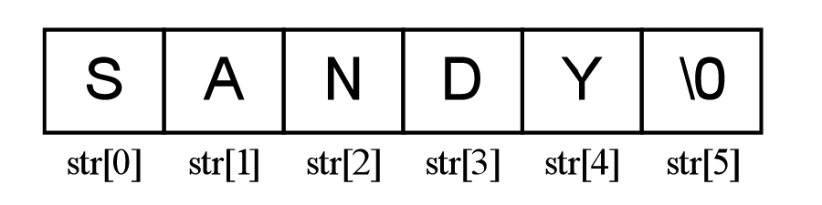
String Constant
Is an array of characters terminated by a NULL(‘\0’).
Example:
char str[] = "SANDY";
Can be schematically represented as:

Slide 6
Demo: Introducing Arrays
Problem Statement:
  As a member of a team that is developing the billing system software for Diaz Telecommunications Inc., you have been assigned the task of creating a software module that accepts the following customer details and displays it.
    1. Mobile number, containing a maximum of 12
    characters
    2. Name, containing a maximum of 25 characters
    3. Date of birth, containing a maximum of 10
    characters

Slide 7
Demo: Introducing Arrays (Contd.)
        4. Billing address, containing a maximum of 50
        characters
        5. City, containing a maximum of 25 characters
        6. Residence phone number, containing a
        maximum of 13 characters
        7. Amount outstanding, containing decimal values

Slide 8
Introducing Structures
C++ provides structures that allow you to store
information as a record.
You can use structures to group various types of data
under one name.

Slide 9
Defining Structures
Structures are defined by using the struct keyword.
Structures and its variable can be declare by using
the following syntax:
struct struct_name{
...
...
};
struct_name struct_variable;

Slide 10
Defining Structures (Contd.)
Example:
  struct salesdata
  { char transno [4];
  int salesno;
  int prodno;
  int unit_sold;
  float value_of_sale;
  };salesdata salesrec;

Slide 11
Defining Structures (Contd.)
The member variables of the structure can be
accessed by using the dot operator.
Example:
salesrec.salesno

Slide 12
Array of Structures
You can create an array of a structure to store
multiple records.
Consider the following code snippet that declares an
array of a structure:
  Student_details stud_records[] ={
  {"Sach",1,0},
  {"Jim",2,0,},
  {"Bryan",3,0,},
  {"Steven",4,0}
  };

Slide 13
Summary
In this session, you learned that:
An array is a collection of elements of a single data type stored in adjacent memory locations.
The array can be initialized when it is defined or later.
An array must be given a constant dimension size, which should be at least 1.
Each element of an array can be accessed by its subscript number.
C++ provides you with structures that allow you to store information as a record.

