Slide 1
Collection

Slide 2
Collections in Java
A Collection is a group of individual objects represented as a single unit. Java provides Collection Framework which defines several classes and interfaces to represent a group of objects as a single unit.

Slide 3
Advantages of Collection Framework:
Consistent API : The API has a basic set of interfaces like Collection, Set, List, or Map. All classes (ArrayList, LinkedList, Vector, etc) that implement these interfaces have some common set of methods.
Reduces programming effort: A programmer doesn’t have to worry about the design of Collection, and he can focus on its best use in his program.
Increases program speed and quality: Increases performance by providing high-performance implementations of useful data structures and algorithms.

Slide 4


Slide 7
ArrayList in Java
An ArrayList in Java represent a resizable list of objects. We can add, remove, find, sort and replace elements in this list. ArrayList is part of Java’s collection framework and implements Java’s List interface.

Slide 8
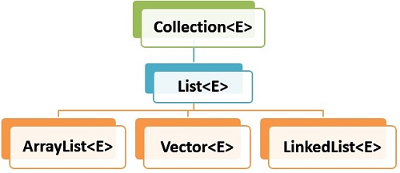

Slide 9
1. ArrayList Features
ArrayList has following features –
Ordered – Elements in arraylist preserve their ordering which is by default the order in which they were added to the list.
Index based – Elements can be randomly accessed using index positions. Index start with '0'.
Dynamic resizing – ArrayList grows dynamically when more elements needs to be added than it’s current size.
Non synchronized – ArrayList is not synchronized, by default. Programmer needs to use synchronized keyword appropiately or simply use Vector class.
Duplicates allowed – We can add duplicate elements in arraylist. It is not possible in sets.

Slide 10
import java.util.*;
class TestJavaCollection1{
public static void main(String args[]){
ArrayList<String> list=new ArrayList<String>();//Creating arraylist
list.add(“Mukesh");//Adding object in arraylist
list.add(“Krishna");
list.add("Ravi");
list.add("Ajay");
//Traversing list through Iterator
Iterator itr=list.iterator();
while(itr.hasNext()){
System.out.println(itr.next());
}
}
}
Create ArrayList

Slide 11
Add and remove elements
Use add(), set() and remove() methods to add or update the elements in the list.
Add/remove elements in the arraylist
//Create arraylist
List<String> names = new ArrayList<>();
names.add("lokesh"); //[lokesh]
names.add("alex"); //[lokesh, alex]
names.set(1, "brian"); //[lokesh, brian]
names.remove(1); //[lokesh]

Slide 12
LinkedList
LinkedList implements the Collection interface. It uses a doubly linked list internally to store the elements. It can store the duplicate elements. It maintains the insertion order and is not synchronized. In LinkedList, the manipulation is fast because no shifting is required.

Slide 13
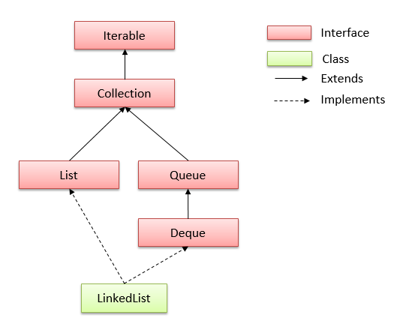

Slide 14
LinkedList Features
Doubly linked list implementation which implements List and Deque interfaces. Therefore, It can also be used as a Queue, Deque or Stack.
Permits all elements including duplicates and NULL.
It is not synchronized. If multiple threads access a linked list concurrently, and at least one of the threads modifies the list structurally, it must be synchronized externally.
Use Collections.synchronizedList(new LinkedList()) to get synchronized linkedlist.
The iterators returned by this class are fail-fast and may throw ConcurrentModificationException.
It does not implement RandomAccess interface. So we can access elements in sequential order only. It does not support accessing elements randomly.
We can use ListIterator to iterate LinkedList elements.

Slide 15
LinkedList Constructors
LinkedList() : initializes an empty LinkedList implementation.
LinkedListExample(Collection c) : initializes a LinkedList containing the elements of the specified collection, in the order they are returned by the collection’s iterator.

Slide 16
import java.util.*;
public class TestJavaCollection2{
public static void main(String args[]){
LinkedList<String> al=new LinkedList<String>();
al.add(“Mohan");
al.add(“Aman");
al.add(“Suraj");
al.add("Ajay");
Iterator<String> itr=al.iterator();
while(itr.hasNext()){
System.out.println(itr.next());
}
}
}

Slide 17
How to sort LinkedList
Java example to sort a LinkedList using Collections.sort() method. Please note that for custom sorting of objects, we can use Collections.sort(linkedList, comparator) method.

Slide 18
LinkedList<String> linkedList = new LinkedList<>();
linkedList.add("A");
linkedList.add("C");
linkedList.add("B");
linkedList.add("D");
//Unsorted
System.out.println(linkedList);
//1. Sort the list
Collections.sort(linkedList);
//Sorted
System.out.println(linkedList);
//2. Custom sorting
Collections.sort(linkedList, Collections.reverseOrder());
//Custom sorted
System.out.println(linkedList);

Slide 19
LinkedList Methods
boolean add(Object o) : appends the specified element to the end of a list.
void add(int index, Object element) : inserts the specified element at the specified position index in a list.
void addFirst(Object o) : inserts the given element at the beginning of a list.
void addLast(Object o) : appends the given element to the end of a list.
int size() : returns the number of elements in a list
boolean contains(Object o) : return true if the list contains a specified element, else false.
boolean remove(Object o) : removes the first occurence of the specified element in a list.

Slide 20
Object getFirst() : returns the first element in a list.
Object getLast() : returns the last element in a list.
int indexOf(Object o) : returns the index in a list of the first occurrence of the specified element, or -1 if the list does not contain specified element.
lastIndexOf(Object o) : returns the index in a list of the last occurrence of the specified element, or -1 if the list does not contain specified element.
Iterator iterator() : returns an iterator over the elements in this list in proper sequence.
Object[] toArray() : returns an array containing all of the elements in this list in proper sequence.
List subList(int fromIndex, int toIndex) : returns a view of the portion of this list between the specified fromIndex (inclusive) and toIndex (exclusive).

Slide 21
ArrayList vs LinkedList
Let’s list down few notiable differences between arraylist and linkedlist.
ArrayList is implemented with the concept of dynamic resizable array. While LinkedList is a doubly linked list implementation.
ArrayList allows random access to it’s elements while LinkedList does not.
LinkedList, also implements Queue interface which adds more methods than ArrayList, such as offer(), peek(), poll(), etc.
While comparing to LinkedList, ArrayList is slower in add and remove, but faster in get, because there is no need of resizing array and copying content to new array if array gets full in LinkedList.
LinkedList has more memory overhead than ArrayList because in ArrayList each index only holds actual object but in case of LinkedList each node holds both data and address of next and previous node.

Slide 22
Vector
Vector uses a dynamic array to store the data elements. It is similar to ArrayList. However, It is synchronized and contains many methods that are not the part of Collection framework.

Slide 23
import java.util.*;
public class TestJavaCollection3{
public static void main(String args[]){
Vector<String> v=new Vector<String>();
v.add(“Mukesh");
v.add(“Kumar");
v.add(“Krishna");
v.add(“Maya");
Iterator<String> itr=v.iterator();
while(itr.hasNext()){
System.out.println(itr.next());
}
}
}

Slide 24
Stack
The stack is the subclass of Vector. It implements the last-in-first-out data structure, i.e., Stack. The stack contains all of the methods of Vector class and also provides its methods like boolean push(), boolean peek(), boolean push(object o), which defines its properties.

Slide 25
import java.util.*;
public class TestJavaCollection4{
public static void main(String args[]){
Stack<String> stack = new Stack<String>();
stack.push(“Mukesh Kumar");
stack.push(“Armani Davis");
stack.push(“Mukesh Kumar");
stack.push(“Baby");
stack.push(“Mukesh Kumar");
stack.push(“Kulsoom");
stack.pop();
Iterator<String> itr=stack.iterator();
while(itr.hasNext()){
System.out.println(itr.next());
}
}
}

Slide 26
#include <stdio.h>
int main()
{
int i, j, rows;
int stars, spaces;
printf("Enter rows to print : ");
scanf("%d", &rows);
stars = 1;
spaces = rows - 1;
/* Iterate through rows */
for(i=1; i<rows*2; i++)
{
/* Print spaces */
for(j=1; j<=spaces; j++)
printf(" ");
/* Print stars */
for(j=1; j<stars*2; j++)
printf("*");
/* Move to next line */
printf("\n");
if(i<rows)
{
spaces--;
stars++;
}
else
{
spaces++;
stars--;
}
}
return 0;
}

Slide 27
c#include <stdio.h>
int main()
{
int i, j, N;
printf("Enter N: ");
scanf("%d", &N);
for(i=1; i<=N; i++)
{
for(j=1; j<=i; j++)
{
printf("%d", i);
}
printf("\n");
}
return 0;
}

Slide 28
#include <stdio.h>
int main()
{
int i, j, N;
printf("Enter N: ");
scanf("%d", &N);
for(i=1; i<=N; i++)
{
// Logic to print spaces
for(j=i; j<N; j++)
{
printf(" ");
}
// Logic to print numbers
for(j=1; j<=i; j++)
{
printf("%d", i);
}
printf("\n");
}
return 0;
}

Slide 29
#include <stdio.h>
int main()
{
int i, j, N;
printf("Enter N: ");
scanf("%d", &N);
for(i=1; i<=N; i++)
{
// Logic to print numbers
for(j=1; j<=N-i+1; j++)
{
printf("%d", j);
}
printf("\n");
}
return 0;
}

Slide 30
#include <stdio.h>
int main()
{
int i, j, N;
printf("Enter N: ");
scanf("%d", &N);
for(i=1; i<=N; i++)
{
// Logic to print spaces
for(j=1; j<i; j++)
{
printf(" ");
}
// Logic to print numbers
for(j=1; j<=N-i+1; j++)
{
printf("%d", j);
}
printf("\n");
}
return 0;
}

