Slide 1
Objectives
In this session, you will learn to:
  Perform file and directory operations
  Channel I/O and stream I/O
  Explore byte streams
  Read and change file and directory attributes
  Recursively access a directory tree

Slide 2
File Operations
Operations performed on a file or directory:
  Checking a file or directory
  Deleting a file or directory
  Copying a file or directory
  Moving a file or directory
  Managing metadata
  Reading, writing, and creating files
  Random access files
  Creating and reading directories

Slide 3
Checking a File or Directory
Files class methods to check the existence of a file/directory:
  exists(Path p, LinkOption... option)
  notExists(Path p, LinkOption... option)
The following code snippet shows usage of the exists()method:
  Path p = Paths.get(“d:\test\bar\file1.txt");
  System.out.format(Path %s exists: %b%n", p, Files.exists(p, LinkOption.NOFOLLOW_LINKS));
Optional argument

Slide 4
Checking a File or Directory (Contd.)
boolean methods of the Files class:
  isReadable(Path)
  isWritable(Path)
  isExecutable(Path)
isSameFile (Path, Path) method:
  Checks whether two paths point to the same file
  Useful in file systems that support symbolic links
These methods ensure that the file is accessible or not.

Slide 5
Creating Files and Directories
Files and directories can be created using the following methods:
  Files.createFile (Path dir);
  Files.createDirectory (Path dir);
createDirectories()method:
  Used to create directories that do not exist
  Example: Files.createDirectories(Paths.get("D:/Temp/foo/bar/ example"));

Slide 6
Deleting a File or Directory
Files class methods to delete files, directories, or links:
  delete(Path)
  deleteIfExists(Path)
The following code snippet shows usage of the delete() method:
  //...
  Files.delete(path);
  //...
The following code snippet shows usage of the deleteIfExists() method:
  //...
  Files.deleteIfExists(Path);
  //...
Throws a NoSuchFileException,
DirectoryNotEmptyException, or
IOException.
No exception thrown

Slide 7

Copying a File or Directory
  When directories are copied, the files inside the directory are not copied.
copy()method:
  Used to copy a file or directory
  Supports the following StandardCopyOption and LinkOption enums:
    REPLACE_EXISTING
    COPY_ATTRIBUTES
    NOFOLLOW_LINKS

Slide 8
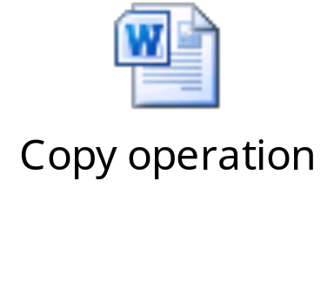
Copying Between a Stream and Path
The Files class methods to copy or write:
  copy(InputStream source, Path target, CopyOption... options)
  copy(Path source, OutputStream out)
The following embedded Word document shows copy operation from a Web page to a file.

Slide 9


Activity: CopyStreamExample

Slide 10
Moving a File or Directory
move()method:
  Used to move a file or directory
  Does not move the contents of the directory
Guidelines to be followed while moving a file or directory:
  If the target path is an empty directory:
    Move succeeds if REPLACE_EXISTING is set
  If the target directory does not exist:
    Move succeeds
  If the target directory exists and is not empty:
    DirectoryNotEmptyException is thrown
  If the source is a file and the target is a directory that exists and REPLACE_EXISTING is set:
    File renamed to the intended directory name

Slide 11
Moving a File or Directory (Contd.)
Perform the following steps to move a non empty directory:
  Recursively copy the contents of the directory.
  Delete the old directory.
The ATOMIC_MOVE option is used to perform an atomic file operation.
The following code snippet shows how to use the move()method:
  import static java.nio.file.StandardCopyOption.*;
  //...
  Files.move(source, target, REPLACE_EXISTING);

Slide 12
Listing a Directory’s Contents
To iterate over all the entries in a directory:
  DirectoryStream class is used
  DirectoryIteratorException is thrown if an I/O error occurs while iteration
  PatternSyntaxException is thrown when the pattern provided is invalid
  Example: Path dir = Paths.get("D:/Temp");
  try( DirectoryStream<Path> stream =
  Files.newDirectoryStream(dir, "*.zip")) {
  for (Path file : stream) {
  System.out.println(file.getFileName());
  }
  }catch(Exception x) {
  System.err.println(x);
  }
The DirectoryStream class is used here.

Slide 13

Activity: ListDirectoryExample

Slide 14
Reading/Writing All Bytes or Lines from a File
readAllBytes()or readAllLines()method:
  Used to read content of a small file in one pass
  Takes care of opening and closing of the stream
  Not used for handling large files
The write()method(s):
  Used to write bytes, or lines, to a file

Slide 15

Activity: CopyAllLinesExample

Slide 16
Finding Files
To find a file in a directory:
  Search tool or the following command can be used:
    dir /s *.java
java.nio.file.PathMatcher interface:
  Includes a match() method to determine whether a Path object matches a specified search string
  Provides a PathMatcher that can be retrieved by using the FileSystems factory
    Example: PathMatcher matcher = FileSystems.getDefault().getPathMatcher (String syntaxAndPattern);
This command recursively searches the directory tree for all files that contain the .java extension.

Slide 17
Managing Metadata
The following table shows methods of the Files class to manage metadata.
Method | Explanation
size | Returns the size of the specified file in bytes
isDirectory | Returns true if the specified Path locates a file that is a directory
isRegularFile | Returns true if the specified Path locates a file that is a regular file
isSymbolicLink | Returns true if the specified Path locates a file that is a symbolic link
isHidden | Returns true if the specified Path locates a file that is considered hidden by the file system
getLastModifiedTime setLastModifiedTime | Returns or sets the specified file’s last modified time
getAttribute setAttribute | Returns or sets the value of a file attribute

Slide 18
Channels and ByteBuffers
Channel I/O reads a buffer at a time.
The ByteChannel interface provides the basic read and write functionality.
SeekableByteChannel:
  Maintains a position in the channel
  Changes the position
  Accesses a file randomly
Methods for reading and writing channel I/O:
  newByteChannel(Path, OpenOption...)
  newByteChannel(Path, Set<? extends OpenOption>, FileAttribute<?>...)

Slide 19
Channels and ByteBuffers (Contd.)
Random access:
  Files permit non-sequential, or random, access to a file’s contents
  Functionality is enabled by the SeekableByteChannel interface
  File operation methods:
    position(): Returns the channel’s current position.
    position(long): Sets the channel’s position.
    read(ByteBuffer): Reads bytes into the buffer from the channel.
    write(ByteBuffer): Writes bytes from the buffer to the channel.
    truncate(long): Truncates the file (or other entity) connected to the channel.

Slide 20
Buffered I/O
newBufferedReader()method:
  Opens a file for reading
  Example: //... BufferedReader reader=Files.newBufferedReader(file, charset); line = reader.readLine();
newBufferedWriter()method:
  Writes to a file using a BufferedWriter
  Example: //... BufferedWriter writer=Files.newBufferedWriter(file, charset); writer.write(s, 0, s.length());

Slide 21
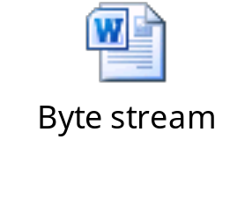
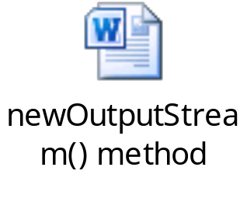
Byte Streams
NIO.2 supports methods to open byte streams.
The following embedded Word document shows how to open a byte stream.
To create a file, append or write to a file, the newOutputStream()method is used.
The following embedded Word document shows usage of the newOutputStream()method.

Slide 22
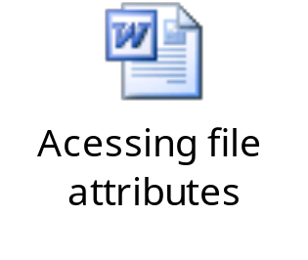
File Attributes (DOS)
DOS:
  File attributes is read from a file or directory in a single call
  Example: DosFileAttributes attrs = Files.readAttributes (path, DosFileAttributes.class);
  File systems can modify attributes after file creation
  Example: Files.createFile (file); Files.setAttribute (file, "dos:hidden", true);
  The following embedded Word document shows an example of accessing file attributes in the file system.

Slide 23

Activity: FileAttributesExample

Slide 24
Recursive Operations
walkFileTree(Path start, FileVisitor<T>) method:
  Provided by the Files class
  Used to walk the file tree for recursive operations
FileVisitor interface methods:
  Are invoked as each node in a file tree is visited
  Includes:
    preVisitDirectory
    visitFile
    postVisitDirectory
    visitFileFailed

Slide 25
Recursive Operations (Contd.)
  FileVisitor interface methods results:
  Determines actions when node is reached
  Enumerated in the FileVisitResult class
Results of FileVisitResult class:
  CONTINUE
  SKIP_SIBLINGS
  SKIP_SUBTREE
  TERMINATE
SimpleFileVisitor class:
  Implements each method of the FileVisitor interface with a return type of FileVisitResult.CONTINUE
  Rethrows any IOException

Slide 26
FileVisitor Method Order
The following diagram depicts method invocation order of the FileVisitor interface.
preVisitDirectory()
start
file
dir
link
dir
file
file

Slide 27

FileVisitor Method Order (Contd.)
The following diagram depicts the preorder method invocation of the FileVisitor interface.
start
The visitFile() method is called if the file is not a directory.
preVisitDirectory()
visitFile()
file
dir
link
preVisitDirectory()
dir
file
visitFileFailed()
visitFile()
file
The visitFileFailed() method is called on I/O exception.

Slide 28
FileVisitor Method Order (Contd.)
The following diagram depicts the postorder method invocation of the FileVisitor interface.
Here, the postVisitDirectory()method is called after reaching all the children in a node.
start
postVisitDirectory()
postVisitDirectory()
file
dir
link
postVisitDirectory()
dir
file
postVisitDirectory()
file

Slide 29

Activity: WalkFileTreeExample

Slide 30

Quiz

Slide 31
Quiz (Contd.)
Which of the following methods checks whether two paths point to the same file?
  move()
  exists(Path p, LinkOption... option)
  copy(Path source, OutputStream out)
  isSameFile (Path, Path)
Solution:
  isSameFile (Path, Path)

Slide 32
Quiz (Contd.)
Fill in the blank:
  The _______ interface methods are invoked as each node in a file tree is visited.
Solution:
  FileVisitor

Slide 33
Summary
In this session, you learned that:
  The isSameFile (Path, Path) method checks whether two paths point to the same file.
  The createDirectories() method is used to create directories that do not exist, from top to bottom.
  The copy() method is used to copy a file or directory.
  To iterate over all the entries in a directory the DirectoryStream class is used.
  Random access files permit non-sequential, or random, access to a file’s contents.
  Channel I/O reads a buffer at a time.
  The newBufferedReader() method opens a file for reading.
  DOS file attributes can be read from a file or directory in a single call.
  The walkFileTree(Path start, FileVisitor<T>) method is used to walk the file tree for recursive operations.

