Slide 1
Objectives
In this session, you will learn to:
  Use the java.util.concurrent packages
  Describe the synchronizer classes
  Work with concurrent IO
  Use parallelism

Slide 2
The java.util.concurrent Package
java.util.concurrent package:
  Contains classes useful in concurrent programming
  Features:
    Concurrent collections
    Synchronization and locking alternatives
    Thread pools

Slide 3
The java.util.concurrent.atomic Package
java.util.concurrent.atomic package:
  Contains classes that support lock-free, thread-safe programming on single variables
  Example: AtomicInteger ai = new AtomicInteger(5); if(ai.compareAndSet(5, 42))
  {
  System.out.println("Replaced 5 with 42");
  }
An atomic operation ensures that the current value is 5 and then sets it to 42.

Slide 4

The java.util.concurrent.locks Package
java.util.concurrent.locks package:
  Framework for locking and waiting for conditions
  Implements multi-reader, single writer lock
  The following embedded Word document shows implementation of the read and write locks.
    Lock:
  Read can be acquired by multiple threads concurrently
  Write can be acquired by a single thread at a time
Reentrant lock:
  A thread that has already acquired the write lock calls additional methods that also acquire the write lock

Slide 5
Thread-Safe Collections
java.util collections:
  Not thread-safe
To use thread-safe collections:
  Use synchronized code blocks to access a collection while writing.
  Create a synchronized wrapper using library methods, such as java.util.Collections.synchronizedList
  (List<T>).
  Use the java.util.concurrent collections.

Slide 6
Synchronizers
Synchronizer classes:
  Allow threads to block until a certain state or action is reached.
  The following table shows synchronizer classes of the java.util.concurrent package.
Class | Description
Semaphore | Semaphore is a classic concurrency tool
CountDownLatch | A very simple yet very common utility for blocking until a given number of signals, events, or conditions hold
CyclicBarrier | A resettable multiway synchronization point useful in some styles of parallel programming
Phaser | Provides a more flexible form of barrier that may be used to control phased computation among multiple threads
Exchanger | Allows two threads to exchange objects at a rendezvous point, and is useful in several pipeline designs

Slide 7

java.util.concurrent.CyclicBarrier
CyclicBarrier class:
  Example of the synchronizer category of classes
  Provided by the java.util.concurrent package
  The following embedded Word document shows an example of the CyclicBarrier class.

Slide 8

Activity: CyclicBarrierExample

Slide 9
High-Level Threading Alternatives
Alternatives for high-level threading:
  java.util.concurrent.ExecutorService:
    Higher level mechanism used to execute tasks
  Fork-Join framework:
    Specialized work-stealing ExecutorService class
ExecutorService class:
  May create and reuse Thread objects
  Allows to submit work
  Helps to check the results in future

Slide 10
java.util.concurrent.ExecutorService
ExecutorService:
  Eliminates the need to manually create and manage threads
  Used to execute the tasks depending on it’s implementation
    Tasks can be:
      java.lang.Runnable
      java.util.concurrent.Callable

Slide 11
java.util.concurrent.Callable
Callable interface:
  Defines a task submitted to ExecutorService
  Similar to Runnable
  Returns a result using generics
  Throws a checked exception
  Example: package java.util.concurrent; public interface Callable<V> {
  V call() throws Exception; }

Slide 12
java.util.concurrent.Future
Future interface:
  Used to obtain the results from a callable’s call() method
  Example: Future<V> future = es.submit(callable); //submit many callables try {
  V result = future.get(); } catch (ExecutionException|InterruptedException ex) { }
ExecutorService controls when the work is done
Gets the result of the Callable’s call() method (blocks if needed).
If the Callable threw an Exception

Slide 13
Shutting Down an ExecutorService
ExecutorService threads:
  Are non daemon threads
  Keep JVM from shutting down
  Shutting down the ExecutorService thread is important
  Example: es.shutdown(); try {
  es.awaitTermination(5, TimeUnit.SECONDS);
  } catch (InterruptedException ex) {
  System.out.println("Stopped waiting early");
  }
If you want to wait for the Callables to finish
Stop accepting new Callables.

Slide 14
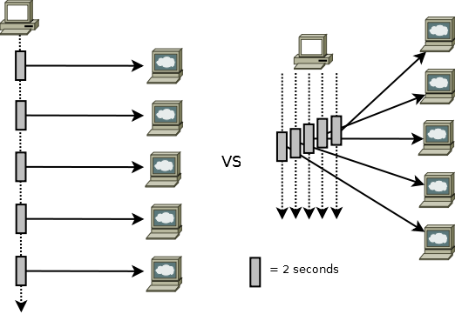
Concurrent I/O
Sequential blocking calls:
  Execute over a longer duration of time than concurrent blocking calls.
  The following figure depicts sequential v/s concurrent blocking calls.

Slide 15

A Single-Threaded Network Client
A single threaded application performs tasks synchronously.
The following embedded Word document shows the code for a single threaded network client application.

Slide 16

A Multithreaded Network Client
A multithreaded application performs tasks asynchronously.
The following embedded Word document shows the code for a multithreaded network client application.

Slide 17
Parallelism
Parallelism:
  Executes tasks in parallel on multiple CPUs
  Takes the advantage of the processing power
  Supports divide and conquer approach
  Scheduled in excess can negatively impact performance
  Not applicable for all problems

Slide 18
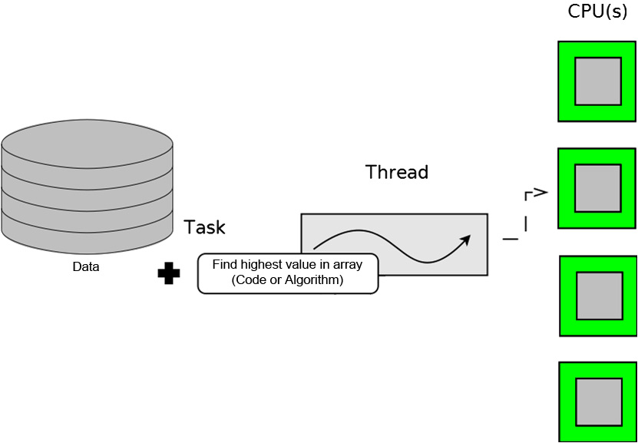
Without Parallelism
If parallelism is not implemented on multiple CPUs:
  Only a part of the system’s processing power is utilized.
  The following diagram depicts the same.

Slide 19
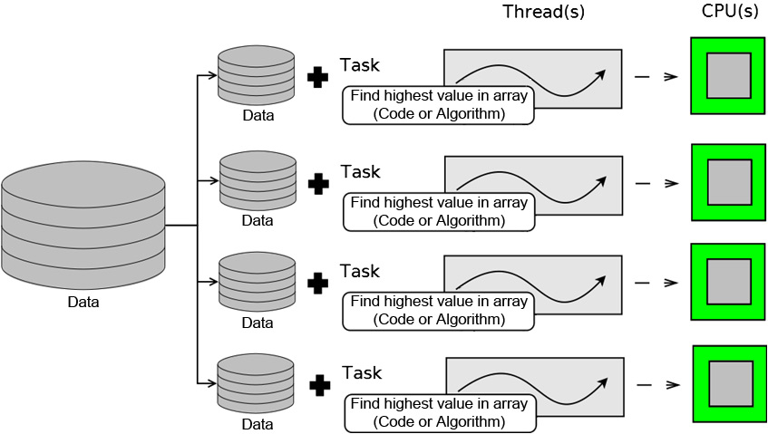
Naive Parallelism
A simple parallel solution:
  Breaks data to be processed into multiple sets:
    One data set for each CPU
    One thread to process each data set
  The following diagram depicts simple parallelism.

Slide 20

Quiz

Slide 21
Quiz (Contd.)
  Fill in the blank:
  The ___________ threads are non daemon threads.
Solution:
  ExecutorService

Slide 22
Quiz (Contd.)
Fill in the blank:
  The _______ interface is used to obtain results from a callable’s call() method.
Solution:
  Future

Slide 23
Summary
In this session, you learned that:
  The java.util.concurrent package contains classes that are useful in concurrent programming.
  The java.util.concurrent.atomic package contains classes that support lock-free thread-safe programming.
  The synchronizer classes allow threads to block until a certain state or action is reached.
  The ExecutorService class may create and reuse Thread objects.
  The Callable interface is similar to the Runnable interface.
  The ExecutorService threads are non daemon threads.
  The single threaded application does the tasks synchronously.
  Parallelism supports the divide and conquer approach.

