Slide 1
Objectives
In this session, you will learn to:
  Apply the Fork-Join Framework
  Use the JDBC API
  Close JDBC objects

Slide 2
The Need for the Fork-Join Framework
Parallel computing:
  CPU intensive problem can be split into smaller, independent tasks
  Tasks can be assigned to different processors
Problems in splitting tasks into equal sized subsets:
  CPUs may run at different speeds
  Non-Java tasks require CPU time
  Time available to execute a Java thread reduces
  Data being analyzed may require varying amounts of time for processing
  The preceding problems can be addressed using the
  Fork-Join Framework.

Slide 3

The Need for the Fork-Join Framework (Contd.)
Fork-Join Framework:
  Utilizes multiple processors
  Designed for work that can be broken into smaller pieces recursively
  Uses all the available processing power to enhance application performance
  For the framework implementation, the following steps are performed:
    Divide the data in large number of subsets.
    Assign the data subsets to a thread’s processing queue.
    Queue subsets for each thread.
    Threads can “steal” subsets from another thread, known as work-stealing.

Slide 4
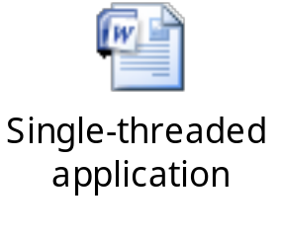
A Single-Threaded Example
The following embedded Word document shows the code of a single-threaded application.

Slide 5
java.util.concurrent.ForkJoinTask<V>
ForkJoinTask class:
  Object represents a task to be executed:
    Task contains code and data to be processed
    Similar to the Runnable or Callable interface
    Processed by a small number of threads in Fork-Join pool
  Creates ForkJoinTask instances:
    Till data to processed has been subdivided adequately
  Subclasses used to work with its objects:
    RecursiveAction
    RecursiveTask

Slide 6
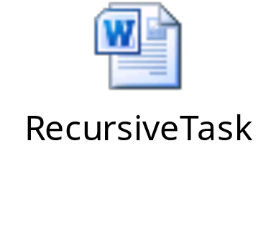
RecursiveTask Example
The following embedded Word document shows how to use the RecursiveTask class.

Slide 7
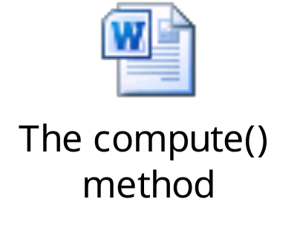
compute Structure
The following embedded Word document shows code of the compute()method used in the previous example.

Slide 8
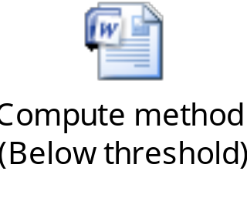
compute Example (Below Threshold)
The following embedded Word document shows the code of the compute()method, where the value of the threshold variable is less than length of the array.

Slide 9
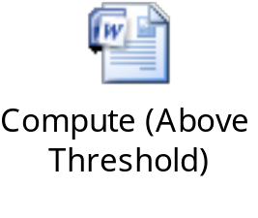
compute Example (Above Threshold)
The following embedded Word document shows the code of the compute()method, where the value of the threshold variable is greater than length of the array.

Slide 10
ForkJoinPool Example
ForkJoinPool class:
  Used to execute ForkJoinTask
  Creates a thread for each CPU in the system by default
  Example: ForkJoinPool pool = new ForkJoinPool(); FindMaxTask task = new FindMaxTask(data, 0, data.length-1, data.length/16); Integer result = pool.invoke(task);
The task's compute method is automatically called.

Slide 11
Fork-Join Framework Recommendations
Avoid I/O or blocking operations.
Before using Fork-Join Framework:
  Check hardware.
  Analyze and execute the problem in parallel.

Slide 12
Using the JDBC API
JDBC API:
  Consists of concrete classes
  Consists of interfaces that are implemented in a driver class
Perform the following steps to access the database vendor’s driver classes:
  1. Use the DriverManager class to obtain a reference to a Connection object using the getConnection()method:
    getConnection()sigature:
    getConnection(url, name, password);
  2. Use the Connection object to obtain a reference to a Statement object through the createStatement() method:
    createStatement() signature:
    createStatement();

Slide 13
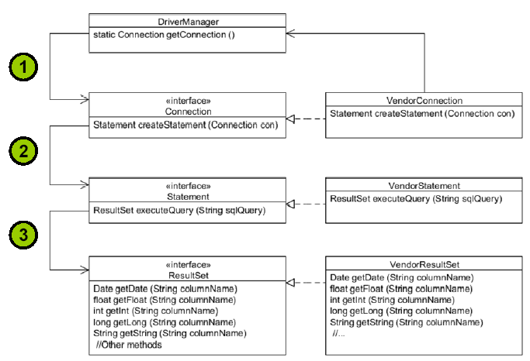
Using the JDBC API (Contd.)
  3. Use the Statement object to obtain an instance of ResultSet through an executeQuery(query)method:
    executeQuery(query)accepts a string, where query is a static string of SQL.
  The following figure shows the preceding sequence.

Slide 14
Using a Vendor’s Driver Class
DriverManager class:
  Used to get an instance of a Connection object
  Example: String url="jdbc:derby://localhost:1527/EmployeeDB"; Connection con = DriverManager.getConnection(url);
URL syntax:
  JDBC driver: jdbc:<driver>:[subsubprotocol:][databaseName] [;attribute=value]
  Oracle thin driver: jdbc:oracle:thin:@//[HOST][:PORT]/SERVICE
The JDBC 4.0 drivers found in the class path are automatically loaded.

Slide 15
Using a Vendor’s Driver Class (Contd.)
DriverManager.getConnection():
  Load driver class
  Uses the META_INF/services/java.sql.Driver file
Driver classes:
  Passed to the interpreter on the command line
  Example: java –djdbc.drivers=<fully qualified path to the driver> <class to run>

Slide 16
Key JDBC API Components
API classes used by the vendor’s JDBC driver class:
  java.sql.Connection:
    Represents the session between the Java application and the database
    Example:
    Connection con = DriverManager.getConnection(url, username, password);
  java.sql.Statement:
    Used to execute a static SQL statement and return the result
    Example:
    Statement stmt = con.createStatement();
  java.sql.ResultSet:
    Represents a database result set
    Example:
    String query = "SELECT * FROM Employee";
    ResultSet rs = stmt.executeQuery(query);

Slide 17
Using a ResultSet Object
The following diagram shows use of the ResultSet object.
String query = "SELECT * FROM Employee";
ResultSet rash = stmt.executeQuery(query);
The first next() method invocation returns true, and rs points to the first row of data.
ResultSet cursor
rs.next()
110 | Troy | Hammer | 1965-03-31 | 102109.15
123 | Michael | Walton | 1986-08-25 | 93400.20
201 | Thomas | Fitzpatrick | 1961-09-22 | 75123.45
101 | Abhijit | Gopali | 1956-06-01 | 70000.00
rs.next()
rs.next()
rs.next()
rs.next()
null
The last next() method invocation returns false, and the rs instance is now null.

Slide 18
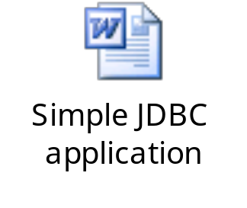
Putting It All Together
The following embedded Word document shows a simple JDBC application.

Slide 19
Writing Queries and Getting Results
To execute the SQL queries with JDBC:
  Create an instance of the Statement class.
  Example: Statement stmt = con.createStatement();
  The following table shows the execute methods of the Statement interface.
Method | Returns | Used for
executeQuery(sqlString) | ResultSet | SELECT statement
executeUpdate(sqlString) | int (rows affected) | INSERT, UPDATE, DELETE, or a DDL
execute(sqlString) | boolean (true if there was a ResultSet) | Any SQL command or commands

Slide 20
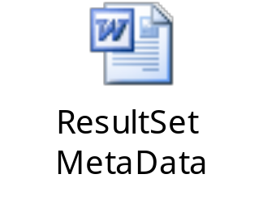
ResultSetMetaData
The following embedded Word document shows code that dynamically retrieves the number of columns and their type.

Slide 21

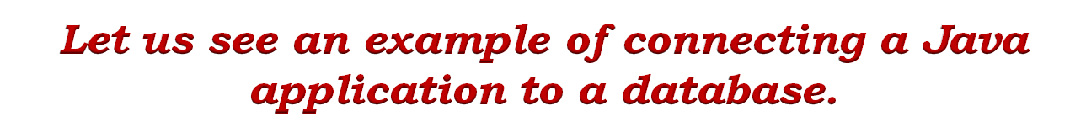
Activity: SimpleJDBCExample

Slide 22

Activity: ResultSetMetaDataExample

Slide 23
Writing Portable JDBC Code
JDBC driver:
  Provides abstraction between the Java application and the database
  Example:
    Connection con = DriverManager.getConnection(url, username, password);
    DatabaseMetaData dbm = con.getMetaData();
    if (dbm.supportsANSI92EntrySQL()) {
    // Support for Entry-level SQL-92 standard
    }

Slide 24
The SQLException Class
SQLException:
  Used to report database errors
  Must be iterated
  Example: catch(SQLException ex) { while(ex != null) { System.out.println("SQLState: "+ex.getSQLState()); System.out.println("Error Code:"+ex.getErrorCode()); System.out.println("Message:"+ex.getMessage()); Throwable t = ex.getCause(); while(t != null) { System.out.println("Cause:" + t); t = t.getCause(); }
    ex = ex.getNextException(); } }

Slide 25
Closing JDBC Objects
The following figure depicts how to close JDBC objects in two different ways.
One Way
Better Way
close()
Connection
close()
Connection
Closes Statements
Statement
close()
Statement
Invalidates ResultSets
Calls close explicitly or
in try-with-resources
ResultSet
close()
ResultSet
Resources not
released until
next GC
Resources
released

Slide 26
The try-with-resources Construct
try-with-resources statement:
  Can be used in the JDBC application
  Example: try(Connection con=DriverManager.getConnection(url, username, password); Statement stmt = con.createStatement(); ResultSet rs = stmt.executeQuery (query)){

Slide 27

Quiz

Slide 28
Quiz (Contd.)
    Which of the following options is used to execute a static SQL statement and return the result?
  java.sql.Connection
  java.sql.Statement
  java.sql.ResultSet
  java.sql.Result
Solution:
  java.sql.Statement

Slide 29
Quiz (Contd.)
Fill in the blank:
  The _________ class is used to report database errors.
Solution:
  SQLException

Slide 30
Summary
In this session, you learned that:
  All CPUs should be fully utilized until the task is finished.
  If a thread finishes all its subsets early, it can “steal” subsets from another thread. This is known as work-stealing.
  A ForkJoinPool class is used to execute a ForkJoinTask object.
  The JDBC API is made up of some concrete classes.
  The DriverManager class is used to get an instance of a Connection object.
  To execute SQL queries with JDBC, you must create an instance of the Statement object.
  The SQLException class is used to report database errors.

