Slide 1

Objectives
In this session, you will learn to:
  Define a thread
  Create separate threads in a Java technology program, controlling the code and data that are used by that thread
  Control the execution of a thread and write platform independent code with threads
  Describe the difficulties that might arise when multiple threads share data
  Use wait and notify to communicate between threads
  Use synchronized to protect data from corruption

Slide 2
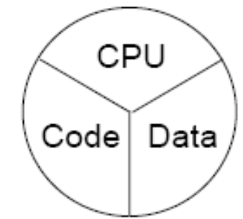
Threads
Threads are a virtual CPU.
The three parts of the thread are:
  CPU
  Code
  Data
A thread or execution context

Slide 3
Creating the Thread
Extend the class from Thread Class. For example:
  public class HelloRunner extends Thread
  {
  //code
  }
Implement the Runnable interface. For example:
  class HelloRunner implements Runnable
  {
    //code
  }

Slide 4
Creating the Thread (Contd.)
Multithreaded programming has following characteristics:
  Multiple threads are from one Runnable instance.
  Threads share the same data and code. For example:
    Thread t1 = new Thread(r);
    Thread t2 = new Thread(r);

Slide 5
Starting the Thread
Use the start() method
Place the thread in a runnable state

Slide 6
Thread Scheduling
Fundamental Thread State Diagram:
Blocked
Dead
New
Unblocked
Event Blocked
start()
run() Completes
Scheduler
Runnable
Running

Slide 7
Thread Scheduling (Contd.)
Thread Scheduling Example:
  public class Runner implements Runnable
  {public void run()
    {while (true){
        // Do lots of interesting stuff
        // Give other threads a chance
        try{
        Thread.sleep(10);
        }catch (InterruptedException e)
        {
        // This thread’s sleep was interrupted by another thread
        }}}}
One of Thread Scheduling Method

Slide 8
Terminating a Thread
The thread comes to the end of its run() method.
The thread throws an Exception or Error that is not caught.
Another thread calls one of the deprecated stop() methods.

Slide 9
Basic Control of Threads
Test Threads:
  isAlive()
Access Thread Priority:
  getPriority()
  setPriority()
Put Threads on Hold:
  Thread.sleep() // static method
  join()
  Thread.yield() // static method

Slide 10
Basic Control of Threads (Contd.)
Use of join() method:
  public static void main(String[] args) {
  Thread t = new Thread(new Runner());
  t.start();
  // Do stuff in parallel with the other thread for a while
  // Wait here for the other thread to finish
  try {
  t.join();
  }
  catch (InterruptedException e)
  {
  // the other thread came back early
  }
  // Now continue in this thread
  }

Slide 11
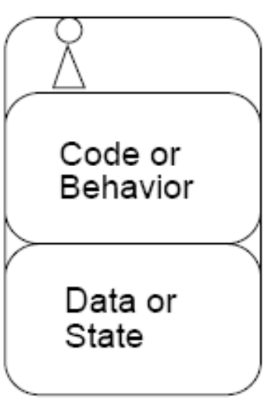
The Object Lock Flag
Every object has a flag that is a type of lock flag.
The synchronized enables interaction with the lock flag.
Object this
Thread before synchronized(this)
public void push (char c)
{
synchronized(this) {
data[idx] = c;
idx++;
}
}

Slide 12
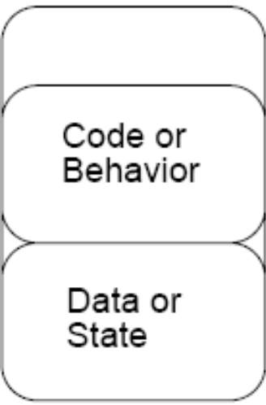
The Object Lock Flag (Contd.)
Object this
Thread after synchronized(this)
public void push (char c)
{synchronized(this)
{
data[idx] = c;
idx++;
}
}

Slide 13
The Object Lock Flag (Contd.)
Object this
lock flag missing
Another thread, trying to execute synchronized(this)
public char pop(char c)
{
synchronized(this)
{
idx--;
return data[idx];
}
}
Waiting for
object lock

Slide 14
Releasing the Lock Flag
The lock flag is released in the following events:
  Released when the thread passes the end of the synchronized code block
  Released automatically when a break, return, or exception is thrown by the synchronized code block

Slide 15
Using synchronized
All access to delicate data should be synchronized.
Delicate data protected by synchronized should be private.
The following two code segments are equivalent:
  public void push(char c)
  {
    synchronized(this) {
      // The push method code
    }}
  public synchronized void push(char c)
  {
    // The push method code
  }

Slide 16
Using synchronized (Contd.)
Thread State Diagram with Synchronization:
Blocked
Dead
New
Unblocked
Event Blocked
start()
run() Completes
Scheduler
Runnable
Running
Lock Acquired
Blocked in Object’s Lock Pool
Synchronized

Slide 17
Deadlock
A deadlock has the following characteristics:
  It is two threads, each waiting for a lock from the other.
  It is not detected or avoided.
  Deadlock can be avoided by:
    Deciding on the order to obtain locks
    Adhering to this order throughout
    Releasing locks in reverse order

Slide 18
Thread Interaction
wait and notify Methods
  Scenario:
    Consider yourself and a cab driver as two threads.
  Problem:
    How do you determine when you are at your destination?
  Solution:
    You notify the cab driver of your destination and relax
    The driver drives and notifies you upon arrival at your destination

Slide 19
Thread Interaction (Contd.)
Thread interactions include:
  The wait() and notify() methods
  The pools:
    Wait pool
    Lock pool

Slide 20
Thread Interaction (Contd.)
Thread State Diagram with wait() and notify() methods:
Blocked
New
Dead
Unblocked
Event Blocked
start()
run() Completes
Runnable
Scheduler
Running
wait()
Lock Acquired
Synchronized
Blocked in Object’s Lock Pool
Blocked in Object’s Wait Pool
notify() or
interrupt()

Slide 21
Monitor Model for Synchronization
Leave shared data in a consistent state
Ensure programs cannot deadlock
Do not put threads expecting different notifications in the same wait pool.

Slide 22
Lets see how to create a Java class that represents a separate thread of control flow.
Demonstration

Slide 23
Summary
In this session, you learned that:
  Threads are a virtual CPU.
  The three parts of at thread are CPU, Code, and Data.
  Thread can be created by extend the class from Thread Class or by implementing Runnable interface.
  A Java program can have multiple threads.
  Thread need to start by using start() method.
  Various states of thread are runnable, running, and blocked.
  sleep() method pauses the thread for given amount of time.
  The thread dies when run() method completes.
  sleep(), join(), and yield() methods put the thread on hold.
  Use getPriority() method to determine the current priority of the thread.

Slide 24
Summary (Contd.)
  When multiple threads are working on shared data, synchronized keyword should be used to maintain the consistency of the data.
  Deadlock is the situation where two threads, each waiting for a lock from the other.
  wait() and notify() are methods for thread communication.

