Slide 1
Objectives
In this session, you will learn to:
  Explore the Java platforms and versions
  Explore the open nature of Java and its community
  Create simple Java classes
  Create primitive variables
  Use Java SE 7 numeric and binary literals
  Manipulate strings
  Use if-else branching statement

Slide 2
Java Programs Are Platform-Independent
Java technology applications:
  Compiled to Java bytecode using Java SE Development Kit (JDK)
  Bytecode gets executed on the Java platform
Java Runtime Environment (JRE):
  Runnable Java platform
  Makes Java platform-independent

Slide 3
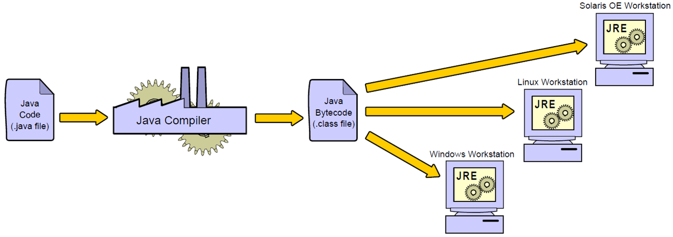
Java Programs Are Platform-Independent (Contd.)
The following diagram depicts platform-independence of Java programs.

Slide 4
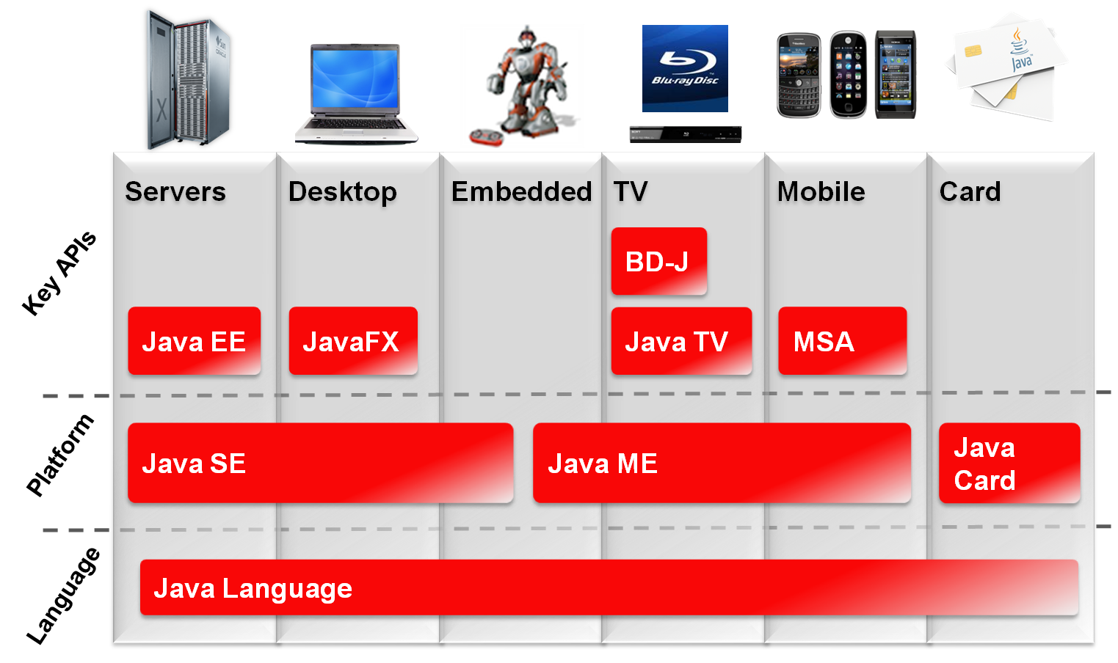
Java Technology Product Groups
The following diagram depicts different product groups used by the Java technology.

Slide 5
Java SE Platform Versions
The following table shows different versions of JDK.
Year | Developer Version (JDK) | Platform
1996 | 1.0 | 1
1997 | 1.1 | 1
1998 | 1.2 | 2
2000 | 1.3 | 2
2002 | 1.4 | 2
2004 | 1.5 | 5
2006 | 1.6 | 6
2011 | 1.7 | 7

Slide 6

Java in Server Environments
Java is common in the following enterprise environments:
  Oracle Fusion Middleware
  Database servers

Slide 7
The Java Community
The Java community:
  Refers to individuals and organizations that develop, innovate, and use the Java technology.
  Allows to download and use Java libraries from non-Oracle sources.

Slide 8












The Java Community (Contd.)
The following diagram depicts various prominent members of the Java community.
Mobile & Embedded

Slide 9
The Java Community Process (JCP)
JCP:
  Develops new Java standards
  Provides:
    Free download of all Java Specification Requests (JSRs).
    Early access to specifications.
    Public review and feedback opportunities.
    Open membership.

Slide 10
OpenJDK
OpenJDK is the open-source implementation of Java and provides:
  GPL licensed open-source project.
  JDK reference implementation.
  Location, where new features are developed.
  Open membership to community contributions.
  Basis for Oracle JDK.

Slide 11
Oracle Java SE Support
Java is available free of cost.
Oracle provides following pay-for Java solutions:
  The Java SE Support program provides updates for
  end-of-life Java versions
  Oracle Java SE Advanced and Oracle Java SE Suite

Slide 12

Quiz

Slide 13
Quiz (Contd.)
Fill in the blank:
  ________ refers to individuals and organizations that develop, innovate, and use the Java technology.
Solution:
  Java community

Slide 14
Quiz (Contd.)
Which of the following statement is incorrect regarding Java?
  Java is available free of cost.
  OpenJDK is the open-source implementation of Java.
  The JCP develops new Java standards.
  The JDK compiler converts bytecode to Java source code.
Solution:
  The JDK compiler converts bytecode to Java source code.

Slide 15

Activity: Verifying Software Installation

Slide 16
Java Language Review
To work on Java, you need to be familiar with the following concepts:
  The basic structure of a Java class
  Program block and comments
  Variables
  Basic if-else and switch branching constructs
  Iteration with for and while loops
The following link provides information on new features in java 7:
http://www.youtube.com/watch?v=APZ17LsFt-k

Slide 17
Class Structure
The following code snippet shows the syntax of a basic class in a Java program: package <package_name>;
import <other_packages>;
public class ClassName
{
<variables(also known as fields)>;
<constructor method(s)>;
<other methods>;
}

Slide 18
A Simple Class
The following code snippet shows a simple Java class with the main() method: public class Simple {
public static void main(String args[])
{
}
}

Slide 19
Code Blocks
In Java:
  The class and method declarations are enclosed in a code block.
  Fields and methods have a block (or class) scope.
  Code blocks are defined in braces {}, as shown in the following example:
public class SayHello {
public static void main(String[] args) {
System.out.println("Hello world");
}
}

Slide 20
Primitive Data Types
The following table lists the primitive data types used in Java.
Category | Integer | Floating Point | Character | True False
Data Types | byte short int long | float double | char | boolean
Examples | 1, 2, 3, 42 07 0xff | 3.0F .3337F 4.022E23 | ‘a’ ‘\u0061’ ‘\n’ | true false
Default Values | 0 | 0.0 | ‘\u0000’ | false

Slide 21
Java SE 7 Numeric Literals
To improve readability, numeric literals can have any number of underscore characters (_) between digits.
The following table shows the comparison of numeric literals in the earlier versions and the current version of Java.
Here, you can see the improvement in readability.
Prior to Java 7 | In Java 7
long cardNo = 1234567890123456L; | long cardNo = 1234_5678_9012_3456L;
long socialSecurityNumber = 999999999L; | long socialSecurityNumber = 999_99_9999L;
long hexWords = 0xCAFEBABE; | long hexWords = 0xCAFE_BABE;
long maxLong = 0x7ffffffffffffffL; | long maxLong = 0x7fff_ffff_ffff_ffffL;
The following link provides information on the numeric literals:
http://www.youtube.com/watch?v=Zz_k2u-whHQ

Slide 22
Java SE 7 Binary Literals
Binary literals:
  Are Java integer values.
  Can be expressed using the binary system by adding the prefixes 0b or 0B to the number.
The following table shows the comparison of binary literals in the earlier versions and the current version of Java.
Here, you can see the improvement in readability.
Earlier Versions | In Java 7
byte aByte = 00100001; | byte aByte = 0b0010_0001;
short aShort = (short)101000010100; | short aShort = (short)0b1010_0001_0100;
int anInt2 = 101; | int anInt2 = 0b101; or int anInt3 = 0B101; //B is upper or lower case

Slide 23
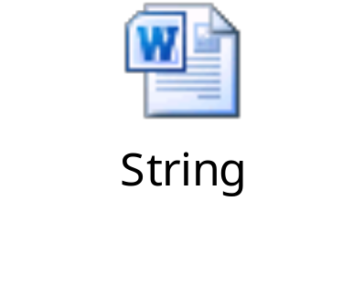
Strings
The following embedded Word document shows how to use the string literals and string objects.

Slide 24
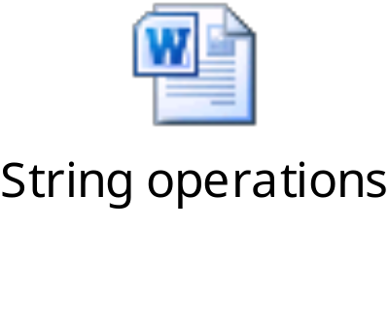
String Operations
The following embedded Word document shows string operations.

Slide 25
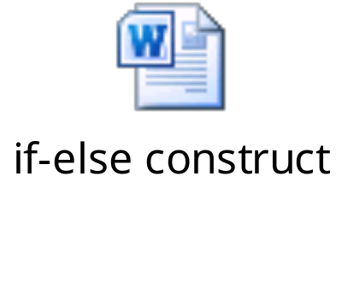
if-else
The following embedded Word document shows the if-else construct.

Slide 26
Activity: Summary Level-Creating Java Classes

Slide 27
Summary
In this session, you learned that:
  Java SE has various versions.
  Java and its community is open in nature.
  Java classes are created using the class keyword.
  Java supports the following primitive data types:
    int, short, byte, long
    float, double
    boolean
    char
  Strings can be manipulated using the string operations.
  The if-else branching statement can be used for conditional execution.

