Slide 1
Objectives
In this session, you will learn to:
  Use logical operators
  Iterate with loops
  Create arrays
  Use switch branching statements
  Use Java classes, methods, and constructors
  Use package and import statements
  Work with pass-by-value concepts

Slide 2

Logical Operators
Java provides the following logical operators:
  Equality and relational operators:
    == Equal to
    != Not equal to
    > Greater than
    >= Greater than or equal to
    < Less than
    <= Less than or equal to
  Conditional operators:
    && Conditional-AND
    || Conditional-OR
    ?: Ternary (shorthand for if-then-else statement)
  Type comparison operator:
    Instanceof

Slide 3
Loop
    Loops:
  Help to execute a block of code repeatedly.
  Gets executed for a specific number of iterations or until the condition evaluates to false.
  Types:
      for
      while
      do-while

Slide 4
for Loop
The for loop:
  Is used to iterate for a fixed number of times.
  Consists of the following three expressions separated by a semicolon:
    The initialization expression
    The test expression
    The iteration expression (increment/decrement)

Slide 5
while and do-while Loop
The while loop performs a test and continues if expression evaluates to true.
In the do-while loop, the condition test is performed after the expression has run at least once.

Slide 6
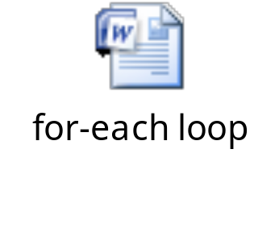
Arrays and for-each Loop
Array:
  Group of variables of the same data type
  Referred by a common name
  Created as an object by default
  Code snippet to declare and initialize an array: String[]names;
  names = new String[3];
The for-each loop is used to traverse each element in an array, even if the length is unknown.
The following embedded Word document shows the use of the for-each loop in an array.

Slide 7
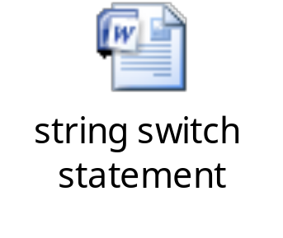
String switch Statement
The switch statement is used to check constant expressions for a given variable.
The following embedded Word document shows how to use the string switch statement.

Slide 8
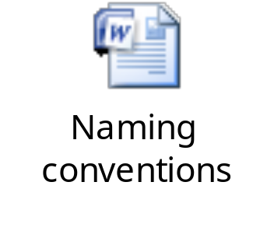
Java Naming Conventions
In Java:
  The class names should be nouns in upper camel case.
  Methods should be verbs in lower camel case.
  Variable names should be short but meaningful.
  One-character variable names should be avoided except as temporary variables.
  Constants should be declared using all uppercase letters.
The following embedded Word document shows the naming conventions to be used in Java programs.

Slide 9

A Simple Java Class: Employee
The following embedded Word document shows a simple Employee class in Java.

Slide 10

Methods
Methods:
  Are created to manipulate data fields of a class.
  Can be used to set the value of each field.
  Can be used to retrieve the value of each field.
The following embedded Word document shows the methods that are used as getters and setters.

Slide 11
Constructors
Constructor:
  Used to create an instance of a class
  Can take parameters
  Without arguments is called a no-arg constructor
The following code snippet shows a no-arg constructor:
  public class Employee
  {
  public Employee()
  {
  }
  }
The following code snippet shows how the constructor is implicitly invoked:
Employee emp = new Employee();
A simple no-argument (no-arg) constructor

Slide 12
Creating an Instance of an Object
new keyword:
  Used to create an instance of a class
Example:
Employee emp = new Employee();
  emp.empId = 101;
  // legal if the field is public, but not good // practice
  emp.setEmpId(101); // use a method instead
  emp.setName("John Smith");
  emp.setSsn("011-22-3467");
  emp.setSalary(120345.27);

Slide 13
package Statement
Package:
  Declared using the package keyword
  Used to group Java classes
  Implemented as a folder
  Provides a namespace to a class
  Declaration must always appear at the top of the file
The following figure depicts the different views of a package.
namespace view
folder view
com.example.domain
+com
|_+example
|_+domain
|_+Employee.java
|_+Manager.java
Employee
Manager

Slide 14
import Statements
Import statements:
  import keyword is used
  Used to import a single class or an entire package
  Multiple import statements can be used in a program
  Example: import java.util.*; import java.util.Date; import java.util.Calendar;

Slide 15
More on import
The import statement:
  Follows the package declaration and precede the class declaration.
  Is not mandatory for an application.
By default, a class always imports java.lang.*;.
There is no need to import classes that are in the same package.

Slide 16

Quiz

Slide 17
Quiz (Contd.)
Which of the following options is a valid class identifier in Java?
  creditcard
  creditCard
  CreditCard
  1creditCard
Solution:
  CreditCard

Slide 18
Quiz (Contd.)
Which of the following import statements is used by default in all the Java applications?
  import java.lang.*;
  import java.util.*;
  import java.awt.*;
  Import java.net.*;
Solution:
  import java.lang.*;

Slide 19
Java Is Pass-By-Value
    Java uses pass-by-value for all assignment operations.
    int x = 3;
    int y = x;
If x is later modified (for example, x = 5;), the value of y remains unchanged.
3
3
x
y
Copy the value of x

Slide 20
Pass-By-Value for Object References
For Java objects, the value of the right side assignment is a reference to memory that stores the object.
Example:
  Employee x = new Employee();
  Employee y = x;
x
memory address = 42
42
y = x;
Employee
object
42
y
  Here, the value of y is equivalent of x. Therefore, both x and y hold the reference to the same Employee object.

Slide 21
Objects Passed as Parameters
Consider the following code snippet to understand the concept of memory allocation for an object:
Employee x = new Employee();
foo(x);
public void foo(Employee e)
{
e = new Employee();
e.setSalary (1_000_000.00);
// What happens to x here?
}
Memory address referred by x is 42.
e will receive value of x, which is 42.
e will get new memory address reference, assume 99.
x remains unchanged

Slide 22
Objects Passed as Parameters (Contd.)
The value of x is unchanged even after a call to the foo() method, as shown in the following figure.
42
Employee
object
x
99
Employee
object
e

Slide 23
Summary
In this session, you learned that:
  Loops help to execute a block of code repeatedly.
  Array is a group of variables of the same data type.
  Constructor is used to create an instance of a class.
  The new keyword is used to create an instance of a class.
  The package is declared using the package keyword.
  Import statements are used to import a single class or an entire package.
  By default, a class always imports java.lang.*;.
  Java uses pass-by-value for all assignment operations.

