Slide 1
Objectives
In this session, you will learn to:
  Use virtual method invocation
  Explore polymorphism
  Use the instanceof operator
  Use casting
  Override methods of the Object class
  Enable generalization

Slide 2
Virtual Method Invocation
  An object’s methods are associated to it either at compile time or at runtime.
  Its behavior is determined by its runtime reference.
This is known as virtual method invocation.
The following code snippet shows the implementation of virtual method invocation:
Employee e = new Manager (102, "Joan Kern",
"012-23-4567", 110_450.54, "Marketing");
System.out.println (e.getDetails());
Here, the superclass object, e, holds the reference to the instance of the subclass.
Method invoked virtually
The object’s type is determined to be the Manager type at runtime. Thus, the getDetails() method of the Manager class is called.

Slide 3
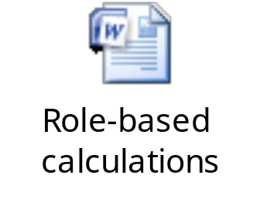
Applying Polymorphism
Polymorphism:
  Ability to create a variable, a function, or an object that has more than one form
The following embedded Word document shows a class that calculates stock grants for employees based on their role.
If the number of employee roles increase, new methods need to be added.
The programming approach used in the preceding scenario is not object-oriented.
To resolve the preceding problem, write methods that accept generic parameters.

Slide 4
Applying Polymorphism (Contd.)
The following code snippet refines the EmployeeStockPlan class by using polymorphism: public class EmployeeStockPlan
  {
    public int grantStock (Employee e)
    {
    // perform a calculation based on
    //Employee data
    }
  }
The Employee is superclass of all employee roles.

Slide 5
Using the instanceof Keyword
The instanceof operator determines an object’s type at runtime, as shown in the following code snippet:
  public class EmployeeRequisition {
  public boolean canHireEmployee(Employee e) { if(e instanceof Manager)
  {
  return true;
  } else {
  return false;
  }
  }
  }
The instanceof operator checks whether e holds the reference to the Manager class or not.

Slide 6
Casting Object References
Superclass:
  Object can hold the reference of its subclass
  Object reference can call a method of the subclass that does not exist in it
  Object reference must be cast to its subclass type to call the subclass method, as shown in the following code snippet: public void modifyDeptForManager (Employee e,
String dept) {
    if (e instanceof Manager) {
    Manager m = (Manager) e;
    m.setDeptName(dept);
    }
    }
Here, e is an Employee class object that holds the reference to the Manager class and the setDeptName() method of the Manager class is called.

Slide 7
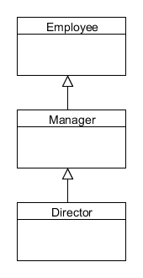

Casting Rules
Casting can be of the following types:
  Upward
  Downward
The following figure depicts upward casting of the object.
Director d=new Director();
Manager m=new Manager();
Here, d is an object of the Director class and m is an object of the Manager class.
Employee e = m; // OK
Employee e = d;//Ok
Manager m = d; // OK

Slide 8
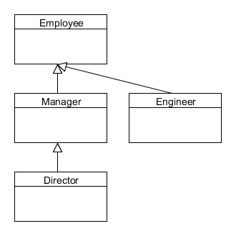

Casting Rules (Contd.)
The following figure depicts downward casting of an object.
Casting operator
Manager m = (Manager) e;
// Would also work if
// e was a Director obj
Director d = (Director) m;
// fails at run time
Engineer eng = (Engineer)m;
// compiler error
The downward cast is invalid, as there is no hierarchical relationship between the Manager and the Engineer classes.
The statement compiles, but throws a runtime exception. However, if m is an object of the Director class, the downward cast will succeed.

Slide 9
Overriding Object Methods
java.lang.Object class:
  Parent of all Java classes by default
  Contains several methods
  Has the following important non-final methods that can be overridden:
    toString()
    equals()
    hashCode()
The following code snippets show the inheritance of the Object class in a user-defined Employee class:
public class Employee { //... }
Or
public class Employee extends Object { //... }

Slide 10
Object toString() Method
toString()method:
  Called to return the string value of an object
  Can be overridden to provide instance information
The following code snippet shows how to override the toString() method in the Employee class:
  public class Employee{
  //fields of Employee class
  public String toString () {
  return "Employee id: " + empId + "\n"
  "Employee name:" + name;
  }
  }
Here, empId and name are data fields of the Employee class.

Slide 11
Object equals() Method
The equals()method of the Object class compares only the object references.
If x and y are two objects of a class, then x is equal to y
if and only if x and y refer to the same object.
To test the contents of the objects, instead of their references, override the equals()method.

Slide 12
Overriding equals() in Employee
The following embedded Word document shows how to override the equals() method in the Employee class.

Slide 13
Overriding Object hashCode()
hashcode() method:
  Must return the same hashcode value for the objects that are considered equal by the equals() method
  Must be overridden, if the equals() method of the class is overridden
The following code snippet shows how to override the hashcode() method: public int hashCode() {
  int hash = 7;
  hash = 83 * hash + this.empId;
  hash = 83 * hash + Objects.hashCode(this.name);
  hash = 83 * hash + Objects.hashCode(this.ssn);
  hash = 83 * hash +
  (int)(Double.doubleToLongBits(this.salary) ^
  (Double.doubleToLongBits(this.salary) >>> 32)); return hash; }

Slide 14


Activity: HashcodeExample

Slide 15
Need for Generalization
While designing an object-oriented solution, code duplication should be avoided.
Techniques to avoid code duplication are:
  Create library methods and classes.
  Use method inheritance.
  Use generalization.

Slide 16
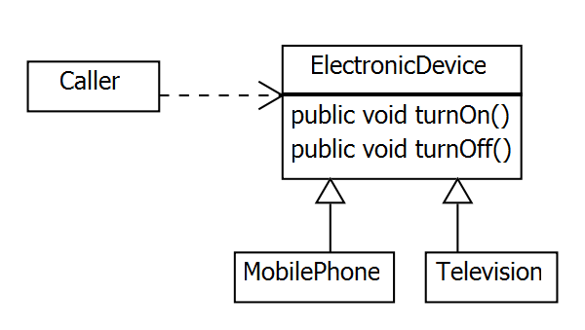
Enabling Generalization
Generalization:
  Process of extracting shared characteristics from two or more classes
  Implemented through attributes, associations, or methods
The following figure depicts generalization.
The following code snippet shows the implementation of generalization:
  ElectronicDevice dev = new Television();
  dev.turnOn();
  // all ElectronicDevices can be turned on

Slide 17

Quiz

Slide 18
Quiz (Contd.)
  Which of the following options compares only object references?
    toString()
    equals()
    ==
    hashCode()
  Solution:
    ==

Slide 19
Quiz (Contd.)
Fill in the blank:
  ________ is the process of extracting shared characteristics from two or more classes.
Solution:
  Generalization

Slide 20
Summary
In this session, you learned that:
  Virtual method invocation is an aspect of polymorphism.
  Using the most generic form of the object is a good practice of polymorphism.
  An object’s type can be determined at runtime using the instanceof operator.
  There two rules of casting objects:
    Upward cast
    Downward cast
  The Object class is default parent class of all Java classes.
  Code duplicity is a business problem, which can be avoided through libraries, inheritance, and generalization.
  Generalization is the process of extracting shared characteristics from two or more classes.

