Slide 1
Objectives
In this session, you will learn to:
  Use abstract classes
  Use the static and final keywords

Slide 2

Identifying the Need for Abstract Classes
When sibling classes have a common method, it should be placed in a parent class.
Abstract parent class:
  Should contain the common methods of the sibling classes
  Methods can be overridden with a specialized implementation
The following embedded Word document shows a subclass that implements the methods of an abstract parent class.

Slide 3
Defining Abstract Classes
Abstract classes:
  Declared using the abstract modifier, as shown in the following code snippet:
  public abstract class ElectronicDevice { }
  Can be subclassed, as shown in the following code snippet:
  public class Television extends
  ElectronicDevice { }
  Cannot be instantiated, as shown in the following code snippet: ElectronicDevice dev = new ElectronicDevice();
  Can be used as a reference type
Error

Slide 4
Defining Abstract Methods
An abstract method:
  Can be declared by using the abstract modifier, as shown in the following code snippet:
  public abstract class ElectronicDevice
  {
  public abstract void turnOn();
  public abstract void turnOff();
  }
  Cannot have a body
  Must be declared in an abstract class
  Can be overridden in the subclasses
A child class that inherits an abstract method, inherits the method signature but not the implementation.
No braces

Slide 5
Validating Abstract Classes
Rules for using abstract classes and methods:
  An abstract class may have any number of abstract and
  non abstract methods.
  While inheriting from an abstract class:
    Declare the child class as abstract.
    Or
    Override all abstract methods inherited from the parent class.

Slide 6


Activity: AbstractElectronicDevice

Slide 7
static Keyword
The static modifier is used to declare fields and methods as class-level resources.
Static class members:
  Used when objects of the same type need to share fields
  Used when a problem can be solved without using objects
  Used without object instances
  Should not be used to bypass the object orientation

Slide 8
Static Methods
Static methods:
  Can be called without an instance of a class
  Also called class methods
  Useful for APIs that are not object-oriented
  Can be used instead of constructors to object initialization
  Cannot access non-static members of the class
  Can be hidden in the subclasses, but cannot be overridden
  Can be used to retrieve object references instead of directly invoking constructors

Slide 9
Static Methods (Contd.)
A public static factory method:
  Maintains a cache of objects for reuse
  Creates new instances, if the cache is depleted
  Produces an object that subclasses the method’s return type, as shown in the following code snippet:
  NumberFormat nf = NumberFormat.getInstance();

Slide 10
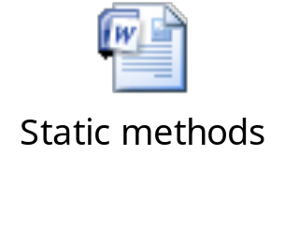
Implementing Static Methods
The following embedded Word document shows the implementation of static methods.

Slide 11
Calling Static Methods
To call static methods:
  Use the class name
    Avoid using an object reference, as shown in the following code snippet: double d = Math.random(); StaticUtilityClass.printMessage(); StaticUtilityClass uc = new StaticUtilityClass();
    uc.printMessage();
    sameClassMethod();
Here, the object reference will work but it is misleading.

Slide 12
Static Variables
Static variables:
  Can be accessed without creating an instance of a class
  Also called class variables
  Limited to a single copy per JVM
  Useful for containing shared data
  Initialized when the containing class is first loaded
  Shared by all object instances
  Store data for static methods
  Cause class loading on being accessed

Slide 13
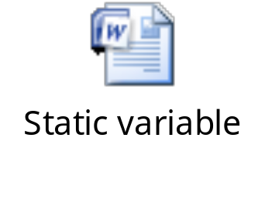
Defining Static Variables
The following embedded Word document shows how to define a static variable.

Slide 14
Using Static Variables
The following code snippet shows how to use a static variable:
  double p = Math.PI;
  . . .
  new StaticCounter();
  new StaticCounter();
  System.out.println("count: "+
  StaticCounter.getCount());
If all the members of a class are static, then use a private constructor to prevent object instantiation.
Here, the StaticCounter() method is called twice. Therefore, the counter variable declared inside this method will be incremented twice.
Thus, the final value of the counter variable will be 2.

Slide 15
Static Imports
The static import statement makes the static members of a class available using their simple name.
The following code snippet shows how to call the Math.random() method:
  import static java.lang.Math.random;
  import static java.lang.Math.*;
  public class StaticImport
  {
  public static void main(String[] args) {
  double d = random();
  }
  }
Here, the random() method is called without the fully-qualified name, import static java.lang.Math.random;.

Slide 16

Activity: StaticExamples

Slide 17
Final Methods
Final methods:
  Declared using the final keyword
  Cannot be overridden
The following code snippet shows how to declare a final method: public class MethodParentClass{ public final void printMessage() {
  System.out.println("This is a final method");
  }}
  public class MethodChildClass extends
  MethodParentClass
  {
  public void printMessage(){
  System.out.println("Cannot override method");
  }}
This will result in compilation error because the printMessage() method is declared as final in the base class.

Slide 18
Final Classes
Final classes:
  Can be declared using the final keyword
  Cannot be extended, as shown in the following code snippet:
  public final class FinalParentClass { }
  // compile-time error
  public class ChildClass extends FinalParentClass
  {
  }
The FinalParentClass class is declared as final and does support inheritance.

Slide 19

Final Variables
Final variables:
  Declared using the final modifier
  May not change their values after they are initialized
  Can be of the following types:
    Class fields
    Method parameters
    Local variables
  Help in bug prevention and thread safety.
Final references:
  Must always reference the same object
  Allow the content of the object to be modified

Slide 20
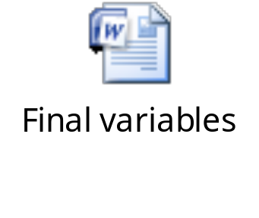
Declaring Final Variables
The following embedded Word document shows how to declare and use the final variables.
Final fields:
  Should be assigned value during the declaration
  That are also static, are considered as constants
The constant fields conventionally use identifiers having only uppercase letters and underscores.

Slide 21

Quiz

Slide 22
Quiz (Contd.)
Which of the following statements is correct regarding static variables and methods?
  Static methods cannot retrieve object references.
  Static variables are limited to a single copy per JVM.
  Static variables cannot contain shared data.
  Static methods store data in local variables.
Solution:
  Static variables are limited to a single copy per JVM.

Slide 23
Quiz (Contd.)
Which of the following statements is correct regarding final variables?
  Final variables can change their value after initialization.
  Final fields should not be assigned a value in every constructor.
  Final variables must be declared using both static and final modifier.
  A field that is both static and final is considered as a constant.
Solution:
  A field that is both static and final is considered as a constant.

Slide 24

Activity: FinalExamples

Slide 25
Summary
In this session, you learned that:
  Abstract classes are declared using the abstract modifier.
  An abstract method cannot have a body.
  Static class members are used when objects of the same type need to share fields.
  Static variables are limited to a single copy per JVM.
  Final methods cannot be overridden.
  Final classes cannot be extended.
  Final fields that are also static, are considered as constants.

