Slide 1
Objectives
In this session, you will learn to:
  Use interface and class inheritance
  Extend an interface
  Implement the DAO pattern

Slide 2
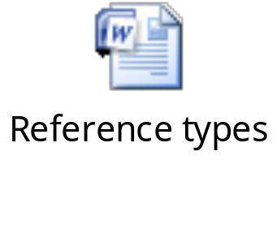
Using Generic Reference Types
While instantiating objects, create reference of an interface or a parent class type.
The following embedded Word document shows the EmployeeDAO interface, to which the reference of the class, EmployeeDAOMemoryImpl, is passed.

Slide 3
Implementing and Extending
Class:
  Can extend another class
  Can implement a single interface
  Can also implement multiple interfaces, as shown in the following code snippet:
    public class AmphibiousCar extends BasicCar
  implements MotorizedBoat, java.io.Serializable
  {
  }
Use a comma to separate multiple interfaces.

Slide 4
Extending Interfaces
Interfaces can extend interfaces, as shown in the following code snippet:
  public interface Boat { }
  public interface MotorizedBoat extends
  Boat { }
Here, the extends keyword is used to extend the Boat interface.

Slide 5
Interfaces in Inheritance Hierarchies
In Java:
  Class can inherit only one class at a time
  Class can inherit from an interface
  Class can also inherit from multiple interfaces
  Class can implement multiple interfaces, directly or indirectly

Slide 6
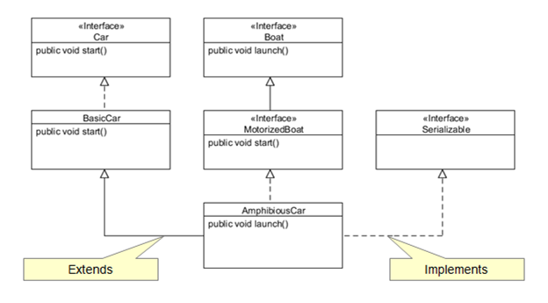
Interfaces in Inheritance Hierarchies (Contd.)
The following figure shows the interfaces in inheritance hierarchy.

Slide 7


Activity: InheritanceHierarchies

Slide 8
Design Patterns and Interfaces
The “Program to an interface, not an implementation” principle of object-oriented design:
  Plays a role in Data Access Object (DAO) and factory design patterns
  Utilizes generic method signatures, interfaces, and return types
  Does not utilize concrete implementations

Slide 9
DAO Pattern
DAO pattern:
  Can be used for applications that persist information
  Separates the problem domain from the persistence mechanism
  Makes implementation of applications easy
  Uses an interface to define the methods used for persistence

Slide 10

DAO Pattern (Contd.)
An interface allows the persistence implementation to be replaced with:
  Memory-based DAOs
  File-based DAOs
  JDBC-based DAOs
  Java Persistence API (JPA)-based DAOs

Slide 11
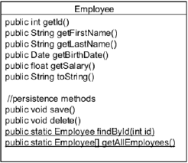
Before the DAO Pattern
The following figure explains the concept of DAO patterns.
The preceding sets of responsibilities may need to be modified for reusability.
These sets should be split into different classes.
This principle of splitting is known as the Single-Responsibility principle.
Here, the Employee class methods are focusing on the two different concerns.
These methods focus on manipulating the representation of a person.
These methods deal with persisting Employee objects.

Slide 12
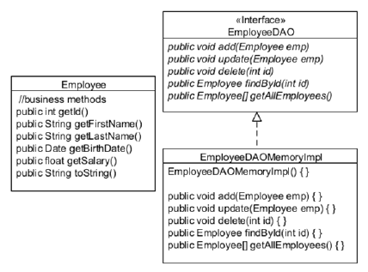
After the DAO Pattern
DAO pattern:
  Moves the persistence logic out of the domain classes.
  Places the persistence logic into separate classes, as shown in the following figure.

Slide 13
After the DAO Pattern (Contd.)
DAO:
  Implementation can be changed to use a different persistence mechanism
  Implementation should use an interface to define the contract
  Interfaces outline the methods to create, read, update, and delete data

Slide 14
The Need for the Factory Pattern
The DAO implementation’s constructor ties to a specific implementation, as shown in the following code snippet: EmployeeDAO dao = new EmployeeDAOMemoryImpl();

Slide 15
Using the Factory Pattern
Factory pattern:
  Eliminates direct constructor calls
  Used in method invocation
  Used while implementing the DAO pattern
  Prevents the application from being tightly coupled to a specific DAO implementation, as shown in the following code snippet:
EmployeeDAOFactory factory = new
EmployeeDAOFactory();
EmployeeDAO dao = factory.createEmployeeDAO();
  Returns a DAO implementation that uses files or a database to store and retrieve data
The EmployeeDAO
implementation is hidden.
Here, the type of persistence mechanism used by the EmployeeDAO class is hidden because it is just an interface.

Slide 16
The Factory
Factory:
  Implementation depends on the concrete DAO classes, as shown in the following code snippet: public class EmployeeDAOFactory
{
public EmployeeDAO createEmployeeDAO()
{
return new EmployeeDAOMemoryImpl();
}
}
  Hardcodes the name of a concrete class to be instantiated
  Can be enhanced by using the class name in an external source
  Can be enhanced by using the java.lang.Class class to instantiate the concrete subclass
Returns an interface
typed reference

Slide 17
The Factory (Contd.)
The following code snippet shows how to use the java.lang.Class class: String name
  "com.example.dao.EmployeeDAOMemoryImpl";
  Class clazz = Class.forName(name);
  EmployeDAO dao = (EmployeeDAO)clazz.newInstance();

Slide 18
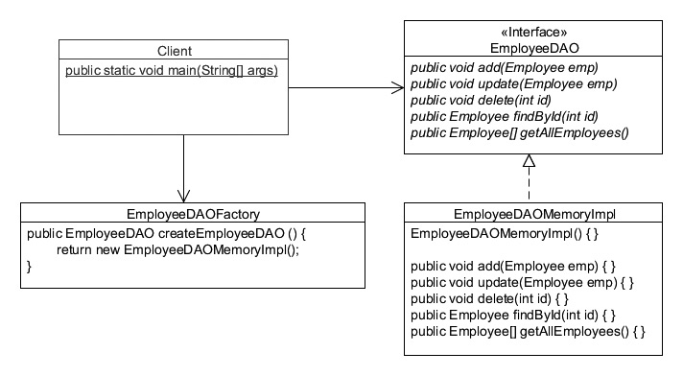
The DAO and Factory Together
The following figure shows how client and factory work together.

Slide 19
Code Reuse
Code duplication:
  Lead to maintenance problems
  Necessary in certain situations
  Avoided by using the Don’t repeat yourself! or the DRY principle

Slide 20
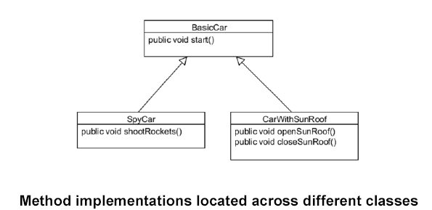
Design Difficulties
Inheritance:
  Allows code to be reused.
  May not be very modular, as shown in the following figure.
But, how do you create a class called SpyCarWithSunRoof?

Slide 21
Design Difficulties (Contd.)
Limitations with inheritance:
  Only single class inheritance possible
  Cannot inherit different implementations of a method having the same signature

Slide 22
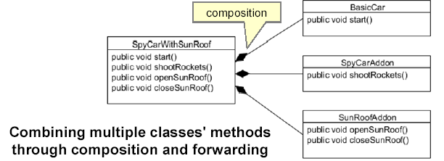
Composition
Object composition allows creation of complex objects.
Steps to implement composition:
  Create a class with references to other classes.
  Add same signature methods that forward to the referenced objects.
The following figure is an example of object composition.

Slide 23
Composition (Contd.)
Method forwarding:
  A method passes execution to another method
Delegation:
  Delegates the responsibility to another class or method

Slide 24

Composition Implementation
The following embedded Word document shows how to implement composition.

Slide 25
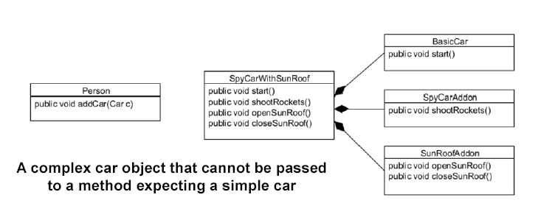
Polymorphism and Composition
Polymorphism helps to pass any sub type as an argument to a method, as shown in the following figure.
Here, the ability to use the addCar() method for any type of Car, no matter how complex, is another form of code reuse.

Slide 26
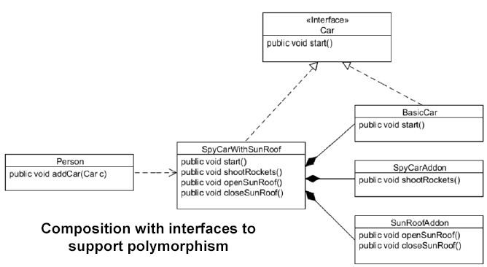
Polymorphism and Composition (Contd.)
Delegate classes:
  Use interfaces to support polymorphism, as shown in the following figure.
  Should implement all of the delegate interface types.
  Help to create an object composed of other objects.

Slide 27

Quiz

Slide 28
Quiz (Contd.)
Which of the following statements is correct regarding interfaces?
  Any class can inherit from multiple classes.
  A class cannot inherit an interface.
  A class can inherit from multiple interfaces.
  A class cannot implement multiple interfaces.
Solution:
  A class can inherit from multiple interfaces.

Slide 29
Quiz (Contd.)
Fill in the blank:
  When a method does nothing else except passing execution to another method, it is termed as ____________.
Solution:
  Method forwarding

Slide 30

Activity: CarCompositionProblem

Slide 31

Activity: CarCompositionSolution

Slide 32
Summary
In this session, you learned that:
  The most generic type should be used while creating references.
  Classes can extend a parent class and implement an interface.
  Java allows multiple interface inheritance but only single class inheritance.
  The DAO pattern is used when creating an application that must persist information.
  The use of factory prevents the application from being tightly coupled to a specific DAO implementation.
  Method forwarding is when you write a method that does nothing except pass execution over to another method.
  The term delegation may imply more than simple forwarding.
  Object composition allows you to create more complex objects.

