Slide 1
Objectives
In this session, you will learn to:
  Explore generics
  Create a custom generic class
  Use the type inference diamond to create an object
  Create a collection without using generics
  Use collections and generics
  Implement an ArrayList
  Use autoboxing and unboxing
  Implement a Set
  Implement a HashMap

Slide 2
Generics
Generics:
  Provides type safety to code
  Moves many errors from runtime to compile time
  Provides cleaner and easier-to-write code
  Reduces the need for casting with collections
  Used extensively in the Java Collections API

Slide 3
Simple Cache Class Without Generics
The following code snippets are examples of simple cache classes without using generics:
public class CacheShirt{
private Shirt shirt;
public void add(Shirt shirt){
this.shirt = shirt;
}
public Shirt get(){
return this.shirt;
}
}
public class CacheString{
private String message = "";
public void add(String message){
this.message = message;
}
public String get(){
return this.message;
}
}
Although, CacheString and CacheShirt are very simple classes created for caching, yet these two separate classes are required for different object types.

Slide 4
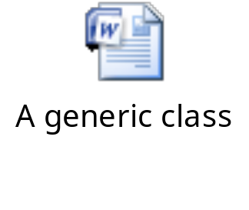
Generic Cache Class
The following embedded Word document shows how to create a generic class.

Slide 5
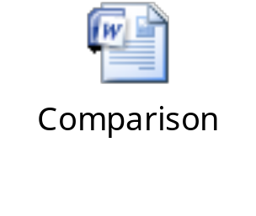
Generics in Action
The following embedded Word document shows the comparison of the type-restricted objects with generic type.

Slide 6
Generics with Type Inference Diamond
Type inference diamond:
  New feature introduced in Java SE 7
  Indicates that the right type definition is equivalent to the left
  Simplifies generic declarations and saves typing
  Works opposite to a normal Java type, as shown in the following example: Employee emp = new Manager();
  Example: ArrayList<Manager> managementTeam = new
    ArrayList <> ();
Here, the emp object is an instance of the Manager class, ie. the right side of the expression determines the type.
Here, the left side of the expression determines the type and need not be repeated on the right side.

Slide 7
Collections
Collection:
  Single object designed to store a group of objects
  Does not hold primitive types
  Implements many data structures including stack, queue, dynamic array, and hash
Collections API:
  Relies on generics for implementation
  Classes are stored in the java.util package

Slide 8
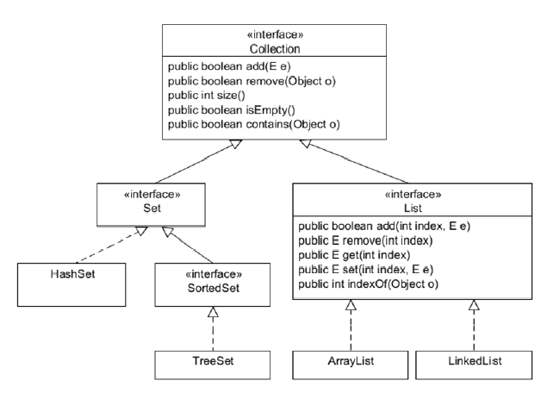
Collection Types
The following figure shows all the collection types that inherit from the Collection class.

Slide 9

Collection Types (Contd.)
The following collection types are inherited from the Collection class:
  HashSet
  TreeSet
  ArrayList
  Deque

Slide 10
List Interface
List interface:
  Defines the generic list behavior
  Helps to store ordered collection of elements
  Defines the behavior of all Collections classes that exhibit list behavior
  Reference type is used to hide the implementation details
List behaviors:
  Adding elements at a specific index
  Adding elements to the end of the list
  Getting an element based on an index
  Removing an element based on an index
  Overwriting an element based on an index
  Getting the size of the list

Slide 11
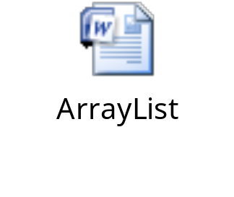
ArrayList Implementation Class
ArrayList:
  Implements a List collection
  Dynamically growable array
  Has a numeric index
  Allows duplicate items
The following embedded Word document shows how to use ArrayList.

Slide 12
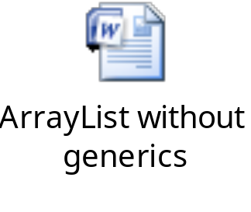
ArrayList Without Generics
The following embedded Word document shows ArrayList without using generics.

Slide 13
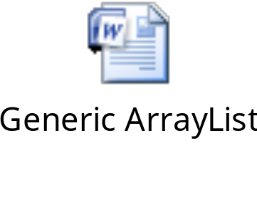
Generic ArrayList
The following embedded Word document shows generic ArrayList.

Slide 14
Generic ArrayList: Iteration and Boxing
Wrapper class:
  Available for each primitive data type
  Wraps a primitive type into an object of the class
Boxing:
  Refers to the conversion of a primitive variable to the corresponding wrapper class object instance
  Example: for (Integer partNumberObj:partList)
    {
    int partNumber = partNumberObj;//Auto unboxing
    System.out.println("Part number: " + partNumber);
    }
The for-each loop provides cleaner code.
No casting is required because of autoboxing and unboxing.

Slide 15


Activity: genericArrayList

Slide 16
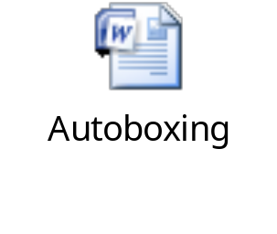
Autoboxing and Unboxing
The following embedded Word document explains the concept of autoboxing.

Slide 17
Set Interface
Set:
  List that contains only unique elements
  Has no index
  Does not allow duplicate elements
  Allows iteration through its elements to access them
  Provides TreeSet for sorted implementation

Slide 18
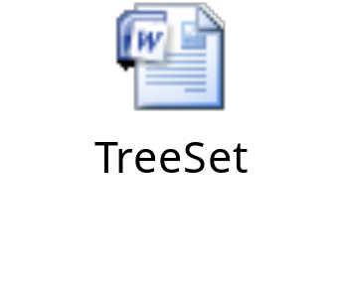
Set Interface: Example
The following embedded Word document shows an example that uses the TreeSet class to sort the items in the Set interface.

Slide 19
Map Interface
Map:
  Collection that stores multiple key-value pairs
  Called associative arrays in other languages
The following table is an example of data stored in
key-value pairs.
Key | Value
101 | Blue Shirt
102 | Black Shirt
103 | Gray Shirt

Slide 20
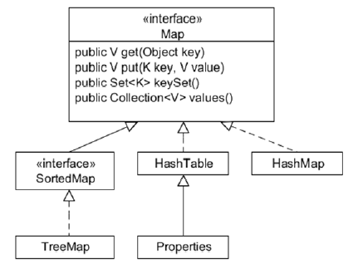
Map Types
Map interface:
  Does not extend the Collection interface
  Represents mappings and not a collection of objects
The following figure shows the key implementation classes of the Map interface.
The HashMap class is just like HashTable, except that it accepts null keys and
values and it is not synchronized.
The TreeMap class is a map where the keys are automatically sorted.
The HashTable class is a classic associative array implementation with keys and values. The HashTable class
is synchronized.

Slide 21
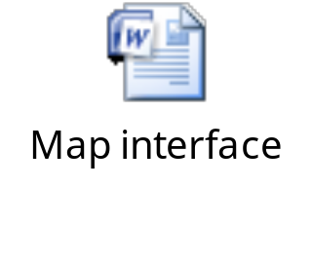
Map Interface: Example
The following embedded Word document shows an example of the Map interface.

Slide 22

Quiz

Slide 23
Quiz (Contd.)
Which of the following statements is correct regarding Collection classes?
  ArrayList implements a Set collection.
  List is a collection that can be used to implement a stack or a queue.
  The Collections classes are all stored in the java.lang package.
  ArrayList is a dynamically growable array.
Solution:
  ArrayList is a dynamically growable array.

Slide 24
Quiz (Contd.)
Fill in the blank:
  A ____ interface is a collection that stores multiple key-value pairs.
Solution:
  Map

Slide 25
Summary
In this session, you learned that:
  Generics provides type safety to code.
  The type inference diamond indicates that the right type definition is equivalent to the left.
  A collection is a single object designed to store a group of objects.
  The List interface helps to store ordered collection of elements.
  An ArrayList is a dynamically growable array.
  A wrapper class wraps a primitive type into an object of the class.
  A Set is a list that contains only unique elements.
  A Map is a collection that stores multiple key-value pairs.

