Slide 1
Objectives
In this session, you will learn to:
  Implement a stack by using a deque
  Order collections
  Read properties from the command line
  Use the PrintWriter class
  Process strings

Slide 2
Deque Interface
Queue:
  Provides First-In-First-Out (FIFO) operation
  Used to track asynchronous message requests
Stack:
  Provides Last-In-First-Out (LIFO) operation
  Used to traverse a directory tree or similar structures
Deque interface:
  Child interface of the Collection interface
  Can be used as a stack or a queue
  Known as “double-ended-queue”
  Pronounced as “deck”

Slide 3
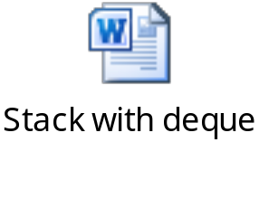
Stack with Deque: Example
The following embedded Word document shows an example of the stack with deque.

Slide 4
Ordering Collections
Comparable and Comparator interfaces:
  Help to order elements of the Collections API
  Can be used with sorted collections, such as TreeSet and TreeMap
Comparable interface:
  Overrides the compareTo() method
  Provides only one sort option
Comparator interface:
  Implemented by using the compare() method
  Creates multiple Comparator classes
  Creates and uses numerous sorting options

Slide 5
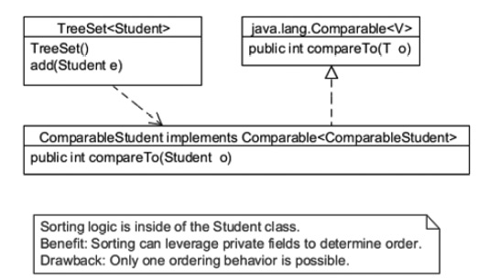
Comparable Interface
The following figure shows how the ComparableStudent class relates to the Comparable interface and TreeSet.

Slide 6
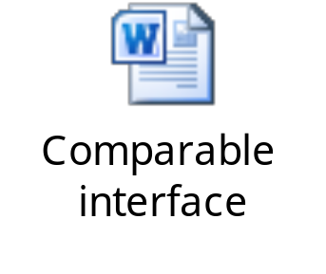
Comparable: Example
The following embedded Word document shows how to implement the Comparable interface.

Slide 7
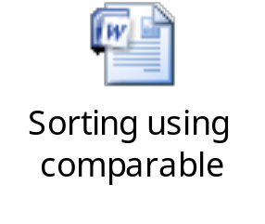
Comparable Test: Example
  The following embedded Word document shows sorting of collection elements using the Comparable interface.

Slide 8

Activity: Comparable Test Example
Let us see how to implement the Comparable interface.

Slide 9
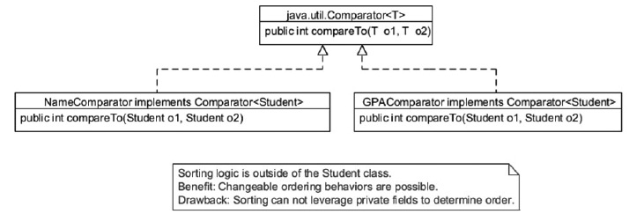
Comparator Interface
  The following figure shows the Comparator classes that can be used with the Student class.

Slide 10
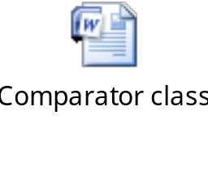
Comparator: Example
  The following embedded Word document shows how to use the Comparator class.

Slide 11
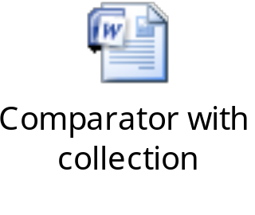
Comparator Test: Example
The following embedded Word document shows how the Comparator objects are used with a collection.

Slide 12
Command-Line Arguments
Command-line arguments:
  Stand-alone tokens or quoted strings
  Placed on the command line after the class name:
    Example:
    java TestArgs arg1 arg2 “another arg”
  Stored in the args array that is passed to the static main() method:
    Example:
    public static void main(String[] args)
  Specify the configuration information for the application

Slide 13
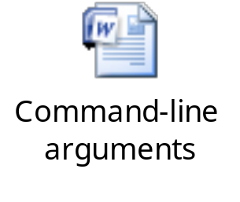
Command-Line Arguments (Contd.)
The following embedded Word document shows an example of the command-line arguments.
The following code snippet shows a sample execution of the preceding code:
java TestArgs "Ted Baxter" 45 100.25
args[0] is 'Ted Baxter'
args[1] is '45'
args[2] is '100.25'
Arguments passed at the runtime.

Slide 14
Properties
Properties can be stored in a simple text file.
Properties file:
  Can have .properties extension
  Helps to set values for the application externally
  Enables to easily inject configuration information or other application data into the application
  Read at the start of the application
  Used for default values
  Can also be an integral part of a localization scheme

Slide 15
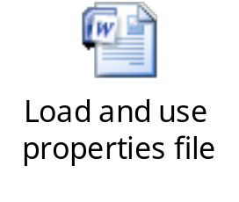
Loading and Using a Properties File
The following embedded Word document shows how to load and use the properties file.

Slide 16
Loading Properties from the Command Line
The java.util.Properties class is used to load the key-value pairs.
The property information is passed on the command line using the –D option:
  Example: java –D propertyname=value –D propertyname=value myApp
The following code snippet shows how to get the property from the System object:
String userName = System.getProperty("username");

Slide 17
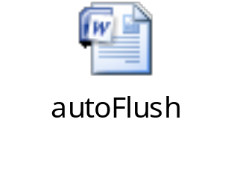
PrintWriter Class
PrintWriter class:
  Converts characters into bytes
  Implements all the print methods of the PrintStream class
  Allows automatic flushing only when the println(), printf(), or format() method is invoked
The following embedded Word document shows how to use the autoFlush option.

Slide 18
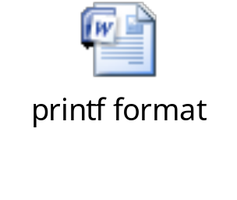
printf format
  To format strings, the printf and String formats are used.
  The following embedded Word document shows the example of the printf format.

Slide 19

Activity: printf format

Slide 20

String Processing
To process strings:
  StringBuilder class
  StringBuffer class
  StringTokenizer class
  Built-in string methods

Slide 21
StringBuilder and StringBuffer
StringBuilder and StringBuffer:
  Preferred tools when strings are small
  More efficient than “+”
  Set the capacity to the size you actually need
  The StringBuilder class is not thread-safe.
  The StringBuffer class is thread-safe.

Slide 22
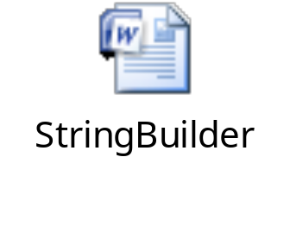
StringBuilder: Example
The following embedded Word document shows an example of the StringBuilder class.

Slide 23

Activity: StringBuilding

Slide 24
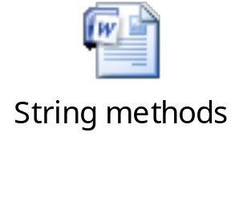
Sample String Methods
Some methods of the String class include:
  equals()
  contains()
  replace()
  substring()
The following embedded Word document shows how to use these string methods.

Slide 25

Quiz

Slide 26
Quiz (Contd.)
Which of the following statements is correct regarding the comparable and comparator interfaces?
  The Comparable interface is implemented by using the compare() method.
  The Comparator interface provides only one sort option.
  The Comparable interface creates multiple Comparator classes.
  The Comparable interface overrides the compareTo() method.
Solution:
  The Comparable interface overrides the compareTo() method.

Slide 27
Quiz (Contd.)
Fill in the blank:
  The _______ class is used for parsing the string.
Solution:
  StringTokenizer

Slide 28
Summary
In this session, you learned that:
  A queue provides FIFO operations.
  A stack provides LIFO operations.
  A Deque interface is a child interface of Collection.
  Command-line arguments are placed in the args array that is passed to the main() method.
  The java.util.Properties class is used to load and save key-value pairs.
  The PrintWriter class converts characters into bytes.
  You can format strings using the printf and String formats.
  StringBuilder and StringBuffer are the preferred tools when string concatenation is nontrivial.

