Slide 1
Objectives
In this session, you will learn to:
  Explore errors and exceptions
  Recognize exception classes and categories
  Handle exceptions
  Use the try-with-resources statement
  Work with the AutoCloseable interface and supressed exceptions
  Use the multi-catch clause
  Use the throw clause
  Create custom exceptions and use Wrapper exceptions
  Use assertions and invariants

Slide 2
Errors and Exceptions
Errors:
  Handled to create reliable applications
  Result of application bugs
  Beyond the control of the application
Exceptions:
  An error that occurs at runtime
  Abnormal behavior that leads to unpredictable result
  Disrupts the normal flow of application execution

Slide 3
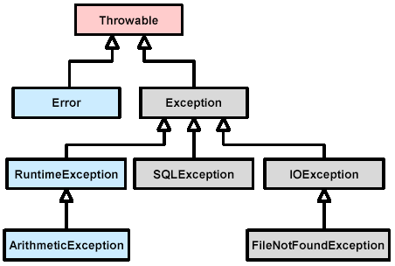
Exception Categories
java.lang.Throwable class:
  Parent class of all exceptions, as shown in the following figure.
  Outlines several useful methods.
Main categories of exceptions:
  Unchecked exceptions
  Checked exceptions

Slide 4

Exception Categories (Contd.)
Unchecked exceptions:
  Types:
    java.lang.RuntimeException
    java.lang.Error
  Occur during the execution of application
  Discovered by using the try-catch statement
  Some RuntimeExceptions:
    ArrayIndexOutOfBoundsException
    NullPointerException
    ArithmeticException
Checked exceptions:
  Type:
    The Exception, except the RuntimeException
  Handled using the try or the throws statement

Slide 5
Exception Handling
Libraries that require knowledge of exception handling include:
  File IO (NIO: java.nio)
  Database access (JDBC: java.sql)
try-catch blocks:
  Used for handling exceptions
  try block:
    Handles exceptions
    Sends the execution to the attached catch block
  catch block:
    Used to retry the operation
    Used to try an alternate operation
    Used to gracefully exit or return
    Must not be empty
    Gets a reference to the java.lang.Exception object

Slide 6
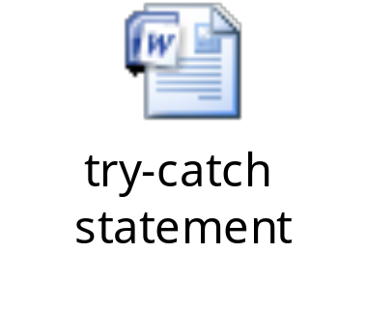
The try-catch Statement
The following embedded Word document shows an example of using a try-catch statement.

Slide 7
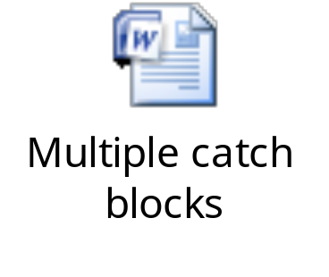
The try-catch Statement (Contd.)
General purpose catch block:
  Cannot deal with every possible error
  Should not catch the base type of Exception
Multiple catch blocks:
  Can be associated with a single try block.
  The following embedded Word document shows how multiple catch blocks can be associated with a single try block.

Slide 8
The finally Clause
finally block:
  Closes the opened resources
  Executed with or without an error in the try block
  Always executes after the catch block
  May generate an Exception

Slide 9
The try-with-resources Statement
try-with-resources statement:
  Eliminates the need for a lengthy finally block
  Always closes the opened resources
  Allows opening of multiple resources
  Closes multiple resources in the opposite order of opening
A class that implements the AutoCloseable interface can be used as a resource.
If a resource must be autoclosed, its reference must be declared within the try statement’s parentheses.
The following link provides information on the try-with-resource statement:
http://www.youtube.com/watch?v=4uZPgFJjoDw&playnext=1&list=PL0364366AF01C5F07&feature=results_video

Slide 10
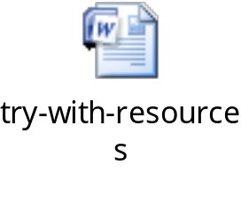
The try-with-resources Statement (Contd.)
The following embedded Word document shows how to declare a try-with-resources statement.

Slide 11
The AutoCloseable Interface
Resource in a try-with-resources statement must implement:
  java.lang.AutoCloseable
      Or
  java.io.Closeable
The following code snippet shows how to declare the AutoCloseable interface with the close() method:
public interface AutoCloseable {
void close() throws Exception;
}

Slide 12
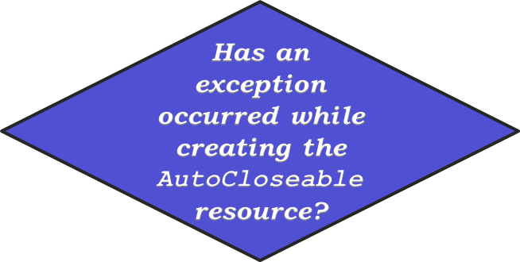
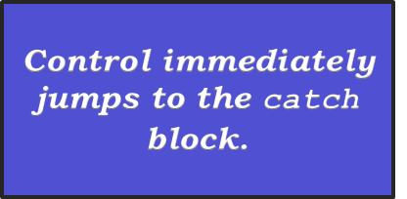
Suppressed Exceptions
  Consider the following blocks of the try-with-resources statement:
  try(resource_name)
  {
  //Statements
  }catch(Exception e)
  {
  //Statements
  }
Yes

Slide 13
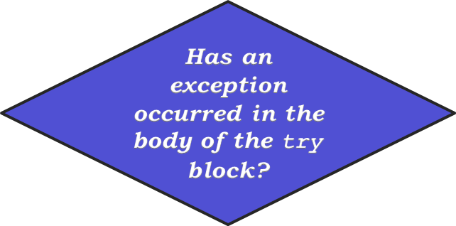
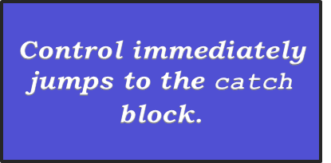
Suppressed Exceptions (Contd.)
  Consider the following syntax of the try-with-resources statement:
  try(resource_name)
  {
  //Statements
  }catch(Exception e)
  {
  //Statements
  }
Yes

Slide 14
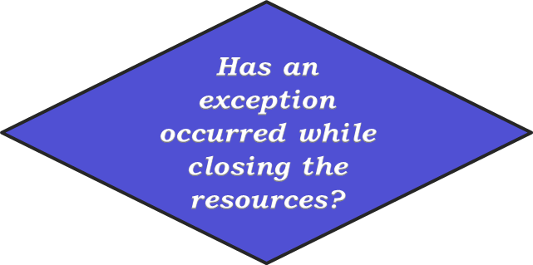
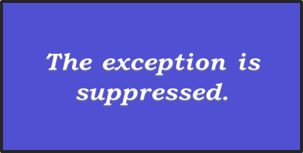
Suppressed Exceptions (Contd.)
  Consider the following syntax of the try-with-resources statement:
  try(resource_name)
  {
  //Statements
  }catch(Exception e)
  {
  //Statements
  }
Yes

Slide 15
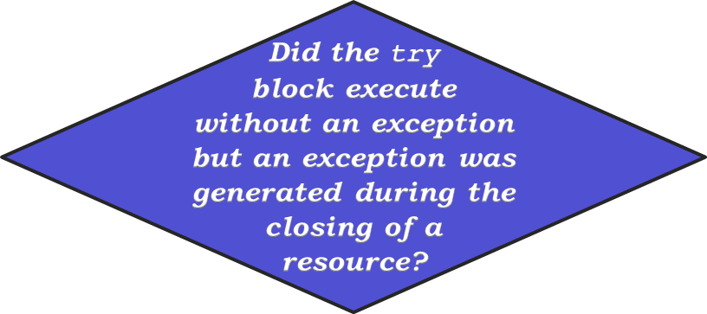
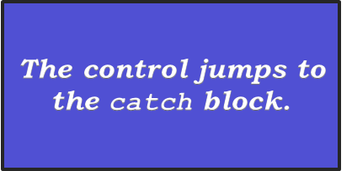
Suppressed Exceptions (Contd.)
  Consider the following syntax of the try-with-resources statement:
  try(resource_name)
  {
  //Statements
  }catch(Exception e)
  {
  //Statements
  }
Yes

Slide 16
Suppressed Exceptions (Contd.)
The following code snippet shows the exceptions that are suppressed: catch(Exception e)
  {
    System.out.println(e.getMessage());
    for(Throwable t : e.getSuppressed())
    {
    System.out.println(t.getMessage());
    }
  }

Slide 17
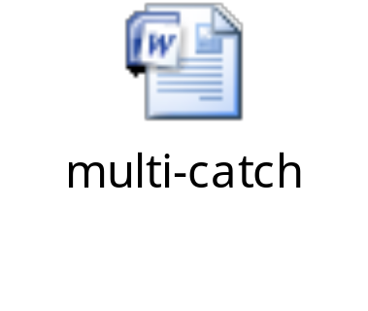
Catching Multiple Exceptions
Multi-catch statement:
  Reduces the amount of code to be written
  Avoids catching generic exceptions
  Separates type alternatives by vertical bars
  Alternatives must not have inheritance relationship
Catching an Exception object prevents catching other types of exceptions.
The following embedded Word document shows how to use the new multi-catch clause.

Slide 18

Activity: MultiCatchExample

Slide 19
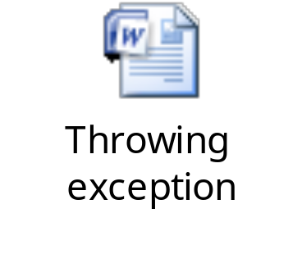
Declaring Exceptions
Methods:
  Use the throws clause to throw one or more exceptions
  Stop executing when exception is generated
  The exception is thrown to the caller
The following embedded Word document shows how a method throws an exception instead of handling it.

Slide 20
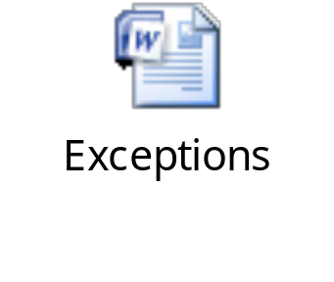
Declaring Exceptions (Contd.)
Exceptions while declaring overridden methods:
  Declare same exceptions
  Declare fewer exceptions
  Declare more specific exceptions
  Do not declare additional exceptions
  Do not declare more generic exceptions
The following embedded Word document shows how a method declare multiple exceptions.

Slide 21
Throwing Exceptions
throws clause:
  Delays exception handling
  Can repeatedly throw exception up the call stack
  Must be handled before it is thrown out of the main() method
  Declaration makes it someone else’s job to handle it, as shown in the following code snippet:
  public static void main(String[] args) {
  try {
  int data = readByteFromFile();
  } catch (IOException e) {
  System.out.println(e.getMessage());
  }
  }
Method that declared an exception.

Slide 22
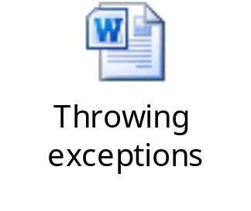
Throwing Exceptions (Contd.)
Java SE 7 supports rethrowing the precise exception type.
The following embedded Word document shows how to rethrow an exception in Java SE 7.

Slide 23
Activity: ThrowExample

Slide 24
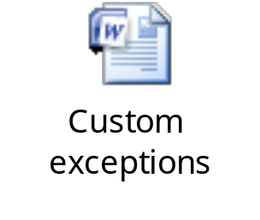
Custom Exceptions
Custom exceptions:
  Are created when a class extends the Exception class
  Are not thrown by the standard Java class libraries
  Class may override methods or add new functionality
  Capture information about a problem that has occurred
  Example:
  throw new DAOException();
getMessage() method:
  Used for string type
  All Exception classes inherit it from Throwable
  Returns a string that is stored by exception constructors
The following embedded Word document shows how to create custom exceptions.

Slide 25
Wrapper Exceptions
Wrapper exception:
  Hides the type of exception being generated without ignoring it.
  Example:
  public class DAOException extends Exception {
  public DAOException(Throwable cause) {
  super(cause);
  }
  public DAOException(String message, Throwable cause){
  super(message, cause);
  }}

Slide 26
Wrapper Exceptions (Contd.)
Throwable class:
  Contains the getCause() method to retrieve a wrapped exception
  Example:
    try {
    //…
    } catch (DAOException e) {
    Throwable t = e.getCause();
    }

Slide 27
Assertions
Assertion:
  Ensures that the application is executing as expected
  Documents and verifies the assumptions and internal logic of a single method
  Implementation types:
    Internal invariants
    Control flow invariants
    Postconditions and class invariants
  Combines the exception-handling mechanism with conditionally executed code
  Syntax:
    assert <boolean_expression> ;
    assert <boolean_expression> :
    <detail_expression> ;
If <boolean_expression> evaluates false, then an AssertionError is thrown.

Slide 28
Assertions (Contd.)
  Disabled by default
  Enabled or disabled at runtime
  Enabled by using any of the following commands:
  java -enableassertions MyProgram
  Or
  java -ea MyProgram
The following code snippet shows the behavior of assertion:
  if (AssertionsAreEnabled) {
  if (condition == false) throw new AssertionError();
  }

Slide 29
Internal Invariants
Code without assertion:
if (x > 0) {
// do this
} else {
// do that
}
After implementing assertion:
if (x > 0) {
// do this
} else {
assert ( x == 0 );
// do that, unless x is negative
}
Here, the assertion evaluates the variable x even when it contains the value 0, which was not handled previously.

Slide 30
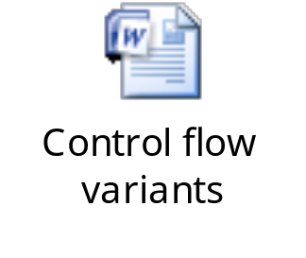
Control Flow Invariants
The following embedded Word document shows an example of control flow invariants.

Slide 31
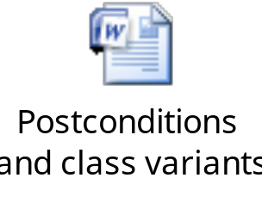
Postconditions and Class Invariants
The following embedded Word document shows an example of postconditions and class invariants.

Slide 32

Quiz

Slide 33
Quiz (Contd.)
Fill in the blank:
  The ____________ statement eliminates the need for a lengthy finally block.
Solution:
  try-with-resources

Slide 34
Quiz (Contd.)
Which of the following statements is correct regarding exceptions in Java?
  Custom exceptions are created when a class extends the RuntimeException.
  Checked exceptions must be handled using a try or throws statement.
  Unchecked exceptions are discovered by using the throws statement.
  Overridden methods can declare broader set of exceptions.
Solution:
  Checked exceptions must be handled using a try or throws statement.

Slide 35
Summary
In this session, you learned that:
  An error should be an exception instead of an expected behavior.
  The java.lang.Throwable class is the parent class of all exceptions.
  The try-catch blocks handle exceptions.
  The try-with-resources statement always closes the opened resources.
  The new multi-catch statement reduces the amount of code to be written.
  The throws clause with a method is used to throw one or more exceptions.
  Custom exceptions are created when a class extends the Exception.
  Assertion ensures that the application is executing as expected.

