Slide 1
Objectives
In this session, you will learn to:
  Describe the basics of input and output in Java
  Read and write byte and character data
  Process streams
  Read data from and write data to the console
  Use channel I/O
  Read and write objects by using serialization

Slide 2
Java I/O Basics
Java I/O:
  Provides a set of libraries to perform input/output operations
  Defines an I/O channel as a stream
Stream:
  I/O represents an input source or an output destination
  Supports sequential flow of data
  Source:
    Initiates the flow of data
    Also called an input stream
    Node stream
  Sink:
    Terminates the flow of data
    Also called an output stream
    Node stream
  Closed when the work is finished

Slide 3
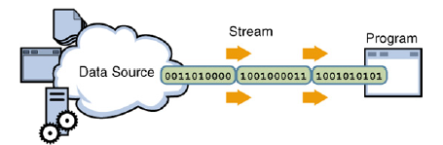
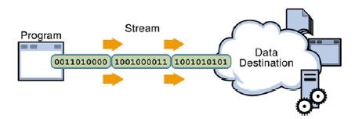
I/O Streams
Program:
  Uses an input stream to read data from a source, as shown in the following figure.
  Uses an output stream to write data to a destination, as shown in the following figure.

Slide 4
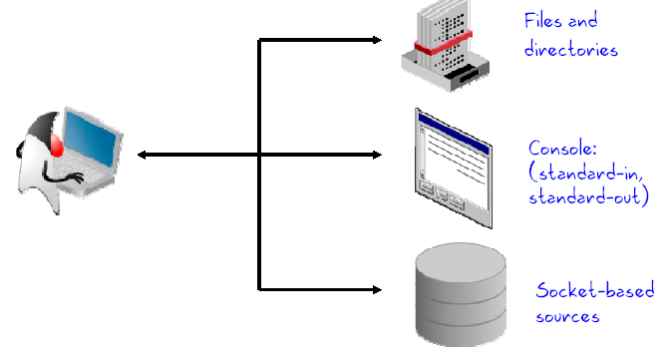
I/O Application
The following figure shows the three ways to use I/O.
I/O streams:
  Used to read from some output device and the console (standard out)
  Used to write information to (standard in)
  Used sockets to communicate with another application on a remote system

Slide 5
Data Within Streams
Supported types of data in streams:
  Byte data:
    Handled by the input streams and output streams
    Uses the InputStream and the OutputStream classes
    Used to read and write the raw bytes, such as:
      Image files
      Audio files
      Objects
  Character data:
    Handled by the readers and writers
    Uses the Reader and the Writer classes

Slide 6
Byte Stream InputStream Methods
Byte stream uses the read() method to read data.
read() methods:
  int read()
  int read(byte[] buffer)
  int read(byte[] buffer, int offset, int length)
Other InputStream methods:
  void close();
  int available();
  long skip(long n);
  boolean markSupported();
  void mark(int readlimit);
  void reset();
The available() method reports the number of bytes that are immediately available to be
read from the stream.
The skip() method discards the specified number of bytes from the stream.
The markSupported(), mark(), and reset() methods perform push-back operations on a stream.

Slide 7
Byte Stream OutputStream Methods
Byte stream uses the write() method to write data.
write() methods:
  void write(int c)
  void write(byte[] buffer)
  void write(byte[] buffer, int offset, int length)
Other OutputStream methods:
void close(); // Automatically closed in
// try-with-resources
void flush(); // Force a write to the stream

Slide 8
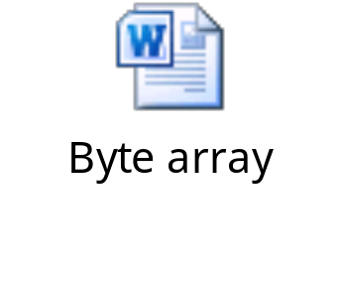
Byte Stream Example
The following embedded Word document copies one file to another by using the byte array.

Slide 9


Activity: ByteStreamsExample

Slide 10
Character StreamReader Methods
Character stream uses the read() method to read data.
read methods:
  int read()
  int read(char[] cbuf)
  int read(char[] cbuf, int offset, int length)
Other StreamReader methods:
  void close()
  boolean ready()
  long skip(long n)
  boolean markSupported()
  void mark(int readAheadLimit)
  void reset()

Slide 11
Character StreamWriter Methods
Writer methods are analogous to the OutputStream methods.
Character stream uses the Write() method to write data.
write methods:
  void write(int c)
  void write(char[] cbuf)
  void write(char[] cbuf, int offset, int length)
  void write(String string)
  void write(String string, int offset, int length)
Other StreamWriter methods:
  void close()
  void flush()

Slide 12
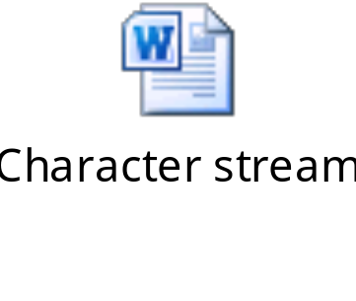
Character Stream Example
The following embedded Word document copies one file to another by using the character array.

Slide 13

Activity: CharStreamsExample

Slide 14
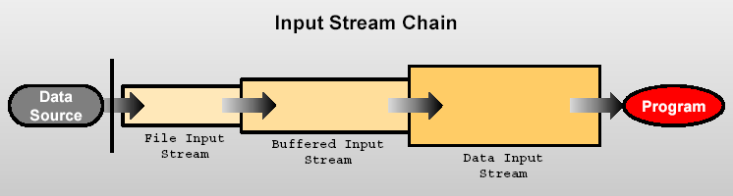
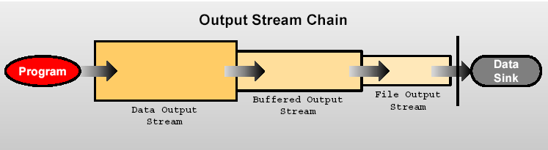
Processing Streams
Processing stream performs the conversion of one stream to another.
Stream chaining:
  Processes data
  The following figure shows the stream chaining of input streams.
  The following figure shows the stream chaining of output streams.

Slide 15
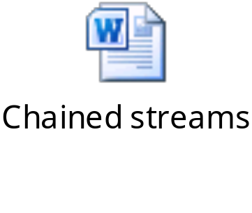
Processing Streams (Contd.)
The following embedded Word document illustrates the use of a BufferedReader class chained to the FileReader class.

Slide 16
Processing Streams (Contd.)
  The following table shows the various streams according to their functionality.
Functionality | Character Streams | Byte Streams
Buffering (Strings) | BufferedReader BufferedWriter | BufferedInputStream BufferedOutputStream
Filtering | FilterReader FilterWriter | FilterInputStream FilterOutputStream
Conversion (byte to character) | InputStreamReader OutputStreamWriter
Object serialization |  | ObjectInputStream ObjectOutputStream
Data conversion |  | DataInputStream DataOutputStream
Counting | LineNumberReader | LineNumberInputStream
Peeking ahead | PushbackReader | PushbackInputStream
Printing | PrintWriter | PrintStream

Slide 17
Console I/O
Static instance fields of the System class:
  Out:
    Static instance of a PrintStream object
    Allows to write to the standard output
    Already open and ready to accept output data
    Corresponds to display output
  In:
    Static instance of an InputStream object
    Allows to read from standard input
    Already open and ready to supply input data
    Corresponds to keyboard input or another input source
  Err:
    Static instance of a PrintStream object
    Allows to write to standard error
    Already open and ready to accept output data
    Corresponds to display output and error messages

Slide 18
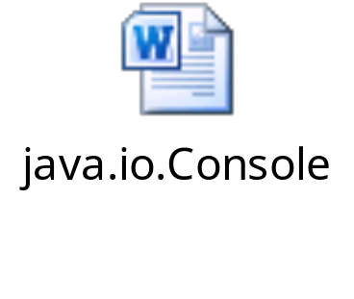
Console I/O (Contd.)
The Console object represents the character-based console associate with the current JVM.
The following embedded Word document shows how the system can access an instance of the java.io.Console class.

Slide 19
Writing to Standard Output
println() method:
  Provided by the java.io.PrintStream
  Prints the argument and a newline character (\n)
  Calls the toString() method
print() method:
  Provided by the java.io.PrintStream
  Prints the argument without a newline character
  Calls the toString() method
The println() and the print() methods are overloaded for:
  Primitive types, such as byte, int, char, float, double, and boolean
  char[] array
  Object class
  String class

Slide 20
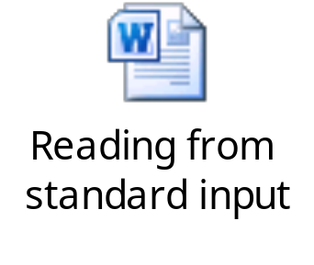
Reading from Standard Input
The following embedded Word document shows the way to read from the standard input.

Slide 21

Activity: SystemConsoleExample

Slide 22
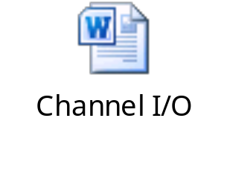
Channel I/O
  Channel:
  I/O was introduced in the java.nio package in JDK 1.4
  Reads bytes and characters
  The following embedded Word document shows a file that is read from a buffer.

Slide 23

Activity: ByteChannelExample

Slide 24

Quiz

Slide 25
Quiz (Contd.)
Fill in the blank:
  The _______ method prints the argument and a newline character (\n).
Solution:
  println()

Slide 26
Quiz (Contd.)
Which of the following InputStream methods reports the number of bytes that are immediately available to be read from the stream?
  available()
  skip()
  markSupported()
  reset()
Solution:
  available()

Slide 27
Persistence
Persistance:
  Saving of data to some type of permanent storage
  Object persists till the JVM is running, if not used
Java serialization is the standard mechanism for saving an object.
java.io.Serializable interface:
  Used to serialize an object of a specific class
  Defines no methods
  Is a marker to indicate that the class should be considered for serialization

Slide 28
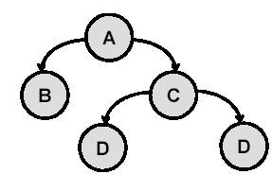
Serialization and Object Graphs
Object:
  When serialized, only the fields of the object are preserved.
  Fields tree constitutes the object graph, as shown in the following figure.
Serialization:
  Traverses the object graph
  Writes data to the output stream for each node of the graph

Slide 29
Transient Fields and Objects
Transient operating system-specific information are not serialized
NotSerializableException thrown, if the object graph contains a nonserializable reference
transient keyword used with non serializable fields
Values stored in static fields not serialized
During deserialization:
  Values of static transient fields set to the values defined in the class declaration
  Values of non static transient fields is set to the default value for the type

Slide 30
Transient: Example
The following code explains the way to use the transient keyword:
public class Portfolio implements Serializable {
public transient FileInputStream inputFile;
public static int BASE = 100;
private transient int totalValue = 10;
protected Stock[] stocks;
}

Slide 31
Summary
In this session, you learned that:
  Streams is a sequential flow of data.
  The byte input and output streams are implemented by using the InputStream and the OutputStream classes.
  The character input and output streams are implemented by using the subclasses of the Reader and the Writer classes.
  Processing stream performs conversion on another stream.
  Static instance fields of the System class are Out, In, and Err.
  The println() and print() method is provided by the java.io.PrintStream.
  A channel reads bytes and characters.
  The java.io.Serializable interface is used to serialize an object of a specific class.

