Slide 1
Objectives
In this session, you will learn to:
  Read and write objects by using serialization
  Explore new File I/O API (NIO.2)
  Use the Path interface to operate on file and directory paths

Slide 2
Serial Version UID
Serialization:
  Process of persisting an object
  serialVersionUID field associates the serialized output with the serialized class
  Enables to declare its own serialVersionUID field
  serialVersionUID explicitly declares the serialVersionUID field as a static final long:
    Example: private static long serialVersionUID = 42L;
Deserialization:
  Process of restoring the serialized object
  serialVersionUID field verifies that the classes loaded are compatible with the object
  If the receiver has loaded classes with different serialVersionUID, it results in an InvalidClassException

Slide 3
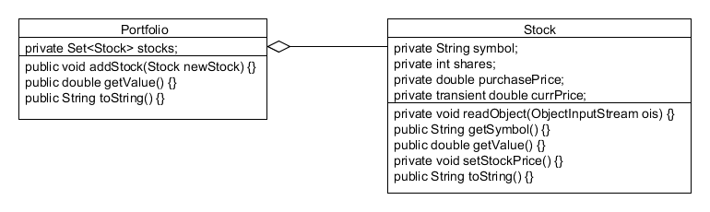
Serialization Example
Consider a scenario of the Portfolio class that is made of a set of Stock classes.
The following diagram depicts class structures of the Portfolio and the Stock classes.
During serialization, the current price should not be serialized, and is therefore, marked as transient.

Slide 4
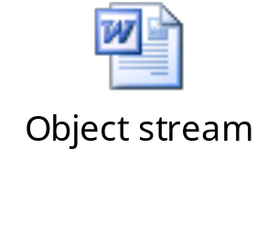
Writing and Reading an Object Stream
Writing object stream:
  writeObject() method:
    Walks the object’s graph
    Writes the data contained in the non transient and non static fields as raw bytes
Reading object stream:
  readObject() method:
    Restores an object containing the non static and the non transient data fields
The following embedded Word document shows the concept of writing and reading an object stream.

Slide 5
Serialization Methods
An object being serialized or deserialized can control the serialization of its own fields.
writeObject() and readObject() methods:
  Overridden in the class to be serialized
  If not overridden, then the object of serialized class calls the defaultWriteObject() and the defaultReadObject() methods

Slide 6
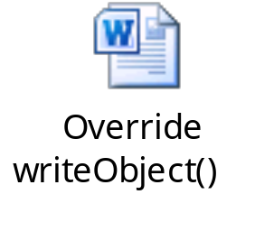
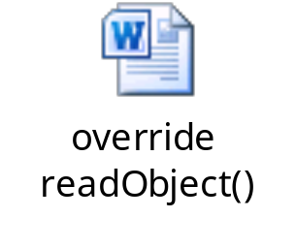
Serialization Methods (Contd.)
  The following embedded Word document shows how to override the writeObject() method.
  The following embedded Word document shows how to override the readObject() method.

Slide 7


Activity: SerializeStockExample

Slide 8
New File I/O API (NIO.2)
New file I/O API:
  Provides improved file system interface
  Package of complete socket-channel functionality
  Provides scalable asynchronous I/O
  Works consistently across platforms
  Makes it easier to write programs
  Provides efficient access to a larger set of file attributes
  Provides platform-specific features
  Allows support for non native file systems

Slide 9






Limitations of java.io.File
The following figure depicts limitations of the java.io.File package.
Does not work well with symbolic links
Scalability issues
Very limited set of
file attributes
Performance issues
Very basic file system access functionality

Slide 10
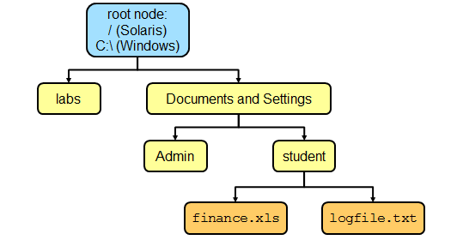
File Systems, Paths, Files
File systems are hierarchical/tree structures.
Path:
  Represents both, files and directories
  Provides the relative or absolute location of the file or the directory
The following diagram depicts a file system structure.

Slide 11
Relative Path Versus Absolute Path
An absolute path contains the root element and the complete directory list required to locate the file.
The following path shows the absolute path:
  D:\test\folder1\file1.txt
The following path shows the relative path:
  folder1\file1.txt

Slide 12

Java NIO.2 Concepts
Prior to NIO.2, the java.io.File class was the entry point for all file and directory operations.
NIO.2 packages and classes:
  java.nio.file.Path
  java.nio.file.Files
  java.nio.file.FileSystem
All the methods that access the file system throw IOException.

Slide 13
Path Interface
Path interface:
  Entry point for the NIO.2 file and directory manipulation
  Defines the methods to locate a file or a directory in a file system
  Objects are immutable
  Operations return new Path objects
  Calls the getPath() method:
    Example: FileSystem fs = FileSystems.getDefault(); Path p1 = fs.getPath("D:\\labs\\resources\\myFile.txt");
Escaped backward slash

Slide 14
Path Interface (Contd.)
  The java.nio.file package also provides a static final helper class called Paths.
  The following code snippets shows how to retrieve the path using the Paths class: Path p1 = Paths.get("D:\\labs\\resources\\myFile.txt");
    Path p2 = Paths.get ("D:", "labs", "resources",
    "myFile.txt");
    Path p3 = Paths.get ("/temp/foo");
    Path p4 = Paths.get (URI.create"file:///~/somefile");

Slide 15
Path Interface (Contd.)
Methods to access the components of a path:
  getFileName()
  getParent()
  getRoot()
  getNameCount()
Methods to operate on a path:
  normalize()
  toUri()
  toAbsolutePath()
  subpath()
  resolve()
  relativize()
Methods to compare paths:
  startsWith()
  endsWith()
  equals()

Slide 16
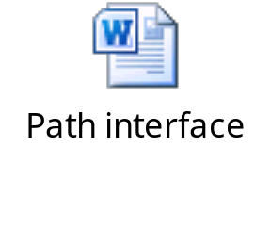
Path: Example
The following embedded Word document shows how to use the Path interface.

Slide 17

Activity: PathExample

Slide 18
Removing Redundancies from a Path
normalize() method:
  Removes the redundant elements from a path
  Example: Path p = Paths.get("/home/peter/../clarence/foo"); Path normalizedPath = p.normalize();

Slide 19
Creating a Subpath
subpath()method:
  Used to obtain a portion of a path
  Syntax: Path subpath(int beginIndex, int endIndex);
  Example: Path p1 = Paths.get ("D:/Temp/foo/bar"); Path p2 = p1.subpath (1, 3);
The element returned by the endIndex argument is one less than it’s specified value.
Temp = 0
foo = 1
bar = 2
Include the element at index 2

Slide 20
Joining Two Paths
resolve()method:
  Used to combine two paths:
    Example: Path p1 = Paths.get("/home/clarence/foo"); p1.resolve("bar"); //Returns /home/clarence/foo/bar
  Passing the absolute path returns the passed-in path:
    Example: Paths.get("foo").resolve("/home/clarence"); //Returns /home/clarence

Slide 21
Creating a Path Between Two Paths
relativize()method:
  Constructs a path:
    From one location in the file system to another location
    Originating from the original path and ending at the location specified by the passed-in path:
      The new path is relative to the original path
      Example: Path p1 = Paths.get("peter"); Path p2 = Paths.get("clarence");
      Path p1Top2 = p1.relativize(p2);
      // Result is../clarence
      Path p2Top1 = p2.relativize(p1);
      // Result is ../peter

Slide 22

Quiz

Slide 23
Quiz (Contd.)
Fill in the blank:
  The _________ method removes the redundant elements from a path.
Solution:
  normalize()

Slide 24
Quiz (Contd.)
  Which of the following methods is used to combine two paths?
    relativize()
    resolve()
    subpath()
    normalize()
Solution:
    resolve()

Slide 25
Summary
In this session, you learned that:
  The serialVersionUID field associates the serialized output with the serialized class.
  The writeObject()method walks the object’s graph.
  The new file I/O API is a package of complete socket-channel functionality.
  A path represents both, files and directories.
  The Path interface provides the entry point for the NIO.2 file and directory manipulation.
  The java.nio.file package also provides a static final helper class called Paths.
  The normalize()method removes the redundant elements from a path.
  The resolve()method is used to combine two paths.
  The relativize()method enables to construct a path from one location in the file system to another location.

