Slide 1

Objectives
In this session, you will learn to:
  Use the PathMatcher class
  Use NIO.2 classes
  Work with threads
  Work with non shared data
  Synchronize threads accessing shared data
  Identify potential threading problems

Slide 2
PathMatcher Syntax and Pattern
PathMatcher interface:
  Implemented by objects that perform match operations on paths
syntaxAndPattern string: syntax:pattern
The glob syntax is similar to regular expressions.
The following table shows the glob patterns.
Pattern Example | Description
*.java | Matches a path that represents a file name ending in .java
*.* | Matches file names containing a dot
*.{java,class} | Matches file names ending with .java or .class
foo.? | Matches file names starting with foo. and a single character extension
C:\\* | Matches C:\foo and C:\bar on the Windows platform (Note that the backslash is escaped. As a string literal in the Java Language, the pattern would be C:\\\\*.)

Slide 3

PathMatcher: Example
The following embedded Word document shows code that extracts the list of files, according to a pattern, using a user-defined Finder class.

Slide 4

Finder Class
The following embedded Word document shows how to define the Finder class.

Slide 5


Activity: FindFileExample

Slide 6
Other Useful NIO.2 Classes
FileStore class:
  Gives information about a file system, such as the total, usable, and allocated disk space
WatchService interface:
  Identifies when files are added, deleted, or modified in a directory
  Instance can report changes to the registered Path objects

Slide 7
Moving to NIO.2
toPath() method:
  Added to the java.io.File class
  Provides forward compatibility with NIO.2
  Provides advantage of NIO.2 without rewriting a lot of code
Path interface:
  Provides a method to construct a java.io.File object
  Example: File file = path.toFile();

Slide 8

Why Threading Matters
Application code can execute in a single threaded or multithreaded environment.
Single threaded applications are slower due to performance bottlenecks.
Performance bottlenecks should be avoided for programs to execute fast.
Some of the bottlenecks include:
  Resource contention
  Blocking I/O operations
  Underutilization of CPUs
Multithreading enables to avoid the potential bottlenecks.

Slide 9
Why Threading Matters (Contd.)
Types of tasks scheduled for execution:
  Process:
    Area of memory that contains both code and data
    Has a thread of execution:
      Scheduled to receive CPU time slices
  Thread:
    Enables scheduled execution of a process
    For a process:
      Shares the same data memory
      May follow different paths

Slide 10
The Thread Class
Thread class:
  Used to create and start threads
Class can create a new thread, if it:
  Extends the Thread class
    Or
  Implements the Runnable interface

Slide 11
Extending Thread
Perform the following steps to implement threads:
  Extend the class from the java.lang.Thread class.
  Override the run() method.
    Example:
run() method:
  Should not be called directly
  Does not start a new thread
public class ExampleThread extends Thread {
@Override
public void run()
{
for(int i = 0; i < 100; i++) {
System.out.println("i:" +i);
}}
}

Slide 12
Starting a Thread
A thread can be started only once.
Thread’s start()method:
  Used to begin executing a thread
  Example: public static void main(String[] args) { ExampleThread t1 = new ExampleThread(); t1.start();
  }
Schedules the run() method to be called.

Slide 13
Implementing Runnable
The following code snippet shows how to implement the Runnable interface:
  public class ExampleRunnable implements Runnable {
  @Override
  public void run() {
  for(int i = 0; i < 100; i++) {
  System.out.println("i:" + i);
  }
  }
  }

Slide 14
Executing Runnable Instances
The following code snippet shows how to start a thread using a runnable instance:
  public static void main(String[] args) {
  ExampleRunnable r1 = new ExampleRunnable();
  Thread t1 = new Thread(r1);
  t1.start();
  }

Slide 15

Activity: ImplementingRunnableExample

Slide 16
A Runnable with Shared Data
Static and instance fields may be shared by threads, as shown in the following code snippet: public class ExampleRunnable implements Runnable {
private int i;
  @Override
  public void run() {
  for(i = 0; i < 100; i++) {
  System.out.println("i:" + i);
  }
  }
  }
Potentially shared variable

Slide 17

One Runnable: Multiple Threads
Runnable:
  Instance can be passed to multiple Thread instances
  Fields are shared by multiple Thread instances
The following embedded Word document shows how the static fields are concurrently accessed by the multiple threads.

Slide 18
Problems with Shared Data
Shared data:
  Instance and static fields
  Must be accessed by threads with caution because it may be changed concurrently by multiple threads

Slide 19
Nonshared Data
Some variable types are never shared.
Any shared data that is immutable is thread-safe.
Thread-safe types:
  Local variables
  Method parameters
  Exception handler parameters

Slide 20
Out-of-Order Execution
Thread operations:
  Performed on one thread may not appear to be executed in the same order by another
  May result in out-of-order execution due to:
    Code optimization
    Threads may be operating on cached copies of shared variables
  Must be synchronized in their actions to ensure consistent behavior
  Have working memory, where it keeps its own copy of variables

Slide 21
Out-of-Order Execution (Contd.)
Synchronization of a thread’s working memory with main memory involves:
  Volatile read or write of a variable
  Locking or unlocking a monitor
  First and last action of a thread
  Actions that start a thread or detect that a thread has terminated

Slide 22
The volatile Keyword
volatile:
  Modifier can be applied to a field
    Example: public volatile int i;
  Field causes a thread to synchronize its working memory with main memory
  Does not mean atomic

Slide 23

Stopping a Thread
  The following embedded Word document shows how a thread stops by completing its run() method.
Main thread:
    Executed in a separate thread
    Automatically created by the JVM

Slide 24
The synchronized Keyword
synchronized keyword:
  Used to create thread-safe code blocks
synchronized code block:
  Causes a thread to write all of its changes to main memory
  Used to group blocks of code for exclusive execution

Slide 25
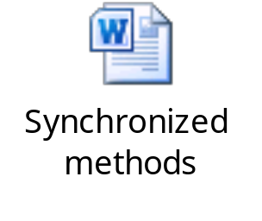
synchronized Methods
  The following embedded Word document shows how to work with synchronized methods.

Slide 26
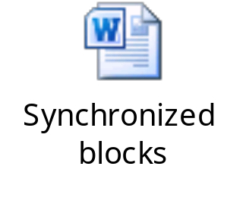
synchronized Blocks
The following embedded Word document shows how to use the synchronized blocks.
  Synchronization in multithreaded applications ensures reliable behavior.
  Synchronized:
    Blocks and methods are used to restrict a section of code to a single thread
    Blocks can be used instead of synchronized methods

Slide 27
Object Monitor Locking
Each object in Java is associated with a monitor.
Synchronized methods:
  Use monitor for the this object
  That are static use the classes’ monitor
Synchronized blocks:
  Specify which object’s monitor to lock or unlock
  Example:
    synchronized ( this ) { }
  Nested to lock multiple monitors simultaneously

Slide 28

Activity: SynchronizedExample

Slide 29
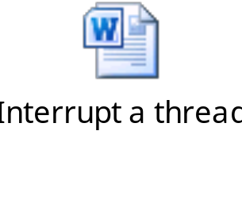
Detecting Interruption
The following embedded Word document shows how to interrupt a thread.

Slide 30
Interrupting a Thread
interrupt() method:
  Convenient way to stop a thread
  Can Interrupt a thread that is blocked
Every thread has the interrupt() and isInterrupted() methods, as shown in the following code snippet: public static void main(String[] args) { ExampleRunnable r1 = new ExampleRunnable(); Thread t1 = new Thread(r1); t1.start(); // ... t1.interrupt(); }
Interrupts a thread

Slide 31
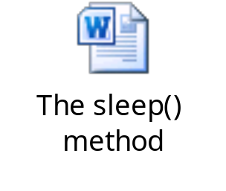
Thread.sleep()
The following embedded Word document shows how a Thread can pause execution, using the sleep() method.

Slide 32

Activity: ThreadSleepExample

Slide 33
Additional Thread Methods
Thread and threading-related methods:
  setName(String)
  getName()
  getId()
  isAlive()
  isDaemon()
  setDaemon(boolean)
  join()
  Thread.currentThread()
Threading methods of the Object class:
  wait()
  notify()
  notifyAll()

Slide 34
Additional Thread Methods (Contd.)
  Daemon thread:
    Background thread
    Less important
  Non daemon thread:
    Main thread
    Keeps the JVM running, even after the main method has returned
    Set for threads that prevent the JVM from quitting

Slide 35
Methods to Avoid
Thread methods that should be avoided:
  setPriority(int)
  getPriority()
Deprecated methods:
  destroy()
  resume()
  suspend()
  stop()

Slide 36
Deadlock
  Potential threading problems:
  Deadlock:
    May occur when two or more threads are blocked forever as they are waiting for each other
    Examples:
  Starvation:
    Thread is unable to gain regular access to shared resources
  Livelock:
    Occurs when threads are busy responding to each other
synchronized (obj1){
synchronized (obj2){
}}
Thread 1 pauses after locking obj1’s monitor.
synchronized (obj2){
synchronized (obj1){
}}
Thread 2 pauses after locking obj2’s monitor.

Slide 37

Quiz

Slide 38
Quiz (Contd.)
Fill in the blank:
  The ________ method is a convenient way to stop a thread.
Solution:
  interrupt()

Slide 39
Quiz (Contd.)
Fill in the blank:
  _________ occurs when threads are busy responding to each other.
Solution:
  Livelock

Slide 40
Summary
In this session, you learned that:
  The glob syntax is similar to regular expressions.
  The FileStore class provides information about a file system, such as the total, usable, and allocated disk space.
  The toPath() method is added to the java.io.File class.
  The Runnable instance can be passed to multiple Thread instances.
  Any shared data that is immutable is thread-safe.
  The synchronized keyword is used to create thread-safe code blocks.
  The interrupt() method is a convenient way to stop a thread.
  Daemon threads are background threads.
  Potential threading problem includes:
    Deadlock
    Starvation
    Livelock

