Slide 1

Objectives
In this session, you will learn to:
  Work with ResultSet
  Work with PreparedStatement and CallableStatement
  Use transactions with JDBC
  Use the JDBC 4.1 RowSetProvider and RowSetFactory
  Use the Data Access Object pattern

Slide 2
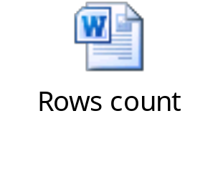
Getting a Row Count
To work with databases, applications require the information related to the number of rows fetched by a ResultSet object.
The following embedded Word document shows the row count returned from a ResultSet object.
The following code snippet shows how to make a ResultSet scrollable: Statement stmt = con.createStatement(ResultSet.TYPE_SCROLL_INSENSITIVE, ResultSet.CONCUR_UPDATABLE);
Notes:
Faculty can use additional activity named ResultSetRowCountExample to show it pracitcally.

Slide 3
Controlling ResultSet Fetch Size
JDBC driver determines the number of rows fetched by a query by default.
setFetchSize()method:
  Controls fetch size behavior for large data sets
  Example:
rs.setFetchSize(25);
After executing this statement, a call to the rs.next() method will fetch 25 rows in one time.

Slide 4
Using PreparedStatement
PreparedStatement interface:
  Subclass of the Statement interface
  Used to pass arguments to a precompiled SQL statement
  Useful when the same SQL statements are executed multiple times
  Example: double value = 100_000.00; String query = "SELECT * FROM Employee WHERE Salary > ?"; PreparedStatement pStmt=con.prepareStatement(query); pStmt.setDouble(1, value); ResultSet rs = pStmt.executeQuery();
Parameter for substitution
Substitutes value for the first parameter in the prepared statement.

Slide 5


Activity: PreparedStatementExample

Slide 6
Using CallableStatement
CallableStatement interface:
  Allows stored procedures to be executed
  Example: CallableStatement cStmt = con.prepareCall("{CALL EmplAgeCount (?, ?)}"); int age = 50; cStmt.setInt (1, age); ResultSet rs = cStmt.executeQuery(); cStmt.registerOutParameter(2, Types.INTEGER); boolean result = cStmt.execute(); int count = cStmt.getInt(2); System.out.println("There are " + count + " Employees over the age of " + age);

Slide 7

Activity: CallableStatementExample

Slide 8

Transaction
Transaction:
  Mechanism to handle groups of operations as single unit
  Either all operations occur or none of them occur at all
  Operations may involve one or more databases
  Defined by the following set of properties, known as ACID properties:
    Atomicity (A)
    Consistency (C)
    Isolation (I)
    Durability (D)

Slide 9
Transferring Without Transactions
The following figure shows transfer of money, from one account to another, without transactions.
The following figure shows unsuccessful transfer without transactions.
$500
-$100
$400
1) Withdraw: $100
Account 1
A
ATM
Bank
Transfer: $100
From: Acct 1
To: Acct 2
$1000
+$100
$1100
2) Deposit: $100
Account 2
1) Withdraw: $100
Account 1
$500
-$100
$400
B
ATM
Bank
Transfer: $100
From: Acct 1
To: Acct 2
Failed
Deposit
Account 2
$1000

Slide 10
Successful Transfer with Transactions
The following figure shows transfer of money, from one account to another, in a transaction.
The following figure shows successful transfer when preceding operations get committed in the transaction.
Transaction Started by Bank
$500
-$100
$400
1) Withdraw: $100
Account 1
A
ATM
Bank
Transfer: $100
From: Acct 1
To: Acct 2
$1000
+$100
$1100
2) Deposit: $100
Account 2
Transaction Started by Bank
$400
Commit
Account 1
B
ATM
Bank
Transfer
Successful
Account 2
$1100
Commit

Slide 11
Unsuccessful Transfer with Transactions
The following figure shows unsuccessful transfer of money, from one account to another.
The following figure shows the rollback of the unsuccessful transaction.
Transaction Started by Bank
$500
-$100
$400
1) Withdraw: $100
Account 1
A
ATM
Bank
Transfer: $100
From: Acct 1
To: Acct 2
Failed
Deposit
Account 2
$1000
Transaction Started by Bank
$500
Rollback
Account 1
B
ATM
Bank
Error Message
$1000
Rollback
Account 2

Slide 12
JDBC Transactions
Connection object:
  In auto-commit mode by default
SQL statement:
  Treated as a transaction
  Automatically committed after execution
  Rolled back programmatically in the event of a failure
Auto-commit mode:
  Can be disabled
  Syntax to disable: con.setAutoCommit (false);
  Once disabled, the commit() method is called explicitly

Slide 13
RowSet 1.1: RowSetProvider and RowSetFactory
Features introduced in the new RowSet 1.1 API:
  javax.sql.rowset.RowSetProvider:
    Used to create a RowSetFactory object
  RowSetFactory:
    Used to create one of the RowSet 1.1 RowSet object types
    Used to create instances of RowSet implementations
  com.sun.rowset.RowSetFactoryImpl:
    Default implementation of RowSetFactory

Slide 14
Using RowSet 1.1 RowSetFactory
The following table shows the various RowSet types.
RowSet type | Provides
CachedRowSet | A container for rows of data that caches its rows in memory.
FilteredRowSet | A RowSet object that provides methods for filtering support.
JdbcRowSet | A wrapper around ResultSet to treat a result set as a JavaBeans component.
JoinRowSet | A RowSet object that provides mechanisms for combining related data from different RowSet objects.
WebRowSet | A RowSet object that supports the standard XML document format required when describing a RowSet object in XML.

Slide 15
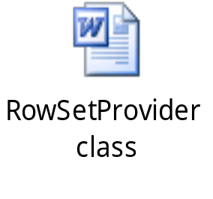
Example: Using JdbcRowSet
The following embedded Word document shows how to use the RowSetProvider class.

Slide 16

Activity: SimpleJDBCRowSetExample

Slide 17
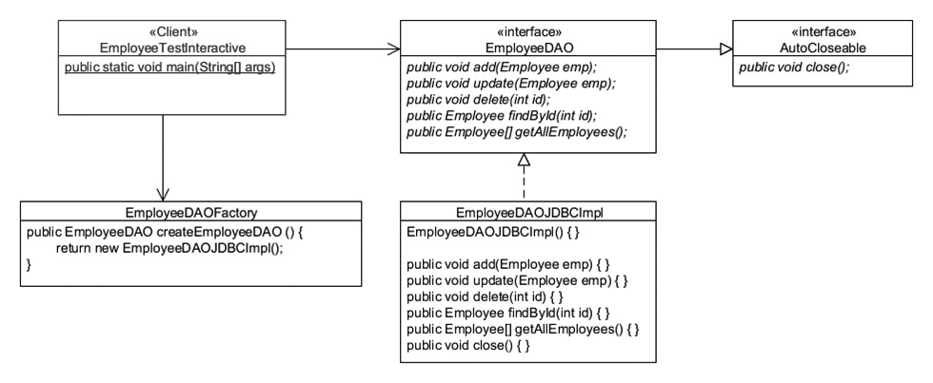
The Data Access Object Pattern
Data Access Object (DAO):
  Separates database-related activities from the business model.
  Ensures loose coupling.
  The following figure shows the implementation of the DAO pattern.
2
An EmployeeDAO interface is designed to model the behavior that you want to allow on the Employee data.
1
3
The EmployeeDAOJDBCImpl implements the EmployeeDAO interface without impacting the client application.
A factory is used to generate instances (references) to an implementation of the EmployeeDAO interface.

Slide 18

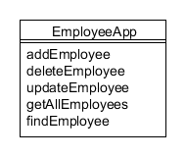
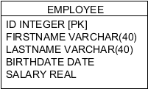
Data Access Objects
Consider the following figure that shows the structure of the Employee table.
Tight coupling:
  Database is combined with the business logic
  Small change impacts the entire application
    Loose coupling:
  Applications should be loosely coupled
  Using data access objects

Slide 19

Quiz

Slide 20
Quiz (Contd.)
Fill in the blank:
  The ___________ interface is a subclass of the Statement interface.
Solution:
  PreparedStatement

Slide 21
Quiz (Contd.)
Which of the following options is not an ACID property of a transaction?
  Atomicity
  Concurrency
  Isolation
  Durability
Solution:
  Concurrency

Slide 22
Summary
In this session, you learned that:
  The setFetchSize() method is used to control the fetch size behavior for large data sets.
  The PreparedStatement interface is a subclass of the Statement interface.
  The CallableStatement interface allows stored procedures to be executed against the database.
  Transaction is a mechanism to handle groups of operations as a single unit.
  By default, the Connection object is in auto-commit mode.
  Features introduced in the new RowSet 1.1 API are:
    javax.sql.rowset.RowSetProvider
    RowSetFactory
    com.sun.rowset.RowSetFactoryImpl
  DAO separates the database-related activities from the business model.

