Slide 1

Core java Value Added
By Mega institute , Noida 62

Slide 2
What is java ?
Java is a Highly Secured and widely-used programming language for coding. It has been a popular choice among developers for over two decades, with millions of Java applications in use today. Java is a multi-platform, object-oriented, and network-centric language that can be used as a platform in itself. It is a fast, secure, reliable programming language for coding everything from mobile apps and enterprise software to big data applications and server-side technologies.
How to program in Java
To begin programming in Java, you need to install a Java Edition on your system. There are three main Java editions:
Java Standard Edition (Java SE)
Java Enterprise Edition (Java EE)
Java Micro Edition (Java ME)
What is Java SE?
Java Standard Edition is the core Java programming platform. It contains all of the libraries and APIs that any programmer needs for java development. Open Java Development Kit(OpenJDK) is the free and open source implementation of Java SE.

Slide 3
Why java ?
Do you have entrepreneurial aspirations?It is highly worth considering Java from the start. Young companies may be tempted to use trendy new languages, only to realize later they need the scalability and performance of Java as the business grows.
Java is everywhere. From android applications and web server tools to enterprise software, Java has, in a way, formed the backbone of the internet revolution.
It is hence both wise and lucrative to look for a career in Java as a software developer. The strong community, enterprise support, and growing popularity among programmers show that Java is set to stay the first choice for most businesses. Hence, java career opportunities are not fading anytime soon.

Slide 4
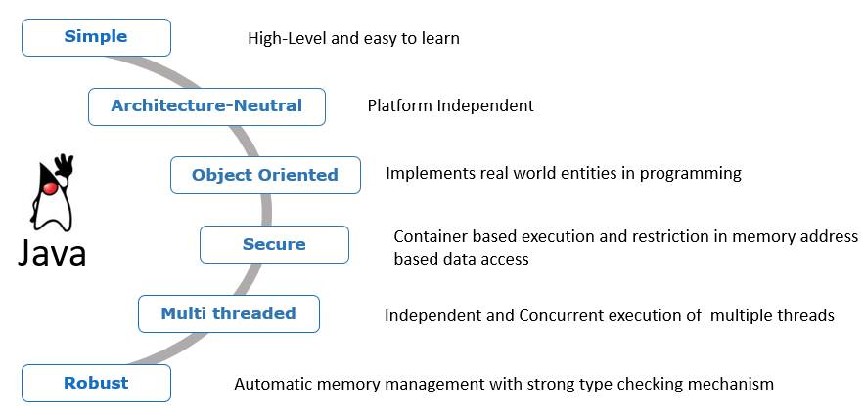
Features of java

Slide 5
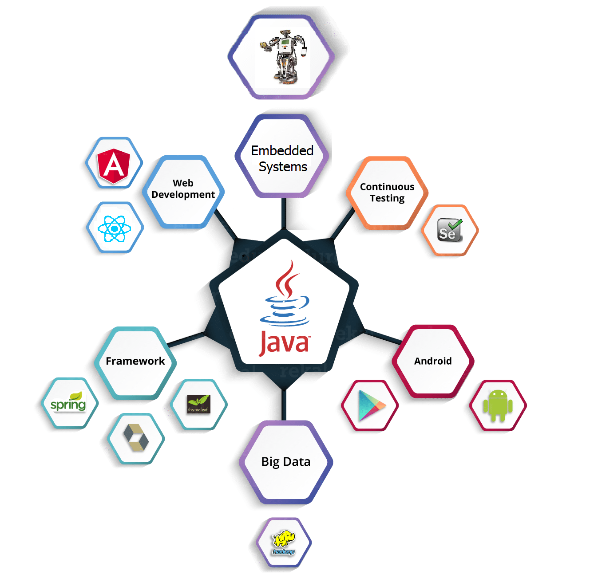
Career in Java

Slide 6
Java: Growing popularity and current market trend
Java is one of the old programming languages that have done well to deliver with the changing demands of the market. According to newrelic.com, Java 8 is currently the most accepted version of Java in the market, with Oracle being the dominant vendor and maintainer of the Java language as well as the Java Virtual Machine (JVM), since the acquisition of Sun Microsystems in 2010.
Even after being declared the most popular programming language of 2019, some say that Java is losing its charm to trending languages like python. But even the most contradicting arguments from trusted sources give the following reports.

Slide 7
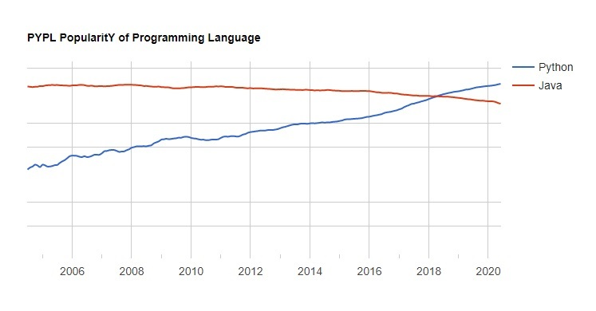

Slide 8
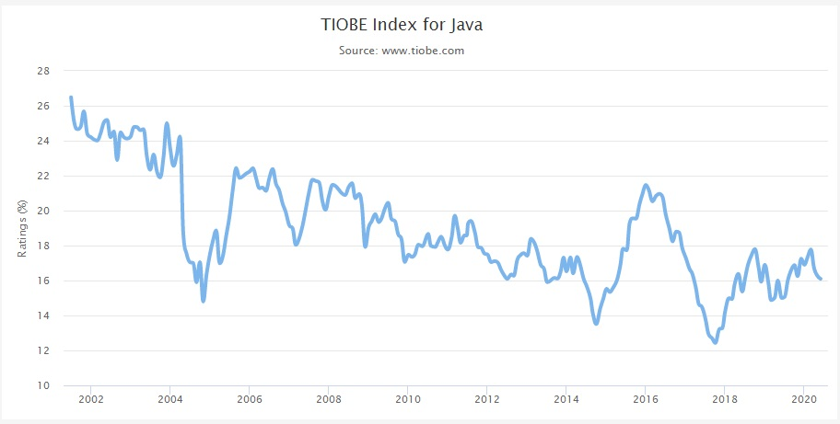
Even this gives us the impression that Java is not a language that is going away anytime soon. As it is safe, portable, comes with a higher level of concurrency tools, is maintainable and serves a purpose in various important industries.
Moreover, to get a better idea of the popularity of java as a programming language, let us look at the trends of its Tiobe index.

Slide 9
Tiobe index is a measure of the popularity of the programming language that is measured after considering factors like market share, number of job postings, open-source projects, etc.
Some might still say that Java is losing its popularity, but if you compare this with the stats of trending programming languages like Python and Javascript you will see that in their period of existence they have achieved a maximum Tiobe index of 10 and 4 respectively, which is way less than Java’s current ranking.

Slide 10

Thank You
amantiwari8861@gmail.com

