Slide 1

Objectives
In this session, you will learn to:
  Design classes
  Identify relationships between classes
  Define information hiding
  Define encapsulation
  Explore the concept of abstraction
  Explore the concept of inheritance

Slide 2

Designing Classes
How do I design classes for use in my program?

Slide 3
Designing Classes (Contd.)
Perform the following steps to design classes:
  Identify the set of classes that will constitute the software system.
  Determine the responsibilities of each class.
  Determine the interactions between classes.
  Identify the attributes and behavior of each class.
  Identify the scope of the class members.

Slide 4

  Identifying Relationships Between Classes
Let us understand how you can identify the relationships between classes.

Slide 5

  Identifying Relationships Between Classes (Contd.)
Object-Oriented Programming (OOP):
  Classes and objects are related to each other
  Object’s behavior is shown by the action it performs:
    Behavior finds out the relationship between the objects and classes

Slide 6
Kinds of Relationships
What are the different kinds of relationships between classes?

Slide 7
  Kinds of Relationships (Contd.)
Relationships between the objects of different classes:
  Composition
  Generalization
  Utilization
  Instantiation

Slide 8
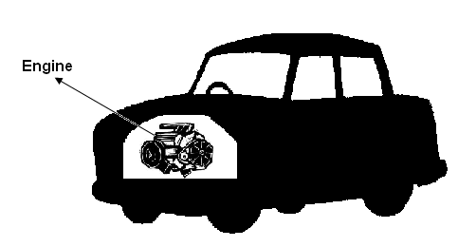
  Kinds of Relationships (Contd.)
Composition relationship:
  Object includes another object as its part.
  Contains objects that have a “has-a” relationship.
  The following figure shows the composition relationship between a car and an engine.

Slide 9
  Kinds of Relationships (Contd.)
Generalization relationship:
  Classes inherit commonly used state and behavior from other classes
  Each class allowed to inherit from one or multiple classes
  Structure and behavior that is common to different classes are combined to form a super class
  Subclass is a specialized form of the super class
  Super class is a generalized (common) class
  Generalization helps to create programs that can be customized in accordance with new requirements

Slide 10
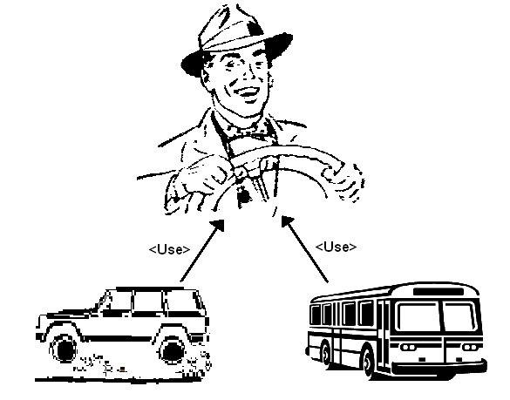
  Kinds of Relationships (Contd.)
Utilization relationship:
  Class uses another class.
  The following figure shows the utilization relationship between a car and a driver; and a bus and a driver.

Slide 11
  Kinds of Relationships (Contd.)
Instantiation relationship:
  Relationship between a class and an instance of that class

Slide 12

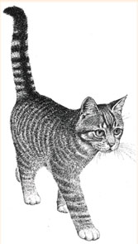




  Kinds of Relationships (Contd.)
  The generalization hierarchy of the Mammal class is shown in the following figure.
The Dog, Cat, and Human classes have similar characteristics and they have inherited these attributes from the Mammal class.
Mammal
Lion, Tiger, and Leopard classes have similar characteristics and they have inherited these attributes from the Cat class.

Slide 13

Quiz

Slide 14
Quiz (Contd.)
OOP allows a class to make use of another class. This kind of relationship is called _________.
Solution:
  utilization relationship

Slide 15
Quiz (Contd.)
The _________ exists between a class and an instance of that class.
Solution:
  instantiation relationship

Slide 16
Exercise 1
Royale Inn is a chain of hotels and resorts. It started in the year 1995, with its head office in California. In the last four years, California has seen a rapid increase in tourist footfall, making it one of the major holiday destinations. Due to its proximity to the airport and its world-class services, Royal Inn has also experienced a significant rise in tourist footfall. The hotel provides two types of suites, deluxe and super deluxe. The deluxe suite provides the basic facilities, such as housekeeping, air conditioning, refrigerator, and geyser. However, the super deluxe suite also provides laundry facility. Due to its world-class services, the hotel has succeeded in capturing most of the tourists visiting California. The hotel has also expanded its facilities as per the demands of the customers.

Slide 17

Exercise 1 (Contd.)
However, the management has found that managing the increased number of tourists visiting the hotel in a manual file system is difficult and is causing inconvenience to the visitors. In addition, the employees are facing problems to keep track of the services provided at the hotel. Therefore, the management has decided to use a hotel management application to automate the booking service and keep track of the facilities provided at the hotel. Analyze the preceding scenario and perform the following tasks:
  Identify the various entities that need to be considered to create the application.
  Identify the classes and subclasses that need to be created to represent the various entities.
  Identify the attributes of the entities that can be created
  as properties of the respective classes and subclasses.

Slide 18
Exercise 3
SunOvens Inc. is a leading microwave manufacturing company in Carmel. The company manufactures microwaves that:
  Provide the grill and convection facility.
  Consist of metallic body with a rotating glass plate.
  Provide the facility to automatically cook and warm meals.
Answer the following questions using the preceding scenario:
  Identify the entities that can be created as Java classes and the various attributes of the entities that can be created as properties of the respective classes.
  The manufacturer does not want a user to tamper with the electrical wiring in the microwave, and hence the wiring must be hidden from the user. Identify the feature of
  object-oriented programming that best describes the given scenario.

Slide 19
Exercise 3 (Contd.)
  A person operating a microwave need not know the details of how the oven works. The person just needs to know how to switch on and off an oven, and change the temperature settings. Identify the feature of object-oriented programming that best describes the given scenario.
  All microwaves have certain common attributes and functionality. For example, every oven has a door. Different companies add various additional features to the basic functionality of an oven. Identify a subclass of the Oven class and its visibility.

Slide 20
Exercise 6
The Princeton University, Canada provides post-graduate programs in Science, Law, Management, and Technology to students around the world. In addition, the university provides separate hostel facility to boy and girl students, with each hostel having its own cafeteria and library.
The university manages information about students, courses, and hostels in a manual file system. However, with increased number of students, courses, and facilities, there has been a rise in data inconsistency. Therefore, the university management has approached David, a software developer, to develop an application that can be used to automate the data management operations of the university.

Slide 21
Exercise 6 (Contd.)
Analyze the preceding scenario and perform the following tasks:
  Identify the various entities that need to be considered to create the application required for the university.
  Identify the classes and subclasses that need to be created to represent the various entities.
  Identify the attributes of the entities that can be created as properties of the respective classes and subclasses.

Slide 22
Information Hiding
What is information
hiding?

Slide 23
Information Hiding (Contd.)
Information hiding:
  Technique of limiting the access to:
    Variables
    Methods
    Classes
To implement information hiding in a program, you can use access specifiers.

Slide 24
Exploring the Concept of Encapsulation
What is encapsulation?

Slide 25
Exploring the Concept of Encapsulation (Contd.)
Encapsulation:
  Process of enclosing data and methods within a logical package:
    Package is called class
    Package includes attributes and methods
  Leads to information hiding

Slide 26
  Exploring the Concept of Abstraction
What is abstraction?

Slide 27
  Exploring the Concept of Abstraction (Contd.)
Abstraction:
  Process of using the relevant information
  Different layers are used for designing classes
  Enables to create the super class
  Super class defines the essential details
  Subclasses are specialized by adding more details

Slide 28
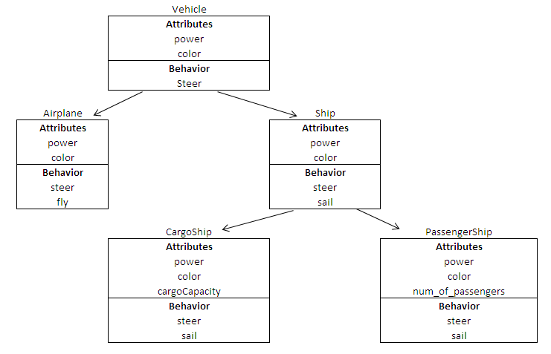
  Exploring the Concept of Abstraction (Contd.)
The following figure shows an example of different layers of abstraction.

Slide 29
  Exploring the Concept of Inheritance
How can I use inheritance in classes?

Slide 30
  Exploring the Concept of Inheritance (Contd.)
Let us understand how you can use inheritance in classes.

Slide 31
  Exploring the Concept of Inheritance (Contd.)
Inheritance:
  Subclass objects get the copy of the data members and member functions of the super class
  Subclass:
    Class inherits attributes from another class
  Super class:
    Class from which attributes are derived

Slide 32
  Types of Inheritance
Types of inheritance:
  Single inheritance
  Multiple inheritance
  Multilevel inheritance

Slide 33
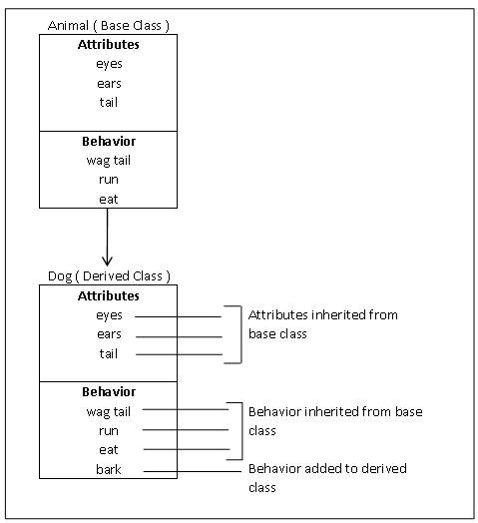
  Types of Inheritance (Contd.)
Single inheritance:
  One child class has one parent class.
  The following figure depicts an example of single inheritance.

Slide 34
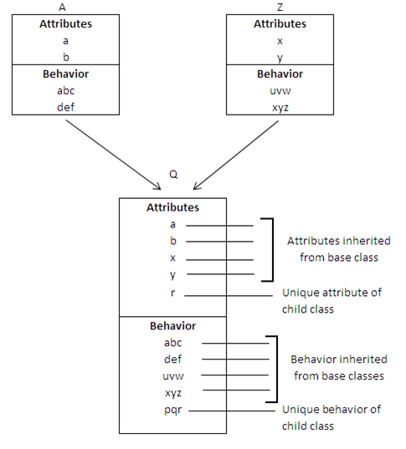
  Types of Inheritance (Contd.)
Multiple inheritance:
  One child class has more than one parent class.
  The following figure depicts an example of multiple inheritance.

Slide 35
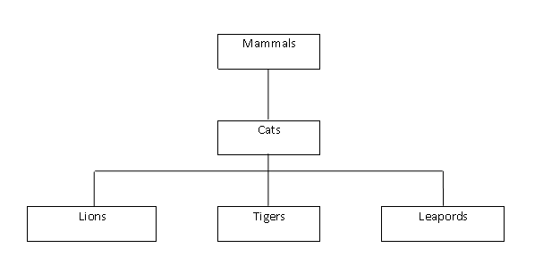
  Types of Inheritance (Contd.)
Multilevel inheritance:
  Subclass is derived from a derived class.
  The following figure depicts an example of multilevel inheritance.

Slide 36
Exploring the Concept of Polymorphism
Greek Words and Their Meanings
Poly = Many
Morphos= Forms
Polymorphism = Many Forms

Slide 37
Exploring the Concept of Polymorphism (Contd.)
Polymorphism:
  Ability to allow a function to exist in different forms
Let us understand polymorphism with the help of examples.

Slide 38



Exploring the Concept of Polymorphism (Contd.)
Different moods of a person depending upon the situation he is in depict polymorphism

Slide 39

Exploring the Concept of Polymorphism (Contd.)
Role of a lady being a mother and an instructor at the same time depicts polymorphism

Slide 40
Summary
In this session, you learned that:
  In Object-oriented programming, classes and objects are related to each other.
  Relationships that exist between the objects of different classes are:
    Composition
    Generalization
    Utilization
    Instantiation
  Types of inheritance are:
    Single inheritance
    Multiple inheritance
    Multilevel inheritance

