Slide 1

Structured Query Language (SQL)
Basic SQL Concepts

Slide 2
Agenda
In this session, you will learn about:
Introduction to SQL
Data Definition Language Statements
Data Manipulation Language Statements
Data Query Language Statements
Aggregate Functions

Slide 3

Introduction to Structured Query Language

Slide 4





History of RDBMS
Relational database concept was first published by E.F Codd
System R with SEQUEL (later called SQL) was launched as the first prototype of a Relational Database
1968
1969
The simplest form of database “Flat Files” were used
Processing characteristics were determined by using magnetic tape medium
Era of relational databases begins.
IBM launches its first commercial relational-database management system named SQL/DS
1974
1979
1981
Systematic tests were performed in real test scenarios by IBM for a Relational Database

Slide 5
Evolution of Database in Phases
Phase I
Phase II
Phase III
Phase IV
Included the file systems and development of DBMS known as hierarchical, network and object-oriented database management systems. This phase was between 1960 to 1999.
Described as relational, saw the introduction of SQL & SQL products.
Online analytical processing (OLAP) was introduced.
Introduced NoSQL supporting the use of Big Data.

Slide 6


Commercial SQL Products
Widely used amongst Windows users
Runs Microsoft Windows OS
Over 20% market share
Widely used in Enterprise Wide Database
Fully complaint with SQL Language
Over 45% market share

Slide 7

SQL was previously known as SEQUEL that stands for Structured English Query Language. Later it was changed as SQL because SEQUEL was a trademark of the UK based aircraft company.

Slide 8


Open-Source SQL Products
Open Source RDBMS
Maintained by Postgre Development Group (Volunteers)
Runs on Windows, Linux & Mac
Open Source RDBMS
Full featured DBMS maintained by Swedish Company MySQL
Runs on Windows, Linux & Mac

Slide 9
Data Models
#1
Data Model is a logical structure that helps to organize elements of data and systematically define how they are related to each other according to the business process.
#2
It conceptually describes the design of a database in a detailed manner.

Slide 10
Data Models
Data Models
Record-Based
Object-Based
Relational Data Model
Object-Oriented Models
Hierarchical Data Models
Entity-Relationship Models
Network Data Models

Slide 11
Record-Based Data Models
#1
In Record-based models, the database is organized in fixed format records of several types.
#2
A fixed number of fields or attributes are defined in each record type, and each field is usually of a fixed length.
Three most popular record-based data models
Relational Data Model
Hierarchical Data Models
Network Data Models

Slide 12
Record-Based Data Models
Relational Data Model
The relational data model uses tables to represent data and the relationships among these data.
Each table has multiple columns and each column is identified by a unique name. It is a low-level model.
The relational data model makes it easy to design, implement, maintain, uses the database.
The main reason for the popularity of relational model is the presence of powerful query capability.

Slide 13
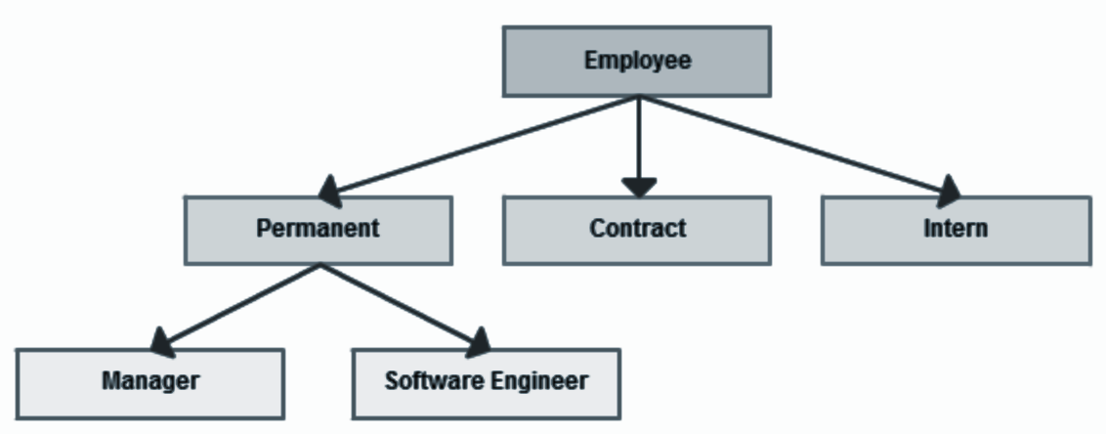
Record-Based Data Models
Hierarchical Data Model
In this model, the data is organized into a tree-like structure.
It uses parent-child like relationship.
Data is stored as records and records are connected to one another through links.

Slide 14
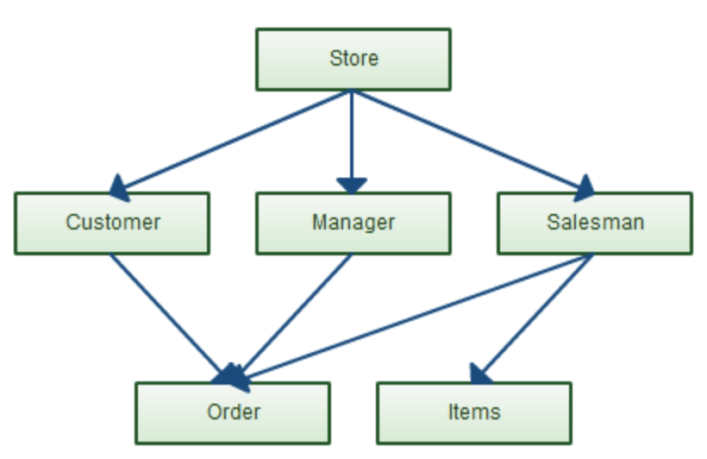
Record-Based Data Models
Network Data Model
Network database model uses many-to-many relationship approach.
This modeling technique provides an efficient way to retrieve information and organize the data such that it can be looked at multiple ways.

Slide 15
Object-Based Data Models
#1
In object-based data model, the database is organized in real-world objects of several types.
#2
Each entity has some defining attributes.
#3
These entities are connected through relationships.

Slide 16
Object-Based Data Models
Examples of object-based data models are:
Entity Relationship Data Model
Object Oriented Data Model
Semantic Data Model
Functional Data Model
Among the above, Entity Relationship Data Model is the most popular.

Slide 17
Object-Based Data Models
Object-Oriented Data Model
The object-oriented model is based on collection of objects.
An object contains values stored in instances variable within the object .
Object-oriented database systems are not suited for all applications.
It is difficult to maintain when organizational information changes.

Slide 18
Object-Based Data Models
Entity-Relationship Data Model
ER Data Model is based on the notion of real-world entities and relationships between them.
An entity is an easily recognizable living or non-living real-world object.
Example: Student, Customer, Product
A relationship is an association between two entities.
Example: A customer buys a product
It is considered a best practice to design an ER diagram before implementing your database.

Slide 19
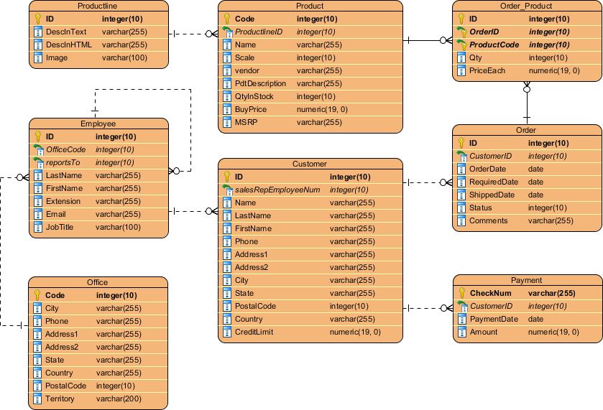
Entity Relationship(ER) Diagram
An ER diagram displays the relationships between entities stored in a database.
In technical language, we can say an ER diagrams shows the logical structure of a database.

Slide 20
Why use ER diagram?
ER diagram helps you to:
define the entities & their relationships
define the attributes of each entity
provide a complete preview of the logical structure of your database
gain a better understanding of the information contained in a database

Slide 21
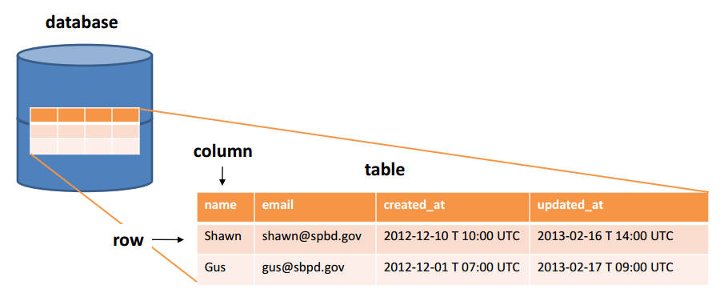
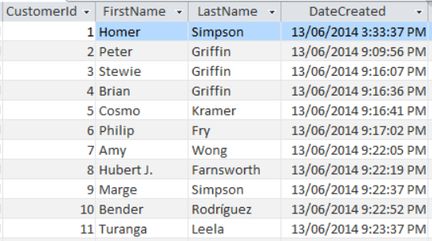
Table in Database
There can be one or more tables in a database
It is where all the data is stored
It consists of rows & columns
Columns represents attributes of the entity

Slide 22
Table Records
Each row in a table is a record
Each record represents information of each object, say a person or a product

Slide 23
Table Columns
Each column in a table is an attribute
This gives one piece of information about the entity. For example, last name of a customer

Slide 24
Schemas
A database schema is a skeleton structure that represents the logical view of the database.
It defines its entities and the relationships between them.
A database schema is categorized into:
Physical Schema
Pertains to the actual storage of the data
Logical Schema
Pertains to the logical constraints that need to be applied to the data stored
It may define integrity constraints, views & tables

Slide 25
Logical vs Physical Schemas
Physical Schema
Logical Schema
Physical schema represents the actual connection to the data source or data target.
Logical schema represents the logical name associated to that source or target.
A physical model is what is actually implemented in your DBMS.
It is a model that exists on a white board or in a diagraming tool.

Slide 26
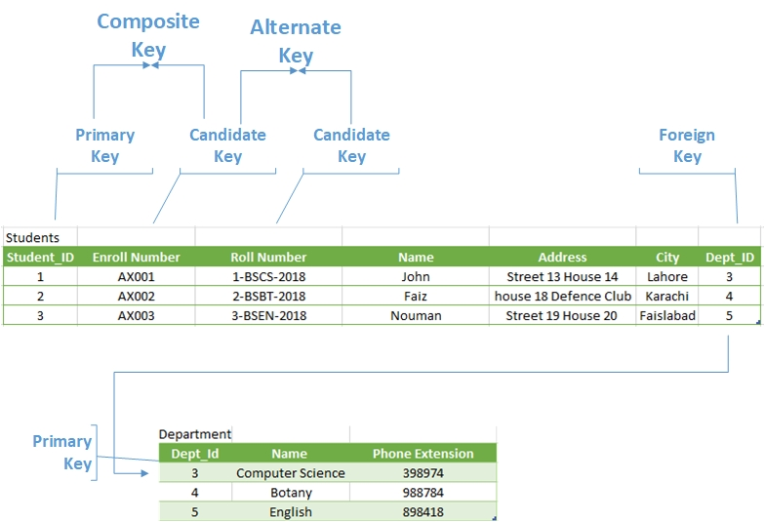
Keys
A key is a data item (a column or a set of columns) to uniquely identify a record in a table.
It is used to fetch a single or set of records from a table.
A database supports various types of keys. Some of them are:
Candidate key
Primary key
Foreign key
Unique key
Alternate key

Slide 27
Keys
An attribute (column) or a set of attributes that uniquely identifies a record.
Candidate key
Example: Customer ID + Store ID + Location ID in a customer transaction table
Identifies each record in a table and must never be the same for two records in a table.
Primary key
Example: Customer ID identifying a customer uniquely in a customer table

Slide 28
Keys
An alternate key is a candidate key that is not considered as a primary key.
Alternate key
Example: Store Name + Store Location in a store information table
An attribute or a set of attributes to uniquely identify a record in a table. This is similar to a primary key but can contain a null value.
Unique key
Example: Store Name in a store information table

Slide 29
SQL Introduction
SQL is used to communicate with a database. According to ANSI (American National Standards Institute), it is the standard language for relational database management systems.
Data Definition Language (DDL)
Data Manipulation Language(DML)
Data Query Language (DQL)
Data Control Language (DCL)
Transactional Control Language (TCL)
The commands available in SQL can be broadly categorized as:

Slide 30
Types of SQL Commands
Types of SQL Commands
Data Definition Language
Data Manipulation Language
Data Query Language
CREATE
INSERT
SELECT
DROP
UPDATE
TRUNCATE
DELETE
ALTER
RENAME

Slide 31
Data Definition Language (DDL)

Slide 32

Data Definition Language (DDL)
A database is a collection of many tables and a database server can hold many of these databases.
What is a Database?
Server
DB
DB
Database Server —> Databases —> Tables (defined by columns) —> Rows
Databases and tables are referred to as database objects. Any operation, such as creating, modifying, or deleting database objects, is called Data Definition Language (DDL).

Slide 33
Data Definition Language (DDL)
DDL commands are used to create a new schema as well as to modify an existing schema.
The typical commands available in DDL are:
CREATE
ALTER
DROP
TRUNCATE
RENAME

Slide 34
Creating Database
The CREATE DATABASE statement is used to create a new SQL database.
Syntax
CREATE DATABASE databasename;
The semicolon character (;) is a SQL statement terminator

Slide 35
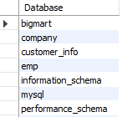
Creating Database
We will create a database called customer_info.
Syntax
CREATE DATABASE customer_info;
Use SHOW DATABASES to check if the database customer_info has been CREATED.
The database customer_info is now created
Default system databases

Slide 36
Creating Database
Once you create the database use the following command to leverage that database:
Syntax
USE DATABASE_NAME
For example, we have created the database ‘customer_info’. To utilize the database we run the following query:
Syntax
USE customer_info

Slide 37

Creating Tables
We will now create tables
While creating a table, you should mention:
Column Name
Datatype (integer, floating point, string, etc. ),
Constraints (), and
default value (if any)
We can create one or more tables inside a database

Slide 38
Data Types
What are the different data types used in SQL?
01
Numeric: TINYINT, SMALLINT, MEDIUMINT, INT, BIGINT, and BIT
02
Floating numbers: DECIMAL, FLOAT, and DOUBLE
03
Strings: CHAR, VARCHAR, BINARY, VARBINARY, BLOB, TEXT, ENUM, and SET
04
Date and Time: DATE, TIME, DATETIME, TIMESTAMP, and YEAR

Slide 39
Numeric Data Types
Datatype | Minimum size limit | Maximum size limit
Bit | 0 | 1
Tinyint | 0 | 255
Smallint | -32.768 | 32.767
mediumint | -8388608 | 8388607
int | -2,147,483,648 | 2,147,483,647
bigint | -9,223,372,036,854,775,808 | 9,223,372,036,854,775,807

Slide 40
Floating Numbers Data Types
Datatype | From | To
Decimal | -10^38 +1 | 10^38 -1
Float | -1.79E + 308 | 1.79E + 308

Slide 41
String Data Types
Data Type
Description
CHAR
Fixed length with maximum length of 8,000 characters
VARCHAR
Fixed length with maximum length of 8,000 characters
BINARY
Fixed length with maximum length of 8,000 bytes
VARBINARY
Variable length storage with maximum length of 8,000 bytes
BLOB
For binary large objects
TEXT
Variable length storage with maximum size of 1GB data

Slide 42
Every relational database has its own maximum and minimum size limit for different data types, you don’t need to remember the limit. Idea is to have the knowledge of what data type to be used in a specific scenario

Slide 43
Date and Time Data Types
Data Type
Description
DATE
Stores date in the format YYYY-MM-DD
TIME
Stores time in the format HH:MI:SS
DATETIME
Stores date and time information in the format YYYY-MM-DD HH:MI:SS
TIMESTAMP
Stores number of seconds passed since the Unix epoch (‘1970-01-01 00:00:00’ UTC)
YEAR
Stores year in 2 digit or 4 digit format. Range 1901 to 2155 in 4-digit format. Range 70 to 69, representing 1970 to 2069

Slide 44
MySQL supports various data types. Refer to the MySQL documentation for more details (https://dev.mysql.com/doc/refman/8.0/en/data-types.html)

Slide 45
SQL Constraints
#1
SQL constraint is a restriction placed on one or more columns of a table to limit the type of values that can be stored in that column.
#2
Constraints are to be specified when the table is created with the CREATE TABLE statement or after the table is created with the ALTER TABLE statement.

Slide 46
SQL Constraints
The following constraints are commonly used in SQL:
NOT NULL
UNIQUE
PRIMARY KEY
FOREIGN KEY
CHECK
DEFAULT
INDEX

Slide 47
SQL Constraints
Let us now look at the syntax for creating a table and understand its constraints.
Syntax
CREATE TABLE table_name (
column_name1 datatype1 constraint1,
column_name2 datatype2 constraint2,
column_name3 datatype3 constraint3,
....
);

Slide 48
SQL Constraints
We will create a customer table, which will hold the following customer information:
Cust_ID
Name
Country
City

Slide 49
SQL Constraints
The Cust_ID column is of type int and will hold an integer.
The Name, Country, and City columns are of type varchar and will hold characters, and the length for these fields is 20 characters.
To check the definition of the table we use: describe information.

Slide 50
NOT Null Constraints
By default, a column can hold NULL values.
The NOT NULL constraint enforces a column to NOT accept NULL values.
This enforces a field to always contain a value, which means that you cannot insert a new record, or update a record without adding a value to this field.

Slide 51
NOT Null Constraints
The following SQL statement ensures that the "Cust_Id", "Name", and "Country" columns will NOT accept NULL values when the "customer_info" table is created.
Syntax
CREATE TABLE information(Cust_Id int Not Null,
Name varchar(20) Not Null,
Country varchar(20) Not Null,
City varchar(20));

Slide 52
UNIQUE Constraint
The UNIQUE constraint ensures that all values in a column are different.
Both the UNIQUE and PRIMARY KEY constraints provide a guarantee for uniqueness for a column or set of columns.
A PRIMARY KEY constraint automatically has a UNIQUE constraint.
However, you can have many UNIQUE constraints per table, but only one PRIMARY KEY constraint per table.

Slide 53
UNIQUE Constraint
The following SQL statement creates a UNIQUE constraint on the "Cust_id" column when the "customer_info" table is created.
Syntax
CREATE TABLE information (Cust_id int Not Null UNIQUE,
Name varchar(20) Not Null,
Country varchar(20) Not Null,
City varchar(20));

Slide 54
PRIMARY KEY Constraints
The PRIMARY KEY constraint uniquely identifies each record in a table.
Primary keys must contain UNIQUE values, and cannot contain NULL values.
A table can have only ONE primary key; and in the table, this primary key can consist of single or multiple columns (fields).

Slide 55
PRIMARY KEY Constraints
The following SQL statement creates a UNIQUE constraint on the "Cust_id" column when the "customer_info" table is created.
Syntax
CREATE TABLE personal_info (Cust_id int Not Null,
Name varchar(20) Not Null,
Country varchar(20) Not Null,
City varchar(20),
PRIMARY KEY (Cust_id));

Slide 56
FOREIGN KEY Constraints
A FOREIGN KEY is a key used to link two tables together.
A FOREIGN KEY is a field (or collection of fields) in one table that refers to the PRIMARY KEY in another table.
The table containing the foreign key is called the child table, and the table containing the candidate key is called the referenced or parent table.

Slide 57
Foreign Key Constraint
Cust_id | Name | Country | City
101 | Allex | USA | New York
102 | Mia | Australia | Sydney
103 | Joy | India | Delhi
personal_info table
Order_id | Order_num | Cust_id
201 | 76675 | 103
202 | 54498 | 103
203 | 45467 | 102
204 | 82986 | 101
order_info table

Slide 58
Foreign Key Constraint
Notice that the "Cust_id" column in the "Order_info" table points to the "Cust_id" column in the "personal_info" table.
The "Cust_id" column in the "Customer_info" table is the PRIMARY KEY in the "personal_info" table.
The "Cust_id" column in the "Order_info" table is a FOREIGN KEY in the "Orders" table.
The FOREIGN KEY constraint is used to prevent actions that would destroy links between tables.
The FOREIGN KEY constraint also prevents invalid data from being inserted into the foreign key column, because it has to be one of the values contained in the table it points to.

Slide 59
Foreign Key Constraint
The following SQL creates a FOREIGN KEY on the "Cust_id" column when the "Order_id" table is created.
Syntax
CREATE TABLE order_info (Order_id int NOT NULL,
Order_num int NOT NULL,
Cust_id int,
PRIMARY KEY (Order_id),
FOREIGN KEY (Cust_id)
REFERENCES personal_info(Cust_id) );

Slide 60
Dropping Database
The DROP DATABASE statement is used to drop an existing SQL database.
Syntax
DROP DATABASE databasename;

Slide 61
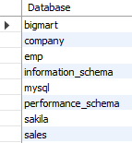
Dropping Database
The following SQL statement drops the existing database "customer_info":
Syntax
DROP DATABASE customer_info;
Use SHOW DATABASES to check if the database customer_info has been DROPPED.
We see the database customer_info does not exist

Slide 62
Dropping Table
The DROP TABLE statement is used to drop an existing table in a database
Syntax
DROP TABLE table_name;
The following SQL statement drops the existing table "information":
Syntax
DROP TABLE information;

Slide 63

Be careful before dropping a table. Deleting a table will result in loss of complete information stored in the table!

Slide 64
Deleting Data from table
The TRUNCATE TABLE statement is used to delete the data inside a table, but not the table itself.
Syntax
TRUNCATE TABLE table_name;

Slide 65
Altering Table
Sometimes we need to incorporate changes to an already existing table. For example, renaming a field, changing the data-type, etc.
The alter command is used to make modification in an existing database/table that demands a change during its lifecycle.
Alter command is generally used with clauses such as:
Change
Modify
Add
Drop

Slide 66
Alter Command - Change Clause
To make changes in the column’s definition we use the Change clause.
The change clause allows you to:
Change the name of the column
Change the column data type
Change column constraints
Syntax
ALTER TABLE table_name CHANGE old_column_name new_column_name data type;

Slide 67
Alter Command - Change Clause
Changing Column Definition
#1
We specify that we want a change in the structure of the table using the ALTER TABLE command, followed by a command that tells the MySql server that we want to change the column name.
#2
The CHANGE clause is followed by an existing column name that needs to be changed then we mention the new definition (new name, new data type, new constraint (optional)).

Slide 68

Alter Command - Change Clause
Example: Consider a table personal_info with below fields
Here, we need to rename ‘Name’ as ‘Full_Name’ with an increase in the number of characters

Slide 69


Alter Command - Change Clause
Use below alter query to change the name of the field ‘Name’ to ‘Full_Name’
Syntax
ALTER TABLE personal_info CHANGE Name Full_Name varchar(20);
Use describe personal_info to check if the column name has changed to the desired column name

Slide 70


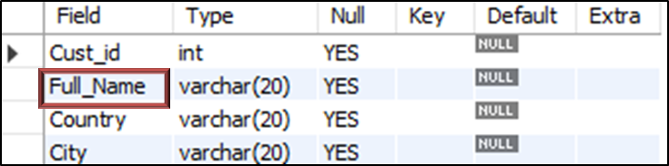
Alter Command - Change Clause
How does the process work in the background?
Here: ALTER TABLE personal_info will tell MySql server to make modifications to the table personal_info.
personal_info
MySQL Server
Request
Output
CHANGE Name Full Name varchar(30) is the command that tells the MySql server to change the existing column name Name to Full_Name with an increase in the number of characters that can be allocated

Slide 71
Alter Command - Modify Clause
The Modify clause allows you to:
Modify Column Data Type
Modify Column Constraints
Syntax
ALTER TABLE table_name MODIFY current_column_name data type constraint;

Slide 72
Alter Command - Modify Clause
Modifying Column Definition
#1
We specify that we want a change in the structure of the table using the ALTER TABLE command, followed by a command that tells the MySql server that we want to change the column name.
#2
Suppose we are only interested in changing the data type and constraints on the field without affecting the field name, we can use the MODIFY keyword to accomplish that.

Slide 73
Alter Command - Modify Clause
Example: Consider a table personal_info with below fields.
Here, we need to increase the width of ‘Full_Name’ field from 20 to 35.

Slide 74

Alter Command - Modify Clause
Use below alter query to change the width of ‘Full_Name’ to varchar(35) with a NOT NULL constraint.
Syntax
ALTER TABLE personal_info MODIFY Full_Name varchar(35) NOT NULL;
Use describe personal_info to check if the column name has changed to the desired column name.

Slide 75
Difference between Change and Modify Clause
Change Clause
Modify Clause
If you have already created your MySQL database, and later get to know that one of your columns is named incorrectly, you don't need to remove it and make a replacement, you can simply rename it using CHANGE
This command does everything CHANGE can, but without renaming the column.
You can use the MODIFY command if you need to resize a column in MySQL
By doing this you can allow more or less characters than before.
You can't rename a column using modify

Slide 76
Modify clause CANNOT be used to rename a column

Slide 77
Alter Command - Add Clause
The Add clause allows you to:
Add a new column to an existing table
Add primary key constraint to an existing column

Slide 78
Alter Command - Add Clause
Adding a new column to a table
To add a new column to an existing table, we use the ADD COLUMN clause with the ALTER command in the following way:
Syntax
ALTER TABLE table_name ADD COLUMN column_name;

Slide 79
Alter Command - Add Clause
Example: Consider the previously created table personal_info:
Here, we add a new column ‘Income’ to this table

Slide 80
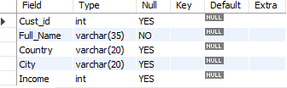
Alter Command - Add Clause
Use below alter query with the add clause.
Syntax
ALTER TABLE personal_info ADD COLUMN Income int;
Use describe personal_info to check if a new column has been added to the table.

Slide 81
By default, the ADD clause adds a column at the end of the table. Use the AFTER keyword to add a column at a particular position in a table

Slide 82
Alter Command – Add-after Clause
Let’s say you want to add a ‘Gender’ column after ‘Full_Name’ column in the table personal_info, we use the following query to achieve this:
Syntax
ALTER TABLE personal_info ADD Gender varchar(5) AFTER Full_Name;

Slide 83
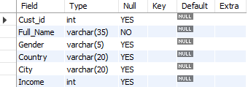
Alter Command – Add-after Clause
Use describe personal_info to check if a new column has been added at the desired position.

Slide 84
Alter Command – Add Clause
Assigning Primary Key Constraint to an Existing Field
To create a PRIMARY KEY constraint on, say, ‘emp_id’ column when the table is already created, we use the ADD clause with the ALTER command.
Syntax
ALTER TABLE table_name ADD PRIMARY KEY(column_name);

Slide 85
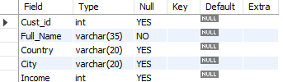
Alter Command - Add Clause
Example: Consider the previously created table personal_info:
Here, we need to declare “Cust_id” as primary key.

Slide 86
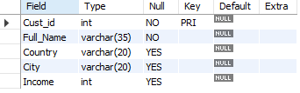
Alter Command - Add Clause
Use below alter query to add primary key to an existing field ‘Cust_id’:
Syntax
ALTER TABLE personal_info ADD PRIMARY KEY(Cust_id);
Use describe personal_info to check if the primary key has been assigned to the field.

Slide 87
Alter Command - Drop Clause
The Drop clause with the alter command allows you to:
Delete a column from the table
Remove a constraint from a column

Slide 88
Alter Command - Drop Clause
Dropping the Primary Key Constraint from a Field
To drop a PRIMARY KEY constraint from an already created table, use below syntax:
Syntax
ALTER TABLE table_name DROP PRIMARY KEY;

Slide 89
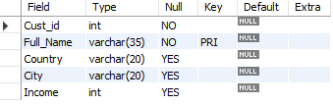
Alter Command - Drop Clause
Example: Consider a table personal_info with below fields:
Syntax
ALTER TABLE personal_info ADD PRIMARY KEY(Full_Name);
It would be not be a good practise to declare ‘Full_Name’ as Primary Key.

Slide 90
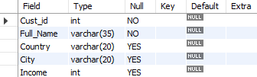
Alter Command - Drop Clause
Use below alter query to drop primary key from an already defined primary key field ‘First_name’:
Syntax
ALTER TABLE personal_info DROP PRIMARY KEY;
Use describe personal_info to check if the primary key has been dropped from the field.

Slide 91
There is only one Primary Key in a table. Hence, we don’t need to specify the name of the column while dropping the Primary Key using the ALTER command

Slide 92
Alter Command - Drop Clause
Dropping a column from the table
#1
Suppose you no longer need a column from a table for your analysis.
#2
In this scenario we use the ALTER command with the DROP clause to remove a column from the table.
Syntax
ALTER TABLE table_name DROP COLUMN column_name;

Slide 93
Alter Command - Drop Clause
Example: Consider a table personal_info with below fields:
Here, we don’t need the column ‘Income’ from the table.

Slide 94

Alter Command - Drop Clause
Use below alter query to drop the ‘Income’ column from the table personal_info:
Syntax
ALTER TABLE personal_info DROP COLUMN Income;
ALTER TABLE personal_info DROP COLUMN Income;
Use describe personal_info to check if the column has been drop from the table.

Slide 95
Rename Command
#1
The rename command is used to change the name of an existing database table to a new name.
#2
Renaming a table does not make it to lose any data is contained within it.
Syntax
RENAME TABLE current_table_name TO new_table_name

Slide 96

Rename Command
Example: Let us rename the current personal_info table to information
You can use show tables command to retrieve the name of all the tables present in a database. ‘customer_info’ is the name of the database

Slide 97

Rename Command
We use the below command to change the name of the table
Syntax
RENAME TABLE personal_info TO information;
The name of the table personal_info is now changed to information:

Slide 98
Data Manipulation Language (DML)

Slide 99

Data Manipulation Language (DML)
As a data analyst, the majority of your work will focus on insight generation, and you will be working with DML commands.
The typical commands available in DML are:
INSERT
UPDATE
DELETE

Slide 100
Inserting Records in Table
The INSERT INTO statement is used to insert new records
in a table.
It is possible to write the INSERT INTO statement in two ways.
The first way specifies both the column names and the values to be inserted.
Syntax
INSERT INTO table_name (column1, column2, column3, ...)
VALUES (value1, value2, value3, ...);

Slide 101
Inserting Records in Table
If you are adding values for all the columns of the table, you do not need to specify the column names in the SQL query.
Make sure the order of the values is in the same order as the columns in the table.
Syntax
INSERT INTO table_name
VALUES (value1, value2, value3, ...);

Slide 102
Inserting Records in Table
We have created an empty customers table, now we will insert values into it, using the INSERT statement
The INSERT statement is used to create new records in a table.
Syntax
INSERT INTO personal_info (Cust_id, Name, Country, City)
VALUES (101, 'Allex', 'USA', 'New York’),
(102, 'Mia', 'Australia', 'Sydney’),
(103, 'Joy', 'India', 'Delhi');

Slide 103
Inserting Records in Table
The "personal_info" table will now look like this:
Cust_id | Name | Country | City
101 | Allex | USA | New York
102 | Mia | Australia | Sydney
103 | Joy | India | Delhi

Slide 104
Updating Existing Records
The UPDATE statement is used to modify the existing records in a table.
Syntax
UPDATE table_name SET column1 = value1, column2 = value2,...
WHERE condition;

Slide 105
Be careful when updating records in a table! Notice the WHERE clause in the UPDATE statement. The WHERE clause specifies which record(s) that should be updated. If you omit the WHERE clause, all records in the table will be updated!

Slide 106
Updating Existing Records
We are updating name as John where country is USA.
Syntax
UPDATE personal_info SET Name = 'John’ WHERE 'country' = 'USA';

Slide 107
Updating Existing Records
The "personal_info" table will now look like this:
Cust_id | Name | Country | City
101 | John | USA | New York
102 | Mia | Australia | Sydney
103 | Joy | India | Delhi
Updated Record

Slide 108
Deleting Records
The DELETE statement is used to delete existing records in a table.
Syntax
DELETE FROM table_name WHERE condition;

Slide 109
Be careful when deleting records in a table! Notice the WHERE clause in the DELETE statement. The WHERE clause specifies which record(s) should be deleted. If you omit the WHERE clause, all records in the table will be deleted!

Slide 110
Updating Existing Records
We are deleting the first row where name is Joy.
Syntax
DELETE FROM personal_info WHERE Name='Joy';
The "personal_info" table will now look like this:
Cust_id | Name | Country | City
101 | Allex | USA | New York
102 | Mia | Australia | Sydney

Slide 111
Data Query Language (DQL)

Slide 112
The Select Query
#1
The SELECT statement is used to retrieve data from a table.
#2
The data returned is stored in a result table, called the result-set.
Syntax
SELECT column1, column2, ...FROM table_name;
Here, column1, column2, ... are the field names of the table you want to select data from. If you want to select all the fields available in the table, use the following syntax:
Syntax
SELECT * FROM table_name;

Slide 113
The Select Query
Consider the below "personal_info" table in the “customer_info” database:
Cust_id | Name | Country | City
101 | Allex | USA | New York
102 | Mia | Australia | Sydney
103 | Joy | India | Delhi
104 | Sara | India | Mumbai

Slide 114
The Select Query
The following SQL statement selects the "Name"and “City”columns from the "personal_info" table:
Syntax
SELECT Name, City FROM personal_info;
Name | City
Allex | New York
Mia | Sydney
Joy | Delhi
Sara | Mumbai
Output

Slide 115
The Select Query
The following SQL statement retrieves all the columns from the "personal_info" table:
Syntax
SELECT * FROM personal_info;

Slide 116
Filtering Records
#1
The WHERE clause is used to filter records.
#2
The WHERE clause is used to extract only those records that fulfill a specified condition.
Syntax
SELECT column1, column2, ...FROM table_name WHERE condition;

Slide 117
The WHERE clause is not only used in SELECT statement, it is also used in UPDATE, DELETE statement, etc.!

Slide 118
Filtering Records
The following SQL statement selects all the customers from the City "New York", in the "personal_info" table:
Syntax
SELECT * FROM personal_info WHERE City = 'New York';
Output
Cust_id | Name | Country | City
101 | Allex | USA | New York

Slide 119
Where Clause Predicates
#1
A Where clause predicate is an expression which evaluates to a Boolean value to determine which row or a set of rows are relevant to a particular query.
#2
More precisely we can say by using predicates in the where clause we can filter out records.

Slide 120
Where Clause Predicates
The Where Clause supports the following types of predicates:
Comparison
= Equal
<> Not Equal
< Less Than
<= Less Than Or Equal
Pattern Matching
LIKE ( Used for Wildcard Filtering)
BETWEEN
IN
IS NULL

Slide 121
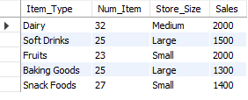
Where Clause Predicates
Consider the table, product_sales, and let us build some query examples using it.

Slide 122

Where Clause Predicates - Comparison Operator
Let’s say you want to retrieve Item_Type, Num_Item and Sales of products where product’s sales is greater than 1500.
Syntax
SELECT Item_Type, Num_Item, Sales FROM product_sales Where Sales > 1500;
Output

Slide 123

Where Clause Predicates - Comparison Operator
We will use the ‘=’ operator to retrieve records of large size store.
Syntax
SELECT * FROM product_sales WHERE Store_Size = 'Large';
Output

Slide 124

Where Clause Predicates - Between Predicate
BETWEEN predicate is used to select rows within a specified range of values.
From the previous table let’s say we want to display the items whose sales are in between 1000 and 1500, we use the following query using BETWEEN predicate.
Syntax
SELECT Sales, Item_Type FROM product_sales WHERE Sales BETWEEN 1000 AND 1500;
Output

Slide 125

Where Clause Predicates - IN Predicate
IN predicate is used to select rows within a set of specified values.
From the previous table let’s say we want to display the Item_types whose Num_Item are 25 and 23, we use the following query using IN predicate.
Syntax
SELECT Num_Item, Item_Type FROM product_sales WHERE Num_Item IN (25, 23);
Output

Slide 126

Where Clause Predicates - IS NULL Predicate
IS NULL predicate with a where clause is used to select rows if a specified column value contains a null value.
For Example:
Syntax
SELECT * FROM product_sales WHERE Item_Type IS NULL;
Output
There are no missing data in the table

Slide 127
Where Clause Predicates - IS NULL Predicate
The BETWEEN condition, IN condition and NOT with between condition allows us to test if an expression is within a range of values
The values in range test can be text, date, or numbers
The BETWEEN condition returns the records where expression is within the range of value1 and value2

Slide 128
Wildcards
Wildcards are characters that are used to filter/search data from the database on the basis of certain patterns
They are often used with the operators like LIKE and NOT LIKE in conjunction with the WHERE clause
We will look at following Wildcards:
% (percent character)
_ (underscore character)

Slide 129
Wildcards
Using wildcard in MySQL can increase the performance of an application
It can reduce the time to filter the record from the database
Complex SQL queries can be converted into simple one using wildcards
Using wildcards we can develop powerful search engines in a large data-driven application
Searching in the data-driven application are much more dependent on the use of wildcards

Slide 130

Wildcards
Wildcard filtering is generally used in cases when you:
Do not know how to spell someone’s last name, but you know what letter it starts with
Do not know the name of a song but you know the lyrics
Do not know the name of a song but you know the lyrics

Slide 131
Wildcards
To carry out the wildcard filtering exercise we use movie_metadata dataset
Load the data in a mysql table:
Download the data using the link:
https://www.dropbox.com/s/0hs5x2n1x6cm16b/movie_metadata.csv?dl=0

Slide 132
Wildcard Filtering - ‘%’ Wildcard
% wildcard is used in searching or filtering a record by matching any string of zero or more character.
Syntax
SELECT statement … WHERE column_name LIKE ‘xxx%’;
Here,
"SELECT statement..." is the standard SQL SELECT command.
"WHERE" is the key word used to apply the filter.
"LIKE" is the comparison operator that is used in conjunction with wildcards.
'xxx' is any specified starting pattern such as a single character or more and "%" matches any number of characters starting from zero (0).

Slide 133
Wildcard Filtering - ‘%’ Wildcard
% can be used either in the first place, in the last or at both side of the string
If used in the first place (“%xxx”), all those rows will be extracted from the database where the column will contain strings ending with ‘xxx’
If used at both the ends (“%xxx%”), all those rows will be extracted from the database where the column will contain the string ‘xxx’ anywhere in the column string
If used at the last (“xxx%”), all those rows will be extracted from the database where the column will contain string starting with ‘xxx’

Slide 134
Wildcard Filtering - ‘%’ Wildcard
Let us understand % wildcard with an example:
Suppose you forgot the names of all the movies in the ‘Lord of the rings’ franchise and you only remember that the movie has “lord of the rings...” in its title
Searching each and every movie in the database will not be a good option to recall the name

Slide 135

Wildcard Filtering - ‘%’ Wildcard
Below is the SQL statement that can help you filter records.
Syntax
SELECT movie_title FROM moviesdata WHERE movie_title LIKE '%Lord of the%';
Output
You can now easily recall the name of the song by looking at the above output.

Slide 136
Wildcard Filtering - ‘%’ Wildcard
The query translates to:
Select the column ‘movie_title’ from the ‘moviesdata’ table
Return the movie_title that has the string 'lord of the' in its title that is followed or preceded by zero or more occurrences of any character

Slide 137
Wildcard Filtering - ‘_’ Wildcard
The underscore(_) wildcard is used to match exactly one character.
Syntax
SELECT statement … WHERE column_name LIKE ‘xxx_’;
Here,
"SELECT statement..." is the standard SQL SELECT command
"WHERE" is the key word used to apply the filter
"LIKE" is the comparison operator that is used in conjunction with wildcards
'xxx' is any specified starting pattern such as a single character or more and _ matches the string with only one characters

Slide 138
Wildcard Filtering - ‘_’ Wildcard
_ can be used either in the first place, in the last or at both side of the string
If used in the first place (“_xxx”), all those rows will be extracted from the database where the instance of column will contain string that starts with any single character and ends with ‘xxx’
If used at both the ends (“_xxx_”), all those rows will be extracted from the database where the column will contain the string ‘xxx’ that starts and ends with any single character
If used at the last (“xxx_”), all those rows will be extracted from the database where the column will contain string starting with ‘xxx’ followed by any single character
You can use n number of underscore character for matching n number of character

Slide 139
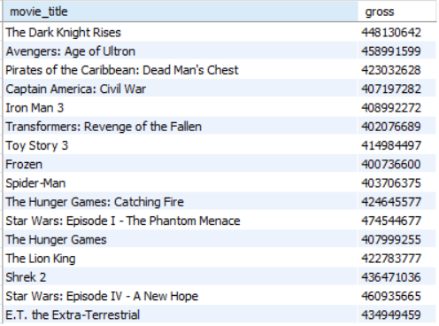
Wildcard Filtering - ‘_’ Wildcard
Example: Let’s say you want to take a look at all the movies that made gross revenue in 400 millions. Use the ‘_’ wildcard 9 times in the select query:
Syntax
SELECT movie_title, gross FROM moviesdata WHERE gross like '4________';
Output

Slide 140
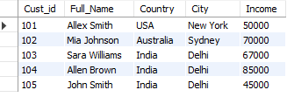
Sorting Records
Consider below table as ‘personal_info’ for further operations:

Slide 141
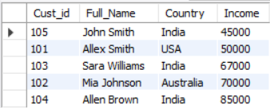
Sorting Records
The order by clause causes the tuples in the result of a query to appear in sorted order
Let us write a query which will show the users according to the ascending order of their Income.
Syntax
SELECT Cust_id, Full_Name, Country, Income FROM personal_info ORDER BY Income
Output
By default, the order by clause lists items in ascending order.

Slide 142
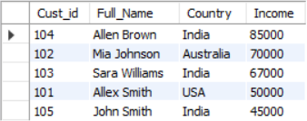
Sorting Records
To specify the sort order we use: desc for descending order or asc for ascending order
Now let us see an example to show the users according to the descending order of their income
Syntax
SELECT Cust_id, Full_Name, Country, Income FROM personal_info ORDER BY Income desc;
Output

Slide 143
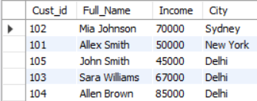
Sorting Records
Furthermore ordering can be performed on multiple attributes.
Suppose we wish to order record in descending order of City and then ascending order of income. Then we express this query in SQL as follows:
Syntax
SELECT Cust_id, Full_Name, Income, City FROM personal_info ORDER BY City desc, Income asc
Output

Slide 144

Write a query to display customers having Income greater than 60000 and whose name starts with either ‘s’ or ‘A’

Slide 145
Aggregate Functions

Slide 146

Aggregate Functions
Aggregate Functions are all about performing calculations on multiple rows of a single column of a table and returning a single value.
COUNT
The ISO standard defines five (5) aggregate functions namely:
COUNT
SUM
AVG
MIN
MAX
DISTINCT

Slide 147
Aggregate Functions
#1
Aggregate functions allows us to easily produce summarized data from our database.
#2
For instance, from a company database, management may require following reports:
Minimum Salary of a particular department
Highest paid employee details
Average salary of HR department
We can easily produce these reports using aggregate functions

Slide 148
Create Table
Create the following table for this exercise:
Syntax
CREATE DATABASE store_sales; USE store_sales;
CREATE TABLE my_sales (month varchar(15), prod_name VARCHAR(15), sales INT );
INSERT INTO my_sales VALUES('Jan', 'Fruits', 45000),
('Jan', 'Vegetables', 67000),
('Jan', 'Dairy', 55000),
('Feb', 'Fruits', 42000),
('Feb', 'Vegetables', 32000),
('Feb', 'Dairy', 52000),
('March', 'Fruits', 61000),
('March', 'Vegetables', 43000),
('March', 'Dairy', 92000);

Slide 149
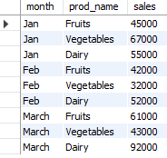
Create Table
The my_sales table created looks as follows:

Slide 150
COUNT() Function
#1
If you want to count total records matching a condition, then call the COUNT function to get the number. However, it returns zero when no matching rows exist in the table.
#2
The COUNT() function is an aggregate function that returns the number of rows in a table. The COUNT() function allows you to count all rows or only rows that match a specified condition.
Syntax
SELECT COUNT([DISTINCT] field_name) FROM target_table[WHERE test_expr];
The COUNT(DISTINCT expression) returns the number of distinct rows that do not contain NULL values as the result of the expression.

Slide 151
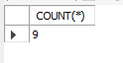
COUNT() Function
If you want to count the total number of observation, you can use the count function as follows:
Syntax
SELECT COUNT(*) FROM my_sales;
Output
The total number of observation is 9

Slide 152
Sum() Function
If you want to total a set of values, then call the SUM function to get the result. However, it returns NULL when no matching rows exist in the table.
Syntax
SELECT SUM(field_name) FROM target_table [WHERE test_expr];
Optional
This is the column or expression that will be summed

Slide 153
Avg() Function
#1
If you want to find the average of a set of values, then call the AVG function to get the result.
Syntax
SELECT AVG(field_name) FROM target_table [WHERE test_expr];
However, it returns zero when no matching rows exist in the table

Slide 154
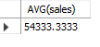
Avg() Function
If you want to find the average sales of the product, you can use the AVG function as follows:
Syntax
SELECT AVG(sales) FROM my_sales;
Output
The average salary of all employees is 50622.3750

Slide 155
Min() Function
#1
If you want to find the minimum from a set of values, then call the MIN function to get the number.
Syntax
SELECT MIN(field_name)FROM target_table [WHERE test_expr];
However, it returns zero when no matching rows exist in the table

Slide 156
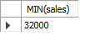
Min() Function
If you want to find the product with the lowest sales, you can use the MIN function as follows:
Syntax
SELECT MIN(sales) FROM my_sales;
Output
The minimum salary of the employee is 32000

Slide 157
Max() Function
#1
If you want to find the maximum from a set of values, then call the MAX function to get the number.
Syntax
SELECT MAX(field_name)FROM target_table[WHERE test_expr];
However, it returns zero when no matching rows exist in the table

Slide 158
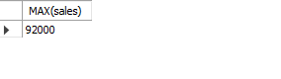
Max() Function
If you want to find the product with the highest sales, you can use the MAX function as follows:
Syntax
SELECT MAX(sales) FROM my_sales;
Output
The maximum sales of the product is 92000

Slide 159
Group By Clause
#1
The GROUP BY statement groups rows that have the same values into summary rows, like the number of patients in each hospital.
Syntax
SELECT statements... GROUP BY column_name1[,column_name2,...] [HAVING condition];

Slide 160
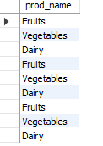
Group By Clause
In order to help understand the effect of Group By clause, let's execute a simple query that returns all the products from the my_sales table.
Syntax
SELECT MAX(sales) FROM my_sales; SELECT prod_name from my_sales;
Output
The maximum sales of the product is 92000

Slide 161

Group By Clause
Suppose if we want unique values from prod_name, you can use groupby function as below:
Syntax
SELECT prod_name FROM my_sales GROUP BY prod_name;
Output
There are 3 unique products, namely Fruits, Vegetables, and Dairy

Slide 162
Summarizing Values
The GROUP BY clause is normally used along with five built-in, or "aggregate" functions
Often we find it useful to group data by some characteristic of the group, such as department or division, or benefit level, so that summary statistics about the group (totals, averages, etc.) can be calculated
For example, to calculate average departmental salaries, the user could group the salaries of all employees by department

Slide 163
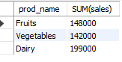
Summarizing Values
If you want to find the total sales of each product, you can use the sum function as follows:
Syntax
SELECT prod_name, SUM(sales) FROM my_sales GROUP BY prod_name;
Output
This gives us the total sales for each product

Slide 164
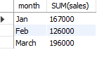
Summarizing Values
If you want to find the month-wise sum of sales you can use the sum function as follows:
Syntax
SELECT month, SUM(sales) FROM my_sales GROUP BY month;
Output
This gives us the sum of the salary of employees month wise

Slide 165
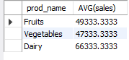
Summarizing Values
If you want to find the average sales of each product, you can use the AVG function as follows:
Syntax
SELECT prod_name, AVG(sales) FROM my_sales GROUP BY prod_name;
Output
Gives the average sales for each product

Slide 166
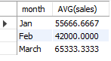
Summarizing Values
If you want to find the month-wise average sales, you can use the AVG function as follows:
Syntax
SELECT month, AVG(sales) FROM my_sales GROUP BY month;
Output
Gives the average sales for each month

Slide 167
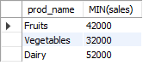
Summarizing Values
If you want to find the minimum sales for each product, you can use the MIN function as follows:
Syntax
SELECT prod_name, MIN(sales) FROM my_sales GROUP BY prod_name;
Output
Gives the minimum sales for each product

Slide 168
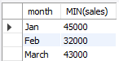
Summarizing Values
If you want to find the month-wise minimum sales, you can use the MIN function as follows:
Syntax
SELECT month, MIN(sales) FROM my_sales GROUP BY month;
Output
Gives the month-wise minimum sales

Slide 169
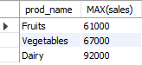
Summarizing Values
If you want to find the highest sales for each product, you can use the MAX function as follows:
Syntax
SELECT prod_name, MAX(sales) FROM my_sales GROUP BY prod_name;
Output
The maximum sales for each product

Slide 170

Group by functions should not be included in the group-by clause
Syntax
Select prod_name, month, sum(sales) From my_sales group by sum(sales);
Output

Slide 171



Thank you
Mumbai | Bangalore | Pune | Chennai | Jaipur
ACCREDITED TRAINING PARTNER:

