Slide 1

Objectives
In this session, you will learn to:
  Query data by using joins
  Query data by using subqueries

Slide 2
Querying Data by Using Joins
To retrieve data from multiple tables in MySQL, you can apply joins using the common attribute.
The types of joins are:
  Inner join
  Outer join
  Natural join
  Cross join
  Self join

Slide 3
Using an Inner Join
An inner join:
  Retrieves records from multiple tables after comparing values present in a common column.
  Retrieves the rows with values satisfying the join condition in the common column only.
  Can be specified by using the JOIN as well as the INNER JOIN keyword.
  Syntax:
    SELECT column_name, column_name [,column_name]
    FROM table1_name JOIN table2_name
    ON table1_name.ref_column_name join_operator table2_name.ref_column_name | USING (ref_column_name)
    [WHERE search_condition]
Specifies the name of column(s) that are to be retrieved.
Is used to specify the condition for applying join on tables.
Specifies the names of the tables to be joined.
Is the comparison operator based on which the join is applied.
Specifies the names of the reference columns on which the join is based.
Is used for the columns that are same in both tables on which the join is applied.
Specifies the condition to be satisfied to return the selected rows.

Slide 4
Using an Inner Join (Contd.)
  For example:
    SELECT c.Customer_ID,c.First_name,c.Last_name,a.Address_ID,
    a.District,a.City_ID,a.Postal_Code,a.Phone FROM Sakila.Customer c JOIN Sakila.Address a ON c.Address_ID=a.Address_ID;
Joins the Customer and Address tables based on the common column, Address_Id, which is the primary key of the Address table and foreign key of the Customer table.

Slide 5
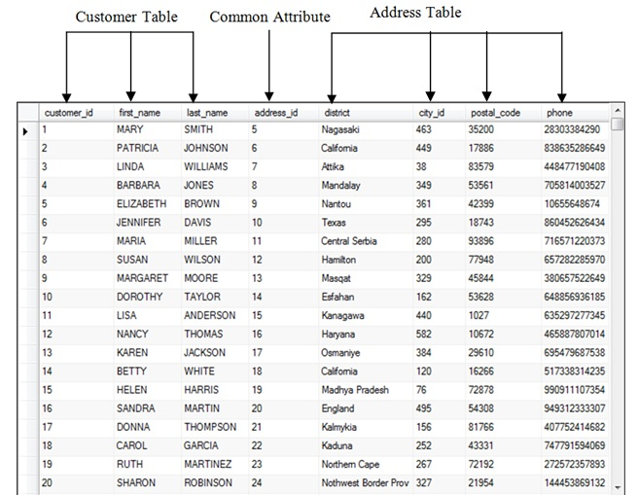
Using an Inner Join (Contd.)
  The following figure displays the output of the preceding inner join query.

Slide 6
Using an Inner Join (Contd.)
A straight join:
  Ensures that the table on the left of the join operator is read before the table on the right.
  Syntax:
  SELECT column_name, column_name [,column_name]
  FROM table1_name STRAIGHT JOIN table2_name
  [WHERE search_condition]
  For example:
    SELECT c.Customer_ID,c.First_Name,c.Last_Name,a.Address_ID,
    a.District,a.City_ID,a.Postal_Code,a.Phone FROM Sakila.Customer c STRAIGHT_JOIN Sakila.Address a ON c.Address_ID=a.Address_ID;
Joins the Customer and Address tables using the straight join.

Slide 7
Using an Outer Join
An outer join:
  Displays the result set containing all the rows from one table and the matching rows from the other table.
  Displays NULL for the columns of the related table where it does not find any matching records.
  Syntax:
    SELECT column_name, column_name [,column_name]
    FROM table1_name [LEFT | RIGHT] OUTER JOIN table2_name ON table1_name.ref_column_name join_operator table2_name.ref_column_name | (USING ref_column_name)
    [WHERE search_condition]
  Can be categorized as:
    Left outer join
    Right outer join

Slide 8
Using an Outer Join (Contd.)
  A Left outer join:
    Returns all the rows from the table specified on the left side of the LEFT OUTER JOIN keyword and the matching rows from the table specified on the right side of the LEFT OUTER JOIN keyword.
    Displays NULL for the columns of the table specified on the right side where it does not find any matching records.
    For example:
      SELECT Film.Film_ID, Film.Title, Film_Actor.Actor_ID FROM Sakila.Film LEFT OUTER JOIN Sakila.Film_Actor ON Film.Film_ID=Film_Actor.Film_ID WHERE Film.Film_ID BETWEEN 257 AND 260;
Joins the Film and Film_Actor tables based on the common column, Film_Id by using the LEFT OUTER JOIN keyword.

Slide 9
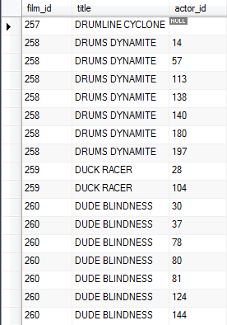
Using an Outer Join (Contd.)
  The following figure displays the output of the preceding query.

Slide 10
Using an Outer Join (Contd.)
  A right outer join:
    Returns all the rows from the table specified on the right side of the RIGHT OUTER JOIN keyword and the matching rows from the table specified on the left side of the RIGHT OUTER JOIN keyword.
    For example:
      SELECT Film.Title,Language.Name FROM Sakila.Film RIGHT OUTER JOIN Sakila.Language ON Film.Language_ID=Language.Language_ID ORDER BY Language.Language_ID DESC;
  Flash Presentation: Outer Joins
Joins the film and language tables based on the common column, Language_ID by using the RIGHT OUTER JOIN keyword.

Slide 11
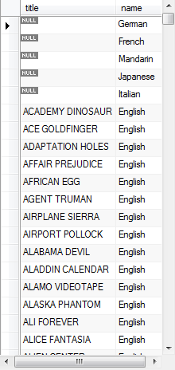
Using an Outer Join (Contd.)
  The following figure displays the output of the preceding right outer join query.

Slide 12
Just a minute
When do you use the right outer join?
Answer:
  You can use the right outer join when you need all the records from the table at the right side of the outer join and only matching records from the table at the left side of the outer join.

Slide 13
Using a Natural Join
  A natural join:
  Is a join that automatically joins columns of one table with another table on the basis of common column.
  Can be a left or a right outer join.
  Syntax:
  SELECT column_name, column_name [,column_name]
  FROM <table reference> NATURAL [{LEFT |RIGHT}[OUTER]] JOIN <table reference>
  For example:
  SELECT * FROM Store NATURAL JOIN City;
Specifies the type of natural join.
Specifies the name of table.

Slide 14

Using a Natural Join (Contd.)
  The following figure displays the output of the preceding query.

Slide 15
Using a Cross Join
  A cross join:
  Is also known as Cartesian product.
  Is used to join each row of one table with each row of the other table.
  For example:
  SELECT a.Hotel_Name,b.Room_Type_Description FROM Hotels AS a CROSS JOIN Room_Types AS b;

Slide 16
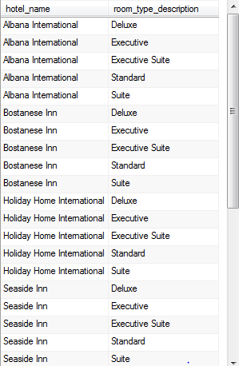
Using a Cross Join (Contd.)
  The following figure displays the output of the preceding cross join.

Slide 17
Using a Self Join
  A self join:
  Consists of a table which is joined to itself.
  Allows one row of a table to correlate with other rows of the same table.
  Consists of a table name used twice in the query.
  For example:
  SELECT DISTINCT f1.Title, f1.Film_ID,f1.Release_Year,f1.Rental_Rate FROM Sakila.Film AS f1, Sakila.Film AS f2 WHERE
  f1.Rental_Rate= f2.Rental_Rate AND f1.Film_ID BETWEEN 320 AND 330;
Creates two instances of a single table Film by giving the table two alias names f1 and f2.

Slide 18
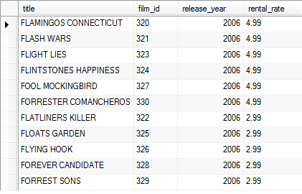
Using a Self Join (Contd.)
  The following figure displays the output of the preceding query.

Slide 19
Demo: Using Joins
  Problem Statement:
  The marketing manager of Rox Luxurious Hotels Ltd. is required to generate a report containing the following details:
    Booking ID
    Hotel name
    Guest name
    Room number
    Room description
  You are the database developer at Rox Luxurious Hotels Ltd. Help the marketing manager generate this report.

Slide 20
Demo: Using Joins (Contd.)
  Solution:
  To generate the required report, you need to perform the following tasks:
    Identify the type of join and the tables required.
    Create a query based on the identified join type and tables.
    Execute the query and verify the result.

Slide 21
  Querying Data by Using Subqueries
A subquery:
  Is a SQL statement that is used within another SQL statement.
  Is nested inside the WHERE or HAVING clause of the SELECT, INSERT, UPDATE, or DELETE statements.
  The database engine executes the inner query and then uses the result of it to calculate the result set for the outer query.

Slide 22

  Using the IN and EXISTS Keywords
A subquery:
  Returns values that are used to execute the outer query.
  Can return one or more values.
  For example:
    SELECT customer.customer_id, customer.first_name, customer.last_name FROM sakila.customer WHERE customer.customer_id=(SELECT payment.customer_id FROM sakila.payment WHERE payment.payment_id=1);
  The following figure shows the output of preceding query.
The inner subquery returns the customer_id column from the payment table of the customer with payment_id as 1.

Slide 23
  Using the IN and EXISTS Keywords (Contd.)
Using the IN or NOT IN Keyword:
  To match a column value in the outer query with any of the values in the list returned by the subquery, you need to use the IN keyword.
  If it is required that the column value in the outer query should not match with any of the values in the list returned by the subquery, you can use the NOT IN keyword.
  Syntax:
    SELECT column, column [,column]
    FROM table_name
    WHERE column IN | NOT IN
    ( SELECT column FROM table_name [WHERE conditional_expression] )

Slide 24
  Using the IN and EXISTS Keywords (Contd.)
  For example:
    SELECT Customer.Customer_ID, Customer.First_Name, Customer.Last_Name FROM Sakila.Customer WHERE Customer.Customer_ID=(SELECT Payment.Customer_iD FROM Sakila.Payment WHERE Payment.Payment_Id=1);
The subquery returns the Film_ID of films that have rental duration of 6 days from the Film table.

Slide 25
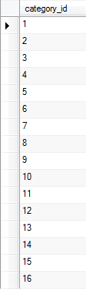
  Using the IN and EXISTS Keywords (Contd.)
  The following figure shows the output by using the IN keyword.

Slide 26
  Using the IN and EXISTS Keywords (Contd.)
Using the EXISTS or NOT EXISTS Keyword:
  You need to use the EXISTS clause with a subquery to check whether the subquery returns at least one matching record.
  The EXISTS keyword always returns a TRUE or a FALSE value.
  Syntax:
    SELECT column, column [,column]
    FROM table_name
    WHERE EXISTS | NOT EXISTS ( SELECT * FROM table_name [WHERE conditional_expression] )

Slide 27
  Using the IN and EXISTS Keywords (Contd.)
  For example:
    SELECT * FROM Sakila.Film WHERE EXISTS (
    SELECT * FROM Sakila.Film_Actor WHERE Film_Actor.Actor_ID = (SELECT DISTINCT Actor.Actor_ID FROM Actor WHERE Actor.First_Name='PENELOPE' AND Actor.Last_Name='GUINESS') AND Film_Actor.Film_ID=Film.Film_ID);
Retrieves the details of all films whose cast includes the actor, PENELOPE GUINESS.

Slide 28
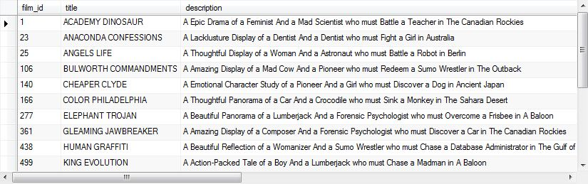
  Using the IN and EXISTS Keywords (Contd.)
  The following figure shows the output of preceding query.

Slide 29
  Using Modified Comparison Operators
While using subqueries, you use the comparison operators such as =, >, and < to create a condition that checks the value returned by the subquery.
To perform this task, you can use keywords such as ALL and ANY with the comparison operators in the subquery.
The ALL keyword returns a TRUE value if the comparison performed is true for all the values that are retrieved by the subquery.
It returns a FALSE value if only some of the values satisfy the comparison operator or if the subquery does not return any rows to the outer statement.

Slide 30
  Using Modified Comparison Operators (Contd.)
For example:
  SELECT * FROM Sakila.Film WHERE Film.Replacement_Cost > All (SELECT Film.Replacement_Cost FROM Film WHERE Length=70);
  The inner query returns the replacement cost of all films having duration of 70 minutes using the Film table.

Slide 31
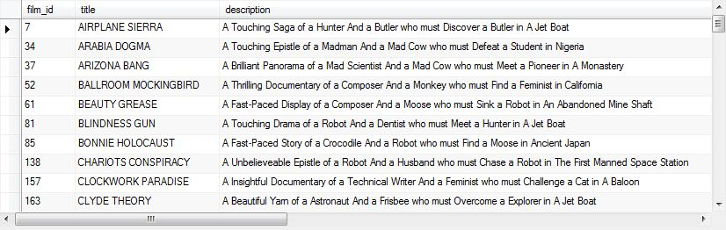
  Using Modified Comparison Operators (Contd.)
The following figure shows the output of preceding query.

Slide 32

  Using Modified Comparison Operators (Contd.)
The ANY keyword returns a TRUE value if any value that is retrieved by the subquery satisfies the comparison operator.
It returns a FALSE value if no values in the subquery satisfy the comparison operator or if the subquery does not return any rows to the outer statement.
For example:
  SELECT count(*) FROM Sakila.Payment WHERE Amount > ANY (SELECT Amount FROM Payment WHERE Customer_ID=7 AND Staff_ID=1);
  The following figure shows the output of preceding query.
The ANY operator compares the payment of each customer to each value returned by the subquery and returns the number of customers that have made the payment greater than the payment made by the customers with the Customer_ID 7 to the staff with the Staff_ID 1.

Slide 33
Using Nested Subqueries
Nested subqueries:
  Can be used to query multiple tables, in which the condition specified in a query is dependent on the result of another subquery, which, in turn, is dependent on the result of another subquery.
  For example:
    SELECT * FROM Sakila.Actor WHERE Actor.Actor_ID IN
    /* Level 3 inner query */
    (SELECT Film_Actor.Actor_ID FROM Sakila.Film_Actor WHERE Film_Actor.Film_ID IN
    /* Level 2 inner query */
    (SELECT Film.Film_ID FROM Sakila.Film WHERE
    Film.Language_ID =
    /* Level 1 inner query */
    (SELECT Language.Language_ID FROM language WHERE Language.Name='English')));

Slide 34
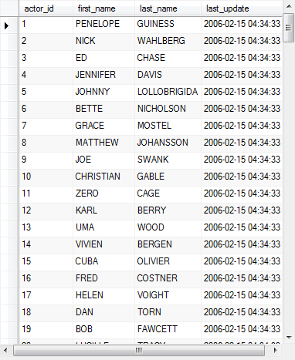
Using Nested Subqueries (Contd.)
  The following figure shows the output of preceding query.

Slide 35
Using Correlated Subqueries
Correlated subquery:
  It allows the inner query to be driven by the outer query.
  The inner query executes once for each row selected by the outer query.
  For example:
    SELECT Customer.Customer_ID,Customer.First_Name, Customer.Last_Name FROM Sakila.Customer WHERE EXISTS (SELECT * FROM Sakila.Payment WHERE Customer.Customer_ID=Payment.Customer_ID GROUP BY Customer.Customer_ID HAVING count(*)>=40);
The customer.customer_id column in the WHERE clause of the inner query is referencing the table specified in the FROM clause of the outer SELECT statement.

Slide 36
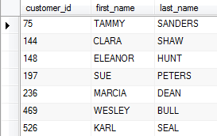
Using Correlated Subqueries (Contd.)
  The following figure shows the output of preceding query.

Slide 37
Demo: Using Subqueries
  Problem Statement:
  The management of Rox Luxurious Hotels Ltd. plans to revise the daily room rate of rooms offered to the executive class customers. For this, they want a report containing the room numbers that belong to the executive class, the daily room rate offered to the customers, and the daily room rate accepted by the customer. You are a database developer at Rox Luxurious Hotels Ltd.
  How will you achieve the desired result?

Slide 38
Demo: Using Subqueries (Contd.)
  Solution:
  To generate the required report, you need to perform the following tasks:
    Identify the tables required for the subquery and the outer query.
    Create a query.
    Execute the query and verify the result.

Slide 39
Summary
In this session, you learned that:
  An inner join retrieves records from multiple tables after comparing values in a common column.
  A table alias is used to refer to a table with another name.
  An outer join displays NULL for the columns of the related table where it does not find any matching records.
  A natural join clubs columns from one table with the columns of another table on the basis of a common column.
  A natural join can be a left or a right outer join.
  A cross join is used to join each row of one table with each row of another table.
  In a self join, a table is joined to itself.
  A subquery returns values that are used to execute an outer query.

Slide 40
Summary (Contd.)
  The EXISTS keyword returns a TRUE value if the result of the inner query contains at least one record.
  The ALL keyword returns a TRUE value if the comparison performed is true for all the values that are retrieved by the subquery.
  The ANY keyword returns a TRUE value if any value retrieved by the subquery satisfies the comparison operator.

