Slide 1
Objectives
In this session, you will learn to:
  Describe the operators that work on relations

Slide 2
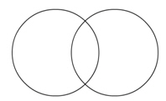
UNION
The union operator builds a relation from tuples appearing in either or both of the specified relations.
The following diagram represents the mathematical representation of the union operator.
Notes:
Student already have learnt about type 2 SCDs in Module I. Therefore, you can start this topic by asking the following questions to students:
What are type 2 SCDs?
Given an example to explain type 2 SCDs.
This will recapitulate what they have learnt about type 2 SCD in Module 1.
Now explain the strategy to update the data into these dimension tables with help the example given in SG.
After explaining the examples, you can ask students to think of an example of a type 2 SCD and then tell the strategy to update the data into this dimension table.

Slide 3
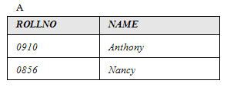
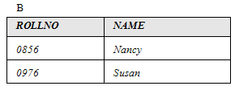
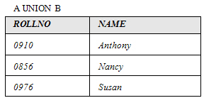
UNION (Contd.)
Consider the tables, A and B, as shown in the following diagram.
UNION
Notes:
Student already have learnt about type 2 SCDs in Module I. Therefore, you can start this topic by asking the following questions to students:
What are type 2 SCDs?
Given an example to explain type 2 SCDs.
This will recapitulate what they have learnt about type 2 SCD in Module 1.
Now explain the strategy to update the data into these dimension tables with help the example given in SG.
After explaining the examples, you can ask students to think of an example of a type 2 SCD and then tell the strategy to update the data into this dimension table.

Slide 4
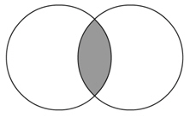
INTERSECT
The intersect operator builds a relation consisting of tuples that appear in both the relations.
The following diagram represents the mathematical representation of the intersect operator.
Notes:
Student already have learnt about type 2 SCDs in Module I. Therefore, you can start this topic by asking the following questions to students:
What are type 2 SCDs?
Given an example to explain type 2 SCDs.
This will recapitulate what they have learnt about type 2 SCD in Module 1.
Now explain the strategy to update the data into these dimension tables with help the example given in SG.
After explaining the examples, you can ask students to think of an example of a type 2 SCD and then tell the strategy to update the data into this dimension table.

Slide 5

INTERSECT (Contd.)
Consider the tables, A and B, as shown in the following diagram.
INTERSECT
Notes:
Student already have learnt about type 2 SCDs in Module I. Therefore, you can start this topic by asking the following questions to students:
What are type 2 SCDs?
Given an example to explain type 2 SCDs.
This will recapitulate what they have learnt about type 2 SCD in Module 1.
Now explain the strategy to update the data into these dimension tables with help the example given in SG.
After explaining the examples, you can ask students to think of an example of a type 2 SCD and then tell the strategy to update the data into this dimension table.

Slide 6
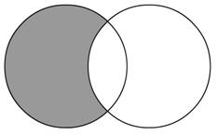
DIFFERENCE
The difference operator builds a relation of tuples appearing in the first but not in the second of the two specified relations.
The following diagram represents the mathematical representation of the difference operator.
Notes:
Student already have learnt about type 2 SCDs in Module I. Therefore, you can start this topic by asking the following questions to students:
What are type 2 SCDs?
Given an example to explain type 2 SCDs.
This will recapitulate what they have learnt about type 2 SCD in Module 1.
Now explain the strategy to update the data into these dimension tables with help the example given in SG.
After explaining the examples, you can ask students to think of an example of a type 2 SCD and then tell the strategy to update the data into this dimension table.

Slide 7

DIFFERENCE (Contd.)
The following set of tables illustrates the difference operation on tables, A and B.
DIFFERENCE
Notes:
Student already have learnt about type 2 SCDs in Module I. Therefore, you can start this topic by asking the following questions to students:
What are type 2 SCDs?
Given an example to explain type 2 SCDs.
This will recapitulate what they have learnt about type 2 SCD in Module 1.
Now explain the strategy to update the data into these dimension tables with help the example given in SG.
After explaining the examples, you can ask students to think of an example of a type 2 SCD and then tell the strategy to update the data into this dimension table.

Slide 8
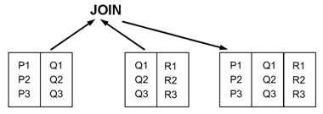
JOIN
The join operator:
  Builds a relation that consists of all the possible combinations of tuples, one from each relation that satisfies the specified condition.
  Requires a common attribute.
The following diagram shows how the join operator works.
Notes:
Student already have learnt about type 2 SCDs in Module I. Therefore, you can start this topic by asking the following questions to students:
What are type 2 SCDs?
Given an example to explain type 2 SCDs.
This will recapitulate what they have learnt about type 2 SCD in Module 1.
Now explain the strategy to update the data into these dimension tables with help the example given in SG.
After explaining the examples, you can ask students to think of an example of a type 2 SCD and then tell the strategy to update the data into this dimension table.

Slide 9
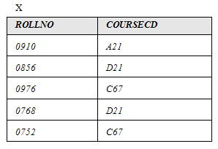
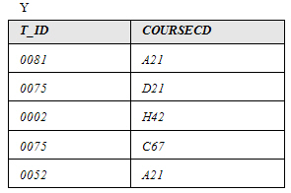
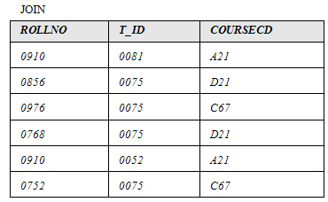
JOIN (Contd.)
The following set of tables illustrates the join operation on tables, X and Y.
JOIN
Notes:
Student already have learnt about type 2 SCDs in Module I. Therefore, you can start this topic by asking the following questions to students:
What are type 2 SCDs?
Given an example to explain type 2 SCDs.
This will recapitulate what they have learnt about type 2 SCD in Module 1.
Now explain the strategy to update the data into these dimension tables with help the example given in SG.
After explaining the examples, you can ask students to think of an example of a type 2 SCD and then tell the strategy to update the data into this dimension table.

Slide 10
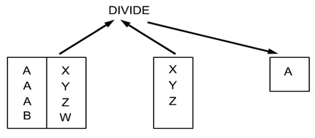
DIVIDE
The divide operator :
  Builds a relation that consists of values of an attribute of one relation that matches all the values in the other relation.
  Is the opposite of the product operation.
The following diagram shows how the divide operator works.
Notes:
Student already have learnt about type 2 SCDs in Module I. Therefore, you can start this topic by asking the following questions to students:
What are type 2 SCDs?
Given an example to explain type 2 SCDs.
This will recapitulate what they have learnt about type 2 SCD in Module 1.
Now explain the strategy to update the data into these dimension tables with help the example given in SG.
After explaining the examples, you can ask students to think of an example of a type 2 SCD and then tell the strategy to update the data into this dimension table.

Slide 11
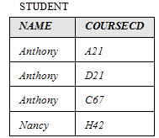
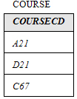

DIVIDE (Contd.)
The following set of tables illustrates the divide operation on the STUDENT table.
DIVIDE
Notes:
Student already have learnt about type 2 SCDs in Module I. Therefore, you can start this topic by asking the following questions to students:
What are type 2 SCDs?
Given an example to explain type 2 SCDs.
This will recapitulate what they have learnt about type 2 SCD in Module 1.
Now explain the strategy to update the data into these dimension tables with help the example given in SG.
After explaining the examples, you can ask students to think of an example of a type 2 SCD and then tell the strategy to update the data into this dimension table.

Slide 12
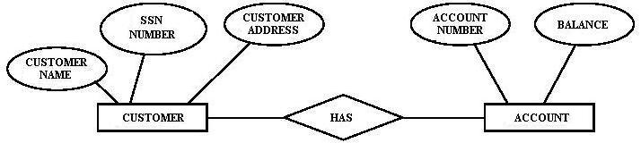
Practice Exercises
Exercise 1:
  Lee Wong is the newly appointed database administrator at Standard bank. The management of this bank wants to computerize the process of banking. According to the bank’s policy, one customer can have many accounts but one account cannot be shared by many customers. The following ER diagram represents the relationship between a customer and the accounts owned by a particular customer.
  In the preceding diagram, you have to identify entities and their attributes and type of relationship between the entities.
Notes:
Student already have learnt about type 2 SCDs in Module I. Therefore, you can start this topic by asking the following questions to students:
What are type 2 SCDs?
Given an example to explain type 2 SCDs.
This will recapitulate what they have learnt about type 2 SCD in Module 1.
Now explain the strategy to update the data into these dimension tables with help the example given in SG.
After explaining the examples, you can ask students to think of an example of a type 2 SCD and then tell the strategy to update the data into this dimension table.

Slide 13
Practice Exercises (Contd.)
Exercise 2:
  Consider the following scenario:
  A customer can have many accounts in a bank but an account can be associated with only one customer. Identify the relationship between customer and account and represent it with an ER Diagram.
Notes:
Student already have learnt about type 2 SCDs in Module I. Therefore, you can start this topic by asking the following questions to students:
What are type 2 SCDs?
Given an example to explain type 2 SCDs.
This will recapitulate what they have learnt about type 2 SCD in Module 1.
Now explain the strategy to update the data into these dimension tables with help the example given in SG.
After explaining the examples, you can ask students to think of an example of a type 2 SCD and then tell the strategy to update the data into this dimension table.

Slide 14
Summary
In this session, you learned that:
  The union operator builds a relation from tuples appearing in either or both of the specified relations where as intersect operator builds a relation consisting of tuples that appear in both the relations.
  The difference operator builds a relation of tuples appearing in the first but not in the second of the two specified relations.
  The join operator builds a relation from two specified relations. This relation consists of all the possible combinations of tuples, one from each relation that satisfies the specified condition.
  The divide operator takes two relations and builds another relation consisting of values of an attribute of one relation that match all the values in the other relation.
Notes:
You can summarize the session by running through the summary given in SG.
In addition, you can also ask students summarize what they have learnt in this session.

