Slide 1
Objectives
In this session, you will learn to:
  Map an ER diagram to a table

Slide 2

Conceptual Model
What is the conceptual model?

Slide 3

Conceptual Model (Contd.)
The conceptual model reflects entities and their relationships based on the data-processing needs of an organization.

Slide 4
Conceptual Model (Contd.)
The conceptual model can be mapped to a relational, hierarchical, or network model.
Data analysis is the first step in designing a conceptual model.
Data analysis involves identifying entities, their attributes, and relationships between entities based on the data collected.
After you complete data analysis, you draw the
entity-relationship diagram that gives a detailed overview of the database design.
Notes:
Student already have learnt about type 2 SCDs in Module I. Therefore, you can start this topic by asking the following questions to students:
What are type 2 SCDs?
Given an example to explain type 2 SCDs.
This will recapitulate what they have learnt about type 2 SCD in Module 1.
Now explain the strategy to update the data into these dimension tables with help the example given in SG.
After explaining the examples, you can ask students to think of an example of a type 2 SCD and then tell the strategy to update the data into this dimension table.

Slide 5
Mapping ER Diagrams to Tables
The following components play an important part while mapping an ER diagram to table:
  Regular entities
  Attributes
  Relationships
  Weak entities
  Subtypes and supertypes
Notes:
Student already have learnt about type 2 SCDs in Module I. Therefore, you can start this topic by asking the following questions to students:
What are type 2 SCDs?
Given an example to explain type 2 SCDs.
This will recapitulate what they have learnt about type 2 SCD in Module 1.
Now explain the strategy to update the data into these dimension tables with help the example given in SG.
After explaining the examples, you can ask students to think of an example of a type 2 SCD and then tell the strategy to update the data into this dimension table.

Slide 6
Mapping ER Diagrams to Tables (Contd.)
Regular entities:
  They can exist alone, independent of any other entity.
  They are the “building blocks” of the database.
  Each regular entity maps to a table.
  For example, STUDENT and BOOKS are two separate entities in the following ER diagram.
STUDENT
ISSUES
BOOKS
Notes:
Student already have learnt about type 2 SCDs in Module I. Therefore, you can start this topic by asking the following questions to students:
What are type 2 SCDs?
Given an example to explain type 2 SCDs.
This will recapitulate what they have learnt about type 2 SCD in Module 1.
Now explain the strategy to update the data into these dimension tables with help the example given in SG.
After explaining the examples, you can ask students to think of an example of a type 2 SCD and then tell the strategy to update the data into this dimension table.

Slide 7
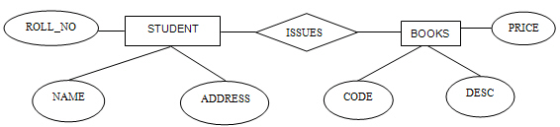

Mapping ER Diagrams to Tables (Contd.)
Attributes:
  Each property or attribute shown in the ER diagram maps to an attribute in the appropriate table.
  In the following ER diagram, STUDENT and BOOKS individually has different attributes.
Entity becomes the table and the attributes of the entity become columns of the table.
Notes:
Student already have learnt about type 2 SCDs in Module I. Therefore, you can start this topic by asking the following questions to students:
What are type 2 SCDs?
Given an example to explain type 2 SCDs.
This will recapitulate what they have learnt about type 2 SCD in Module 1.
Now explain the strategy to update the data into these dimension tables with help the example given in SG.
After explaining the examples, you can ask students to think of an example of a type 2 SCD and then tell the strategy to update the data into this dimension table.

Slide 8
Mapping ER Diagrams to Tables (Contd.)
Relationships:
  There are the following types of relationships:
    One-to-One
    One-to-Many
    Many-to-Many
Notes:
Student already have learnt about type 2 SCDs in Module I. Therefore, you can start this topic by asking the following questions to students:
What are type 2 SCDs?
Given an example to explain type 2 SCDs.
This will recapitulate what they have learnt about type 2 SCD in Module 1.
Now explain the strategy to update the data into these dimension tables with help the example given in SG.
After explaining the examples, you can ask students to think of an example of a type 2 SCD and then tell the strategy to update the data into this dimension table.

Slide 9
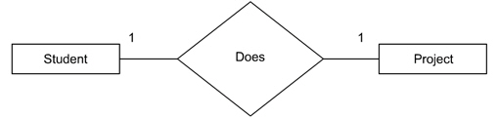
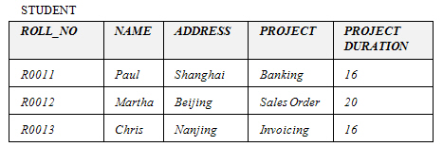
Mapping ER Diagrams to Tables (Contd.)
  One-to-one relationship:
    One instance of an entity can relate to only one instance of the related entity.
    For example:
If frequent queries require data from the two tables, then it is better to merge the two tables to improve query performance.
Notes:
Student already have learnt about type 2 SCDs in Module I. Therefore, you can start this topic by asking the following questions to students:
What are type 2 SCDs?
Given an example to explain type 2 SCDs.
This will recapitulate what they have learnt about type 2 SCD in Module 1.
Now explain the strategy to update the data into these dimension tables with help the example given in SG.
After explaining the examples, you can ask students to think of an example of a type 2 SCD and then tell the strategy to update the data into this dimension table.

Slide 10
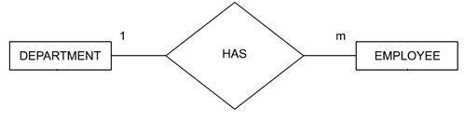
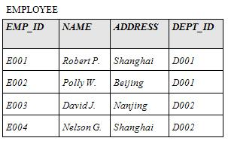
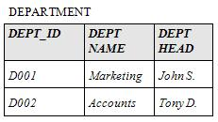
Mapping ER Diagrams to Tables (Contd.)
  One-to-many relationship:
    One instance of an entity can relate to more than one instance of the related entity.
    For example:
Mapped to the DEPARTMENT table
Mapped to the
EMPLOYEE table
Notes:
Student already have learnt about type 2 SCDs in Module I. Therefore, you can start this topic by asking the following questions to students:
What are type 2 SCDs?
Given an example to explain type 2 SCDs.
This will recapitulate what they have learnt about type 2 SCD in Module 1.
Now explain the strategy to update the data into these dimension tables with help the example given in SG.
After explaining the examples, you can ask students to think of an example of a type 2 SCD and then tell the strategy to update the data into this dimension table.

Slide 11




Mapping ER Diagrams to Tables (Contd.)
  Many-to-many relationship:
    Many instances of an entity can relate to more than one instance of the related entity.
    For example:
Mapped to the STUDENT table
Mapped to the ISSUES table
Mapped to the BOOKS table
The primary keys, ROLL_NO and CODE of the STUDENT and BOOKS table will act as the foreign keys in the ISSUE table.
Notes:
Student already have learnt about type 2 SCDs in Module I. Therefore, you can start this topic by asking the following questions to students:
What are type 2 SCDs?
Given an example to explain type 2 SCDs.
This will recapitulate what they have learnt about type 2 SCD in Module 1.
Now explain the strategy to update the data into these dimension tables with help the example given in SG.
After explaining the examples, you can ask students to think of an example of a type 2 SCD and then tell the strategy to update the data into this dimension table.

Slide 12
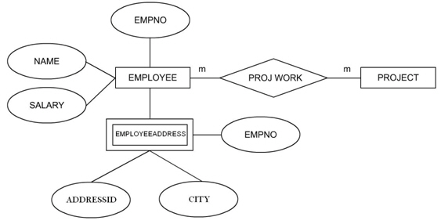

Mapping ER Diagrams to Tables (Contd.)
Weak entity:
  It is an entity whose existence depends on some other entity.
  For example:
The EMPLOYEEADDRESS entity can be mapped to a separate table.
Notes:
Student already have learnt about type 2 SCDs in Module I. Therefore, you can start this topic by asking the following questions to students:
What are type 2 SCDs?
Given an example to explain type 2 SCDs.
This will recapitulate what they have learnt about type 2 SCD in Module 1.
Now explain the strategy to update the data into these dimension tables with help the example given in SG.
After explaining the examples, you can ask students to think of an example of a type 2 SCD and then tell the strategy to update the data into this dimension table.

Slide 13
Mapping ER Diagrams to Tables (Contd.)
Subtypes and supertypes:
  A subtype is a subset of another entity.
  A subtype is always dependent on supertype for its existence.
  The primary key of the supertype creates a link between the supertype and subtypes.
Notes:
Student already have learnt about type 2 SCDs in Module I. Therefore, you can start this topic by asking the following questions to students:
What are type 2 SCDs?
Given an example to explain type 2 SCDs.
This will recapitulate what they have learnt about type 2 SCD in Module 1.
Now explain the strategy to update the data into these dimension tables with help the example given in SG.
After explaining the examples, you can ask students to think of an example of a type 2 SCD and then tell the strategy to update the data into this dimension table.

Slide 14
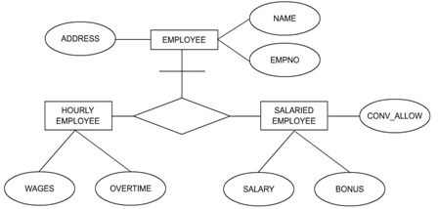
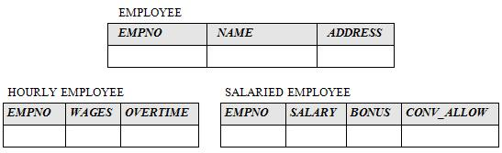

Mapping ER Diagrams to Tables (Contd.)
  For example:
Each subtype and supertype maps to a separate table.
Supertype
Subtypes
Notes:
Student already have learnt about type 2 SCDs in Module I. Therefore, you can start this topic by asking the following questions to students:
What are type 2 SCDs?
Given an example to explain type 2 SCDs.
This will recapitulate what they have learnt about type 2 SCD in Module 1.
Now explain the strategy to update the data into these dimension tables with help the example given in SG.
After explaining the examples, you can ask students to think of an example of a type 2 SCD and then tell the strategy to update the data into this dimension table.

Slide 15
Summary
In this session, you learned that:
  The conceptual model reflects entities and their relationships. Data analysis helps determine entities and relationships. The conceptual model is independent of the system where it is to be implemented.
  Regular entities are not dependent. They can exist in isolation, independent of any other entity.
  Each entity maps to a table. Each attribute in an ER diagram maps to a column in a table.
  Entities with common attributes should be merged. Attributes may acquire further attributes and become entities.
  The mapping of relationships depends on the type of relationship. Each type of relationship maps to tables in a different manner in the relational database management system.
Notes:
You can summarize the session by running through the summary given in SG.
In addition, you can also ask students summarize what they have learnt in this session.

Slide 16
Summary (Contd.)
  In one-to-one relationship, one instance of an entity can relate to only one instance of the related entity.
  In one-to-many relationship, one instance of an entity can relate to more than one instance of the related entity.
  Many-to-many relationships map to tables. One-to-one relationships are not very common and may map to foreign keys in tables.
  A weak entity is an entity whose existence depends on some other entity.
  A subtype is a subset of another entity. A subtype is always dependent on supertype for its existence.
  The primary key of the supertype is the foreign key of the subtype. It creates a link between the two.
Notes:
You can summarize the session by running through the summary given in SG.
In addition, you can also ask students summarize what they have learnt in this session.

