Slide 1
Objectives
In this session, you will learn to:
  Describe data redundancy

Slide 2

Definition of Normalization
Second Normal Form (2NF):
  A table is said to be in 2NF when:
    It is in the 1NF, and
    No partial dependency exists between non-key attributes and key attributes.
  The guidelines for converting a table into 2NF are:
    Find and remove attributes that are functionally dependent on only a part of the key and not on the whole key. Place them in a different table.
    Group the remaining attributes.
Notes:
You can summarize the session by running through the summary given in SG.
In addition, you can also ask students summarize what they have learnt in this session.

Slide 3
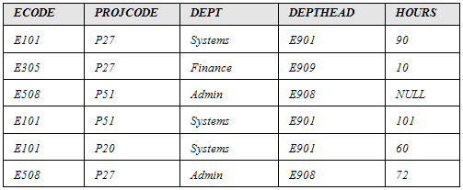
Definition of Normalization (Contd.)
  Consider the PROJECT table, as shown in the following diagram.
  The preceding table could lead to the following problems:
    Insertion
    Updation
    Deletion
Notes:
You can summarize the session by running through the summary given in SG.
In addition, you can also ask students summarize what they have learnt in this session.

Slide 4
Definition of Normalization (Contd.)
  Consider the PROJECT table, as shown in the following diagram.
  The preceding table could lead to the following problems:
    Insertion
    Updation
    Deletion
The department of an employee cannot be recorded until the employee is assigned a project.
Notes:
You can summarize the session by running through the summary given in SG.
In addition, you can also ask students summarize what they have learnt in this session.

Slide 5
Definition of Normalization (Contd.)
  Consider the PROJECT table, as shown in the following diagram.
  The preceding table could lead to the following problems:
    Insertion
    Updation
    Deletion
For an employee, ECODE, DEPT, and DEPTHEAD are repeated. Any change will have to be recorded in every row of the EMPLOYEE table.
Notes:
You can summarize the session by running through the summary given in SG.
In addition, you can also ask students summarize what they have learnt in this session.

Slide 6
Definition of Normalization (Contd.)
  Consider the PROJECT table, as shown in the following diagram.
  The preceding table could lead to the following problems:
    Insertion
    Updation
    Deletion
When the project finishes, the employee details are deleted. This leads to loss in information about the department to which employee belongs.
Notes:
You can summarize the session by running through the summary given in SG.
In addition, you can also ask students summarize what they have learnt in this session.

Slide 7

Definition of Normalization (Contd.)
Let us check if the PROJECT table is in 2NF.

Slide 8
Definition of Normalization (Contd.)
Hours is functionally dependent on the whole key, ECODE+PROJCODE.
Composite key
Notes:
You can summarize the session by running through the summary given in SG.
In addition, you can also ask students summarize what they have learnt in this session.

Slide 9
Definition of Normalization (Contd.)
Dept is functionally dependent on part of the key, which is ECODE.
Composite Key
Notes:
You can summarize the session by running through the summary given in SG.
In addition, you can also ask students summarize what they have learnt in this session.

Slide 10
Definition of Normalization (Contd.)
DEPTHEAD is functionally dependent on ECODE; however, it is not dependent on the attribute, PROJCODE.
Composite Key
Notes:
You can summarize the session by running through the summary given in SG.
In addition, you can also ask students summarize what they have learnt in this session.

Slide 11
Definition of Normalization (Contd.)
To convert the PROJECT table into 2NF, you must remove the attributes that are not functionally dependent on the whole key.

Slide 12
Definition of Normalization (Contd.)
You should place the removed attributes in a different table along with the attribute they are functionally dependent on.

Slide 13
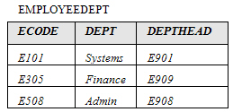
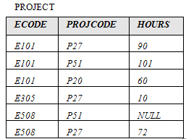
Definition of Normalization (Contd.)
The EMPLOYEEDEPT and PROJECT tables are in 2NF, as shown in the following diagram.
Notes:
You can summarize the session by running through the summary given in SG.
In addition, you can also ask students summarize what they have learnt in this session.

Slide 14
Definition of Normalization (Contd.)
Third Normal Form (3NF):
  A relation is said to be in the 3NF if and only if:
    It is in 2NF, and
    No transitive (indirect) dependency exists between non-key attributes and key attributes.
  The guidelines for converting a table into 3NF are:
    Find and remove non-key attributes that are functionally dependent on attributes that are not the primary key. Place them in a different table.
    Group the remaining attributes.
Notes:
You can summarize the session by running through the summary given in SG.
In addition, you can also ask students summarize what they have learnt in this session.

Slide 15
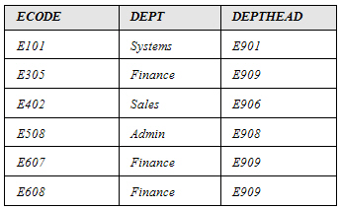
Definition of Normalization (Contd.)
  Consider the EMPLOYEE table, as shown in the following diagram.
  The preceding table could lead to the following problems:
    Insertion
    Updation
    Deletion
Notes:
You can summarize the session by running through the summary given in SG.
In addition, you can also ask students summarize what they have learnt in this session.

Slide 16
Definition of Normalization (Contd.)
  Consider the EMPLOYEE table, as shown in the following diagram.
  The preceding table could lead to the following problems:
    Insertion
    Updation
    Deletion
The department head of a new department that does not have any employees at present cannot be entered in the DEPTHEAD column.
Notes:
You can summarize the session by running through the summary given in SG.
In addition, you can also ask students summarize what they have learnt in this session.

Slide 17
Definition of Normalization (Contd.)
  Consider the EMPLOYEE table, as shown in the following diagram.
  The preceding table could lead to the following problems:
    Insertion
    Updation
    Deletion
For a department, DEPTHEAD is repeated. Any change will have to be made consistently across the table.
Notes:
You can summarize the session by running through the summary given in SG.
In addition, you can also ask students summarize what they have learnt in this session.

Slide 18
Definition of Normalization (Contd.)
  Consider the EMPLOYEE table, as shown in the following diagram.
  The preceding table could lead to the following problems:
    Insertion
    Updation
    Deletion
If an employee record is deleted, the information about DEPTHEAD will also be deleted.
Notes:
You can summarize the session by running through the summary given in SG.
In addition, you can also ask students summarize what they have learnt in this session.

Slide 19
Definition of Normalization (Contd.)
Let us check if the EMPLOYEE table is in 3NF.

Slide 20
Definition of Normalization (Contd.)
DEPTHEAD is functionally dependent on DEPT, which is not a primary key.
Primary key
Notes:
You can summarize the session by running through the summary given in SG.
In addition, you can also ask students summarize what they have learnt in this session.

Slide 21
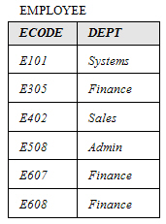
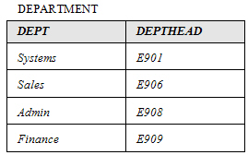
Definition of Normalization (Contd.)
  To convert the EMPLOYEE table into 3NF, you must remove the DEPTHEAD column and place it in another table, as shown in the following diagram.
Notes:
You can summarize the session by running through the summary given in SG.
In addition, you can also ask students summarize what they have learnt in this session.

Slide 22
Definition of Normalization (Contd.)
Boyce-Codd Normal Form (BCNF):
  The original definition of 3NF was not sufficient in some situations. It was not satisfactory for the tables:
    That had multiple candidate keys.
    Where the multiple candidate keys were composite.
    Where the multiple candidate keys overlapped (had at least one attribute in common).
  The guidelines for converting a table into BCNF are:
    Find and remove the overlapping candidate keys. Place the part of the candidate key and the attribute it is functionally dependent on, in a different table.
    Group the remaining items into a table.
Notes:
You can summarize the session by running through the summary given in SG.
In addition, you can also ask students summarize what they have learnt in this session.

Slide 23
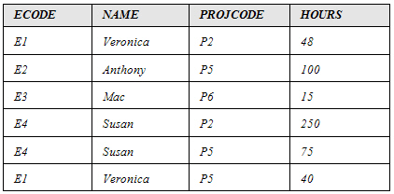
Definition of Normalization (Contd.)
  Consider the PROJECT table, as shown in the following diagram.
NAME+PROJCODE can also be chosen as the primary key and hence, is a candidate key.
Primary Key
PROJECT table is already in 3NF
Notes:
You can summarize the session by running through the summary given in SG.
In addition, you can also ask students summarize what they have learnt in this session.

Slide 24
Definition of Normalization (Contd.)
  The following points describe the functional dependencies in the PROJECT table:
    HOURS is functionally dependent on ECODE+PROJCODE.
    HOURS is also functionally dependent on NAME+PROJCODE.
    NAME is functionally dependent on ECODE.
    ECODE is functionally dependent on NAME.
  You will notice that the PROJECT table has:
    Multiple candidate keys that are ECODE+PROJCODE and NAME+PROJCODE.
    Composite candidate keys.
    Candidate keys that overlap since the PROJCODE attribute is common between the two candidate keys.
Notes:
You can summarize the session by running through the summary given in SG.
In addition, you can also ask students summarize what they have learnt in this session.

Slide 25
Definition of Normalization (Contd.)
  The only non-key item is HOURS, which is dependent on the whole key, ECODE+PROJCODE or NAME+PROJCODE.
  ECODE and NAME are determinants since they are functionally dependent on each other.
  As per BCNF, the determinants have to be candidate keys.
  You can remove NAME and ECODE and place them in a different table.
Notes:
You can summarize the session by running through the summary given in SG.
In addition, you can also ask students summarize what they have learnt in this session.

Slide 26
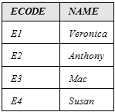
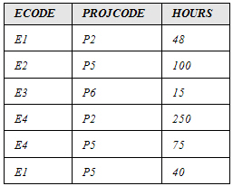
Definition of Normalization (Contd.)
  You can remove NAME and ECODE and place them in a different table, as shown in the following diagram.
Notes:
You can summarize the session by running through the summary given in SG.
In addition, you can also ask students summarize what they have learnt in this session.

Slide 27
Just a minute
Which of the following points helps in achieving a good database design?
  A table should store data for all the related entities together.
  Each table should have an identifier.
  Columns that contain NULL values should be created.
Solution:
  Each table should have an identifier.
Notes:
You can summarize the session by running through the summary given in SG.
In addition, you can also ask students summarize what they have learnt in this session.

Slide 28
Just a minute
In which normal form, you need to remove non-key attributes that are functionally dependent on non-primary key attributes?
Solution:
  Third normal form
Notes:
You can summarize the session by running through the summary given in SG.
In addition, you can also ask students summarize what they have learnt in this session.

Slide 29
Summary
In this session, you learned that:
  A table is said to be in 2NF when it is in the 1NF, and no partial dependency exists between non-key attributes and key attributes.
  A relation is said to be in the 3NF if and only if it is in 2NF, and no transitive (indirect) dependency exists between non-key attributes and key attributes.
  A relation is in BCNF if and only if every determinant is a candidate key.
Notes:
You can summarize the session by running through the summary given in SG.
In addition, you can also ask students summarize what they have learnt in this session.

