Slide 1
Rationale
In today’s global world, the choice of database solution to support the operations of an organization plays a vital role in the overall growth and development of an organization. MySQL offers a scalable, efficient, and cost effective environment to today’s business applications. Its unique features such as database engine architecture and flexibility make it a preferred database solution.

Slide 2

Objectives
In this session, you will learn to:
  Explore MySQL
  Identify MySQL installation considerations
  Explore MySQL interfaces

Slide 3
Exploring MySQL
Every organization needs to maintain information related to employees, customers, business partners, or business transactions.
To store and manipulate the information as well as to generate reports in an efficient way, a user-friendly interface is required.
MySQL is the most popular open source RDBMS that provides its source code free of cost and supports multiple operating systems.

Slide 4
Features of MySQL
The distinguishing features of MySQL are:
  Open source
  Scalable
  Portable
  Works with client/server and embedded architecture
  High performance
  Low TCO
  Reliable
  Easy to use
  Secure
  High availability
MySQL provides its source code freely under GPL distributed across the Internet, which can be modified by anyone.
MySQL can be used to manage a small or a large database of an organization.
MySQL supports multiple operating systems such as Windows, Solaris, Linux, and Mac OS.
In client/server architecture, client and server are considered to be separate processes and execute in different process spaces.
In an embedded architecture, both database server and application are considered to be a single process.
MySQL supports multi-threaded architecture that provides concurrent access to data by multiple users.
MySQL helps in controlling the cost of usage by lowering the system overhead, hardware expenditure, and licensing cost that leads to low TCO.
Each new version that is released is subjected to a variety of tests.
MySQL provides both Graphical User Interface (GUI) as well as Command-line User Interface.
MySQL allows only authorized users to access the database information.
MySQL supports replication.

Slide 5
Database Query Language
MySQL uses a database query language known as Structured Query Language (SQL).
The SQL statements can be divided into the following categories:
  Data Definition Language (DDL)
  Data Manipulation Language (DML)
  Data Control Language (DCL)
  Transaction Control Language (TCL)

Slide 6
Database Query Language (Contd.)
  DDL:
  It is used to define and modify the structure of database objects such as tables, views, and indexes.
  Some of the DDL statements are:
    CREATE
    ALTER
    RENAME
    DROP
    TRUNCATE

Slide 7
Database Query Language (Contd.)
  DML:
  It is used to manipulate the data in database objects.
  Some of the DML statements are:
    INSERT
    UPDATE
    DELETE
    SELECT
  DCL:
  It is used to control the access to the objects in the database.
  Some of the DCL statements are:
    GRANT
    REVOKE

Slide 8
Database Query Language (Contd.)
  TCL:
  It is used to control the processing of a transaction.
  Some of the TCL statements are:
    COMMIT
    ROLLBACK
    SAVEPOINT

Slide 9
Identifying MySQL Architecture
Conceptually, MySQL can be viewed as a layered system that consists of subsystems and their components.
The subsystems are responsible for performing the following tasks:
  Providing the SQL interface
  Parsing queries
  Optimizing and executing queries
  Caching and buffering
  Providing support for different pluggable storage engines
  The flow of execution across the subsystems is arranged in a hierarchical manner.

Slide 10
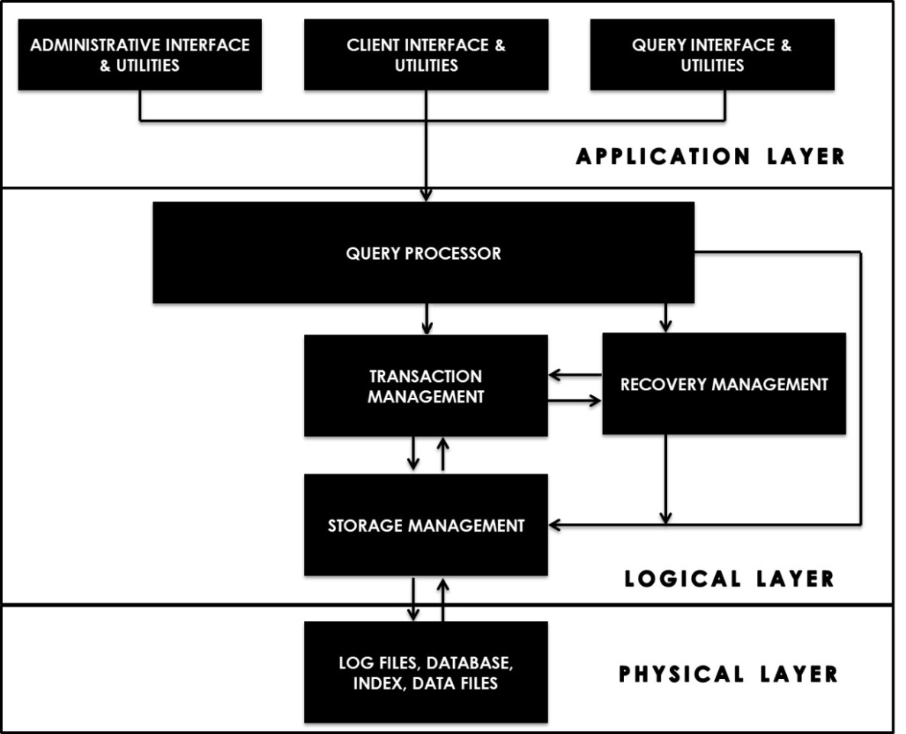
Identifying MySQL Architecture (Contd.)
The following figure displays the MySQL layered architecture.

Slide 11
Identifying MySQL Architecture (Contd.)
The MySQL architecture can be conceptually divided into the following layers:
  Application layer
  Logical layer
  Physical layer

Slide 12
Identifying MySQL Architecture (Contd.)
Application layer:
  Is responsible for enabling the users to interact with the MySQL server.
  Has the following types of users that can interact with the MySQL server:
    Database administrators
    Clients
    Query users

Slide 13
Identifying MySQL Architecture (Contd.)
  Different types of users interact with the MySQL server by using the following interfaces and utilities in the application layer:
    Administrative interface and utilities
    Client interface and utilities
    Query interface and utilities
Used for carrying out administrative operations, such as checking the server configuration, taking the backup of a database, and checking and analyzing tables.
Allow clients to communicate with the MySQL server using various programming languages.
Query users can query the database using a query interface, such as mysql command line utility.
Allow query users to interact with the MySQL server.

Slide 14
Identifying MySQL Architecture (Contd.)
  Logical layer:
  Is responsible for activities such as parsing, analyzing, optimizing, and executing a query.
  Manages transactions and helps the database to recover in case of failures.
  Uses the following subsystems:
    Query processor subsytem
    Transaction management subsystem
    Recovery management subsystem
    Storage management subsystem

Slide 15
Identifying MySQL Architecture (Contd.)
  The query processor subsystem uses the following components:
    Embedded DML precompiler
    DDL compiler
    Query parser
    Query preprocessor
    Query optimizer
    Execution engine
Translates the client commands written in programming languages such as C++ and Java into SQL statements and sends these SQL statements to the query parser.
Deals with the DDL commands issued by the administrator from the administrative interface and utilities.
Breaks the SQL statement into parts for better understanding by the other components.
Checks the syntax and semantics of the SQL statement.
Plans how the speed of query execution can be increased.
Executes the SQL statement.

Slide 16
Identifying MySQL Architecture (Contd.)
  The transaction management subsystem ensures atomicity and concurrency of a transaction.
  Transaction processing can be managed by using the following components:
    Transaction manager:
      Deals with maintaining the atomicity of a transaction.
      Issues the TCL commands such as COMMIT, ROLLBACK and SAVEPOINT.
    Concurrency control manager:
      Ensures the working of one transaction without affecting the work of another transaction.
      Acquires locks on the part of a database such as table(s) and record(s), which a transaction wants to modify.

Slide 17
Identifying MySQL Architecture (Contd.)
  The recovery management subsystem:
    Enables recovery of data if some error occurs in the system.
    Uses the following components:
      Log manager
      Recovery manager

Slide 18
Identifying MySQL Architecture (Contd.)
  The storage management subsystem uses the following components to read and write data to the disk:
    Buffer manager:
      Checks how much memory needs to be allocated per buffer for the retrieval or storage of data and vice versa.
      Maintains the query cache that holds the frequently queried data from the server.
    Storage manager:
      Handles the requests from a buffer manager to the secondary storage or vice versa.
      Uses the storage engines to access the data stored in the secondary storage. Some of the storage engines are:
        InnoDB
        MyISAM
        Memory
    Resource manager:
      Receives a request from the execution engine and issues the request to the buffer manager to access data from the database.

Slide 19
Identifying MySQL Architecture (Contd.)
Physical layer:
  Deals with the physical read and write of data such as user data, system log, and event information into the secondary storage.
  Is closest to the operating system and is responsible for storing the following types of data on the hard disk:
    Log file
    Data file
    Data dictionary
    Indices
    Statistical data
  Flash Presentation: MySQL Architecture
Stores the information about executed SQL statements.
Stores the user data related to a specific application.
Is a central repository that stores metadata.
Stores indexes on unique values of data, which ensure faster retrieval of data from the tables.
Stores information about different ways to execute a query.

Slide 20
Just a minute
How does MySQL ensures high availability?
Answer:
  MySQL ensures high availability by using replication.

Slide 21
Identifying MySQL Installation Considerations
MySQL is an easy to use RDBMS that can be installed on multiple platforms, such as Linux, Solaris, or Windows.
However, prior to the installation, it is very important to be aware of the editions, platforms, and distribution types of MySQL.
This will help you to choose and customize the installation as per your requirements.

Slide 22
Identifying Editions of MySQL
An organization can choose an open source or commercial edition according to its need.
Each edition has a set of add-on features that distinguish it from the others.
An open source edition is available free for download.
The open source edition of MySQL that is available for download through the MySQL site is the MySQL Community Edition.

Slide 23
Identifying Editions of MySQL (Contd.)
MySQL Community Edition:
  Includes multiple storage engines such as InnoDB, MyISAM, and Memory.
  Supports the pluggable storage engine architecture.
The pluggable storage engine architecture enables users to choose a third party storage engine to be added to or removed from a running server.

Slide 24
Identifying Editions of MySQL (Contd.)
The commercial edition of MySQL is a paid edition.
The user can choose an appropriate edition to meet the business requirements.
The various available commercial editions of MySQL are:
  MySQL Standard Edition
  MySQL Enterprise Edition
  MySQL Cluster Carrier Grade Edition

Slide 25
Identifying Editions of MySQL (Contd.)
  MySQL Standard Edition:
  Has Workbench (GUI of MySQL) that contains additional modules for design and administration to enhance the ease of use and improve the productivity of the administrator.
  Allows schema and model validation, which eliminates common modeling errors.
  Automates the process of database documentation generation and documents the information about the database or the model.
  Can be easily upgraded to the Enterprise Edition or MySQL Cluster Carrier Grade Edition.

Slide 26
Identifying Editions of MySQL (Contd.)
  MySQL Enterprise Edition:
  Can perform back up of data while MySQL server is online.
  Supports incremental backups where only the updated data is backed up.
  Supports partial backup where part of the specific table is backed up.
  Enables consistent point in time recovery from failures, where data can be recovered at any point from a past date since the last backup.

Slide 27
Identifying Editions of MySQL (Contd.)
  MySQL Cluster Carrier Grade Edition:
  Ensures 99.999% availability by using multiple copies of the servers distributed across the network.
  Includes automatic scaling of the transactional database, which allows adding servers to the server cluster at the runtime without compromising the efficiency.
  Supports automation of common management tasks, such as managing performance of system and managing log files, thereby improving the productivity of the administrator.
  Can be used to monitor the queries that are time consuming by using the enterprise monitor.

Slide 28
Identifying Editions of MySQL (Contd.)
  The following table lists the most common distinguishing features in different editions.
Feature | Description | MySQL Standard Edition | MySQL Enterprise Edition | MySQL Cluster Carrier Grade Edition
MySQL Enterprise Monitor | It informs the user about the problems that can affect the performance of a system before they actually occur. | NO | YES | YES
MySQL Enterprise Backup | It allows backing up the data while MySQL server is online. | NO | YES | YES
MySQL Cluster Manager | It ensures high availability of the server. In addition, it supports automating the common management tasks. | NO | NO | YES

Slide 29
Identifying Platforms for MySQL
  MySQL can be installed on various platforms.
  Prior to MySQL installation, you should identify the platforms on which MySQL can be installed.
  The most common platforms are:
  Windows
  Linux
  Solaris
  Mac OS X
  FreeBSD

Slide 30
Identifying Distributions of MySQL
  MySQL is distributed in the following formats:
  Binary
  Source code
  The binary distribution:
  Is an installation package that consists of precompiled files.
  Can be installed on any platform.
  Does not contain the source code and therefore does not need to be compiled before installation.
  Is available either as a setup program or as an archive.
  Files are available in the following formats depending on the type of platform you want to install the MySQL server:
    Zipped files
    RPM Package
    .dmg Package

Slide 31
Identifying Distributions of MySQL (Contd.)
  Source code:
  It refers to the source code files that can be customized and compiled before installation.
  The code files come in different formats. Some of the formats are:
    Zipped files
    RPM files
    Compressed archive files

Slide 32
Identifying Hardware and Software Requirements
  The minimum hardware requirements to install MySQL with Workbench on Windows are:
  A 32 or 64-bit CPU.
  A minimum of 4 GB RAM (6 GB or higher RAM is recommended).
  Single core processor (Single Core 3GHz or higher, Dual Core 2GHz or higher is recommended).
  Graphic Accelerators (nVidia or ATI with support of OpenGL 2 or higher).
  A minimum of 1280×1024 display resolution (1920×1200 or higher is recommended).

Slide 33
Identifying Hardware and Software Requirements (Contd.)
  The minimum software requirements to install MySQL with Workbench on Windows are:
  Operating system such as Windows 7.
  Microsoft .NET Framework such as 4.0.
  Microsoft Visual C++ Redistributable Package (x86) such as 2010.

Slide 34
Just a minute
Which MySQL distribution should be used to install and configure MySQL automatically on Windows platform?
Answer:
  The MySQL distribution that should be used to install MySQL automatically on Windows platform is MySQL Installer.

Slide 35
Demo: Installing MySQL
  Problem Statement
  Rox Luxurious Hotels Ltd. is an emerging hotel chain having presence all across the United States. Each hotel offers advance booking facilities to its customers. The information required for the reservation process such as booking details, customer details, and room details are currently stored independently in paper-based files using a manual system.
  However, to enable smooth functioning of the reservation system and keeping in mind the expansion plan of the hotel chain, the management has planned to create a centralized online database system to manage and monitor the functioning of all its hotels. For this purpose, the company needs an efficient and secure RDBMS. In addition, the RDBMS should be platform-independent so that it can run on multiple platforms such as Windows, Linux, and Solaris.

Slide 36
Demo: Installing MySQL (Contd.)
  Moreover, the management has cost constraints in selecting the RDBMS and thus, the management decide to choose an RDBMS that is available free of cost. Therefore, they choose MySQL for creating and managing the data related to the hotel reservation system.
  Before using MySQL, it needs to be installed. For this, the management of Rox Luxurious Hotels Ltd. has hired a Database Administrator. Help the Database Administrator in installing MySQL.

Slide 37
Demo: Installing MySQL (Contd.)
Solution:
  To solve the preceding problem, you need to perform the following tasks:
    Install the MySQL server.
    Configure the MySQL server.

Slide 38
Exploring MySQL Interfaces
MySQL provides two types of interfaces, GUI and CUI, for performing database administration and query execution.
MySQL Workbench is a GUI that helps in creating and maintaining database objects.
MySQL command-line client is a CUI that is used to send the SQL statements to the server for execution.

Slide 39
MySQL Workbench
MySQL Workbench:
  Has the following interfaces to perform various tasks related to:
    SQL development
    Data modeling
    Server administration
  Enables establishing a connection to the existing server and creating and managing database objects.
  Enables you to perform the following tasks:
    Edit table data.
    Edit and execute SQL queries and scripts.
    Manage connections.

Slide 40
MySQL Workbench (Contd.)
  The built-in SQL Editor provided by the Workbench contains the following components:
  Object Browser
  Query Panel
  Main Tabsheets
Is used to view schemas and their components available on the currently connected server instance.
Allows you to perform the following actions:
Execute SQL file
Add schema
Add table
Add view
Add routine
Is used to type and execute SQL statements directly.
Contain the following tabs:
Overview Tabsheet
Output Tabsheet
Snippets Tabsheet
Result Tabsheet

Slide 41
MySQL Workbench (Contd.)
  Workbench provides the workspace to create and manipulate data models, such as Enhanced Entity Relationship (EER) model.
  Workbench allows you to perform the following tasks by using the data modeling workspace:
  Create EER model from the existing database and vice versa.
  Create EER model from SQL script and vice versa.
  Create new EER model.

Slide 42
MySQL Workbench (Contd.)
  Workbench enables an administrator to manage user accounts and server.
  MySQL Workbench allows you to perform the following administrative tasks by providing a separate workspace for it:
  Register a new server instance.
  Manage import and export.
  Manage security.
  Manage server instances.
  Let us explore MySQL Workbench.

Slide 43
MySQL Command Line Client
  MySQL command line client is a command line user interface that enables execution of the SQL statements.
  If you install the full version of MySQL server, the command line client is automatically installed and an executable file is stored for the same in the bin subdirectory of the installation directory of the MySQL server.
  MySQL command line client can also be invoked in Windows through the command prompt.
  For example:
    C:\Program Files\MySQL\MySQL Server [version no.]\bin>mysql
Runs the MySQL command line tool, where version no. specifies the MySQL version.

Slide 44
MySQL Command Line Client (Contd.)
  To connect the MySQL command line tool to the MySQL server, the connection parameters such as username and password need to be specified.
  If the server is running at a remote location, then it is also mandatory to specify the hostname or IP address of the host machine.

Slide 45
MySQL Command Line Client (Contd.)
  The following syntax can be used to connect the mysql command line tool to the database located at a local or remote server:
    mysql -P port_num –h hostname –u username –p yourpassword dbname
  OR
    mysql --port=port_num --host=hostname --user=username --password=yourpassword dbname
Is the TCP/IP port number of the machine on which the MySQL server is running.
Is the name or IP address of the host machine, where the MySQL server is currently running.
Is the username of the user who needs to log in.
Is the name of the database.
Is the password of the current user.

Slide 46
MySQL Command Line Client (Contd.)
  For example:
    mysql –h localhost –u root –p sakila
Connects to the sakila database located at the local server.

Slide 47
MySQL Command Line Client (Contd.)
  In case of a remote connection, you need to specify the port number either with the host name or the IP address of the server.
  For example:
    mysql –-port=22301 –-host=123.0.1.19 –-user=test –-password=test
Establishes the connection to the MySQL server located at a remote location that has the port number, 22301 and IP address, 123.0.1.19.

Slide 48
MySQL Command Line Client (Contd.)
  The MySQL command line tool sends the SQL statements to the server for execution.
  The following table lists the most commonly used MySQL commands.
Command | Description | Example
Help OR \h OR ? | It is used to display the description of commands. | Help show This will display help on the show command.
Clear OR \c | It is used to clear the current input statement. | Clear
  Let us explore command line client.

Slide 49
Just a minute
Which component of Workbench is used to type and execute SQL statements directly?
Answer:
  Query panel is used to type and execute SQL statements directly from a Workbench.

Slide 50
Summary
In this session, you learned that:
  MySQL is the most popular open source RDBMS that provides its source code free of cost, which can be modified by anyone under the restrictions of a GPL.
  MySQL works in a client or server architecture.
  MySQL uses a database query language known as SQL that is used for performing operations, such as storing, accessing, and modifying the data in a database.
  The flow of execution across the subsystems is arranged in a hierarchical manner.
  The logical layer is responsible for activities such as parsing, analyzing, optimizing, and executing a query.
  Once the SQL statement has been parsed, it is sent to query preprocessor.
  The application layer is responsible for enabling the users to interact with the MySQL server.

Slide 51
Summary (Contd.)
  The transaction management subsystem ensures atomicity and concurrency of a transaction.
  The recovery management subsystem enables recovery of data if some error occurs in the system.
  The physical layer deals with the physical read and write of data as well as the system log and event information into the secondary storage.
  Depending on the operating system installed on the server, you can choose the most appropriate edition for installation. In addition, you should identify the distribution types of MySQL.
  An open source edition is available free for download.
  MySQL can be installed on various platforms. Prior to MySQL installation, you should identify the platforms on which MySQL can be installed.

Slide 52
Summary (Contd.)
  MySQL is distributed in the following formats:
    Binary
    Source code
  The binary distribution is an installation package that consists of precompiled files. It can be installed on any platform.
  The source code format refers to the source code files that can be customized and re-compiled before installation.
  MySQL Workbench is a GUI tool that enables execution of SQL queries, creation and management of data models, and administration of server.
  Workbench enables establishing a connection to the existing server and creating and managing database objects.
  Workbench provides the workspace to create and manipulate data models, such as Enhanced Entity Relationship (EER) model.

Slide 53
Summary (Contd.)
  Workbench enables an administrator to manage user accounts and server. It provides a workspace to create a sever instance.
  MySQL command line client is a command line user interface that enables execution of the SQL statements.

