Slide 1

Objectives
In this session, you will learn to:
  Use functions to customize result set
  Sort and group data

Slide 2
Using Functions to Customize Result Set
MySQL provides various in-built functions that can be used to customize the result set.
These in-built functions can be divided into the following categories:
  String functions
  Date functions
  Arithmetic functions
  Information functions
  Conversion functions
  Aggregate functions

Slide 3
String Functions
  MySQL provides string functions to manipulate string literals as well as columns having string data type.
  The following table lists some of the string functions provided by MySQL server.
Function name | Parameters | Example | Description
ASCII | (character_expression) | SELECT ascii ('ABC'); | Returns 65, the ASCII code of the leftmost character 'A'.
LEFT | (character_expression, integer_expression) | SELECT left ('DAVID',4); | Returns 'DAVI', which is a part of the character string after extracting 4 character from the left. That is the number of characters specified in the integer_expression.
REVERSE | (character _expression) | SELECT reverse ('RAM'); | Returns 'MAR', the reverse of the character_expression.
LOWER | (character_expression) | SELECT lower ('RICHARD'); | Returns 'richard', after converting character_expression to lower case.

Slide 4
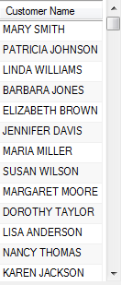
String Functions (Contd.)
  For example:
      SELECT CONCAT(First_Name, ' ', Last_Name) AS 'Customer Name' FROM Customer;
  Output:
Dispalys the full names of all the customers.

Slide 5
String Functions (Contd.)
  To provide the extended regular expression-based pattern matching, the REGEXP operator is used.
  The following table lists some of the special characters and constructs used with the REGEXP operator.
Special character/construct | Description
p* | Matches zero or any number of occurrences of the p character.
p+ | Matches one or any number of occurrences of the p character.
p? | Matches zero or one occurrence of the p character.
^p | Matches the string(s) that begins with a p character.

Slide 6
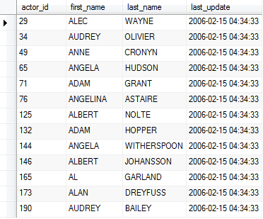
String Functions (Contd.)
  For example:
      SELECT * FROM Sakila.Actor
      WHERE First_Name REGEXP '^a';
  Output:
Display the records of all the actors whose first name begins with an 'a'.

Slide 7
Date Functions
  You can also perform arithmetic operations on date values or parse the date values using the Date functions.
  Date parsing includes extracting components, such as the day, the month, and the year from a date value.
  For example:
      SELECT curdate();
Uses the curdate() function to retrieve the current system date.

Slide 8
Date Functions (Contd.)
  The following table lists the date and time functions provided by MySQL server.
Function name | Parameters | Example | Description
ADDDATE | (date, INTERVAL expr unit) | SELECT ADDDATE('2008-8-24 15:25:52', INTERVAL '8:20' HOUR_MINUTE); | Returns 2008-08-24 23:45:52, which is 8 hours and 20 minutes later than the original date/time value.
DATE | (date) | SELECT DATE('2008-08-16 22:55:56'); | Returns the full date value,2008-08-16.
MONTH | (date) | SELECT MONTH('2007-08-16 16:40:45'); | Returns the month number which is 8.
MONTHNAME | (date) | SELECT MONTHNAME('2008-07-24 20:40:45'); | Returns the name of the month which is July.

Slide 9
Mathematical Functions
  You can use mathematical functions to perform various arithmetic operations on numeric values.
  The following table lists the arithmetic functions provided by MySQL server.
Function name | Parameters | Example | Description
FLOOR | (numeric_expression) | SELECT floor(12.30); | Returns 12, the largest integer less than or equal to the specified value.
COT | (float_expression) | Select cot(3.5); | Returns the cotangent of the specified angle in radians. Here, it returns 2.669616484968866.
PI | No parameters | SELECT pi(); | Returns the constant value of 3.141593.
POW | (numeric_expression, y) | SELECT pow(5,2); | Returns 25, which is 5 to the power of 2.

Slide 10
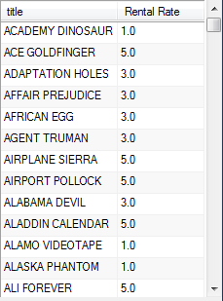
Mathematical Functions (Contd.)
  For example:
      SELECT Title,ROUND(Rental_Rate,1) AS 'Rental Rate' FROM Film;
  Output:
Retrieves the titles and the rental rates of the films from the film table in such a way that the rental rates should be rounded off to one decimal place.

Slide 11
Information Functions
  The information functions are used to query the system tables.
  System tables are a set of tables that are used by MySQL server to store information about users, databases, tables, and security.
  The following table lists the information functions provided by MySQL server.
Function name | Parameter | Example | Description
current_user() | No parameters | SELECT CURRENT_USER(); | Returns the user name and the host name of the user who is currently logged in.
connection_id() | No parameters | SELECT CONNECTION_ID(); | Returns the current connection id.
Database () | No parameters | SELECT DATABASE(); | Returns the name of the database which is being currently used.
Version | No parameters | SELECT VERSION(); | Returns the current version of the MySQL server.

Slide 12
Cast Functions
  MySQL provides various cast functions that enables you to convert the value of one date type into another.
  MySQL supports the following cast functions:
  BINARY
  CAST()
  CONVERT()

Slide 13
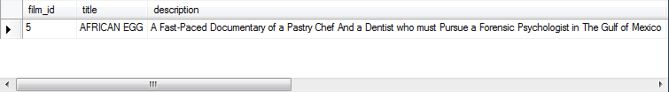
Cast Functions (Contd.)
  The BINARY function:
  Allows you to compare the fields byte-by-byte and provides the case-sensitive search result.
  For example:
      SELECT * FROM Film WHERE Title=BINARY('AFRICAN EGG');
  Output:
Performs the case-sensitive search for the film titled AFRICAN EGG in the title field of the Film table.

Slide 14
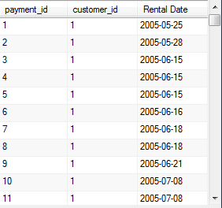
Cast Functions (Contd.)
  The CAST function:
  Takes the value of one type and produces the value of another type.
  Syntax:
  CAST(expr AS type)
  For example:
      SELECT Payment_ID, Customer_ID, CAST(Payment_Date AS date) AS 'Rental Date' FROM Payment;
  Output:
Defines the expression.
Defines the type to which the expression is to be changed using the AS keyword.

Slide 15
Cast Functions (Contd.)
  The CONVERT function:
  Is also used to convert a value of one type into another type.
  Syntax:
  Convert(expr,type)
  For example:
      SELECT Payment_ID, Customer_ID, CONVERT(Payment_Date, date) AS 'Rental Date' FROM Payment;
Defines the expression.
Defines the type to which the expression is to be changed.
Prepares a report that displays only the date of the payment.

Slide 16

Aggregate Functions
  The aggregate functions:
  Summarize the values of a column or a group of columns, and produce a single value.
  Are also known as group functions.
  For example:
      SELECT COUNT(*) as 'Number of films' FROM Film;
  Output:
Counts the number of films in the Film table.

Slide 17
Aggregate Functions (Contd.)
  The following table lists the aggregate functions that can be used to calculate summary values.
Function name | Parameter | Example | Description
Avg | (column name) | select avg(rental_rate) from film; | Returns the average rental rate of the films which is USD 2.980000.
Sum | (column name) | select sum(rental_rate) from film; | Returns the sum of the rental rates of the films which is USD 2980.00.
Min | (column name) | select min(rental_rate) from film; | Returns the minimum rental rate of the films which is USD 0.99.
Max | (column name) | select max(rental_rate) from film; | Returns the maximum rental rate of the films which is USD 4.99.

Slide 18
Demo: Using Functions to Customize Result Set
  Problem Statement:
  You are a database developer at Rox Luxurious Hotels Ltd. The details of the bookings are stored in the Bookings table. The management wants to view the details of all the reservations for March 2011, which have the booking status code 166. In addition, the result should display the number of days for which the hotel rooms were booked under a column heading, Number of Days.

Slide 19
Demo: Using Functions to Customize Result Set (Contd.)
  Solution:
  To solve the preceding problem, you need to perform the following tasks:
    Create a query.
    Execute the query to generate the report.

Slide 20
Sorting and Grouping Data
  The ORDER BY clause of the SELECT statement enables you to display the records in an increasing or decreasing order of values in a given column.
  You can summarize data for different groups based on a criterion by using the GROUP BY clause of the SELECT statement.

Slide 21
Sorting Data
  The ORDER BY clause:
  Provides the facility to retrieve the rows in a particular order.
  Syntax:
    SELECT
    [ALL | DISTINCT]
    select_expr [, select_expr ...]
    [FROM table_references
    [WHERE where_condition]
    [ORDER BY col_name]
    [ASC | DESC]
Specifies the name of the column.
Specifies whether to display the values in ascending or descending order, respectively.

Slide 22
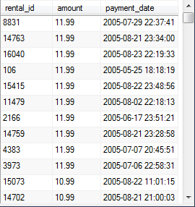
Sorting Data (Contd.)
  For example:
    SELECT Rental_ID, Amount, Payment_Date
    FROM Payment
    ORDER BY Amount DESC;
  Output:
Displays the payment details in the descending order of the payment amount.

Slide 23
Grouping Data
  The GROUP BY clause:
  Summarizes the result set into groups, as defined in the SELECT statement by using aggregate functions.
  Syntax:
    SELECT
    [ALL | DISTINCT]
    select_expr [, select_expr ...]
    [FROM table_references]
    [WHERE where_condition]
    [GROUP BY {col_name | expr}]
    [HAVING where_condition]
Is the conditional expression used to filter the result set produced by the GROUP BY clause.
Specifies the column name(s) or expression(s) on which the result set of the SELECT statement is to be grouped.

Slide 24
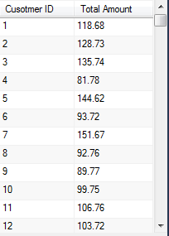
Grouping Data (Contd.)
  For example:
    SELECT Customer_ID AS 'Cusotmer ID', SUM(Amount) AS 'Total Amount' FROM Payment GROUP BY Customer_ID;
  Output:
Displays the total payment amount received by each customer.

Slide 25
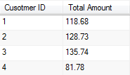
Grouping Data (Contd.)
  The HAVING clause:
  Filters the group of records based on a condition.
  For example:
    SELECT Customer_ID AS 'Cusotmer ID', SUM(Amount) AS 'Total Amount' FROM Payment GROUP BY Customer_ID HAVING Customer_ID < 5;
  Output
Displays the total payment amount received by customers whose ID lies between 1 to 4.

Slide 26
Demo: Sorting and Grouping Data
  Problem Statement:
  You are a database developer at Rox Luxurious Hotels Ltd. The management wants to create a report that should display a list of the average rates of all the rooms for each floor of the hotel to analyze the distribution of room types in the hotel. In addition, the average rates of the rooms on each floor should be displayed in a decreasing order. Also, the heading of the column displaying the average room rent should be Average Room Rent.
  How will you achieve this task?

Slide 27
Demo: Sorting and Grouping Data (Contd.)
  Solution:
  To solve the preceding problem, you need to perform the following tasks:
    Create a query.
    Execute the query to generate the report.

Slide 28
Summary
In this session, you learned that:
  MySQL provides various in-built functions that can be used to customize the result set. These in-built functions can be divided into the following categories:
    String functions
    Date functions
    Arithmetic functions
    Information functions
    Conversion functions
    Aggregate functions
  The ORDER BY clause provides the facility to retrieve rows in a particular order.
  You can group data by using the GROUP BY clause and add a condition by using the HAVING clause of the SELECT statement.

