Slide 1

MOTILAL NEHRU NATIONAL INSTITUTE OF TECHNOLOGY ALLAHABAD
QUIZ - QUEST
SUBMITTED BY:-
AMAN KUMAR TRIPATHI (2022CA010)
YASH PAL SINGH (2022CA112)
YUGAM SAINI (2022CA116)
Dr. Ranvijay Singh
(Associate Professor, CSED)
Under the guidance of :-

Slide 2
PROBLEM STATEMENT
The traditional way of quiz methods is inefficient and lacks the security features related to cheating. While giving quizzes online if we want a cheating-free quiz then we require more and more teachers. Offline quiz methods are time taking and there is so much paperwork. Checking answers and calculating scores is a Time-taking task in the offline quiz method.
Our project solves all the above problems.

Slide 3
OBJECTIVE
1. To develop an online system that can conduct cheating-free online quizzes.
2. To reduce the paperwork while offline quizzes.
3. To reduce wastage of time while checking and calculating scores.
4. To provide a single click solution from leaderboard to excelsheet.

Slide 4
Tech Stack Used
Frontend : HTML, CSS, EJS
Backend : NodeJs, Express
Language : JavaScript
Database : Mongo DB
OTP Verification: NodeMailer
Tools : VS Code, Git

Slide 5
Introduction
Quiz-Quest is a dynamic web app designed to provide users with an engaging and interactive quiz experience. Developed using modern web technologies, our app offers a user-friendly interface and a wide range of quiz topics to cater to various interests and knowledge levels.

Slide 6
DESIGN SPECIFICATIONS

Slide 7
LEVEL 0 DFD
VIEW LEADERBOARD
GIVE QUIZ
CREATE/MANAGE QUIZ
QUIZ QUEST
STUDENT
LOGIN/SIGNUP
LOGIN/SIGNUP
FACULTY
VIEW AVAILABLE QUIZ
CREATE/MANAGE GROUPS
VIEW/DOWNLOAD LEADERBOARD

Slide 8
1 – LEVEL DFD
USER
QUIZ APP
QUESTION SERVICE
ANSWER SERVICE
SCORE SERVICE
Request Quiz
Fetch Questions
Questions
Display Questions
Submit Answer
Update Score
Submit Answer
Display Answer
Confirmation
Score Updated
USER
QUIZ APP
QUESTION SERVICE
ANSWER SERVICE
SCORE SERVICE

Slide 9
LEVEL – 2 DFD
USER
QUIZ APP
QUESTION SERVICE
ANSWER SERVICE
SCORE SERVICE
AUTHENTICATION
Request Quiz
Fetch Questions
Questions
Submit Answer
Submit Answer
Update Score
Authenticate User
Authenticate User
Authenticate Response

Slide 10
USECASE DIAGRAM
USER
Submit Answer
Update Score
Take Quiz
Fetch Questions
Validate Answer
ADMIN

Slide 11
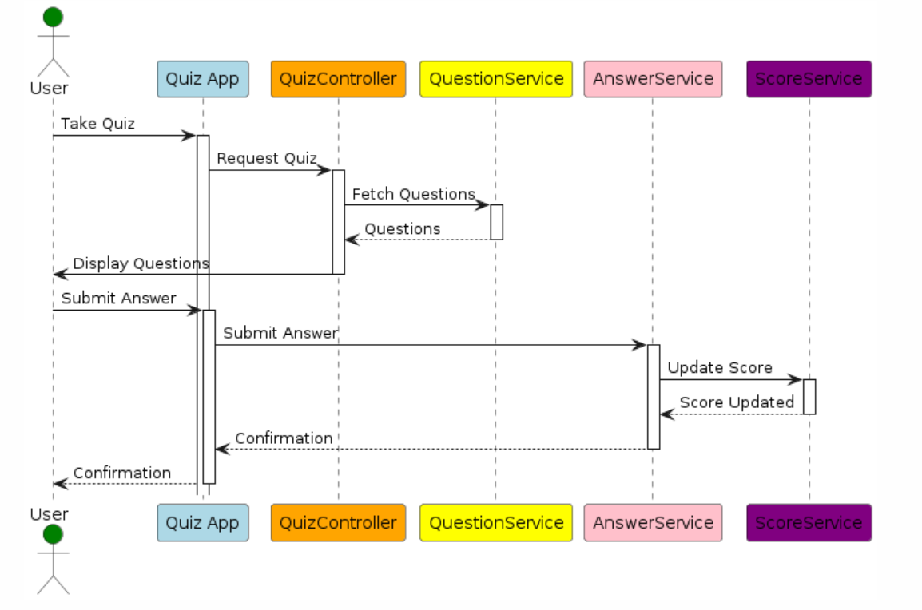
SEQUENCE DIAGRAM
SCORE SERVICE
SCORE SERVICE

Slide 12
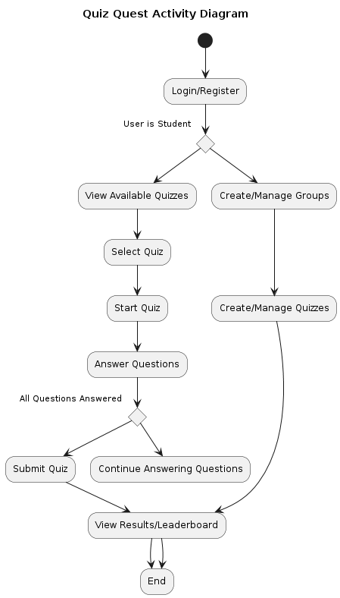

ACTIVITY DIAGRAM
OTP Verification

Slide 13
Features
FACULTY SIDE
Faculty can create the separate group for every course.
After creating the group the unique id will be generated, through which students can join the group.
Faculty itself can set the quiz and schedule it accordingly.
Quiz can be edited any time.
Faculty can download the leaderboard as excel file.

Slide 14
Features
STUDENT SIDE
Student can login through the college g-suite id only.
Login verification is done through the email OTP verification.
While giving quiz the student can not switch the tab if so the quiz will be submit automatically.
Student can not copy the question text.
After completion of the quiz duration the quiz will be submit automatically.
Each and every student can see the leaderboard of all the student of the same group.

Slide 15
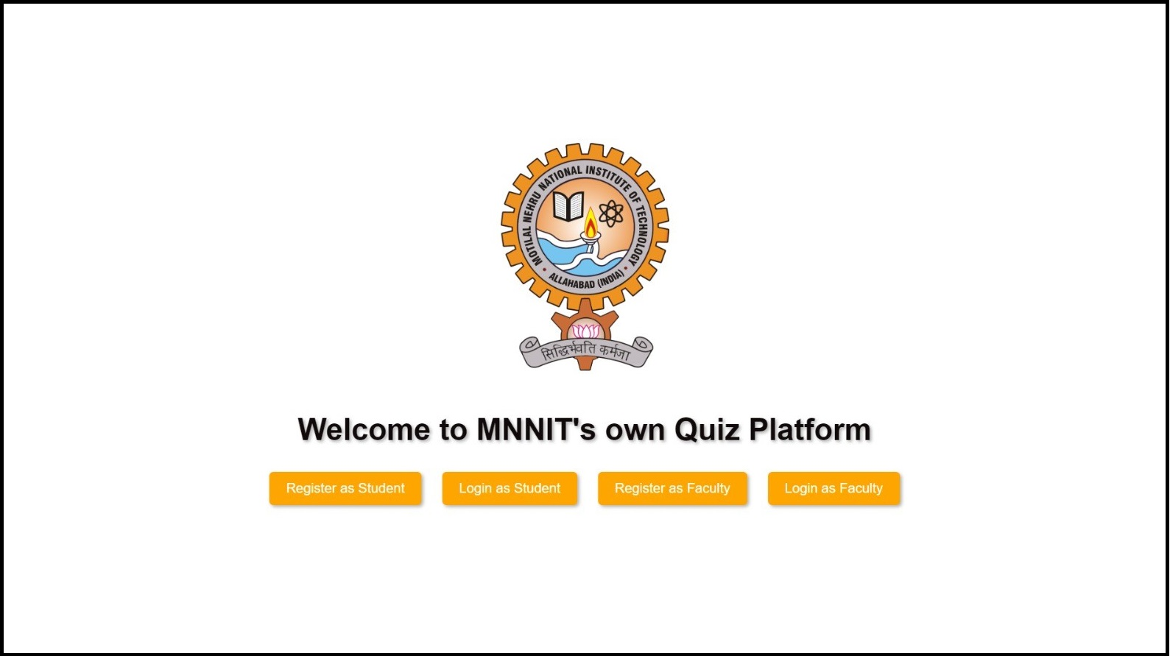

Slide 16
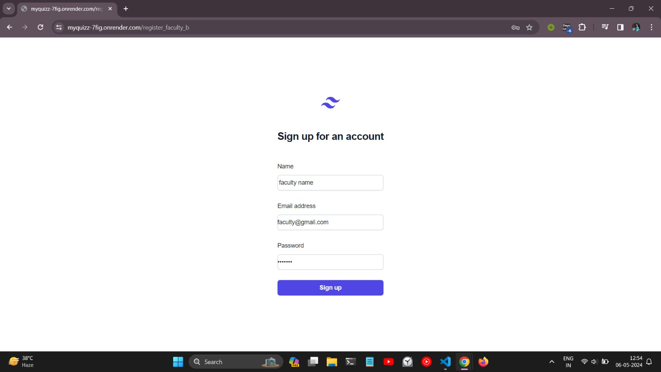

Slide 17
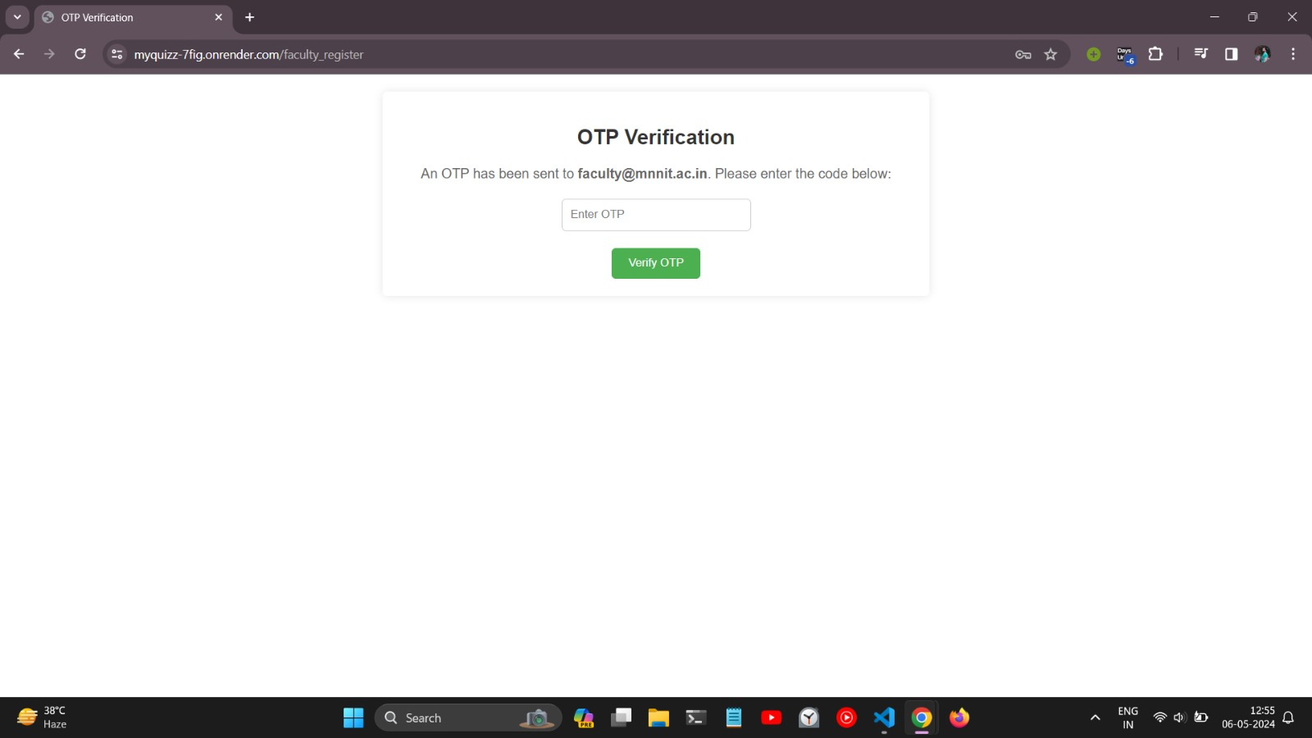

Slide 18
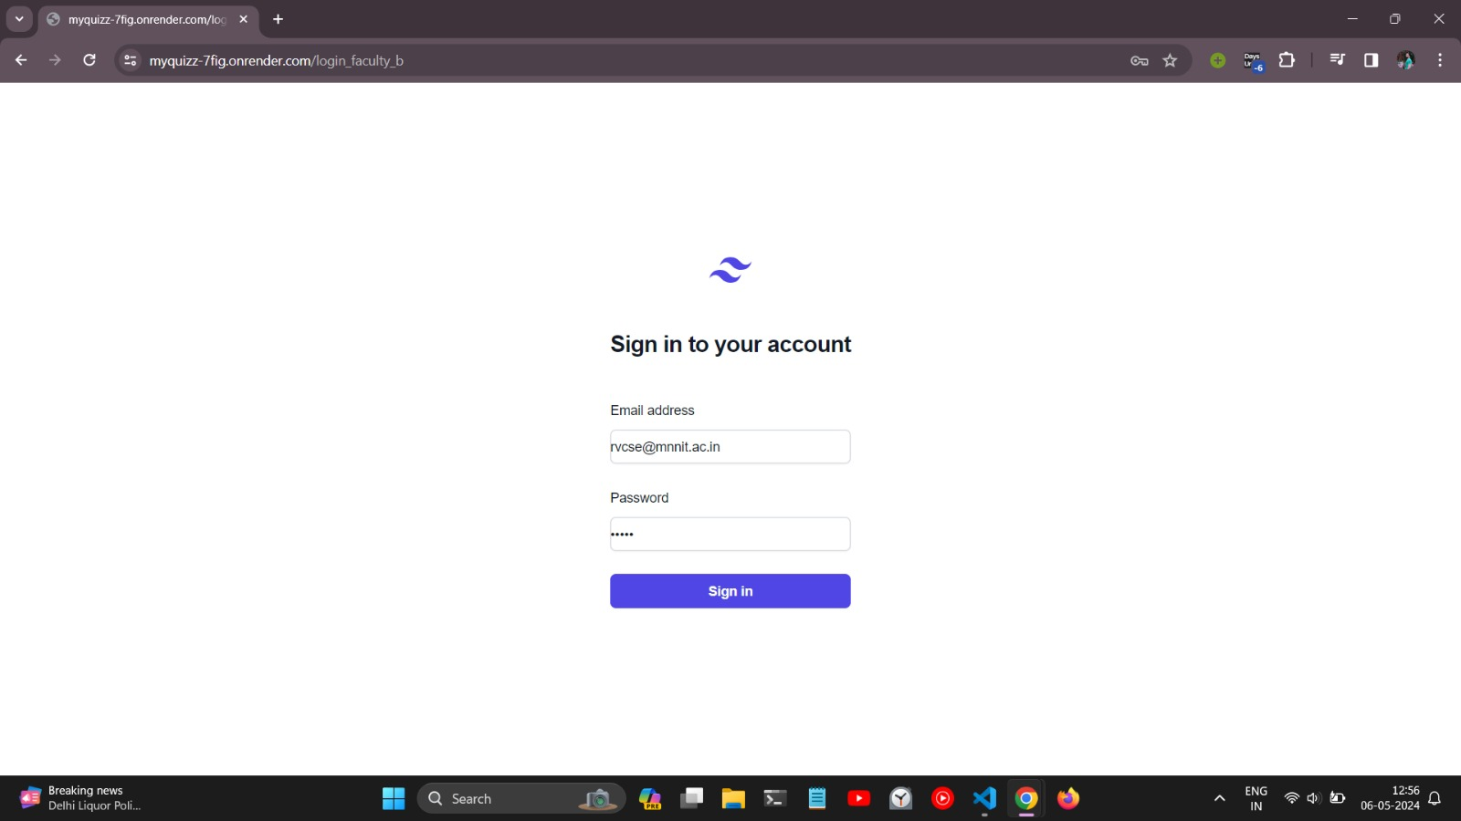

Slide 19
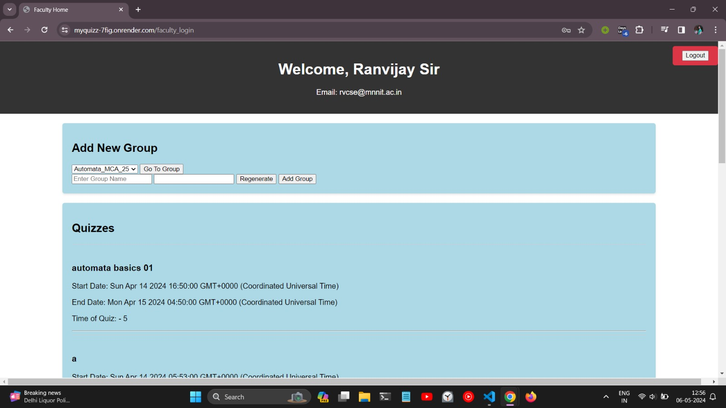

Slide 20
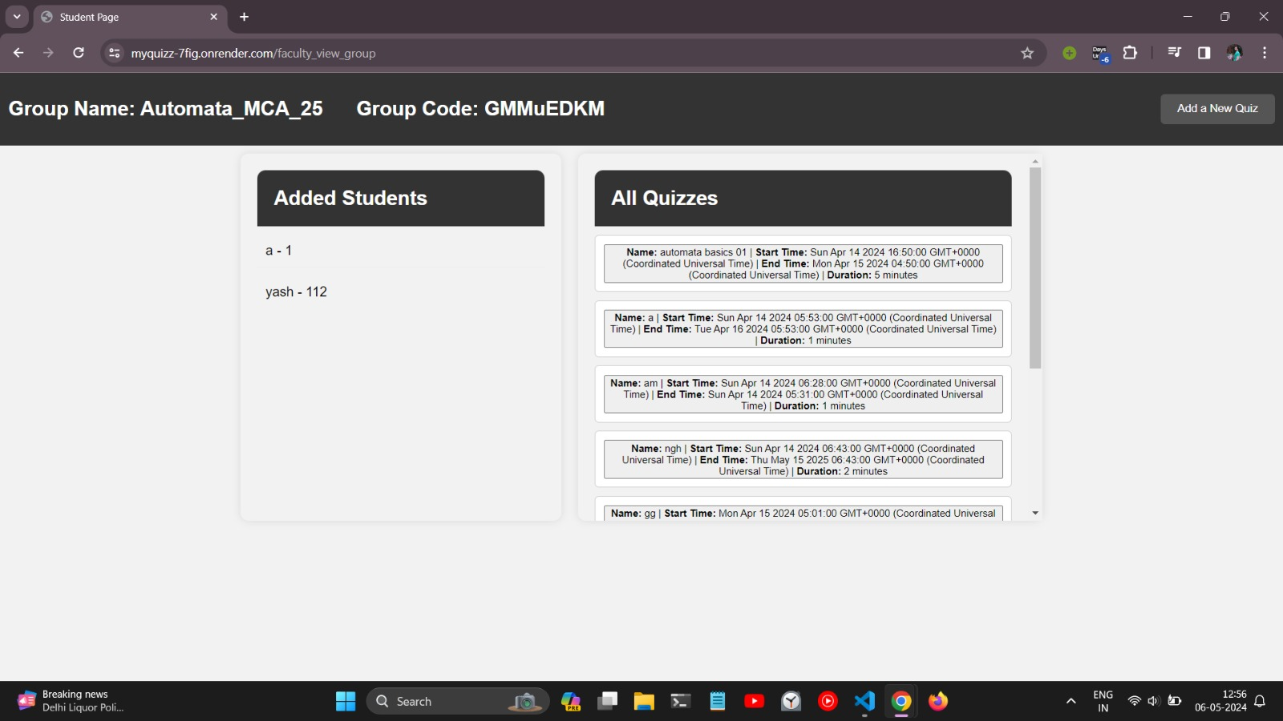

Slide 21
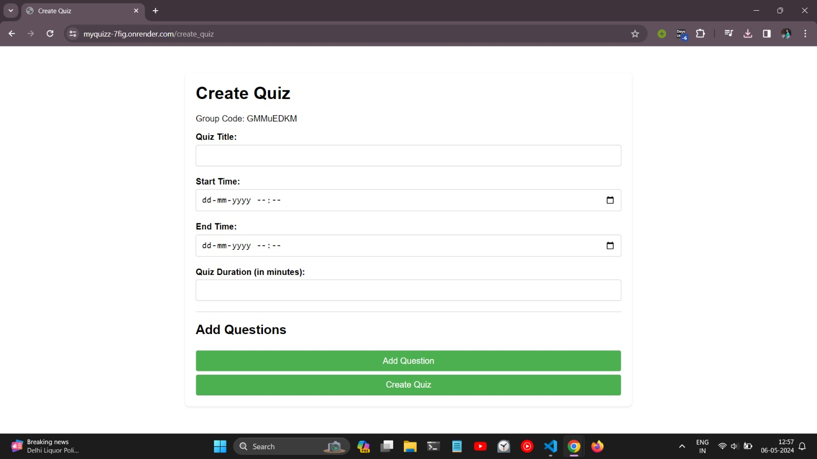

Slide 22
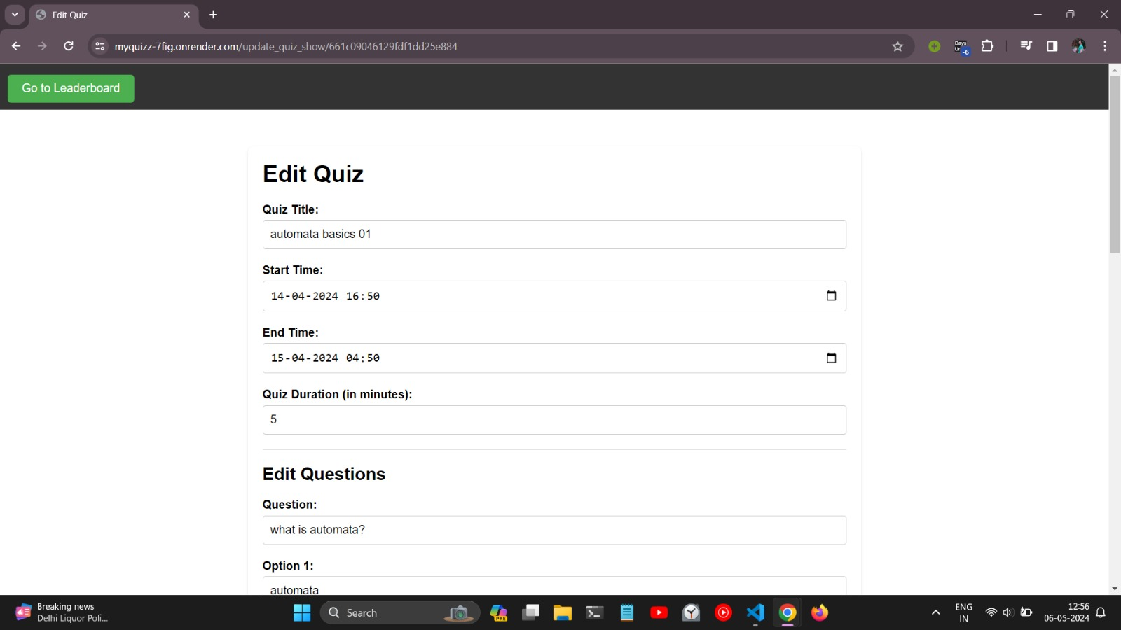

Slide 23
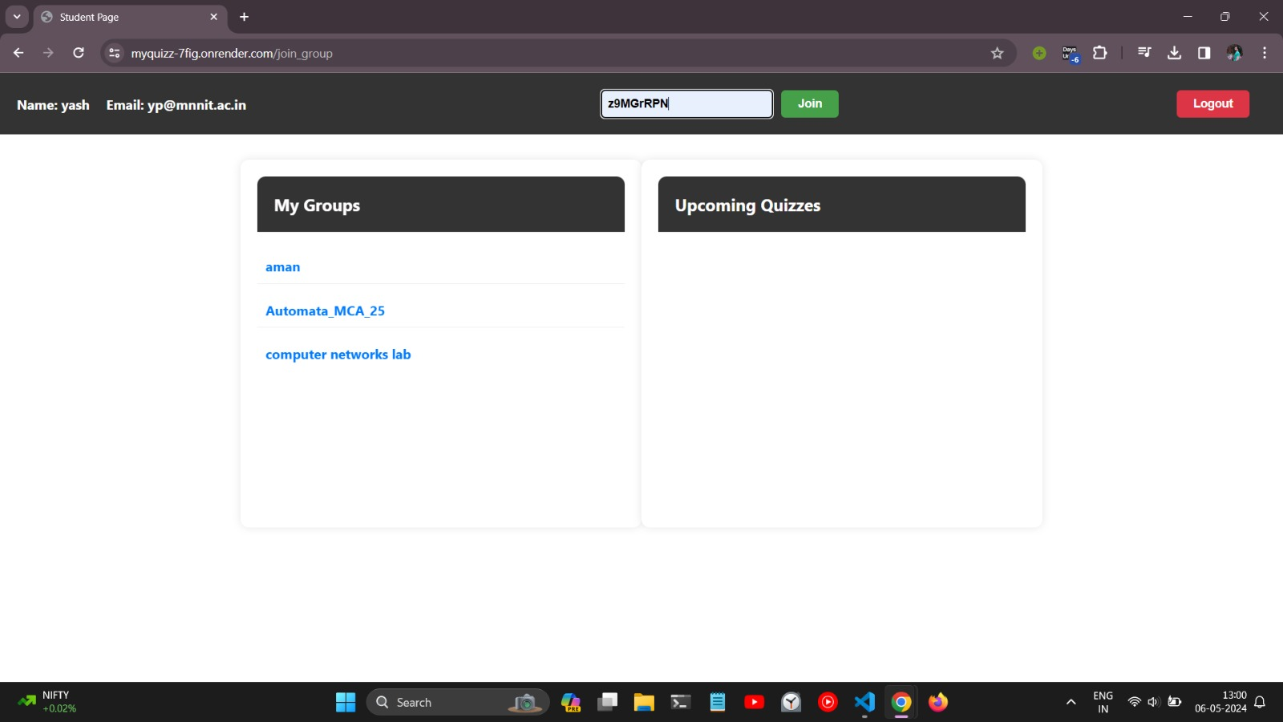

OS

Slide 24
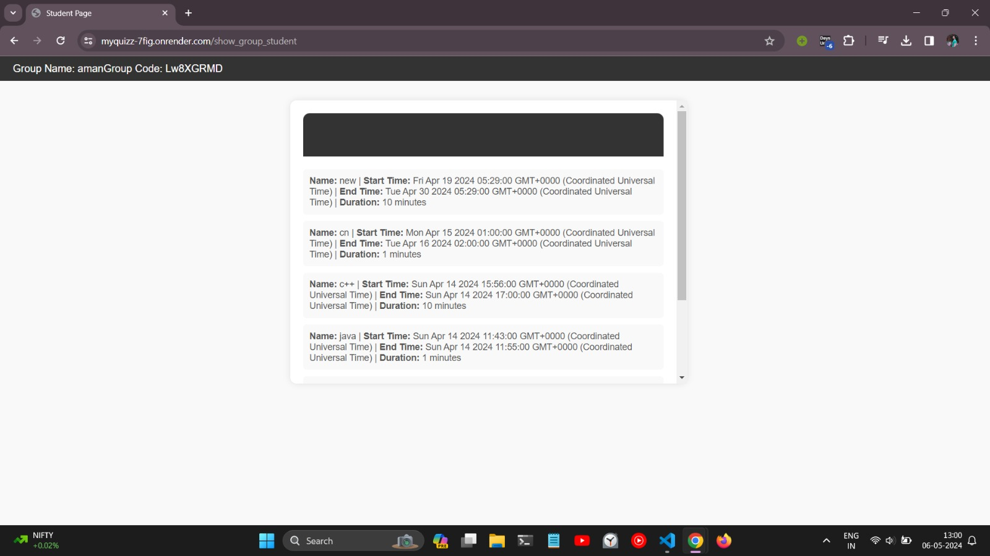
My Quizzes

Slide 25
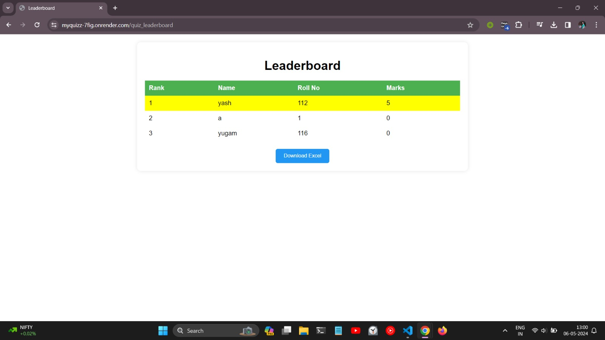
man

Slide 26
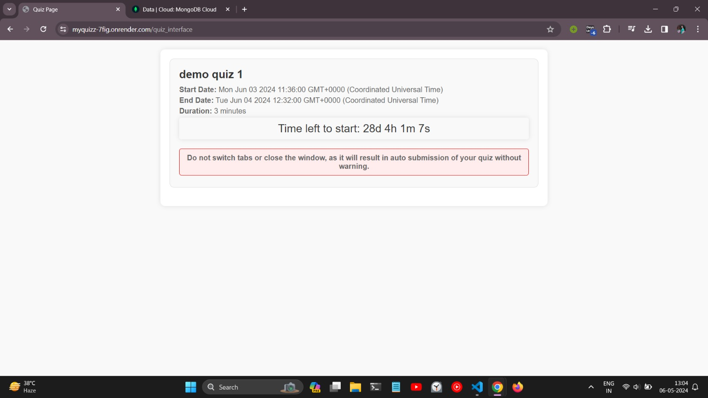

Slide 27
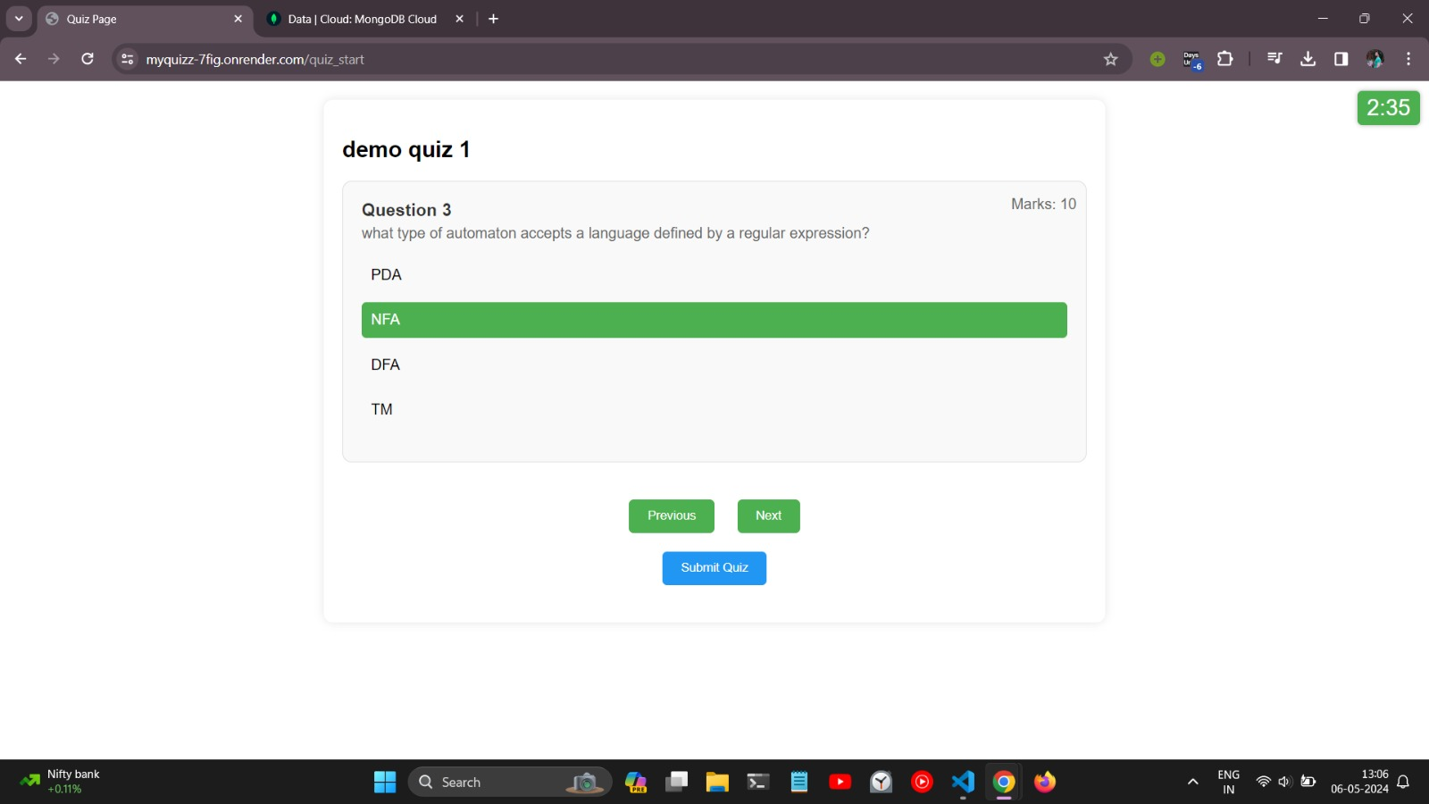

Slide 28
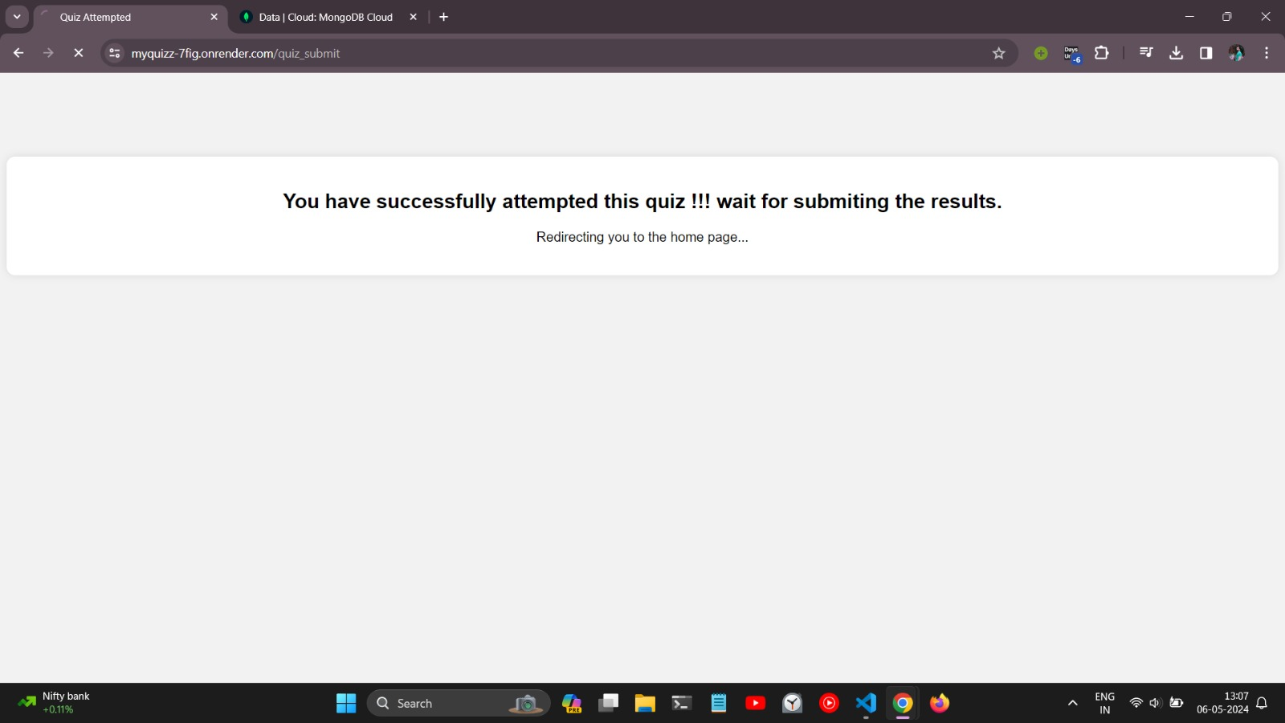

Slide 29
THANK YOU

