Slide 1

TEAM- unics
PUBLIC TRANSPORT

Slide 2
Table of content overview of solution architectural design information flow diagram prototype demo

Slide 3
Overview of solution
We install GPS in the buses to keep track of real time information of buses.
We will create an app “BUSWAY” AND Webpage www.busway.com
Using GPS and database we provide real time information of buses with the help of our website and app.
By easily sign up or login user can access the information about buses.
To save passengers time we provide information about seat availability , timing of bus and delay (if any).

Slide 4
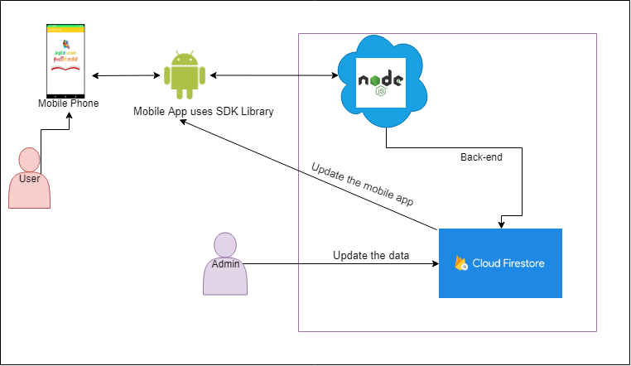
Architectural design

Slide 5
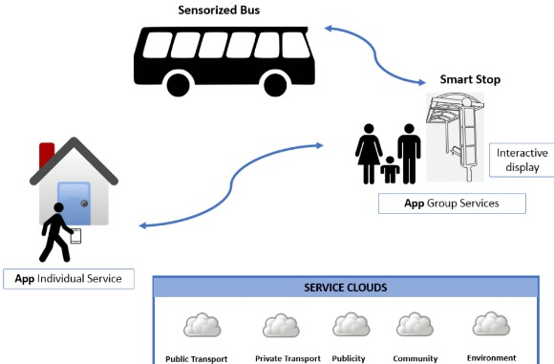
Architectural design

Slide 6
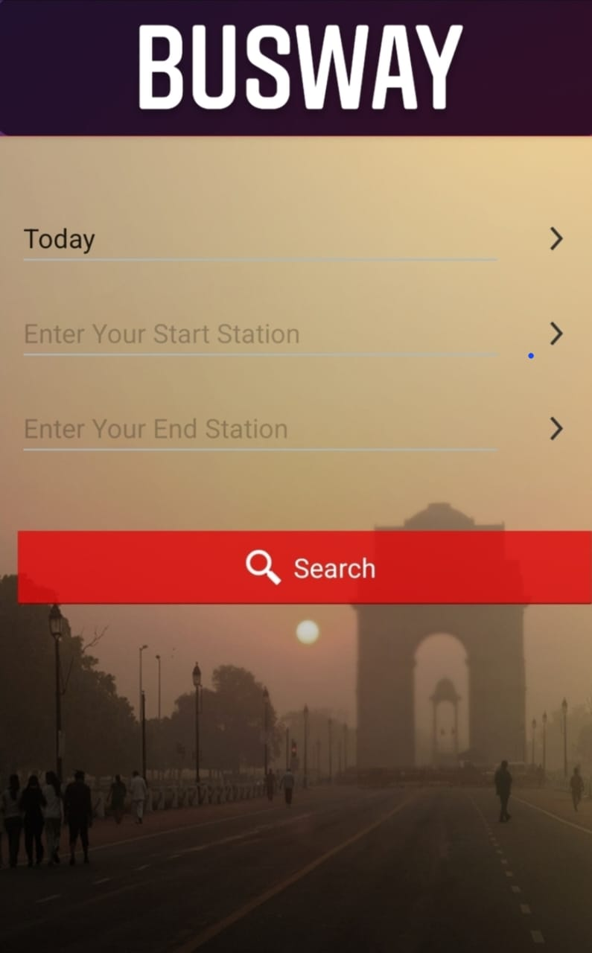
Prototype demo

Slide 7
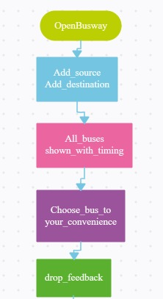
Information flow diagram

Slide 8


