Slide 1
Predicting Breast Cancer Malignancy: A Problog-based Approach with GUI Interface
By Anna Manucharyan

Slide 2
Contents
1. Introduction
4. Code Overview and Details
2. Dataset description and data preprocessing
5. Demonstration and Results
3. Bayesian Network and Problog
6. Conclusion

Slide 3
Breast Cancer
Breast cancer is a significant health concern, and early detection plays a crucial role in improving outcomes.
Accurate diagnosis is essential to provide appropriate treatment and care for patients
This project aims to predict whether a person has malignant or benign breast cancer based on various parameters

Slide 4
Dataset Description
The Wisconsin Breast Cancer dataset is used for prediction in this project.
The dataset contains information about breast cancer patients, including various attributes measured from images of their cell nuclei.
The parameters used for prediction include radius, texture, perimeter, area, smoothness, compactness, concavity, symmetry, and fractal dimension.
These parameters provide insights into the characteristics of the tumor.

Slide 5
Preprocessing
Before performing analysis, the dataset undergoes preprocessing steps.
Irrelevant columns, such as the patient ID, are removed from the dataset.
Rows with missing values are dropped to ensure data integrity.
These preprocessing steps help in creating a clean and reliable dataset for further analysis.

Slide 6
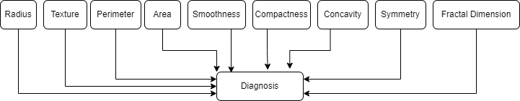
A Bayesian network is used to represent the relationships between the parameters.
Each parameter directly influences the diagnosis, as they provide specific details about the tumor.

Slide 7
Code Overview
GUI
Tkinter library to create a GUI-based application
Pandas
Pandas library for data manipulation
Problog
Problog library for probabilistic logic programming
The libraries can be installed by running this command: pip install -r libraries.txt

Slide 8
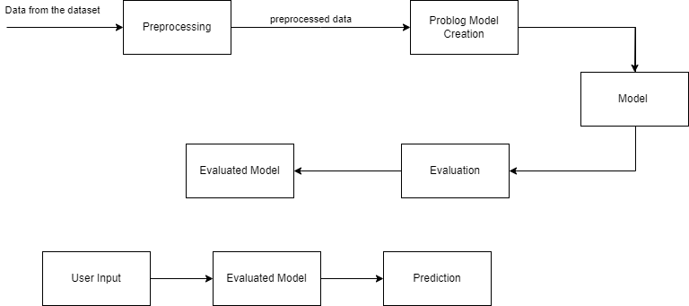

Slide 9
Details
Thresholds
Dividing data into 2 categories: small or large, smooth or rough, short or long, high or low
Reading the dataset
Reading the data and converting into proper Problog code format

Slide 10
Details
LFI
Learning from interpretations (LFI) mode is used to learn from the data
User input
The inputted data is converted into Problog code and the probability is calculated

Slide 11
Summary
The code defines functions for data processing and converting the input values into a format suitable for Problog.
The data is read from the dataset, and an array of evidence is created for Problog.
Minor problems related to reading data, such as handling non-numeric values in the "diagnosis" column, are appropriately addressed.
Users can input parameter values, and the application calculates the corresponding probability of having malignant cancer.

Slide 12
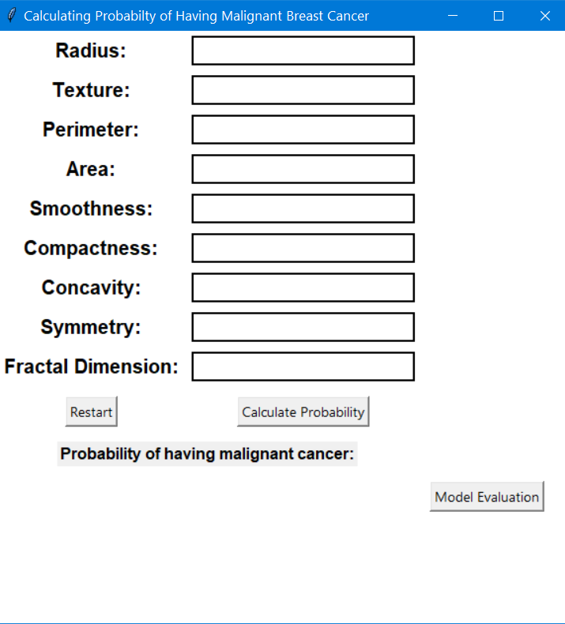

Application: Initial and after Calculation

Slide 13
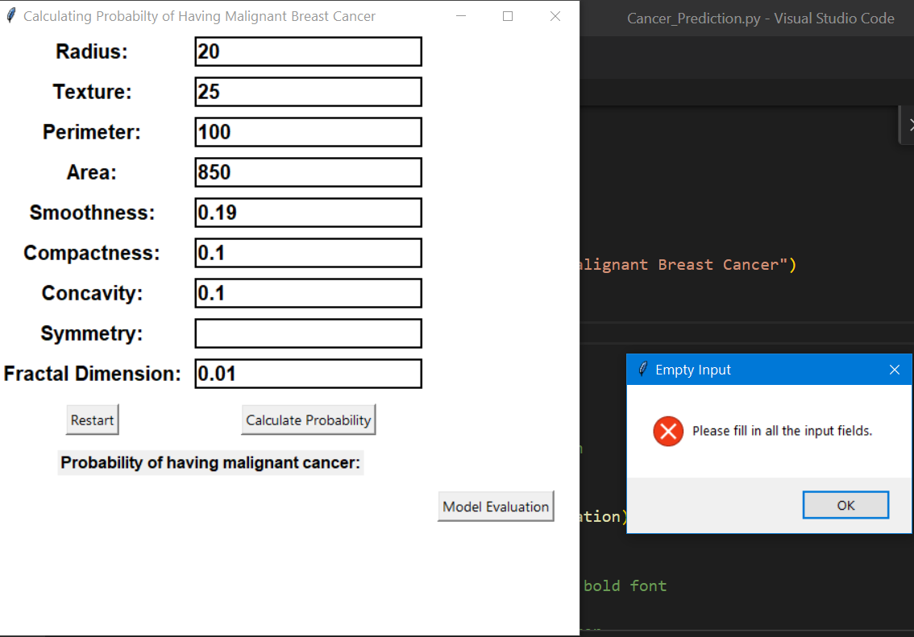
Error message if the user input is incomplete

Slide 14
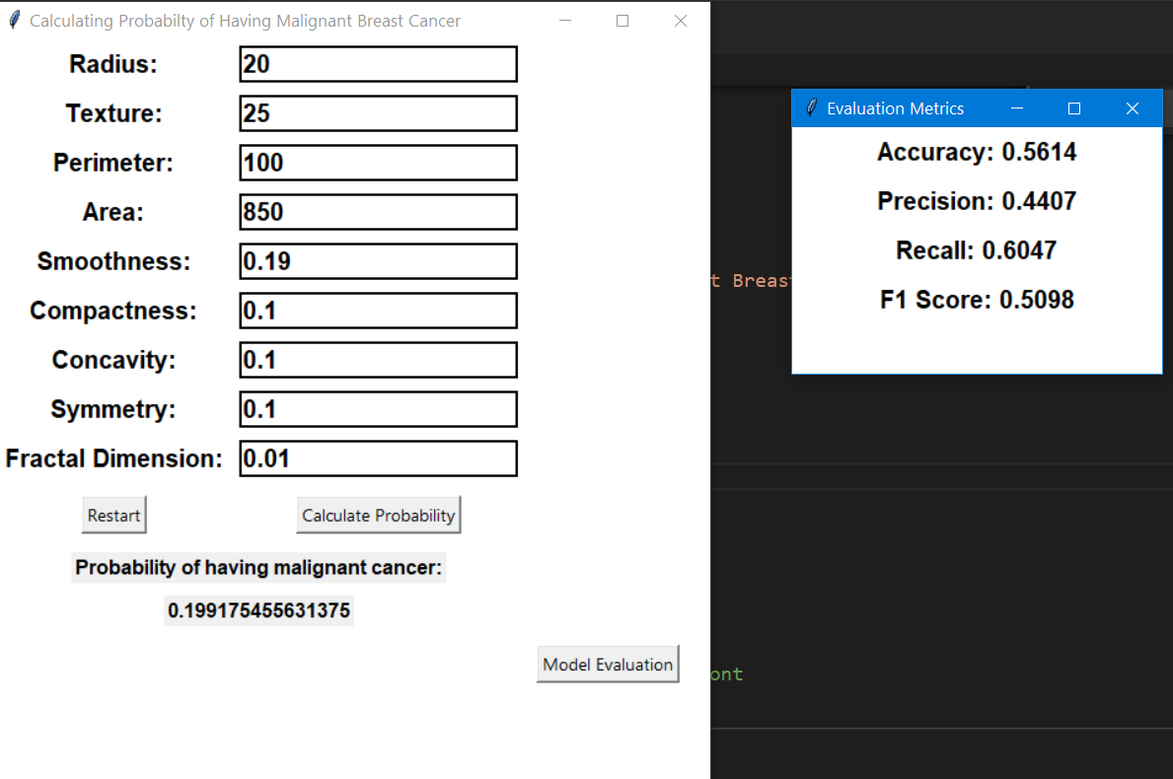
‘Model Evaluation’ button opens a window which shows the evaluation metrics

Slide 15
Thank You!

Slide 16
Resources
GUI Tkinter Library Documentation: Python Software Foundation. "GUI Tkinter Library Documentation." Python 3.9.7 Documentation. Accessed September 2021. https://docs.python.org/3/library/tk.html
Pandas Library Documentation: Pandas Development Team. "Pandas Library Documentation." Pandas 1.3.0 Documentation. Accessed September 2021. https://pandas.pydata.org/docs/
Problog Library Documentation: Problog Development Team. "Problog Library Documentation." Problog Latest Documentation. Accessed September 2021. https://problog.readthedocs.io/en/latest/
Sklearn Library Documentation: https://scikit-learn.org/stable/index.html
5. Problog Library in Python Usage Documentation and Examples: Problog Development Team. "Problog Library in Python Usage Documentation and Examples." Problog Latest Documentation. Accessed September 2021. https://problog.readthedocs.io/en/latest/python.html

Slide 17
Resources
6. Reading and using a dataset in Problog: AGH University of Science and Technology. "Reading and using a dataset in Problog." Artificial Intelligence Group - AGH University of Science and Technology. Accessed September 2021. https://ai.ia.agh.edu.pl/en:dydaktyka:problog:lab1
7. LFI model Documentation: Problog Development Team. "LFI model Documentation." Problog Latest Documentation. Accessed September 2021. https://problog.readthedocs.io/en/latest/modeling_basic.html
8. M. Zaman and C. -H. Lung, "Evaluation of machine learning techniques for network intrusion detection," NOMS 2018 - 2018 IEEE/IFIP Network Operations and Management Symposium, Taipei, Taiwan, 2018, pp. 1-5, doi: 10.1109/NOMS.2018.8406212.

Slide 18
Problog
Problog, a probabilistic logic programming language, is utilized for probabilistic reasoning in this project.
Problog allows us to incorporate uncertainty and probabilistic inference into the prediction process.
It enhances the accuracy and reliability of the predictions by considering the relationships between parameters.

