Slide 1

EIT-M
School of electrical and computer engineering
Presentation on
Semister project “The 3D car racing game”
Presentation Day 7/15/2019

Slide 2

DEVELOPED BY DAF GAMING DEVELOPERS DAWIT GETACHEW(96248/08) AMANUEL KIROS(96489/08) FRAOL ABEBE(96671/08)
DAF CAR RACING

Slide 3
What is our project?
our project Targeted to develop a 3D car racing game software that runs on computers operate by windows operating system only .

Slide 4
Why we choose this project?
This car racing game development become our concern due to some reasons
First we were playing video games and we Discussed about development and we decide that game development must be our project.
Our team is very suspisious on development of various games that are developed in the real world and also we wanted to gather information how they work and then we understood we can make one .
We dont observe such this kind intererest to develop games in our enviroment.

Slide 5
For whom we develop
Generally for all individual who have good habit of playing game on pc and uses windows operating system like
-To Students
-To Teenagers

Slide 6
4.How we build the game?
First we started to gather information about how games are developed and Related concepts.
second we started to dowload game engine and developing enviroments
UNITY
Visual studio
sublime text
Mono-develop

Slide 7
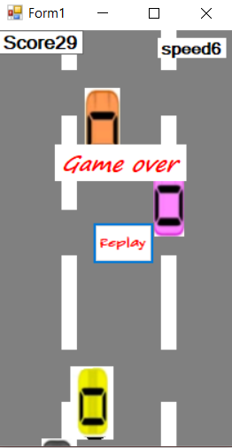
Initially....
Initially we develop a 2D car game As we see in the picture on the Right . This game is very low in graphics(this is because the developing tools have no good graphics design tools and dont have libraries that can be accessed) , The game having low satisfaction by the players.

Slide 8
And to solve this we started to explore
3D game
How it is developed
What is its advantage of developing a game.

Slide 9
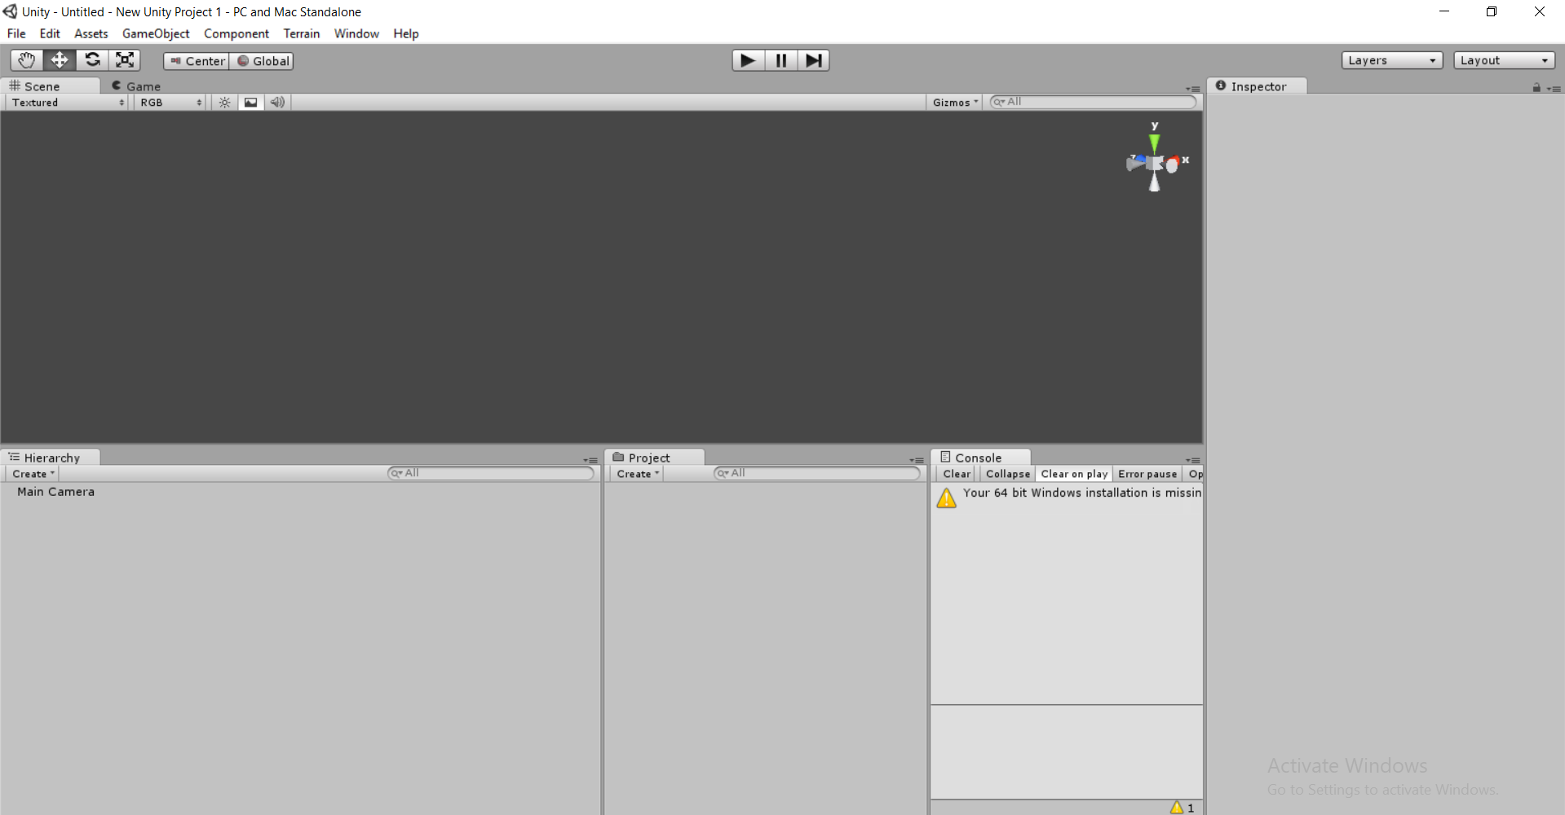
We started to design the game graphics by using Unity

Slide 10
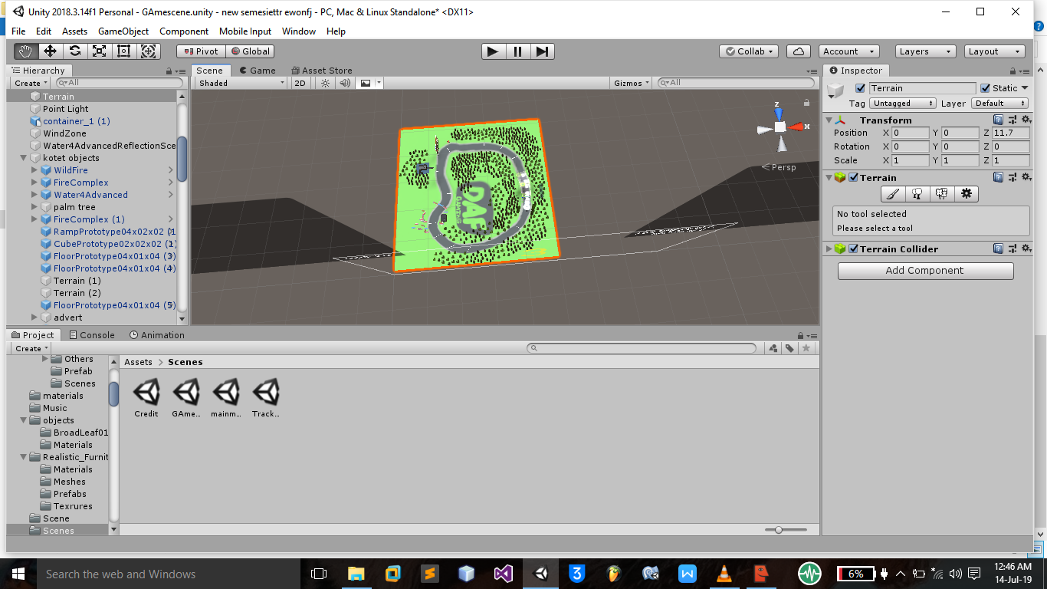
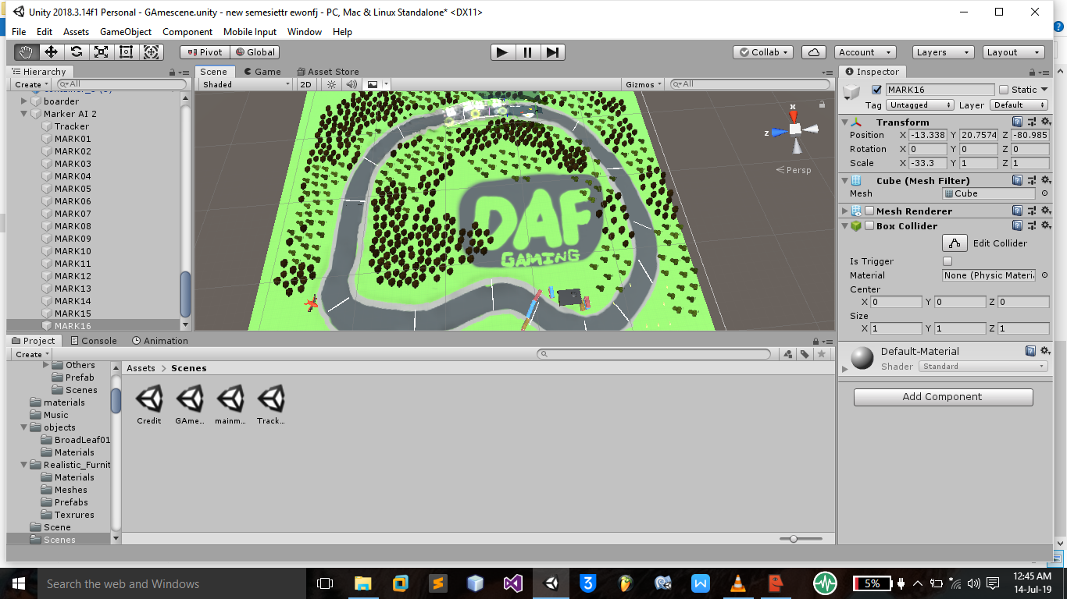
The racing enviroment....

Slide 11
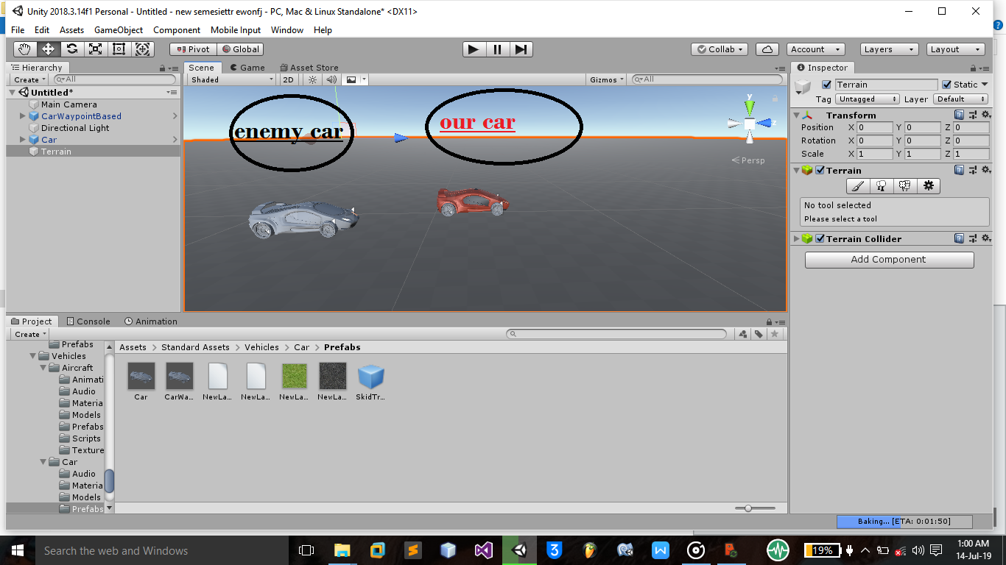
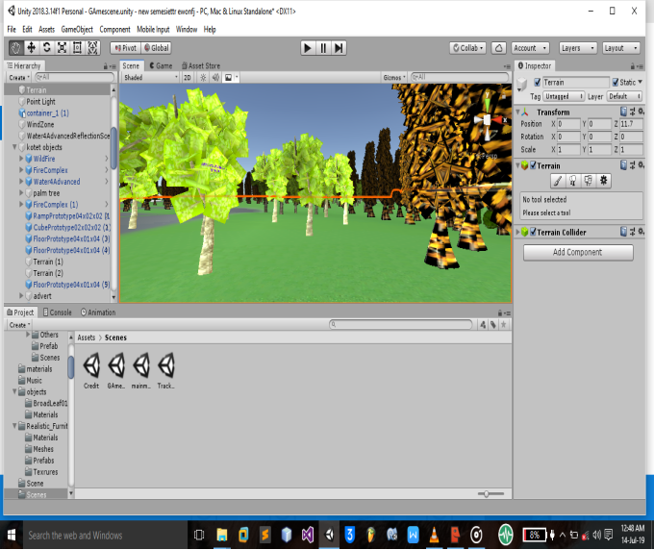
4.1 Adding cars and trees to racing enviroment

Slide 12
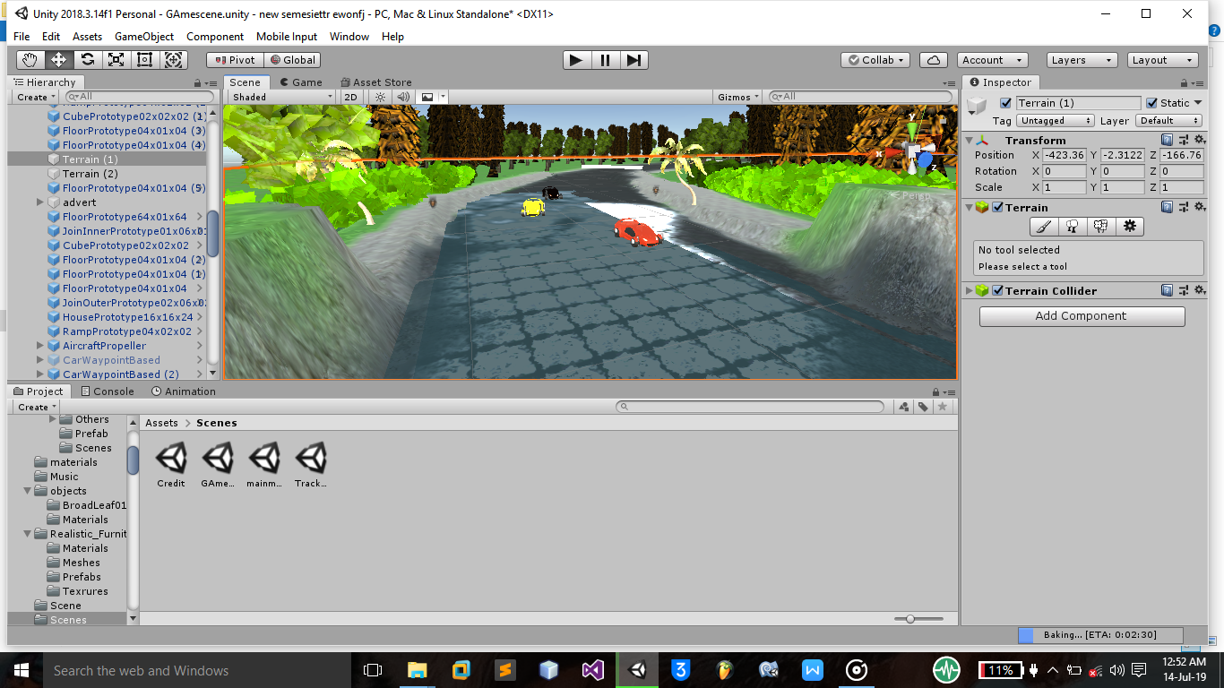
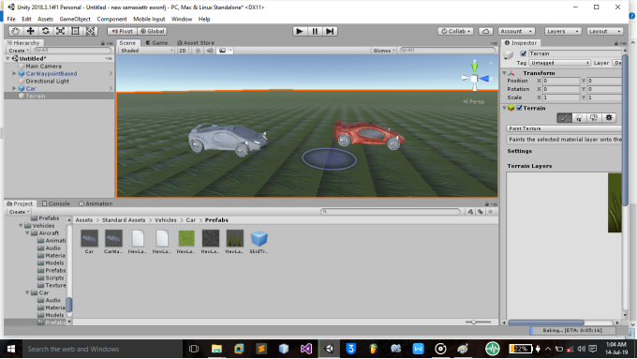
Cars and Trees

Slide 13
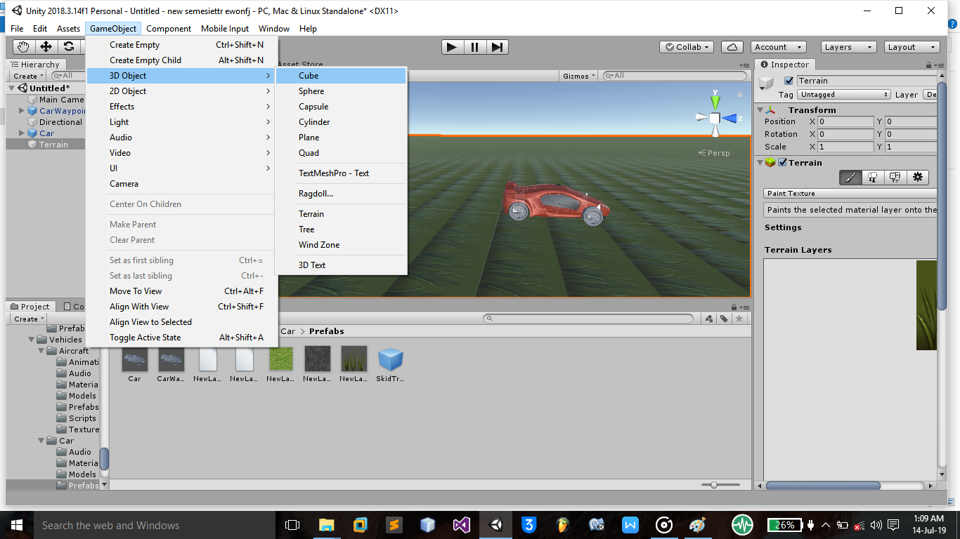
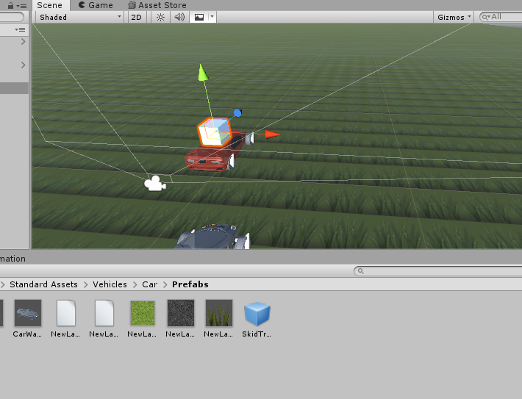
4.2 coding phase. The cars are built in the unity library so the first thing to do is attaching the main camera to our car and code the cube we use visual basic studio,and use C sharp languages

Slide 14
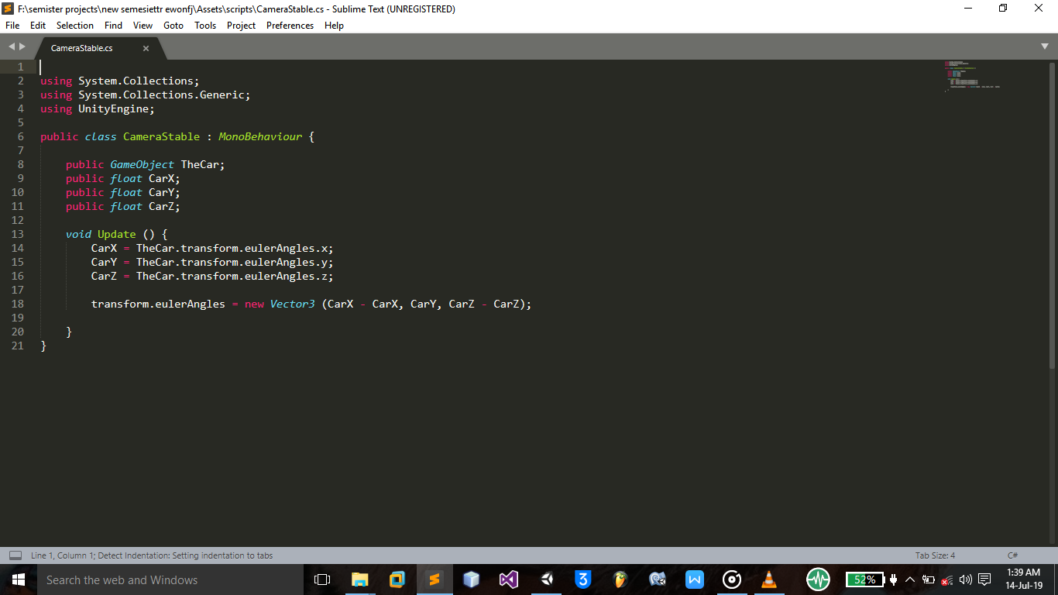
we started the main coding from the main camera and finally the AI cars
Sample code here for the camera-----
public class CameraStable : MonoBehaviour {
public GameObject TheCar;
public float CarX;
public float CarY;
public float CarZ;
void Update () {
CarX = TheCar.transform.eulerAngles.x;
CarY = TheCar.transform.eulerAngles.y;
CarZ = TheCar.transform.eulerAngles.z;
transform.eulerAngles = new Vector3 (CarX - CarX, CarY, CarZ - CarZ);

Slide 15
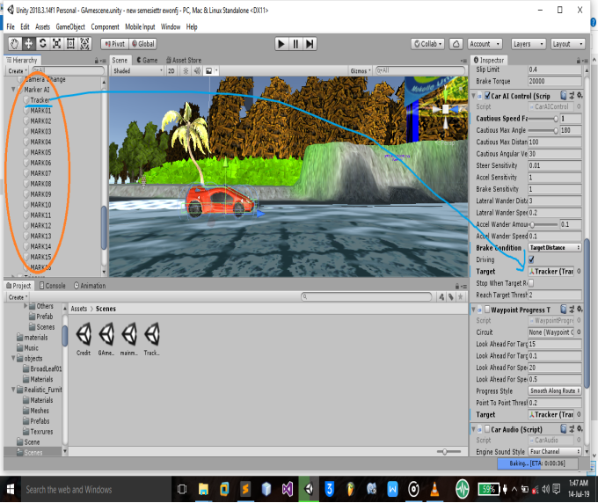
And the AI car coding sample
public class Dreamcar01Track : MonoBehaviour {
public GameObject TheMarker;
public GameObject Mark01;
public GameObject Mark02;
public GameObject Mark03;
public GameObject Mark04;
public GameObject Mark05;
public int MarkTracker;
void Update () {
if (MarkTracker == 0) {
TheMarker.transform.position = Mark01.transform.position;

Slide 16
continued
As we observe in the above pages we code for the cars and the camera and these does not mean it is done there are many code scrpits added to make the game work we show this 2 code sample because they are the main one.

Slide 17
4.2 check for compiler error of the scripts
we checked the scrpits and we face some error and we solve them and we are good to go
5 build the game
Before we build the game we must check if the developed game meets the requirement and then we build the game(Change in to executable form that can run others pc)

Slide 18
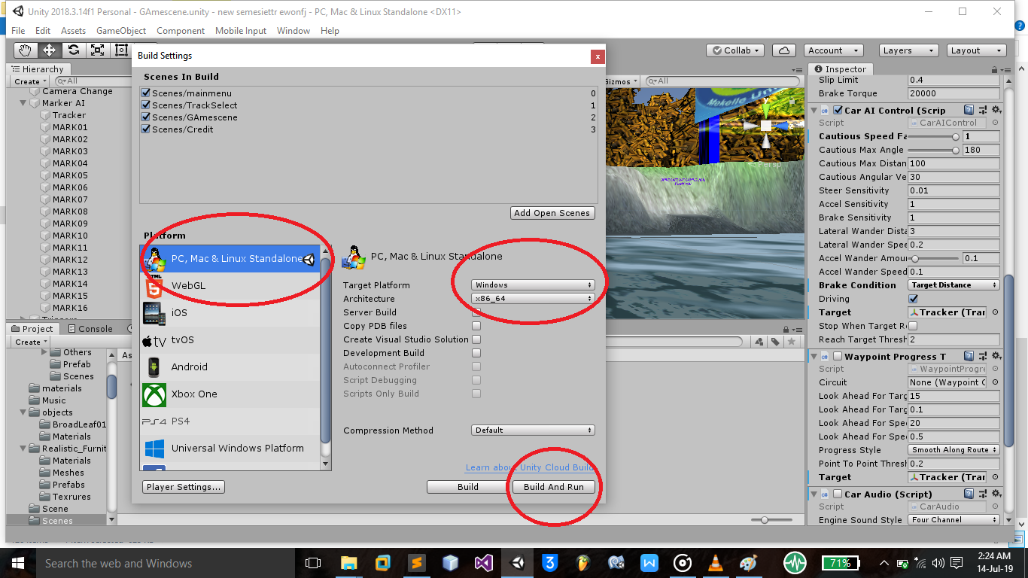
building the final game

Slide 19
Languages C#,Unity
C# is a good for a game & it is a managed language means it manage memory for you which is easier than manauel management but has some draw back c# is not fast Efficient enough
Advantage
1 easy to learn
2 has large online community
3 unity game development
4 make apps for android and ios
unity engine
-unity has power full game development tools that is used in many areas

Slide 20
Summery
Generally we developed an 3D racing game that is compatable for windows operating system . we pass through have different stages to develope(Graphics designs,script coding, debug) and this stages must go step by step and related with each other therefor they meet the requirment of the software.

Slide 21
“Thank you”

