Slide 1
API
APPLICATION
PROGRAMMING
INTERFACE

Slide 2
Introduction to API
An Application Programming Interface (API) is a
set of commands, functions and protocols which programmers can use when building a software.
It’s like a messenger that takes our requests to a system and returns a response back to us.

Slide 3
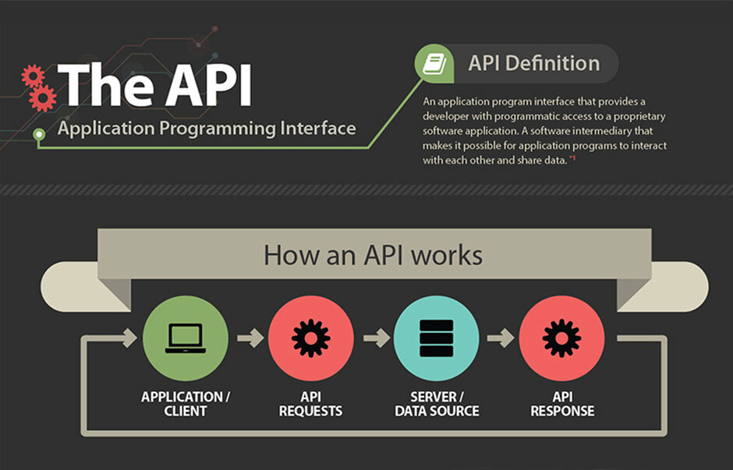

Slide 4
Why do we need API’s ?
We need APIs in many cases like to get data for a web application or to connect to a remote server that has data like weather that keeps changing or to enable two applications to exchange data b/w each other.
API not only provide reusability of code but also uses the concept of Abstraction (showing functionality by hiding complexity).

Slide 5
Different API’s communicate in different ways:
SOAP: Uses only XML format.
RESTful APIs: JSON, XML, etc.

Slide 6
Example: The Twitter API
The Twitter API is a web-based API that allows developers to interact with Twitter data.
Twitter uses a popular and easy-to-use format called JSON.
The Twitter API tells us what we can do with tweets: search for tweets, create a tweet, favorite a tweet.

Slide 7
Thank You

