Slide 1
Financial Time Series Forecasting with Deep Learning
Submitted by:
Amanullah Quamer
12222626
Roll No: 02
Submitted to:
Ms. Sweta Pandey

Slide 2
INTRODUCTION
Goal of the Project:
Predict future Apple stock prices using Deep Learning.
Explore traditional and innovative methods.
Why This is Important:
Stock forecasting is crucial for finance.
Time series data is complex – needs smart models.

Slide 3
Dataset & Experiments
Dataset Info:
AAPL stock prices (Hourly)
From: May 2022 to April 2024
Columns: Open, High, Low, Close
Steps:
Convert data to GADF images (32x32).
Train various deep learning models.
Compare accuracy and graph .

Slide 4
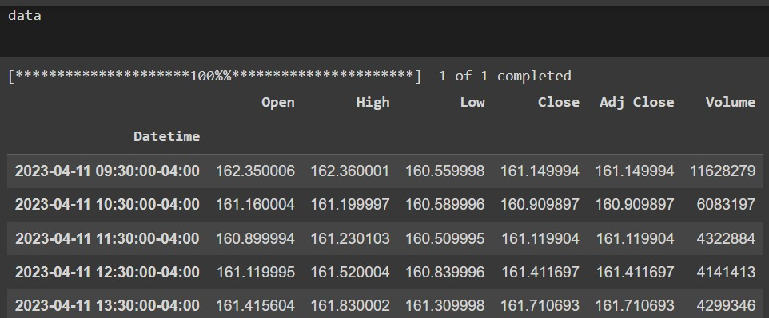

Slide 5
Methodology
GADF Encoding: • Transform each window of “close” prices into a 32×32 Gramian Angular difference Field
Modeling pipeline:
Image generation → 2. Feature extraction → 3. Sequence forecasting
Training setup:
3500 GADF images generated
Batch training, MSE loss, early stopping on validation

Slide 6
Models Implemented
Simple LSTM on raw time series
CNN directly on GADF images
LSTM over sequence of GADF images
ResNet-18 feature extractor + LSTM on embeddings

Slide 7
Results
CNN on images → poor sequence capture
Simple LSTM → decent but struggled at troughs
LSTM on GADF → smoother fit, better at dips
ResNet-18 + LSTM → best overall
Captures spatial patterns (via ResNet) & temporal trends (via LSTM)
Significant reduction in prediction error near sharp movements

Slide 8
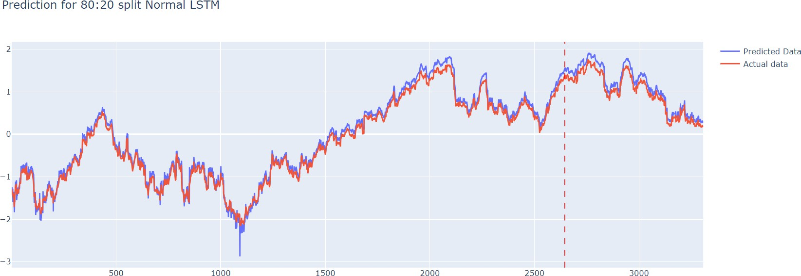
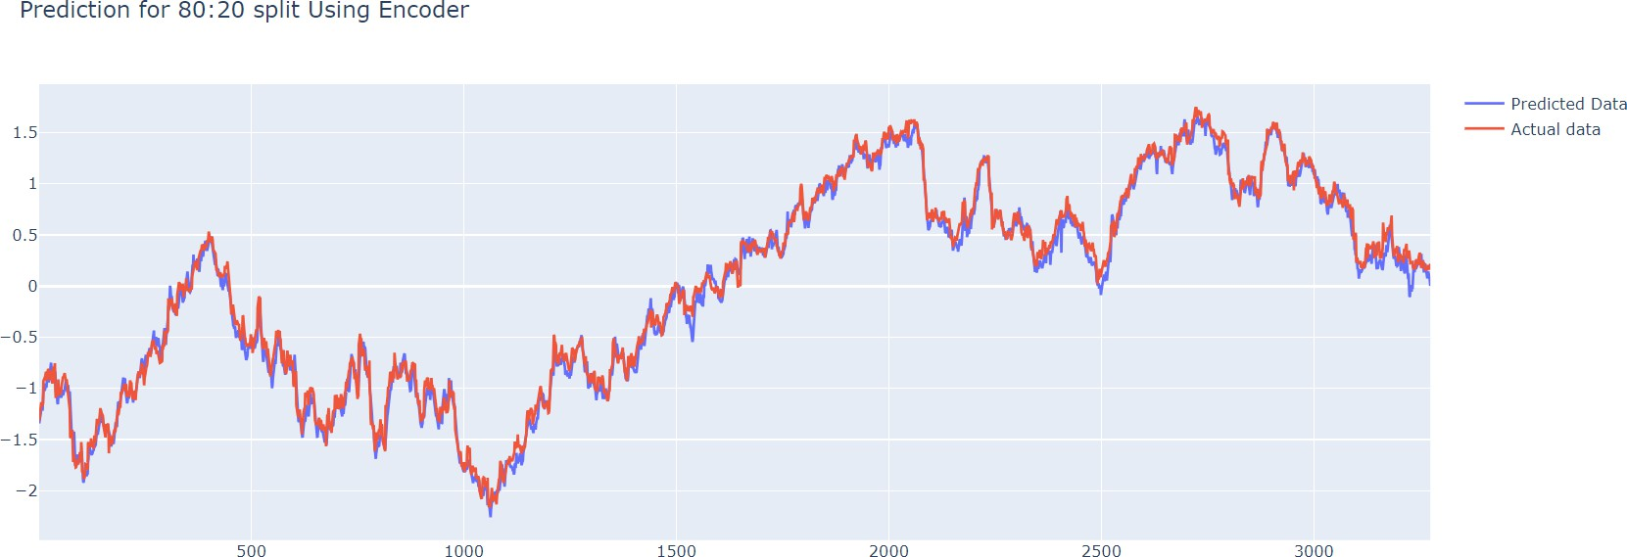
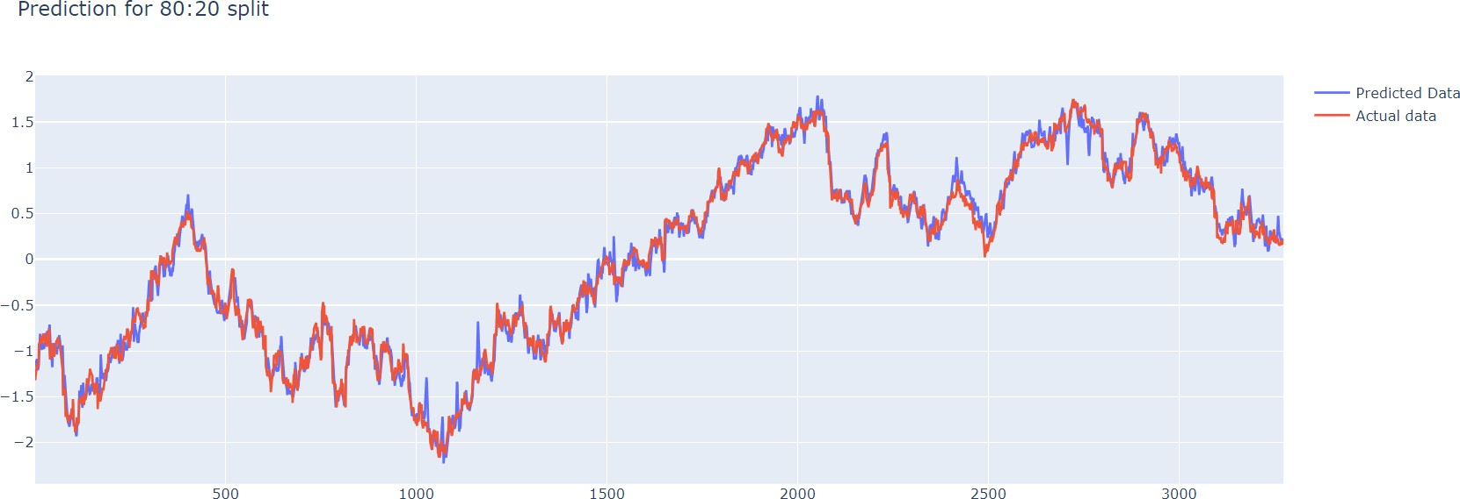
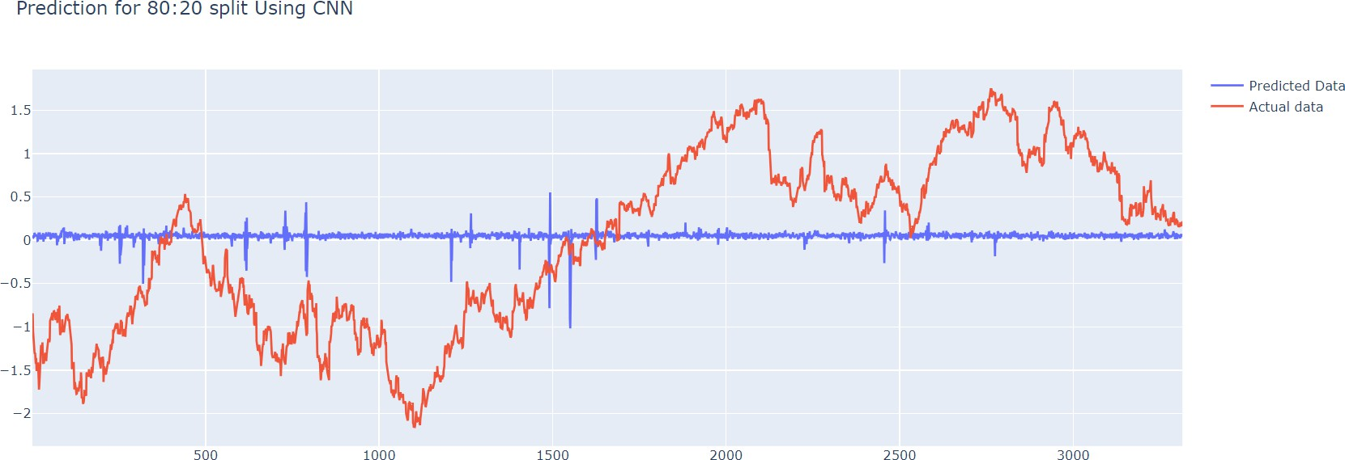

Slide 9
COMPARISONS OF THE BEST MODEL WITH OTHERS
Simple LSTM on time series data vs LSTM on encoded GADF images:
CNN on GADF images vs LSTM on encoded GADF images:
LSTM on GADF images vs LSTM on encoded GADF images:

Slide 10
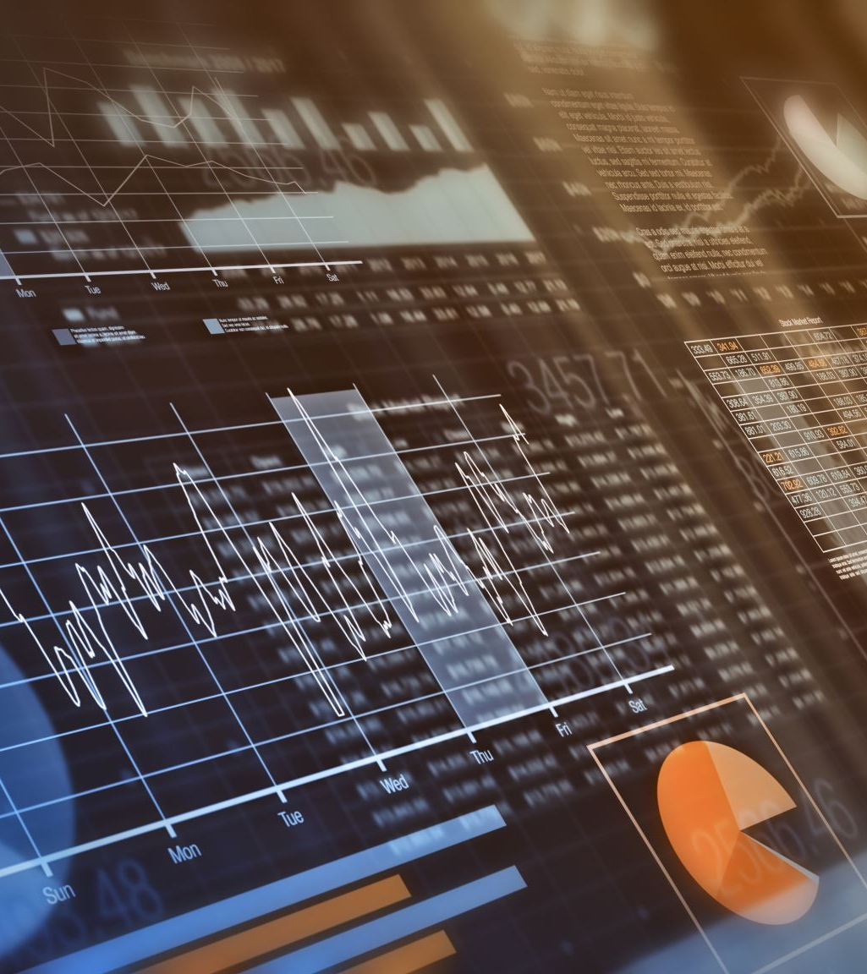
Conclusion & Future Scope
Key Takeaways:
Time series → GADF images → better insights.
Deep learning + vision models = improved forecasting.
Future Work:
Apply to high-frequency trading, medical data.
Experiment with better image generation or hybrid models.

