Slide 1
Which Truth Does the Slide See?
Project update · Week 1 + Week 2
Auditing what pathology foundation models learn when IHC, RNA and protein disagree
Aman Uniyal · Aman Srivastava
Topics in AI for Healthcare, IIIT Hyderabad
Base project: Kamineni – Multimodal Breast Cancer Diagnostic & Outcome Assistant
Notes:
Week 1 slides were not presented, so this deck covers Week 1 (proposal, data, first baselines) and the Week 2 updates, ending with the Week 3 plan.

Slide 2
Proposal: problem, question and pipeline
WEEK 1
Clinical problem
Five experiments
ER/PR/HER2 status drives therapy and is measured by IHC
IHC often disagrees with mRNA; for HER2 0 vs 1+ pathologists agree in only ~26% of cases
H&E models learn whatever label they get: which biological truth do they track?
1a Is the IHC or the RNA label more predictable?
1b On discordant cases, which side does the model take?
1c Does it change from FFPE to frozen slides?
1d Is HER2 0 vs 1+ visible in H&E at all?
1e Do two frozen slides of one tumour agree?
Research question
When IHC, RNA and protein disagree, which one does an H&E foundation model follow, and does it depend on the slide type?
H&E slide
(FFPE / frozen)
Tissue
patches
Frozen encoder
(UNI, CONCH, TITAN)
Slide classifier
(mean-pool, ABMIL)
Compare labels
site-grouped CV
Labels: IHC | RNA | protein (RPPA)
Notes:
Novelty is the evaluation, not a new architecture: same patients, slides and folds, evaluated against different reference standards.

Slide 3
Dataset: TCGA-BRCA
WEEK 1
1,097
40
How often the “truths” disagree (no images)
patients (open access)
tissue-source sites
Marker | Compared | Discordant | mRNA alone → IHC (AUC)
ER | IHC vs RNA | 5.5% | 0.96
PR | IHC vs RNA | 16.7% | 0.92
HER2 | IHC/FISH vs amplification | 10.8% | 0.87
Labels joined per patient: IHC, RNA (ESR1/PGR/ERBB2), PAM50, RPPA protein. Three slide types per patient:
Slide type | Patients
FFPE diagnostic (DX) | 1,060
Frozen top (TS) | 1,043
Frozen bottom (BS) | 427
Notes
TCGA's HER2 field is noisy: we use a strict IHC/FISH rule
ER discordance is mostly ER-low tumours (< 10% of cells stained)
All five experiments are feasible on public data (smallest: 1d, 57 vs 261 cases)
Notes:
Discordance is a minority of patients, which is why the paired, same-patient design matters.

Slide 4
Baselines and first results
WEEK 1
3 frozen encoders on the DX slides of 1,055 patients → logistic regression on the slide embedding (TITAN) or the mean of all patches (UNI, CONCH); 5-fold site-grouped CV over seeds
 | Task | TITAN | UNI v1 | CONCH v1
1a AUC | PR: IHC → RNA (n=986) | 0.80 → 0.79 | 0.80 → 0.73 | 0.78 → 0.75
 | HER2: clin. → amp. (n=478) | 0.68 → 0.72 | 0.63 → 0.68 | 0.62 → 0.68
1b side | ER discordant (n=54) | 39:15** | 34:20 | 35:19*
 | PR discordant (n=169) | 69:100* | 55:114*** | 61:108***
 | HER2 discordant (n=60) | 35:25 | 44:16*** | 39:21*
Control | Shuffled ER labels | 0.46 | 0.51 | 0.46
 | HER2 0 vs low | 0.40 | 0.50 | 0.43
1b: discordant cases siding molecular : IHC; teal = molecular side wins, amber = IHC side wins (binomial *, **, *** = p < 0.05, 0.01, 0.001). HER2-low: mRNA alone 0.69. TITAN 5 seeds, UNI/CONCH 3.
Consistent across all three encoders
Site leakage and HER2-low
ER, HER2: H&E tracks the molecular label more than IHC
PR: the opposite, sides with IHC (to be checked)
Embeddings identify the hospital 82% of the time
HER2 0 vs 1+: 0.63 (random folds) → chance (site-grouped)
Notes:
These are the Week 1 numbers as first computed. The PR result is revisited in Week 2.

Slide 5
ABMIL agrees; PR was a cut-off artefact
WEEK 2
Attention-MIL (ABMIL) on UNI and CONCH patches, 3 seeds, same site-grouped folds
ABMIL | UNI v1 | CONCH v1
1a ER: IHC → RNA | 0.86 → 0.91 | 0.85 → 0.90
1a HER2: clinical → amplif. | 0.67 → 0.69 | 0.67 → 0.73
1b ER discordant (n=54) | 34:20 | 36:18*
1b HER2 discordant (n=60) | 47:13*** | 34:26
Shuffled ER (control) | 0.49 | 0.46
HER2 0 vs low | 0.55 | 0.52
Takeaway
ABMIL agrees with mean-pooling: the RNA-defined ER label is more predictable, and HER2 calls side with amplification
HER2-low stays at chance with attention too
PR: no reliable preference
GMM cut-off labels more tumours PR-negative than IHC does; matching IHC prevalence removes the gap
Discordant PR (n = 133) then splits evenly: all five models p > 0.3
Notes:
Week 1 plan items: finish ABMIL; test the PR RNA cut-off before interpreting the reversal. The apparent PR 'IHC preference' disappears with a prevalence-matched cut-off in all five models.

Slide 6
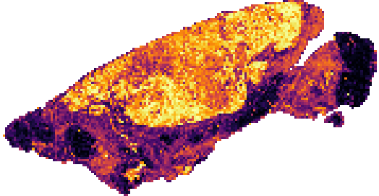
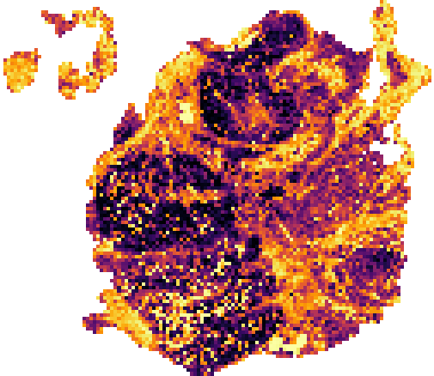
ER-low tumours are read as ER-negative
WEEK 2
Model trained on concordant patients; which label does it agree with on discordant ones? (RNA : IHC)
ER discordant subgroup | n | TITAN | UNI | CONCH
IHC+ / RNA− | 34 | 24:10 | 21:13 | 22:12
IHC− / RNA+ | 20 | 15:5 | 13:7 | 13:7
ER-low (IHC+, < 10% stained) | 11 | 9:2 | 9:2 | 9:2
ER 10–39% stained | 9 | 7:2 | 6:3 | 7:2
ABMIL attention maps: 54 discordant + 10 reference patients (UNI)
35 / 54
8 / 10
r = 0.52
ER-low (IHC+ < 10%), RNA−, Basal → called ER−, P(ER+) = 0.00
discordant: side with RNA
ER-low: side with RNA
P(ER+) vs ESR1 level
Exception: ER-low, RNA−, HER2-enriched → called ER+ (with IHC)
Colour = attention percentile within the slide (bright = high); patch positions only
References correctly classified 8 / 10; attention is focused (5–7% of patches hold half of it) and similar across groups
Both ER-low exceptions are PAM50 HER2-enriched; all 6 Basal ER-low tumours are called ER−
Notes:
Week 1 plan items: ER-low vs ER-high discordant cases; attention maps on discordant cases. The ER RNA preference is driven by ER-low tumours, which the model reads as ER-negative; HER2-enriched tumours are the exception.

Slide 7
Fixed splits; frozen slides encoded
WEEK 2
Fixed site-grouped CV splits
Frozen-slide feature pipeline (Ada, RTX 2080 Ti)
Two scikit-learn versions gave different folds for the same seed
One shared split file (data/splits/folds.csv) for every script; library pinned
All linear baselines rerun on Ada: conclusions unchanged
Manifest
1,516 TS/BS slides
373 TS+BS pairs
Download
IDC copy
(Google Cloud)
TRIDENT
tissue seg. +
256 px @ 20×
UNI v1
(frozen)
Mean + 4,096-
patch bag;
delete slide
1,515
~75 s
1.0000
frozen slides encoded (1,044 TS, 471 BS)
per slide; 3 GPUs in parallel
cosine to TRACE features (46 DX slides re-extracted)
+0.058
TITAN ER ΔAUC on fixed splits (95% CI +0.031, +0.084)
Why IDC, not GDC
Ready for 1c / 1e
GDC from Ada: 0.02–0.3 MB/s per connection (430 GB → weeks)
Same slides in IDC (DICOM) via Google Cloud: ~10 MB/s
Our pipeline reproduces the DX features exactly, so DX vs frozen differ only in tissue
UNI weights access granted; all slides done
Notes:
Week 1 logistics: fixed CV splits; UNI weights access; download + encode the frozen slides. Week 1 plan: start frozen slides for 1c and 1e. Features are ready; the 1c/1e analyses are Week 3.

Slide 8
Plan for the next week (Week 3)
WEEK 3
Done in Week 2
Next experiments
Analysis and logistics
✓ ABMIL (UNI, CONCH) for 1a, 1b, 1d
✓ PR cut-off test: no reliable preference
✓ ER-low vs ER-high discordant cases
✓ Attention maps on discordant cases
✓ Fixed CV splits; baselines rerun
✓ UNI access; 1,515 frozen slides encoded
1c: FFPE vs frozen × IHC vs RNA label; interaction test; % tumour cells as covariate
1e: TS vs BS agreement on 373 pairs (ICC, κ, % flipped calls)
Statistics: DeLong tests for 1a; combined 1b evidence across encoders
Overlay attention on the real slide images (does it sit on tumour?)
Describe discordant patients: PAM50, % of cells ER-stained, histology
Rerun ABMIL on the fixed splits for one set of final tables
Compute on Ada (11 GB GPUs) | Estimate
Frozen-slide features (1,515 slides) | done, ~15 h on 2–3 GPUs
1c / 1e analyses (linear probes, bootstrap) | < 1 h CPU
ABMIL rerun on fixed splits (UNI + CONCH) | ~10 GPU-hours
Notes:
Everything listed under Next is Week 3 work; Week 2 delivered all items planned in Week 1.

