Slide 1
EECS 6895 FINAL PROJECT
Multimodal Visual Search
for Product Catalogs
Aman Upganlawar | au2327
Advanced Big Data and AI

Slide 2
Problem Statement
2
The Challenge
Keyword search ignores visuals
Product attributes embedded in images are completely invisible to search
E-commerce catalogs are broken.
Retailers have hundreds of thousands of product images but search is still keyword-only. Customers ask questions like "show me a waterproof jacket similar to this one" or "which sofa comes in blue?" and get zero useful results.
The cost:
Lost sales, frustrated shoppers, and ops teams manually tagging inventory at scale.
Manual tagging doesn't scale
Labeling 100k+ SKUs by hand is slow, expensive, and inconsistent
No grounded answers
Shoppers need answers, not just a list of images to sift through
EECS 6895 | Aman Upganlawar | au2327

Slide 3
Proposed Solution
3
A multimodal visual search engine for product catalogs users query a retailer's image inventory with natural language or a reference image, and get grounded answers powered by CLIP retrieval and a VLM re-ranking layer.
01
02
03
04
Catalog Ingestion
Vector Index
Query & Retrieve
VLM Re-rank & Answer
Ingest product images, extract CLIP visual embeddings per SKU
→
Store embeddings in FAISS/Chroma; metadata in SQLite for filtering
→
NL or image query encoded → top-K visually similar products retrieved
→
GPT-4V scores top-K results, re-ranks, and returns a grounded answer
EECS 6895 | Aman Upganlawar | au2327

Slide 4
System Architecture
4
Indexing Pipeline
Image Upload
CLIP / LLaVA
Embedding
Vector Store
(FAISS/Chroma)
Index
retrieves
Query Pipeline
NL Query
Query
Embedding
Top-K
Retrieval
VLM
(GPT-4V)
Answer
EECS 6895 | Aman Upganlawar | au2327

Slide 5
Technology Stack
5
Model Layer
Data Layer
GPT-4V / LLaVA (VLM)
CLIP (vision encoder)
Sentence-Transformers (text encoder)
FAISS / ChromaDB (vector store)
SQLite (metadata)
HuggingFace Datasets (eval)
Backend
Frontend / Eval
Python 3.11
FastAPI
LangChain (orchestration)
Streamlit (demo UI)
BLEU / F1 / Recall@K metrics
Latency profiling
EECS 6895 | Aman Upganlawar | au2327

Slide 6
Evaluation Plan
7
Dataset
Metrics
Recall@K
VQAv2 subset
~500–1,000 image-question pairs for eval
Custom domain set (100 images + 10 Q each)
Are the right images retrieved in top-K results?
Answer F1
Token overlap between predicted and ground truth answers
Baselines
Latency (p50/p95)
End-to-end query response time at scale
Keyword metadata search (no embeddings)
Direct VLM query (no retrieval step)
Our full pipeline: retrieval + VLM
Embedding ablation
CLIP vs LLaVA embeddings, evaluate which retrieves better?
EECS 6895 | Aman Upganlawar | au2327

Slide 7
Why This Project
Matters
Real Users
Shoppers and catalog ops teams at every e-commerce company face this problem today
Real Scale
Amazon, Shopify, Pinterest all run versions of this, it's a proven, high-value problem space
Re-ranking
The VLM re-ranking layer is a production technique that goes beyond standard RAG demos
Dataset
Amazon Berkeley Objects and IKEA catalog provide a concrete, public benchmark to evaluate against
Aman Upganlawar | au2327 | EECS 6895

Slide 8
8
Results
n = 150 questions | 2,711 distractors | CLIP ViT-B/32 + FAISS | GPT-4o re-rank
Config
R@1
R@3
R@5
Answer F1
Mean latency
A — image + FAISS
0.113
0.207
0.253
0.424
58 ms
B — text + FAISS
0.173
0.327
0.400
0.373
1.07 s
C — image + FAISS + GPT-4o
0.233
0.253
0.253
0.430
4.43 s
THREE FINDINGS
1
GPT-4o re-rank doubles top-1 accuracy 0.113 → 0.233 (+12 pp). Caps at config A's R@5, re-rank can't recover items the retriever missed.
2
Text retrieval (B) wins on raw recall Eval questions were drafted from product text, known bias in the benchmark.
3
Latency is the cost of re-rank 76× slower than CLIP-only, still acceptable for an interactive demo.
Note on Answer F1: token-overlap penalises paraphrase, GPT-4o writes full sentences, ground truths are terse product strings, so F1 saturates ~0.43 across all configs (a metric ceiling, not a system failure).
EECS 6895 | Aman Upganlawar | au2327

Slide 9
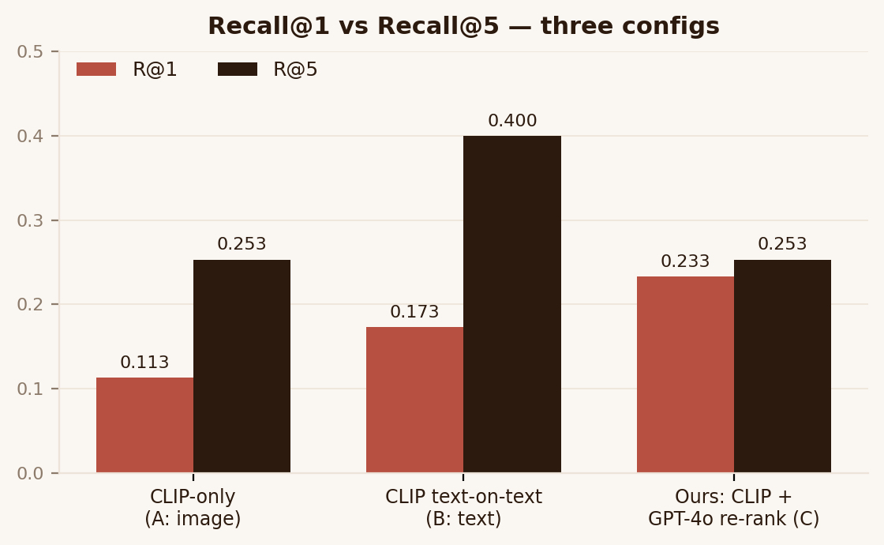
9
Baselines vs Proposed
Same 150 questions, same 2,711-product catalog
TAKE-AWAYS
vs CLIP-only baseline → +12 pp R@1, ~2× lift; re-rank moves the right answer to the top.
vs text retrieval → text wins R@5 (eval-set bias), but ours wins R@1 by +6 pp.
R@5 cap → re-rank is precision, not recall. Future work: better first-stage retriever.
BOTTOM LINE when you only get to show one product, ours is best.
EECS 6895 | Aman Upganlawar | au2327

Slide 10
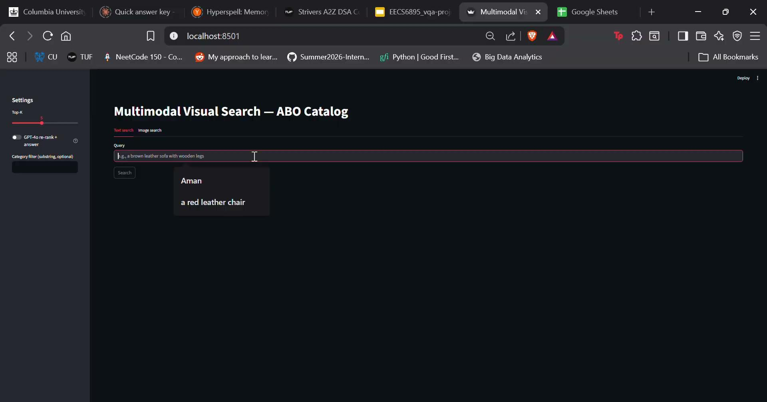
10
Demo
DEMO FLOW
1
Query 1: “a navy velvet tufted sectional sofa”
2
Query 2: “a high back executive office chair in black leather
3
Image Query 1: Image of a blue sofa
EECS 6895 | Aman Upganlawar | au2327

Slide 11
CONCLUSION
BUILT END-TO-END
ABO ingest → CLIP embeddings → FAISS index → GPT-4o re-rank → FastAPI + Streamlit, plus a 3-config ablation eval.
FUTURE WORK
Approximate-NN index for 10⁶+ catalogs · cross-category + multilingual queries · cheaper re-ranker (GPT-4o-mini, BLIP-2).
Thank you. Questions?

