Slide 1

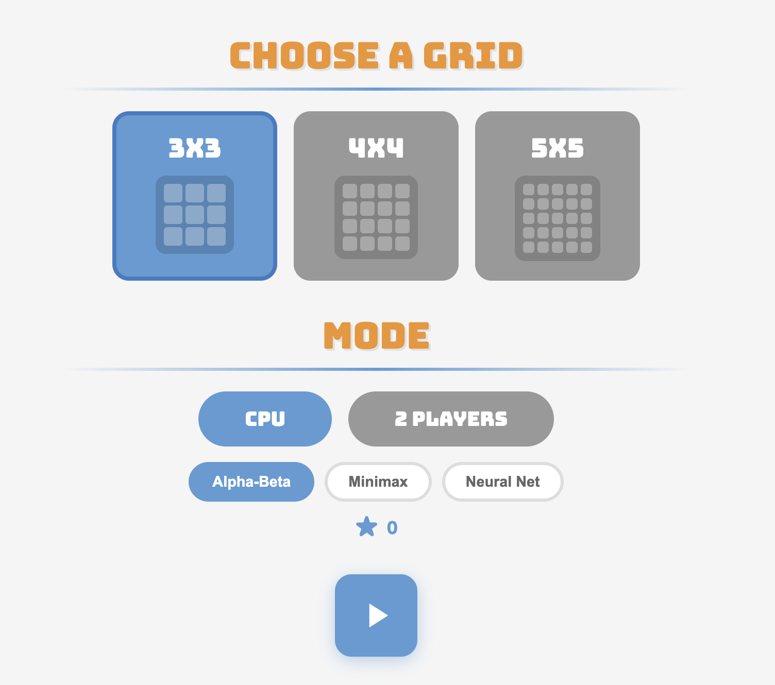
AI Tic-Tac-Toe
Nick Vendeland
Jason Su
Aman Verma
CptS 440/540 — Artificial Intelligence | Spring 2026

Slide 2
Project Overview & Objective
A configurable n×n Tic-Tac-Toe (3×3, 4×4, 5×5). Simple enough to solve optimally on small boards, complex enough to benchmark different AI paradigms side by side.
What? An AI system implementing four different approaches — Minimax, Alpha-Beta pruning, Q-Learning, and a Neural Network heuristic — to play configurable Tic-Tac-Toe. Each algorithm represents a different AI paradigm.
Goals: Compare adversarial search vs reinforcement learning vs learned evaluation. Measure how each algorithm scales when the board size increases from 3×3 to 5×5.
Game Variant: Standard Tic-Tac-Toe rules on n×n boards. Win by completing a full row, column, or diagonal. X always moves first. On 3×3 the AI plays optimally; on larger boards it uses depth-limited search with heuristic evaluation.

Slide 3
Architecture and Tech Stack
board.py: n×n board state, move validation, win detection, undo support.
ai.py: Minimax, Alpha-Beta, and Random agents with stats tracking.
heuristic.py: Handcrafted eval — scores lines by alignment, blocks threats, rewards center and corners.
qlearning.py: Tabular Q-Learning with ε-greedy exploration, backward trajectory updates.
nn_heuristic.py: PyTorch BoardNet trained on minimax labels. NumPy inference at game time.
Tech Stack: Python 3, PyTorch, NumPy, matplotlib, Flask (web UI), Pygame (GUI).

Slide 4
Why These Algorithms?
Minimax: The baseline. Exhaustive search guarantees optimal play by evaluating every possible game outcome. Gives us ground truth to compare against.
Alpha-Beta Pruning: Minimax is too slow for larger boards. Alpha-Beta prunes branches that can't affect the final decision, same optimal result with far fewer nodes explored.
Q-Learning: A fundamentally different paradigm. Instead of searching at play-time, the agent learns a value table during training. Shifts computation from inference to training, enabling instant moves.
Neural Network Heuristic: Hand-tuning heuristics doesn't scale. A neural network can learn evaluation functions directly from data, making it adaptable to new board sizes without manual rule engineering.

Slide 5
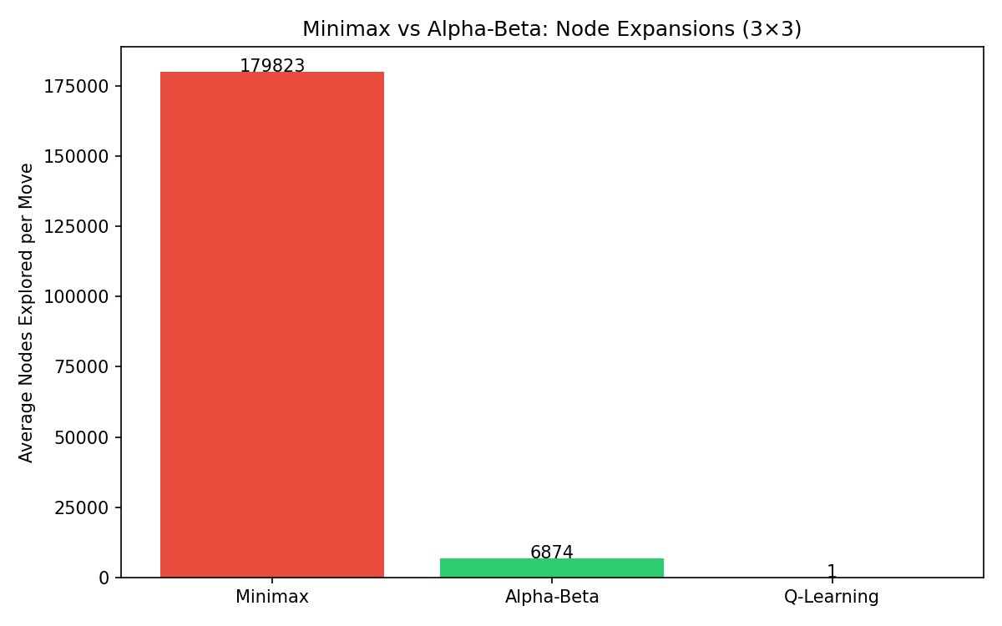
AI Algorithm – Minimax & Alpha-Beta
Minimax: Exhaustive DFS of the game tree. Maximizer picks highest-value child, Minimizer picks lowest. Guarantees optimal play on 3×3.
Alpha-Beta Pruning: Same result, skips provably irrelevant branches. Maintains α (best for Max) and β (best for Min). Prunes when α ≥ β. 96.2% node reduction, 27× faster.
Depth-Limited Search: Full-depth search is infeasible for 4×4+. Cut off at fixed depth and use heuristic evaluation for non-terminal states.
Heuristic scores: Line potential & symbol alignment, blocking opportunities, center (+3) and corner (+1) positional bonuses.

Slide 6
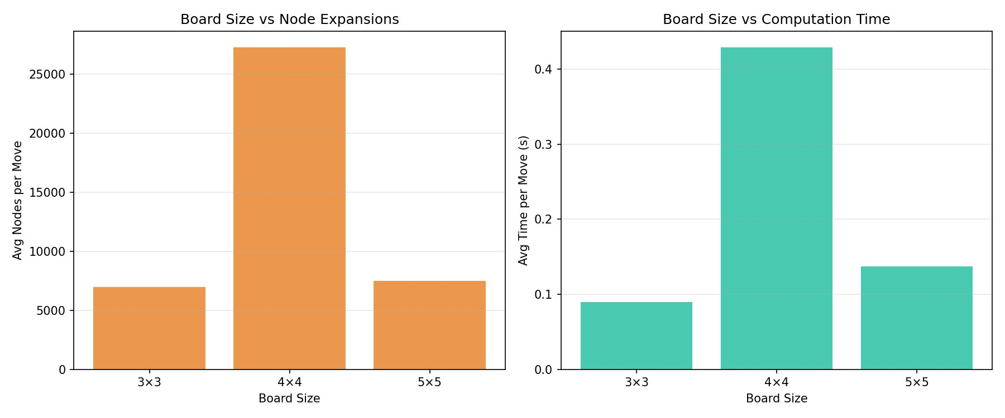
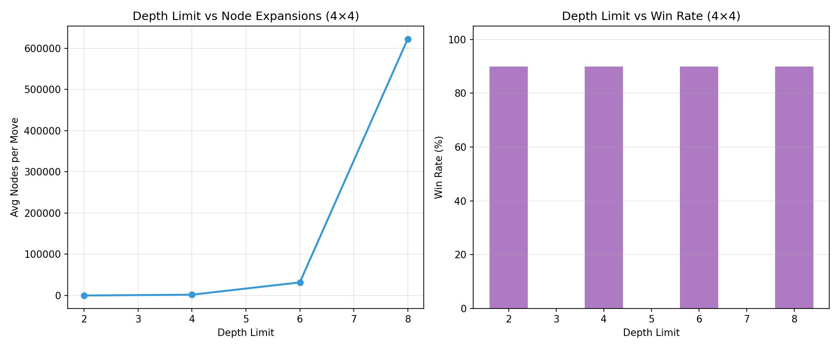
What Happens When the Board Gets Bigger?
The state space grows exponentially. 3×3 has ~362,880 game sequences. 4×4 jumps to ~2×10¹³ — full-depth search becomes infeasible.
Search tree explosion: Branching factor grows from 9 to 25 first moves.
Heuristic becomes critical: With depth limited to 4 on 5×5, heuristic quality determines AI strength.
Q-Learning breaks down: Q-table can't store all states beyond 3×3.
NN advantage: Neural nets generalize from sampled data for larger boards.

Slide 7
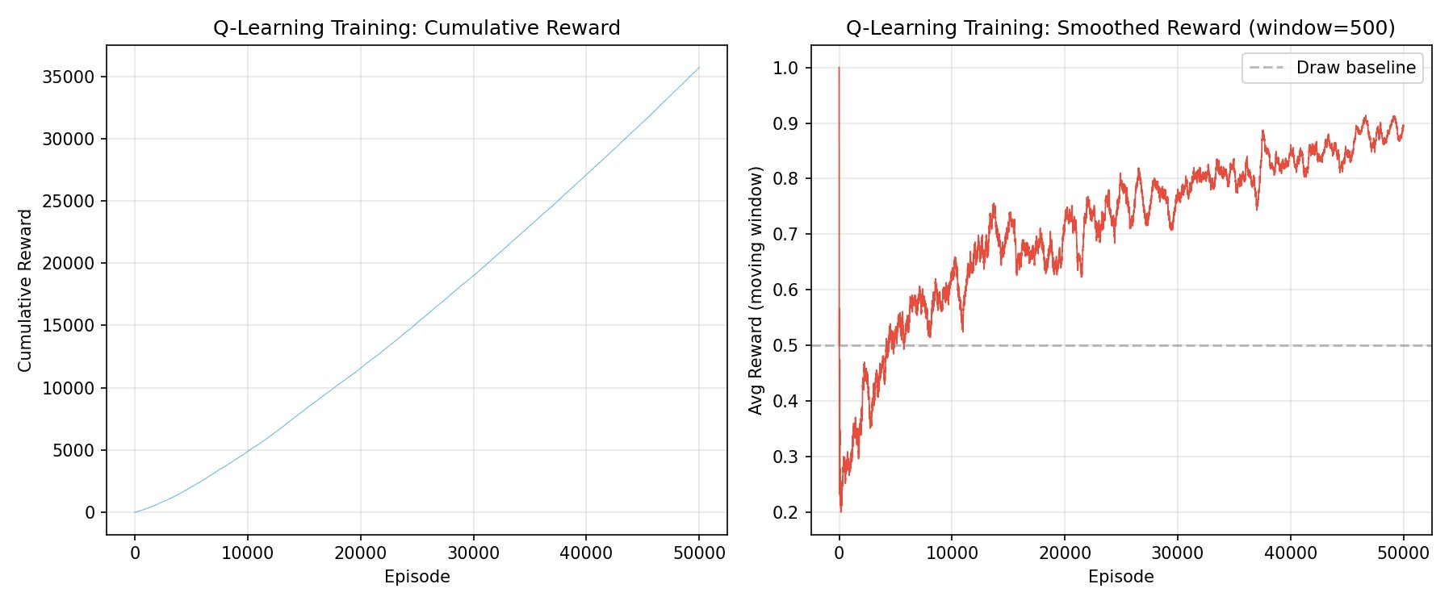
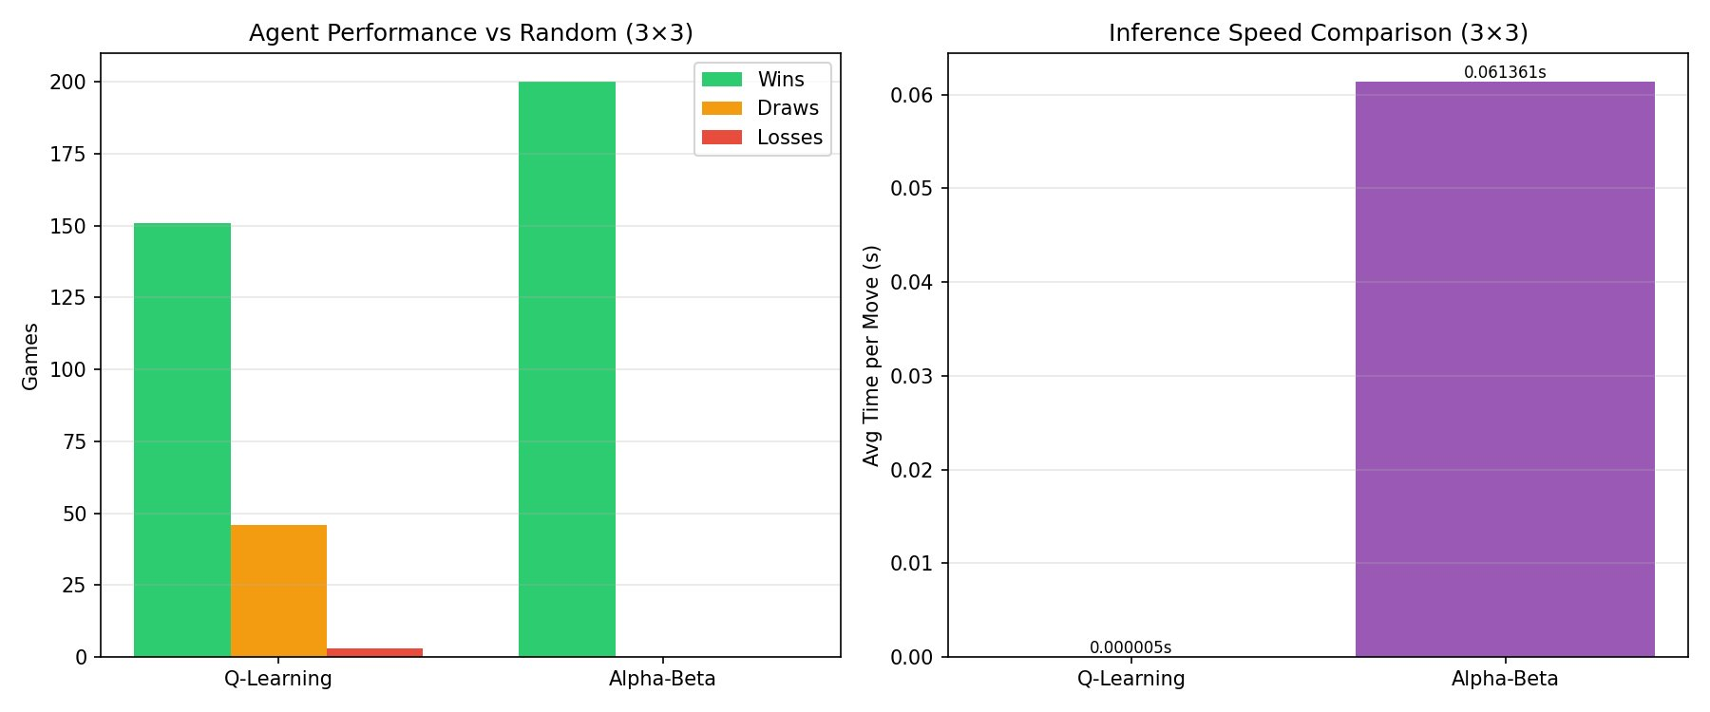
Q-Learning Agent
Model-Free Reinforcement Learning. Agent learns Q(state, action) through self-play against a random opponent.
ε-greedy exploration with linear decay (ε: 0.3 → 0.01).
Update rule:
Q(s,a) ← Q(s,a) + α [ r + γ · max Q(s',a') − Q(s,a) ]
Results: 50,000 episodes, 10,825 Q-table entries, 85.7% win rate vs Random. Inference: 0.005ms (table lookup).
Q-Learning vs Alpha-Beta: performance and inference speed on 3×3

Slide 8
Neural Network Heuristic
BoardNet Architecture: Input (n²+1) → Dense 64 (ReLU) → Dense 32 (ReLU) → Dense 1 (Tanh). ~2,800 parameters.
Input encoding: AI → +1, Opponent → −1, Empty → 0, plus turn indicator.
Training labels: Ground-truth minimax scores normalized to [−1, 1]. 3×3: all states enumerated. 4×4/5×5: 5,000 sampled states.
Training: 500 epochs, Adam optimizer, batch 64, 80/20 split.
Inference: Pure NumPy forward pass — no PyTorch overhead at game time.

Slide 9
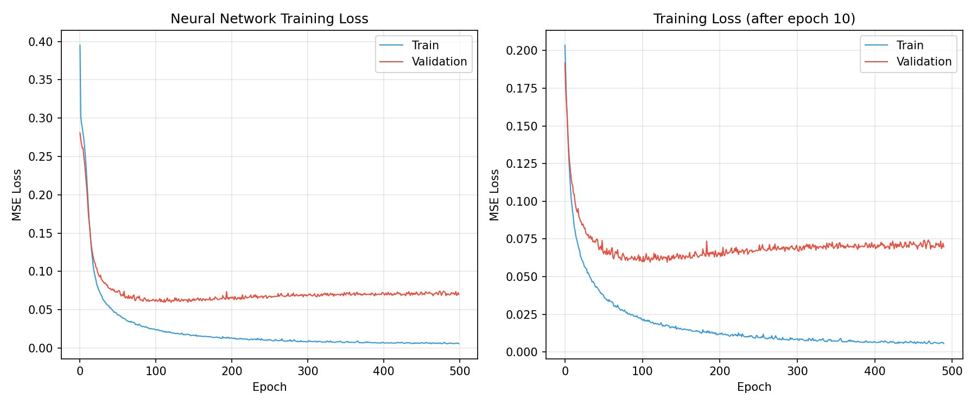
The Loss Function: Mean Squared Error
We train the neural network by minimizing the difference between its predicted board score and the true minimax score.
MSE = (1/N) Σ ( ŷᵢ − yᵢ )²
Why MSE? Output is a continuous score in [−1, 1] — regression, not classification. MSE is the natural choice.
Penalizes large errors quadratically — pushes the network to avoid wildly wrong evaluations of critical positions.
Loss drops sharply in first 50 epochs, plateaus by 200. Small train/val gap shows good generalization.

Slide 10
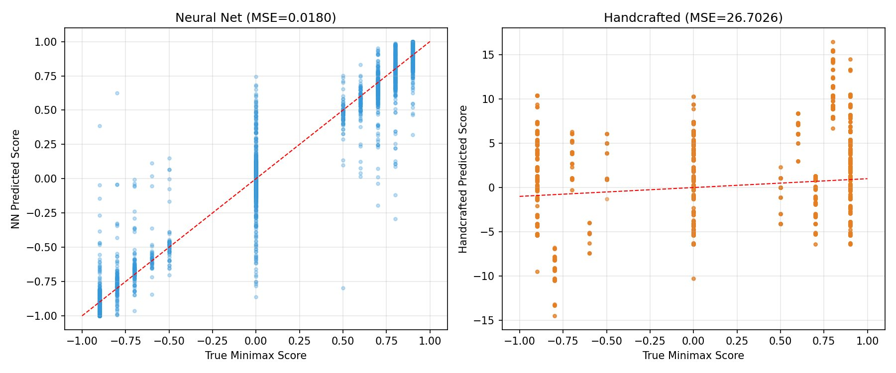
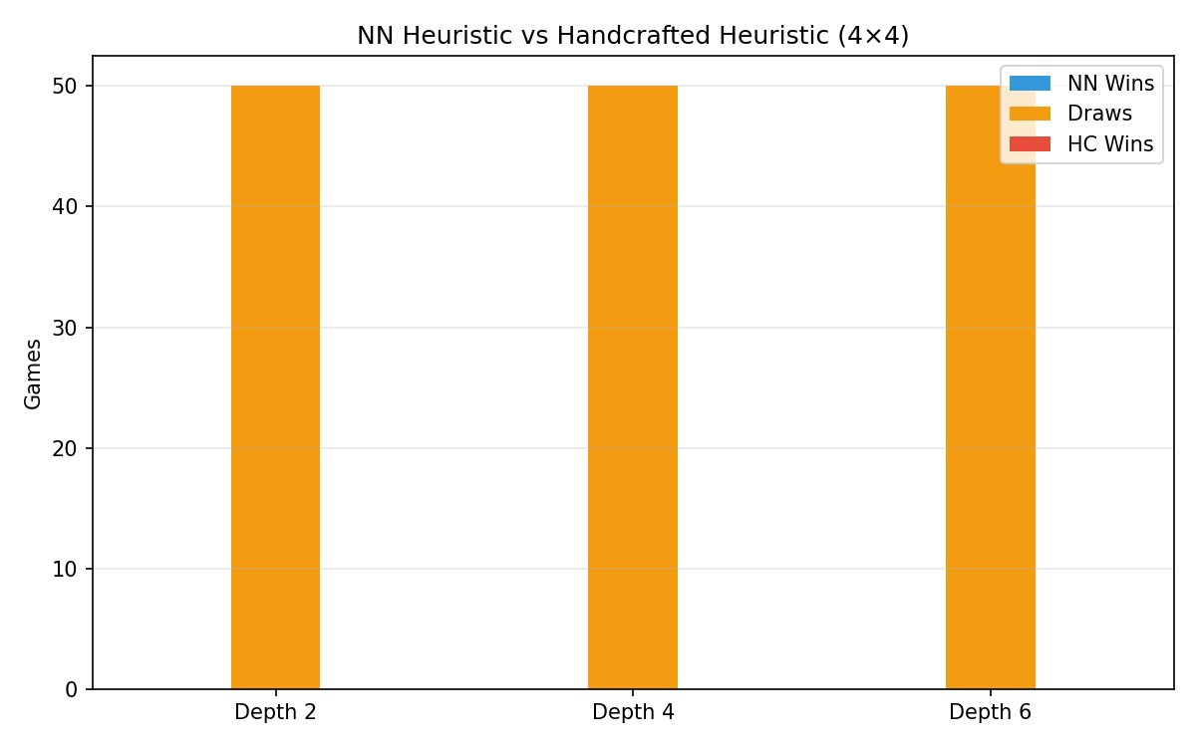
Neural Network: Accuracy & Head-to-Head
NN predictions cluster along the ideal line (left). Handcrafted heuristic is far more scattered (right). NN achieves MSE=0.018 vs HC's MSE=26.7.
NN vs Handcrafted head-to-head on 4×4: mostly draws at all depths — both heuristics produce competitive play.

Slide 11
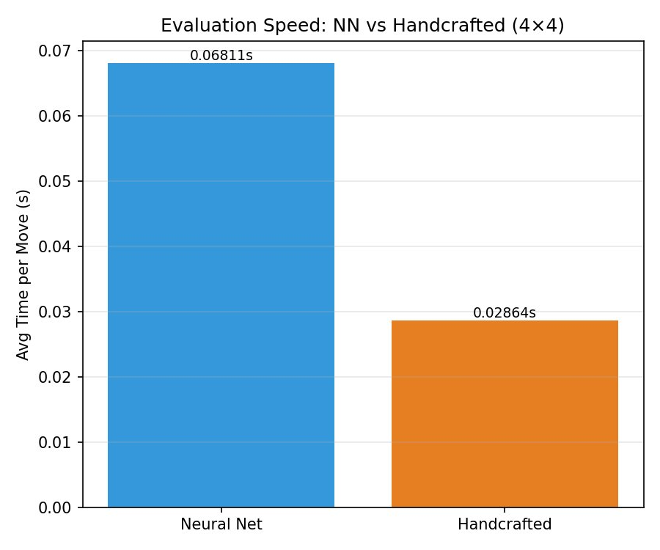
Evaluation Speed: NN vs Handcrafted
On a 4×4 board with depth-4 Alpha-Beta search:
The handcrafted heuristic (0.029s/move) is ~2.4× faster than the neural net (0.068s/move). This is expected — the handcrafted function is simple arithmetic, while the NN requires a matrix multiply per evaluation.
However, the NN's advantage is accuracy and adaptability, not speed. It produces more precise board evaluations and can be retrained for new board sizes without rewriting rules.
Both are fast enough for real-time play — the difference (40ms) is imperceptible to a human player.

Slide 12
Evaluation and Results
Correctness: AI never loses on 3×3 as either X or O against a random opponent (200 games tested).
Move Time Comparison (3×3):
Minimax: 179,823 nodes | ~2,675 ms
Alpha-Beta: 6,874 nodes | ~99 ms
Q-Learning: 1 node | ~0.005 ms
Scaling: 3×3 (full depth) → 4×4 (depth 6, 27K nodes) → 5×5 (depth 4, ~7.5K nodes). Larger boards need depth limits + heuristics.
NN vs Handcrafted: Neural net achieves lower MSE and higher correlation with true minimax scores. Head-to-head on 4×4 is mostly draws.

Slide 13
Limitations and Future Work
Limited scope: Specialized to Tic-Tac-Toe. Extending to larger/more complex games would require significant scaling.
Q-Learning scalability: Tabular Q-Learning is impractical beyond 3×3. A Deep Q-Network (DQN) could address this.
NN training data: For 4×4/5×5, the NN is trained on handcrafted heuristic labels (not true minimax), limiting accuracy.
No MCTS: Monte Carlo Tree Search (AlphaZero-style) was not implemented. Combining MCTS with NN could significantly improve larger boards.
Future: DQN for larger boards, MCTS integration, self-play training, extension to Connect-4 or Gomoku.

Slide 14
Key Takeaways
No single best approach. Each method trades off computation, memory, and generalization differently.
Pruning is essential. Alpha-Beta makes adversarial search practical — same optimal result with 96% fewer nodes.
RL enables instant inference. Q-Learning shifts compute to training time. At play-time: single table lookup, 43,000× faster.
Neural networks learn from data. A small feedforward net approximates minimax evaluation, replacing hand-coded rules.
Board size is the bottleneck. Exponential growth of game trees drives the need for heuristics, depth limits, and learned evaluation.

Slide 15
Thank You!

