Slide 1
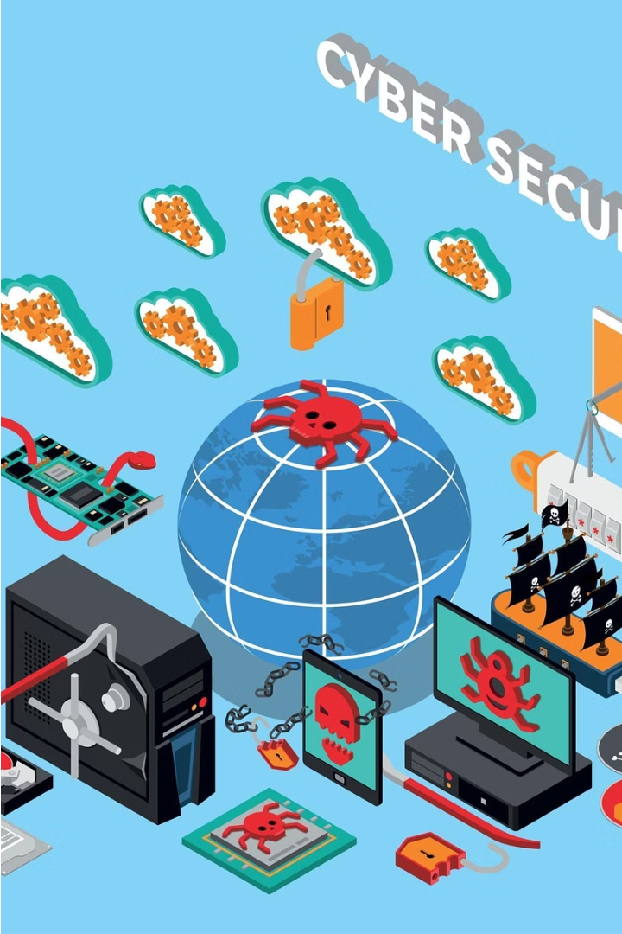
Introduction to Cybersecurity
In today's digital world, the importance of cybersecurity cannot be overstated. As we increasingly rely on technology for our daily activities, from communicating with friends to accessing important information, it's crucial that we understand the basics of keeping ourselves and our devices safe from online threats. In this presentation, we will explore what cybersecurity is, why it's so important, and the steps we can take to protect ourselves and our personal information.

Slide 2
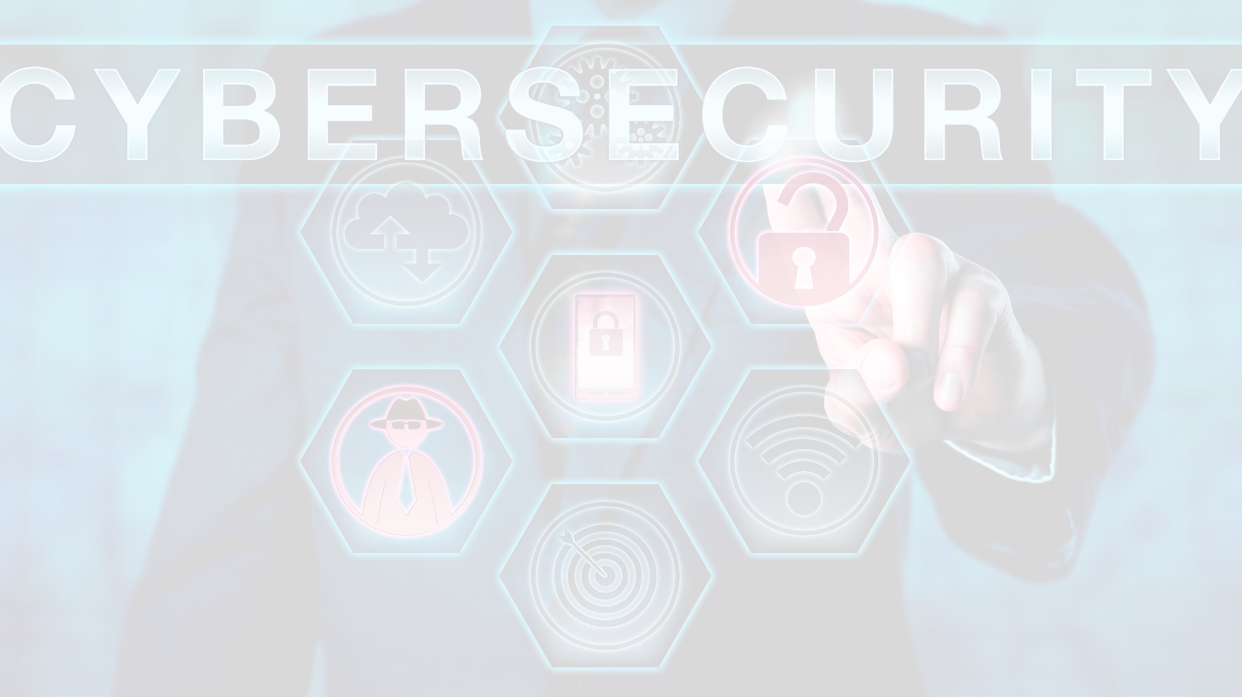
What is Cybersecurity?
Cybersecurity is the practice of protecting devices, networks, and data from unauthorized access, misuse, and digital threats. It involves a wide range of techniques and technologies aimed at safeguarding our digital lives, from the computers and smartphones we use every day to the critical infrastructure that powers our modern world. At its core, cybersecurity is about ensuring the confidentiality, integrity, and availability of our digital information and systems.
In an age where we rely heavily on technology for everything from communication and entertainment to banking and healthcare, cybersecurity has become essential. Cyber criminals, hackers, and other malicious actors are constantly developing new ways to breach our digital defenses, whether it's through malware, phishing scams, or exploiting vulnerabilities in software and hardware. Cybersecurity professionals work tirelessly to stay one step ahead, implementing robust security measures, monitoring for threats, and quickly responding to incidents to minimize the impact on individuals and organizations.

Slide 3
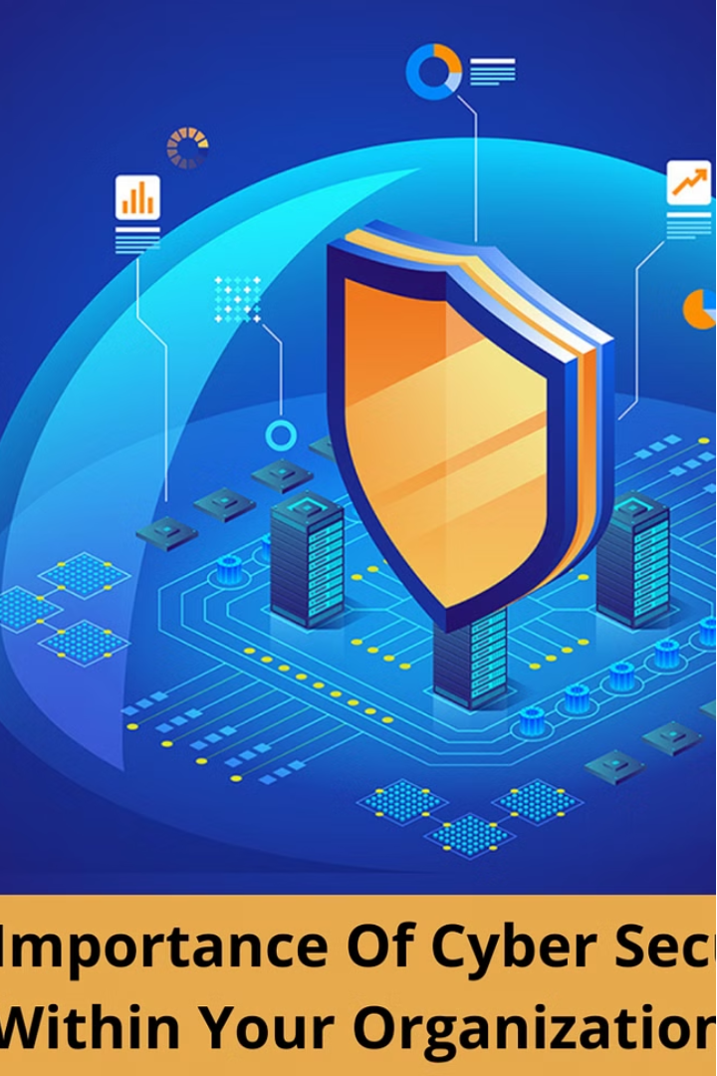
Why is Cybersecurity Important?
Cybersecurity is crucial in today's digital age for several key reasons. First and foremost, it helps protect our personal and sensitive information from falling into the wrong hands. With so much of our lives now stored and shared online - from financial data and medical records to private messages and photos - ensuring the confidentiality and integrity of this information is paramount. Cyber criminals are constantly devising new ways to steal identities, commit fraud, and access private data, and strong cybersecurity measures are our best defense.
Beyond safeguarding our personal information, cybersecurity also plays a vital role in protecting critical infrastructure, such as power grids, transportation systems, and healthcare networks. A successful cyber attack on these systems could have devastating real-world consequences, disrupting essential services and potentially endangering lives. Maintaining robust cybersecurity is thus essential for national security and public safety.
Furthermore, cybersecurity is crucial for businesses and organizations of all sizes. In an increasingly digital world, companies rely heavily on technology to operate, and a cyber breach can result in significant financial losses, reputational damage, and legal liabilities. Effective cybersecurity measures help protect against data breaches, system disruptions, and other threats that could cripple a business and undermine its competitiveness.

Slide 4
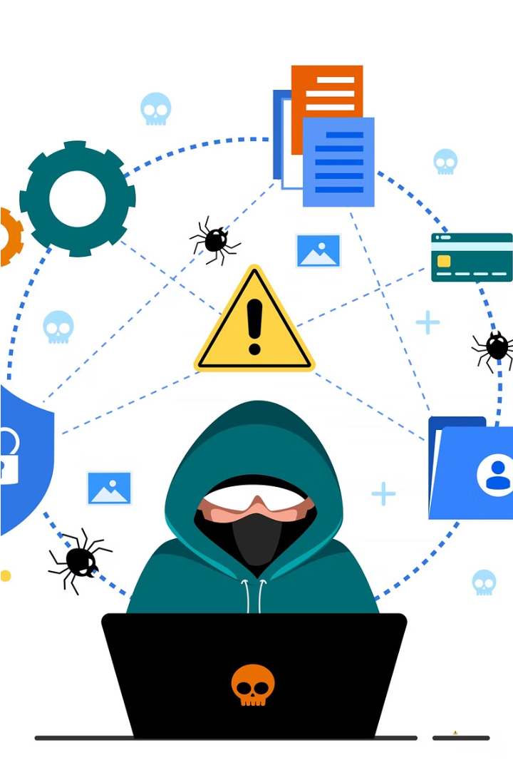
Cyber Threats and Risks
In the digital age we live in, cyber threats and risks are a daily reality that we must be aware of and prepared to address. Cyber criminals, hackers, and other malicious actors are constantly seeking new ways to exploit vulnerabilities in our digital systems and devices to gain unauthorized access, steal sensitive information, disrupt critical infrastructure, and cause harm.
Some of the most common cyber threats include malware (such as viruses, worms, and ransomware), phishing scams, identity theft, data breaches, denial-of-service attacks, and social engineering tactics. These threats can have serious consequences, ranging from financial losses and reputational damage to the compromise of personal privacy and the disruption of essential services.
Moreover, the increasing interconnectedness of our digital world means that the scope and scale of these threats are constantly evolving. As more of our lives and critical systems rely on technology, the potential for widespread and devastating cyber attacks has never been higher. It is essential that we understand the nature of these threats and take proactive steps to protect ourselves, our devices, and our data from harm.

Slide 5
Protecting Yourself Online
Be Cautious with Sharing Information
Use Strong and Unique Passwords
Create strong, unique passwords for all your online accounts. Avoid using the same password across multiple sites, as this can make it easier for cybercriminals to gain access to your information. Consider using a password manager to generate and store complex passwords that are difficult to crack.
Be very selective about the personal information you share online, especially on social media platforms. Avoid posting details like your address, phone number, birthdates, or other sensitive data that could be used to steal your identity or compromise your security. Remember, once information is posted online, it can be very difficult to remove, so it's best to err on the side of caution.
Be Cautious of Public Wi-Fi
Keep Your Software Up-to-Date
When using public Wi-Fi networks, such as those found in airports, coffee shops, or hotels, be aware that these connections may not be secure. Avoid accessing sensitive information or conducting financial transactions while on public Wi-Fi, as it can make you more vulnerable to hackers and data thieves.
Regularly update your devices' operating systems, web browsers, and other software to ensure you have the latest security patches and protections against known vulnerabilities. Cybercriminals often target outdated software, so keeping your devices and apps current is an important step in staying safe online.
Protecting yourself online is essential in today's digital world, where cyber threats and risks are constantly evolving. By being cautious about the information you share, using strong and unique passwords, avoiding public Wi-Fi for sensitive activities, and keeping your software up-to-date, you can significantly reduce your vulnerability to cyber attacks and help safeguard your personal data and online accounts. Remember, staying vigilant and proactive in your online security practices is key to ensuring your digital safety and privacy.

Slide 6
Strong Passwords and Two-Factor Authentication
Importance of Strong Passwords
Tips for Creating Strong Passwords
Two-Factor Authentication
Benefits of 2FA
Significantly enhances the security of your online accounts.
Two-factor authentication (2FA) is an extra layer of security that requires you to provide two different forms of identification to access your accounts. This could involve entering a password and a one-time code sent to your phone, or using a biometric scan like your fingerprint or facial recognition. 2FA makes it much harder for cyber criminals to gain unauthorized access to your accounts, even if they have your password.
In the digital age, strong and unique passwords are the first line of defense against cyber criminals. Weak or easily guessable passwords can make your accounts vulnerable to hacking, identity theft, and other online threats. It's crucial to create complex passwords that include a mix of letters, numbers, and special characters, and to never reuse the same password across multiple accounts.
Use a combination of at least 8 characters, including uppercase and lowercase letters, numbers, and symbols.
Protects against password theft and other forms of identity fraud.
Provides peace of mind knowing your sensitive information is better protected.
Avoid using personal information, common words, or sequential patterns (e.g., "123456").
Many online services and apps offer 2FA options, so be sure to enable it whenever possible.
Consider using a passphrase, which is a sentence or series of words that is easy to remember but difficult to crack.
Use a password manager to generate and store unique, complex passwords for all your accounts.

Slide 7
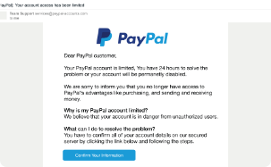

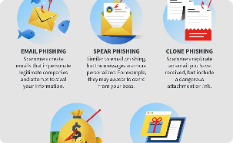
Avoiding Phishing and Scams
Identifying Phishing Emails
Beware of Phone Scams
Protecting Yourself on Social Media
Scammers don't just use email - they also target people through phone calls. These phone scams can range from impersonating technical support staff to claim your computer is infected, to criminals posing as government officials or law enforcement demanding payment for fictitious fines or fees. The key is to never provide personal or financial information over the phone, especially if you didn't initiate the call. If you're unsure, hang up and call the organization directly using a verified phone number to confirm the legitimacy of the request.
Phishing emails are a common tactic used by cybercriminals to trick people into revealing sensitive information or installing malware on their devices. These emails often appear to be from legitimate organizations, like banks or government agencies, and may ask you to click on a link or provide personal details. However, upon closer inspection, you may notice things like spelling errors, suspicious sender addresses, or requests for sensitive information that don't align with standard policies. Being vigilant and learning to spot the telltale signs of a phishing email is crucial to avoiding these scams.
Social media platforms have also become a breeding ground for phishing and scams. Cybercriminals may create fake profiles, impersonating friends or family members, and try to trick you into clicking on malicious links or revealing sensitive details. They may also use social engineering tactics to manipulate you into transferring money or granting them access to your accounts. Be wary of unsolicited messages, even from people you know, and never share personal information or financial details on social media. If something seems suspicious, reach out to the person directly through a verified channel to confirm the legitimacy of the request.
Phishing and scams are two of the most prevalent cyber threats, as they rely on exploiting human vulnerabilities rather than technical ones. By learning to identify the hallmarks of these deceptive tactics, such as suspicious email addresses, urgent requests for information, and too-good-to-be-true offers, you can significantly reduce your risk of falling victim to these scams. Additionally, maintaining a healthy skepticism when it comes to unsolicited messages or requests, and taking the time to verify the legitimacy of any claims before responding, can go a long way in protecting yourself and your personal information. Staying vigilant and proactive in your online security practices is key to avoiding the damaging consequences of phishing and scams.

Slide 8




Staying Safe on Social Media
Protect Your Privacy
Strengthen Security
Think Before You Post
Manage Your Digital Footprint
Be mindful of the personal information you share on social media. Avoid posting sensitive details like your home address, phone number, or daily schedule that could put you at risk of stalking or burglary. Customize your privacy settings to control who can see your posts and limit public access to your profile.
Use strong, unique passwords for all your social media accounts and enable two-factor authentication whenever available. This helps prevent unauthorized access to your accounts, even if your password is compromised. Be cautious of suspicious links or messages that could be phishing attempts to steal your login credentials.
Before sharing anything online, consider how it could be interpreted or used by others. Avoid posting content that could be embarrassing, harmful, or misunderstood, even if it's meant as a joke. Remember that anything you post on social media can have lasting consequences, as it's nearly impossible to truly delete digital content.
Be mindful of the digital trail you're leaving behind on social media. Carefully curate the content you share, as it can shape how others perceive you and potentially impact your future opportunities, such as college admissions or job prospects. Regularly review and clean up your online presence to maintain a positive digital reputation.
Social media has become an integral part of our lives, allowing us to connect with friends, share experiences, and stay informed. However, this digital landscape also comes with its own set of risks that we must be aware of and proactively address. By protecting our privacy, strengthening our security, thinking critically about our online activity, and managing our digital footprint, we can enjoy the benefits of social media while minimizing the potential for harm.
It's crucial to remember that the information and content we share on social media can have long-lasting consequences, both positive and negative. Being mindful of the personal details we reveal, the tone and nature of our posts, and the overall impression we're creating online can go a long way in keeping ourselves and our loved ones safe. By prioritizing digital safety and responsible social media usage, we can unlock the full potential of these powerful platforms while safeguarding our well-being in the process.

Slide 9




Reporting Cyber Incidents
Recognize the Incident
The first step in responding to a cyber incident is recognizing that one has occurred. This could involve detecting suspicious activity on your devices, such as unexpected pop-ups, unusual system behavior, or unauthorized access attempts. It's important to stay vigilant and trust your instincts - if something seems off, it's better to investigate further and take action.
Document the Details
Once you've identified a potential cyber incident, it's crucial to document as much information as possible. Take screenshots, make notes about the timeline of events, and gather any relevant evidence, such as log files or security camera footage. Detailed documentation will be essential if you need to report the incident to the authorities or your service providers.
Report the Incident
Depending on the nature and severity of the cyber incident, you may need to report it to various entities. For personal incidents, like identity theft or financial fraud, you should contact your bank, credit card companies, and local law enforcement. For incidents involving critical infrastructure or national security, you may need to report to government agencies like the Cybersecurity and Infrastructure Security Agency (CISA) or the Federal Bureau of Investigation (FBI).
Seek Support and Assistance
After reporting the incident, you may need to seek additional support and assistance. This could involve working with cybersecurity experts to assess the damage, recover lost data, or implement stronger security measures. You may also need to contact your insurance provider or legal counsel to understand your rights and options for recourse. Remember, you don't have to navigate the aftermath of a cyber incident alone - there are resources and professionals available to help you through the process.
Reporting a cyber incident is a critical step in responding to and mitigating the consequences of a security breach or other digital threat. By recognizing the signs of an incident, carefully documenting the details, and reporting the incident to the appropriate authorities and service providers, you can help protect yourself, your personal information, and your digital devices from further harm. Additionally, seeking support and assistance from cybersecurity experts, legal professionals, and victim support services can ensure that you have the resources and guidance needed to navigate the aftermath of a cyber incident and take the necessary steps to prevent future occurrences.

Slide 10
Conclusion and Key Takeaways
In the ever-evolving digital landscape, cybersecurity has become an essential part of our daily lives. Throughout this presentation, we've explored the fundamental aspects of this critical field, from understanding the definition and importance of cybersecurity to delving into the various threats and risks we face, as well as the strategies and tools we can employ to protect ourselves and our digital assets.
As we conclude this journey, it's important to reflect on the key takeaways that will empower you to navigate the online world with confidence and security. Firstly, maintaining a proactive and vigilant mindset is crucial. By being aware of the cyber threats, such as malware, phishing scams, and social engineering tactics, you can better identify and avoid these malicious attempts to compromise your digital well-being.
1
Develop strong, unique passwords and enable two-factor authentication whenever possible to safeguard your online accounts.
Exercise caution when sharing personal information on social media, and be mindful of your digital footprint, as it can have lasting consequences.
Stay up-to-date with the latest software and security updates to ensure your devices are protected against known vulnerabilities.
Report any suspected cyber incidents to the appropriate authorities and seek support from cybersecurity experts to minimize the impact and prevent future occurrences.
Encourage your friends, family, and community to adopt these cybersecurity best practices, as collective awareness and action are instrumental in creating a safer digital ecosystem for all.
By embracing these key principles and taking proactive steps to safeguard your digital life, you'll be well on your way to becoming a responsible and informed digital citizen. Remember, cybersecurity is a shared responsibility, and by working together, we can create a more secure and resilient online environment for generations to come.

