Slide 1
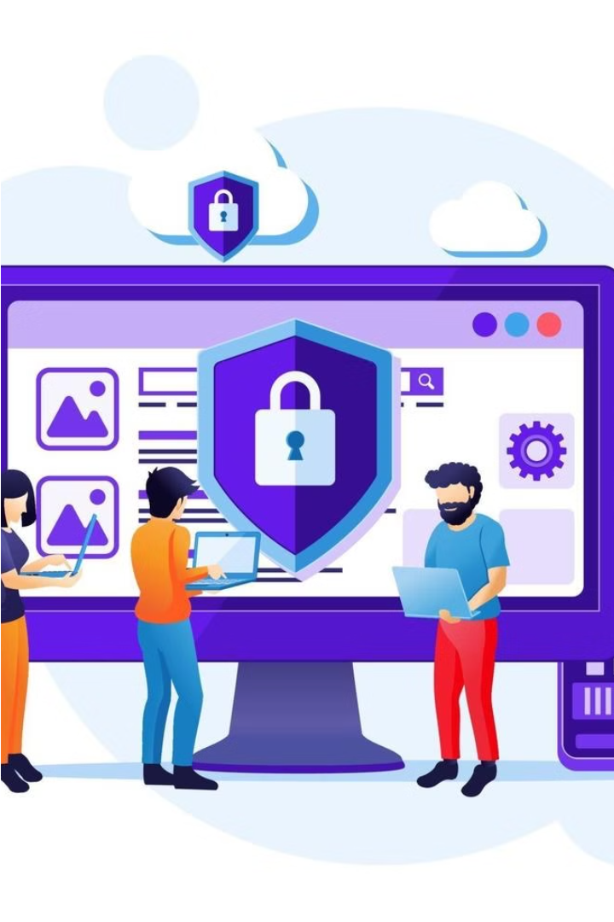


Introduction to Cybersecurity and Cybercrime
Cybersecurity is the practice of protecting digital systems, networks, and data from unauthorized access, theft, and disruption. Cybercrime refers to criminal activities that target or use digital technologies, causing harm to individuals, organizations, or society as a whole.
by 20.DEVANSH CHAUDHARY

Slide 2
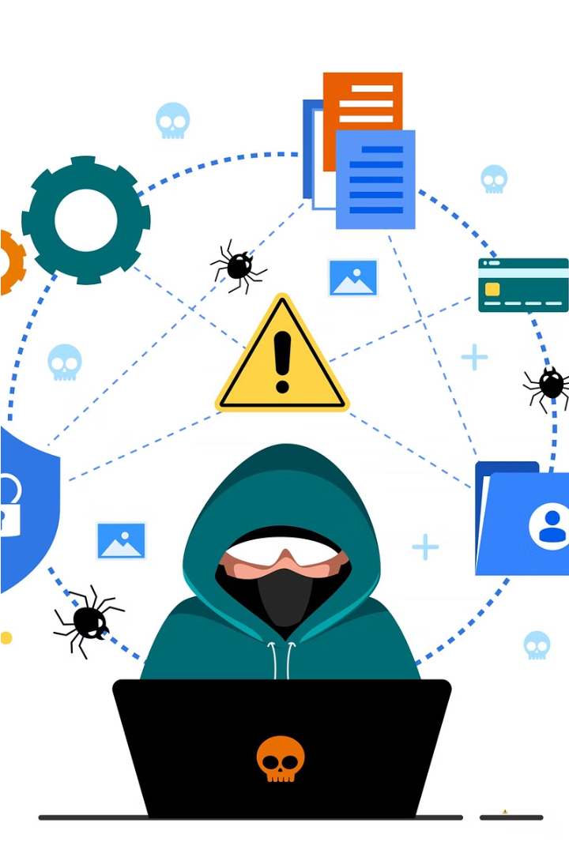
Defining Cybersecurity and Cybercrime
Cybersecurity refers to the protection of digital systems, networks, and data from unauthorized access, theft, or disruption. It involves the use of technologies, processes, and practices to safeguard information and critical infrastructure. Cybercrime, on the other hand, encompasses any criminal activity that targets or exploits digital systems, causing harm to individuals, organizations, or society.

Slide 3
Common Cybersecurity Threats and Attacks
Malware: Viruses, trojans, ransomware, and other malicious software that can infect systems and steal data.
Phishing: Fraudulent emails or websites that trick users into revealing sensitive information or downloading malware.
Distributed Denial of Service (DDoS) Attacks: Overwhelming systems with traffic to disrupt operations and services.
SQL Injection: Exploiting vulnerabilities in web applications to gain unauthorized access to databases.
Social Engineering: Manipulating people into divulging confidential information or performing actions that compromise security.

Slide 4
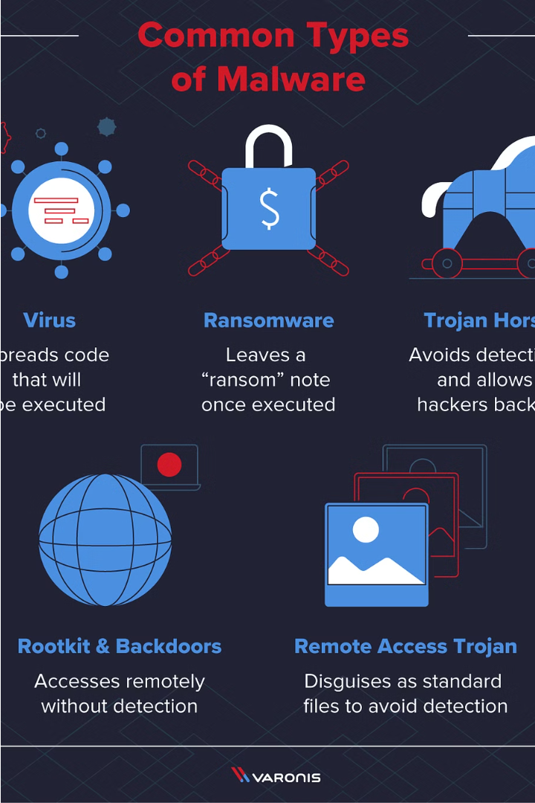
Malware: Types and Prevention
Malware, or malicious software, is a broad category of programs designed to cause harm to computer systems. Common types include viruses, trojans, worms, and ransomware, each with unique characteristics and methods of infection.
Effective malware prevention involves a multi-layered approach, including antivirus software, firewalls, regular software updates, and employee security awareness training.

Slide 5
Social Engineering Tactics and Mitigation
Phishing Attacks
Pretexting
Manipulative emails or messages that trick users into revealing sensitive information or downloading malware.
Creating a plausible pretext to gain the trust of a target and obtain confidential data.
Baiting
Tailgating
Leaving malware-infected physical media (e.g., USB drives) for unsuspecting victims to find and use.
Closely following an authorized individual to gain unauthorized access to a restricted area.

Slide 6
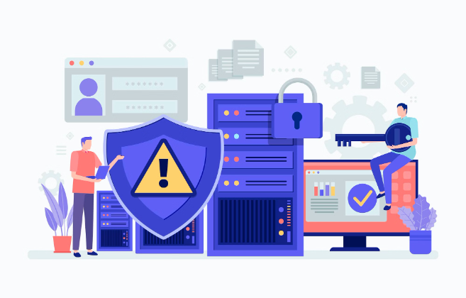
Protecting Sensitive Data and Information
Safeguarding sensitive data and information is crucial in the digital age. This includes personal identities, financial records, intellectual property, and other confidential data that could cause harm if exposed.
Key strategies include encryption, access controls, regular backups, and comprehensive data governance policies. Employees must also be trained to handle sensitive information securely.

Slide 7
Cybersecurity Frameworks and Best Practices
1
Comprehensive Frameworks
2
Defense-in-Depth
Adopt established cybersecurity frameworks like NIST CSF or ISO 27001 to guide your organization's security strategy and implementation.
Implement multiple layers of security controls to create a resilient defense against cyber threats, including firewalls, access management, and monitoring.
3
Employee Training
4
Vulnerability Management
Regularly educate and train employees on cybersecurity best practices, such as recognizing phishing attempts and securely handling sensitive data.
Proactively identify, assess, and remediate security vulnerabilities in systems, applications, and networks to minimize the risk of exploitation.

Slide 8
Incident Response and Disaster Recovery
Incident Detection
Incident Investigation
Quickly identify and assess potential security incidents, whether through automated monitoring or user reports.
Thoroughly investigate the incident to understand its scope, root cause, and impact, gathering forensic evidence as needed.
1
2
3
4
Containment and Mitigation
Remediation and Recovery
Take immediate steps to contain the incident and minimize the damage, such as isolating affected systems or blocking malicious traffic.
Implement a recovery plan to restore normal operations, including repairing systems, recovering data, and addressing vulnerabilities.

Slide 9
Cybersecurity Regulations and Compliance
Regulatory Frameworks
Compliance Programs
Penalties for Non-Compliance
Continuous Improvement
Organizations must comply with various cybersecurity regulations, such as HIPAA, PCI DSS, and GDPR, which mandate controls to protect sensitive data and critical infrastructure.
Effective compliance programs include risk assessments, policy development, employee training, and regular audits to identify gaps and ensure ongoing adherence to regulatory requirements.
Failure to comply with cybersecurity regulations can result in hefty fines, legal liability, and reputational damage, underscoring the importance of a robust compliance strategy.
Cybersecurity regulations and compliance standards are constantly evolving, requiring organizations to stay up-to-date and continuously improve their security posture to mitigate emerging threats.

Slide 10




The Future of Cybersecurity and Emerging Trends
Cloud Security
AI-Powered Cyber Defense
IoT Security
Quantum Cryptography
As more organizations migrate to the cloud, securing cloud infrastructure and data will be a growing priority.
Securing the rapidly expanding network of internet-connected devices, which introduces new attack vectors for cybercriminals.
Leveraging artificial intelligence and machine learning to automate threat detection, incident response, and vulnerability management.
Developing quantum-resistant encryption algorithms to protect against the potential threat of quantum computing-based attacks.

