Slide 1

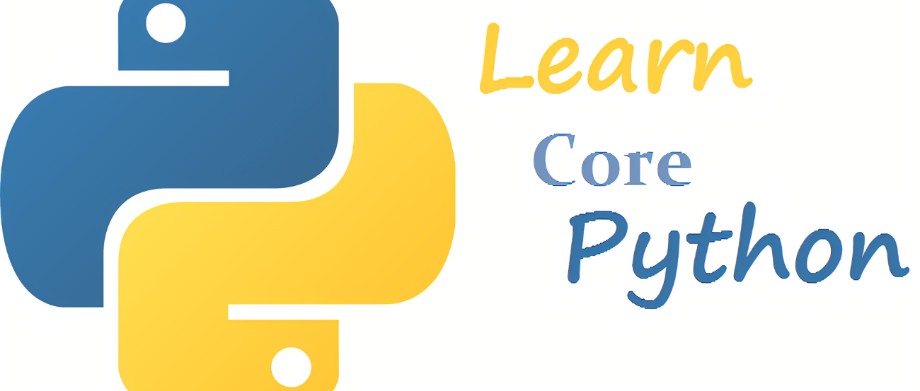
Unlimited Powerful Learning
PRESENTED BY :
Corporate Trainer
Mallikarjuna G D
gdmallikarjuna@gmail.com

Slide 2

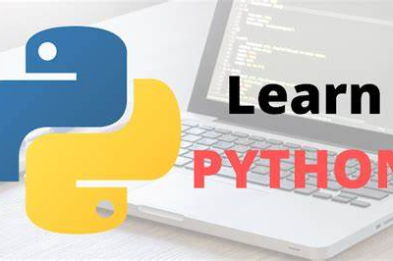

CONTENTS
Unlimited Powerful Learning
FRAMEWORK
CHOOSE RIGHT FRAMEWORK
DJANGO FSD ARCHITECTURE
HISTORY
MVC DESIGN PATTERN
INSTALLATION
PROGRAM STRUCTURE

Slide 3
FRAMEWORK
Unlimited Powerful Learning
A software framework is a platform for developing software applications.
It provides a foundation on which software developers can build programs for a specific environment.
Key Features
Reusable code libraries
Predefined structures and guidelines
Standardized ways to build and deploy applications
Importance of Frameworks
Efficiency: Saves time by providing pre-written code
Consistency: Ensures uniformity across projects
Scalability: Facilitates building scalable applications
Maintainability: Makes code easier to maintain and update
Security: Often includes built-in security features

Slide 4
Unlimited Powerful Learning
Types of Frameworks
Web Frameworks:
For developing web applications
Examples: Django, Ruby on Rails, ASP.NET,SPRING BOOT
Mobile Frameworks:
For developing mobile applications
Examples: React Native, Flutter, Xamarin
Desktop Frameworks:
For developing desktop applications
Examples: Electron, Qt, WPF
Game Development Frameworks:
For creating video games
Examples: Unity, Unreal Engine, Godot
Mobile Frameworks
Frameworks designed for building applications on mobile platforms.
Examples: React Native, Flutter, Xamarin

Slide 5
CHOOSE RIGHT FRAMEWORK
Unlimited Powerful Learning
Project Requirements: Specific needs and goals of the project.
Language Preference: Languages that the development team is comfortable with.
Community and Support: Availability of resources, documentation, and community support.
Scalability: Ability to handle growth and scale with the project.
Performance: Efficiency and speed of the framework.
Benefits:
Speed of Development: Accelerates the development process.
Standardization: Promotes best practices and consistency.
Security: Often includes built-in security measures.
Community Support: Access to a wealth of resources and community assistance.
Maintainability: Easier to maintain and update code
Drawbacks
Learning Curve: Can be steep for beginners.
Overhead: May add unnecessary complexity for simple projects.
Flexibility: Can be restrictive if not suitable for specific project needs.

Slide 6
DJANGO FSD ARCHITECTURE
Philosophy:
"Batteries-included" framework.
Emphasis on reusability and less code.

Slide 7
Unlimited Powerful Learning
Backend Development:
Component | Description | Technology | Example
Model Layer | Define data models using Django's ORM system. | Django ORM | class Book(models.Model): title = models.CharField(max_length=100)
View Layer | Implement views to process HTTP requests and return HTTP responses. | Django Views | def book_list(request): books = Book.objects.all()
Controller (Business Logic) | Handle the business logic of the application by processing requests, validating input, and generating responses. | Django Views | def book_detail(request, pk): book = get_object_or_404(Book, pk=pk)
URL Routing | Define URL patterns to map incoming URLs to views. | Django URLconf | path('books/', views.book_list, name='book_list')
Middleware | Process requests and responses at various stages of the request/response cycle. | Django Middleware | MIDDLEWARE = [ 'django.middleware.security.SecurityMiddleware', ... ]

Slide 8
Unlimited Powerful Learning
Frontend Development:
Component | Description | Technology | Example
Templates | Create HTML templates using Django's template engine. | Django Template Engine | {{ book.title }} in book_list.html
Static Files Handling | Serve static files such as CSS, JavaScript, and images. | Django Static Files | STATICFILES_DIRS = [os.path.join(BASE_DIR, "static")]
Integration with Front-end Frameworks | Integrate with frameworks like React.js, Vue.js, or Angular for building interactive UIs. | Django REST Framework, React.js/Vue.js/Angular | Using Django as a RESTful API backend and React for the front-end UI.
Database Development:
Component | Description | Technology | Example
Multiple Database Support | Supports PostgreSQL, MySQL, SQLite, and Oracle. | Django ORM, PostgreSQL/MySQL/SQLite/Oracle | DATABASES = { 'default': { 'ENGINE': 'django.db.backends.postgresql', 'NAME': 'mydatabase', ... } }
Database Operations | Perform querying, inserting, updating, and deleting records. | Django ORM | Book.objects.filter(author='Author Name')

Slide 9
Unlimited Powerful Learning
Authentication and Authorization
:
component | Description | Technology | Example
User Management | Built-in system for user authentication and authorization. | Django Auth System | from django.contrib.auth.models import User
Password Hashing | Secure password storage and hashing. | Django Auth System | user.set_password('new_password')
Session Management | Handle user sessions and cookies. | Django Sessions | request.session['key'] = 'value'
Permissions Handling | Manage user permissions and groups. | Django Auth System | from django.contrib.auth.models import Permission
Deployment:
component | Description | Technology | Example
Deployment Platforms | Deploy to servers like Heroku, AWS, or DigitalOcean. | Heroku, AWS EC2, DigitalOcean | git push heroku master
Scaling Techniques | Scale horizontally by adding more instances behind a load balancer. | Load Balancer (Nginx/Apache), Docker, Kubernetes | Using AWS ELB (Elastic Load Balancing) to distribute traffic.
Environment Configuration | Manage environment-specific settings and secrets. | Environment Variables, django-environ | DATABASE_URL = os.environ.get('DATABASE_URL')
Static and Media Files Handling | Use services like AWS S3 for storing static and media files. | AWS S3, django-storages | DEFAULT_FILE_STORAGE = 'storages.backends.s3boto3.S3Boto3Storage'

Slide 10
MVC DESIGN PATTERN
Unlimited Powerful Learning

Slide 11
KEY CONCEPTS
Unlimited Powerful Learning
Separation of Concerns: MVC separates the application into three distinct components, ensuring each component has a specific role and responsibility.
Modularity: Each component can be developed, tested, and maintained independently, promoting code reusability and scalability.
Flexibility: Changes in one component (e.g., the model) do not directly affect the other components (e.g., the view or controller), allowing for easier modifications and updates.
BENEFITS:
Maintainability: Clear separation of concerns simplifies code maintenance and updates.
Scalability: Modular design allows for easy scaling of individual components as the application grows.
Testability: Components can be unit tested independently, facilitating comprehensive testing and debugging.
Application in Django:
Django follows the MVC architectural pattern, although it's often referred to as the "Model-View-Template" (MVT) framework.
Models represent data using Django's ORM, views handle user requests and responses, and templates render the HTML UI.

Slide 12
DJANGO ARCHITECTURE
Unlimited Powerful Learning
Component | Description
Model | Represents the application's data and business logic. It interacts with the database and manages data integrity.
View | Handles user input, processes requests, and returns appropriate responses. It acts as an intermediary between the model and the template.
Template | Renders the HTML UI by combining static templates with dynamic data provided by views. It presents the data to the user in a human-readable format.

Slide 13
Unlimited Powerful Learning
Django follows the MVT architectural pattern, which is similar to MVC but with a slight variation in terminology.
Model: Django's models interact with the database using its Object-Relational Mapping (ORM) system, simplifying database operations.
View: Django's views handle HTTP requests and responses, processing data from models and passing it to templates for rendering.
Template: Django's templates are HTML files that include placeholders for dynamic content. They are rendered with data provided by views to generate the final HTML output sent to the client
BENEFITS:
Separation of Concerns: Clear separation of data, logic, and presentation layers enhances maintainability and code organization.
Modularity: Each component can be developed and tested independently, promoting code reusability and scalability.
Rapid Development: Django's built-in features and conventions streamline development, enabling quick creation of web applications.

Slide 14
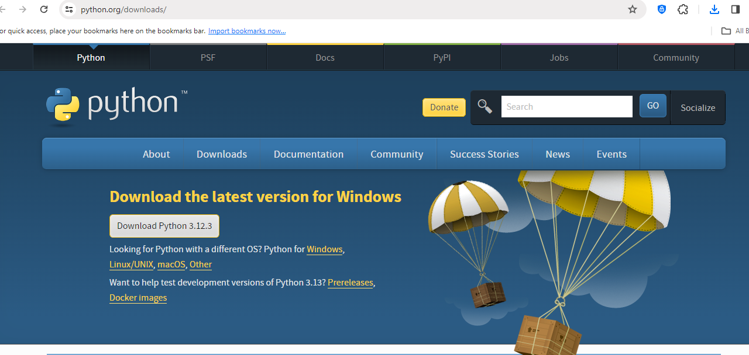
INSTALLATION
Unlimited Powerful Learning
Step 1: Install Python
Download Python Installer: Visit https://www.python.org/downloads/
Choose the appropriate Python version for your operating system.
Download the installer

Slide 15
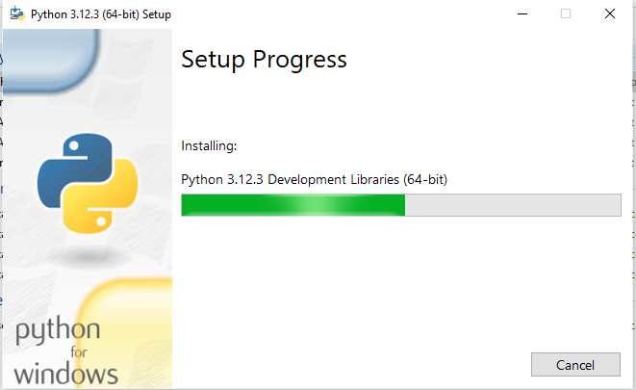
INSTALLATION
Unlimited Powerful Learning
Step 2: Run Python Installer:
Double-click the installer to launch the installation wizard.
Follow on-screen instructions to complete the installation.
Ensure Python is added to PATH during installation.

Slide 16
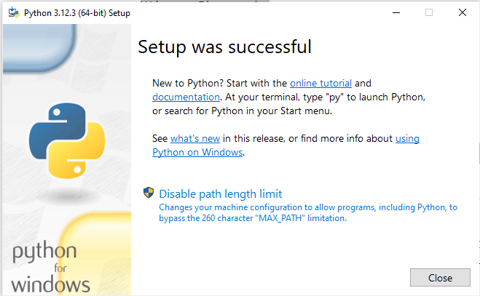
INSTALLATION
Unlimited Powerful Learning

Slide 17
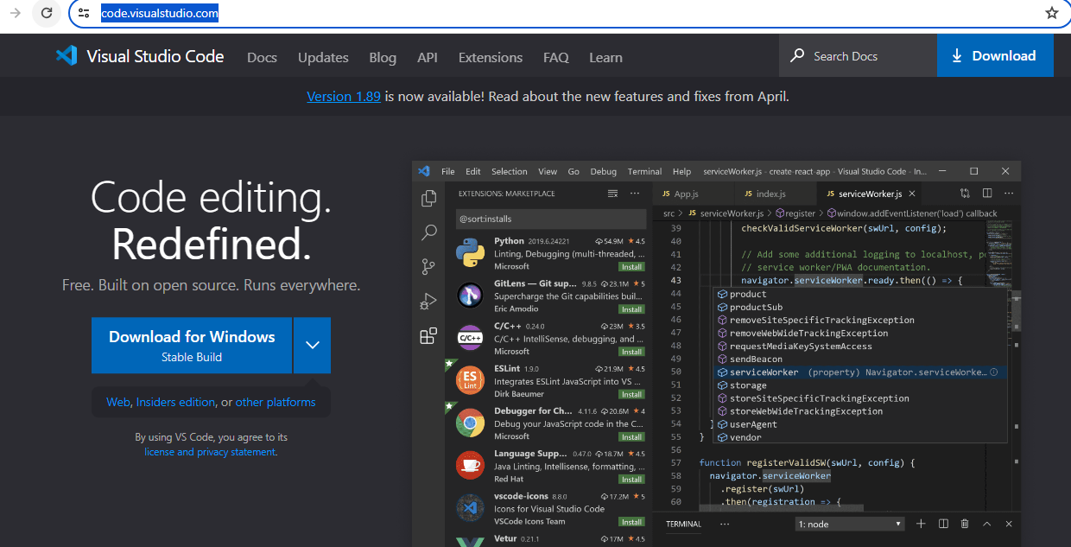
INSTALLATION
Unlimited Powerful Learning
Step 3:Download VS Code Installer:
Visit https://code.visualstudio.com/
Download the installer for Windows.
Run VS Code Installer:.

Slide 18
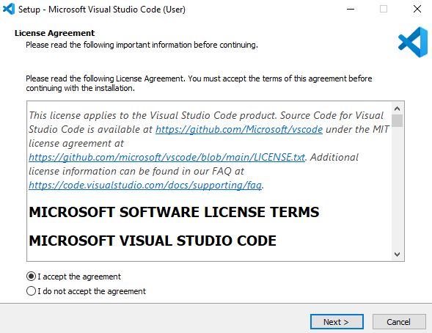
INSTALLATION
Unlimited Powerful Learning
Step 3: Run VS Code Installer:
Double-click the installer to launch the installation wizard.
Follow on-screen instructions to complete the installation.

Slide 19
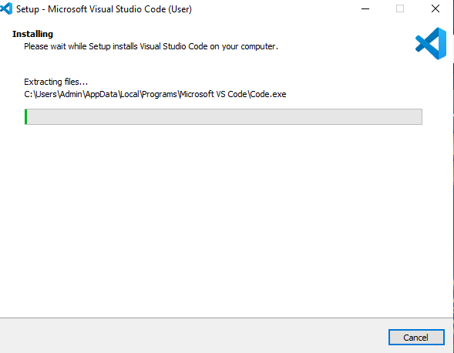
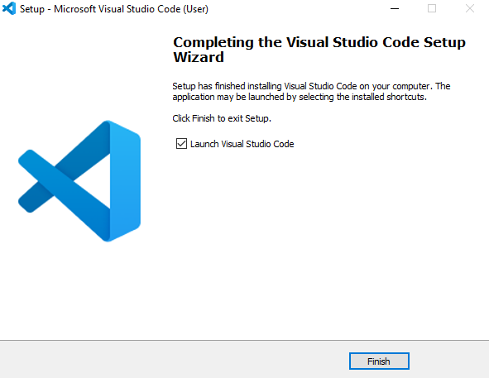
INSTALLATION
Unlimited Powerful Learning
Run VS Code Installer:.

Slide 20
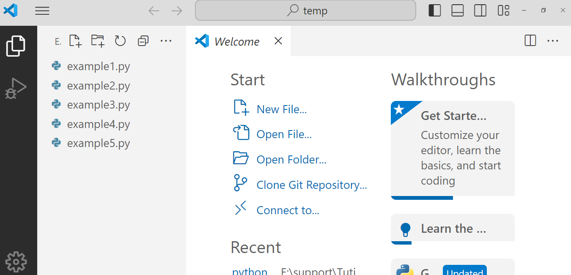
INSTALLATION
Unlimited Powerful Learning
Run VS Code Installer:.

Slide 21
INSTALLATION
Unlimited Powerful Learning
Step 4: Install Django
Open Command Prompt:
Press Win + R, type cmd, and press Enter.
Install Django:
Type pip install django and press Enter.
Wait for Django and its dependencies to install.
Verify django-admin --version
It shows version then Django is installed
Step 5: Create a Virtual Environment:
Following command installs the virtualenvwrapper-win package using pip.
pip install virtualenvwrapper-win
Following command creates a new virtual environment named "mylearn" using virtualenvwrapper-win.
mkvirtualenv mylearn
Following command activates the virtual environment named "mylearn". When a virtual environment is activated
workon mylearn

Slide 22
INSTALLATION
Unlimited Powerful Learning
Step 6 Create a Django Project
Navigate to Desired Directory:
Use cd command to navigate to the directory where you want to create the project.
Create Django Project:
Type django-admin startproject myproject and press Enter.
Replace myproject with your desired project name.
Step 7: Run First Django Program
Navigate to Project Directory:
Use cd myproject to navigate to the project directory.
Run Development Server:
Type python manage.py runserver and press Enter.
Open a web browser and go to
http://127.0.0.1:8000/ to view your Django project.

Slide 23
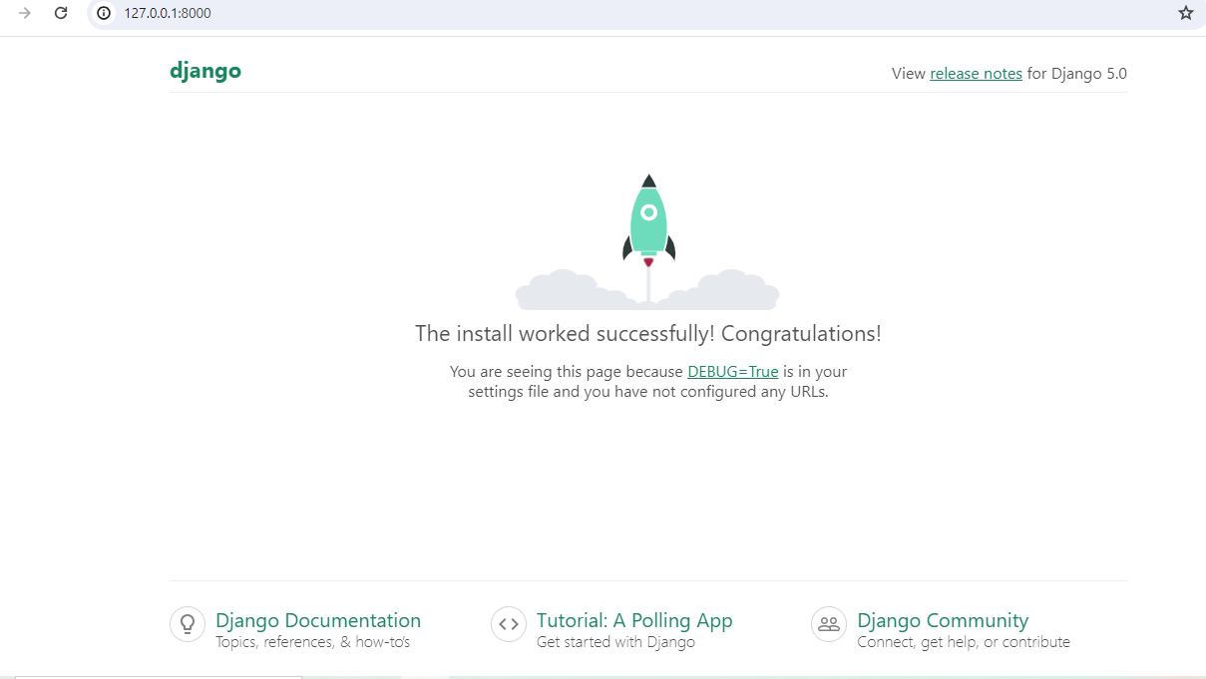
INSTALLATION
Unlimited Powerful Learning

Slide 24
PROJECT STRUCTURE
Unlimited Powerful Learning
django-admin startproject mytest
Directory/File | Description
Project Directory | Main directory for the Django project
manage.py | Command-line utility for interacting with the Django project
settings.py | Configuration settings for the Django project
urls.py | URL patterns for the project
wsgi.py | Entry point for WSGI-compatible web servers
asgi.py | Entry point for ASGI-compatible web servers
Apps | Directory for organizing Django applications
models/ | Contains Python classes representing data models
views/ | Contains logic for processing requests and generating responses
urls.py | URL patterns specific to the app
templates/ | HTML files defining the presentation layer
static/ | Directory for CSS, JavaScript, images, etc.
migrations/ | Contains Python files defining changes to the database schema
static_root/ | Directory where static files are collected during deployment
media_root/ | Directory for storing user-uploaded files

Slide 25


