Slide 1
IBM University Engagement Project Submission
“Exploring the Power of Agentic AI with IBM Granite and LangFlow”

Slide 2

Project Tile – [Write your project title here]
Domain of Project – [ like Agriculture / Education / Healthcare / … ]
Student Name | Recent Passport Photo | Email ID | Mobile number [WhatsApp]
AMAN SHARMA |  | amanvsharma251@gmail.com | 7024606834

Slide 3
Problem Statement(4): College Admission Agent (RAG-Based)
The Challenge:-The college admission process can be confusing and time-consuming for students due to scattered information about admission policies, eligibility criteria, courses, fee structures, application procedures, and important deadlines. Students often struggle to find accurate and updated information from multiple sources.
The Objective:- Build an AI-powered College Admission Agent using Retrieval-Augmented Generation (RAG) that provides accurate, reliable, and up-to-date admission guidance to student
Admission Information Retrieval – Retrieve relevant information about admission policies, eligibility criteria, and institutional guidelines from trusted sources.
Course Selection Guidance – Help students explore available courses and understand their requirements.
Eligibility Assistance – Provide information about admission eligibility based on institutional criteria.
Application Guidance – Guide students through application procedures and required steps.
Fee Structure Information – Retrieve and summarize course-wise fee details.
Deadline & FAQ Assistance – Provide information about important admission dates, deadlines, and frequently asked questions.
RAG-Based Responses – Generate contextual and reliable answers using retrieved information from institutional databases and official sources.

Slide 4
Proposed Solution:-
The proposed solution is an AI-powered College Admission Agent built using IBM Granite models and IBM Cloud Lite services. It uses Retrieval-Augmented Generation (RAG) to provide students with accurate, context-aware, and reliable admission-related information.
At its core, the system uses a RAG pipeline to retrieve relevant information from institutional documents, admission guidelines, official websites, eligibility criteria, fee structures, and FAQs. The retrieved information is processed and provided as context to the IBM Granite model.
The system works through the following steps:
User Query: Students ask admission-related questions in natural language through the chatbot interface.
Information Retrieval: The system searches its knowledge base to find relevant information related to the student's query.
Context Processing: Relevant retrieved information is provided as context to the AI model to improve response accuracy.
AI Response Generation: IBM Granite processes the query and retrieved context to generate meaningful, easy-to-understand answers.
Admission Assistance: The agent provides guidance regarding course selection, eligibility criteria, application procedures, fee structures, admission policies, and important deadlines.
Reliable Information: Responses are generated using retrieved institutional information, helping reduce incorrect answers and improving transparency.
IBM Granite models power natural language understanding and response generation, while IBM Cloud Lite services provide the cloud environment for building and deploying the solution.

Slide 5
Technology Used:-
1. IBM Granite Model (via IBM watsonx.ai) – Used for natural language understanding, processing student queries, and generating contextual admission-related responses.
2. IBM Cloud / IBM watsonx.ai – Provides access to IBM's AI models and cloud-based services for building the College Admission Agent.
3. LangChain – Connects the language model, document retrieval system, and other components to build the RAG pipeline.
4. RAG (Retrieval-Augmented Generation) – Retrieves relevant information from admission documents and provides it as context to the AI model for accurate responses.
5. ChromaDB (Vector Database) – Stores document embeddings and enables semantic similarity search to retrieve relevant admission information.
6. Sentence Transformers (Embedding Model) – Converts documents and user queries into numerical vector representations for semantic search.
7. Streamlit – Used to develop an interactive web interface where students can ask admission-related questions and receive AI-generated responses.
8. PyPDF – Extracts text from PDF documents such as admission brochures, guidelines, and institutional documents.

Slide 6
Component Used -
1) Streamlit – User Interface
Provides an interactive chatbot interface where students can enter admission-related questions and receive responses.
2) PyPDF – Document Loader
Extracts text from PDF documents such as college admission brochures, eligibility criteria, fee structures, and guidelines.
3) LangChain – RAG Framework
Connects document processing, embeddings, vector database retrieval, and the language model to create the RAG pipeline.
4) Sentence Transformers – Embedding Model
Converts extracted document text and user queries into numerical vectors for semantic understanding and similarity search.
5) ChromaDB – Vector Store
Stores document embeddings and retrieves relevant information based on the similarity between student queries and stored documents.
6) IBM watsonx.ai – LLM Integration
Connects the application to IBM Granite models for processing retrieved information and generating contextual responses.
7) IBM Granite Model – Response Generation
Uses the retrieved admission information to generate clear, relevant, and natural-language answers.

Slide 7
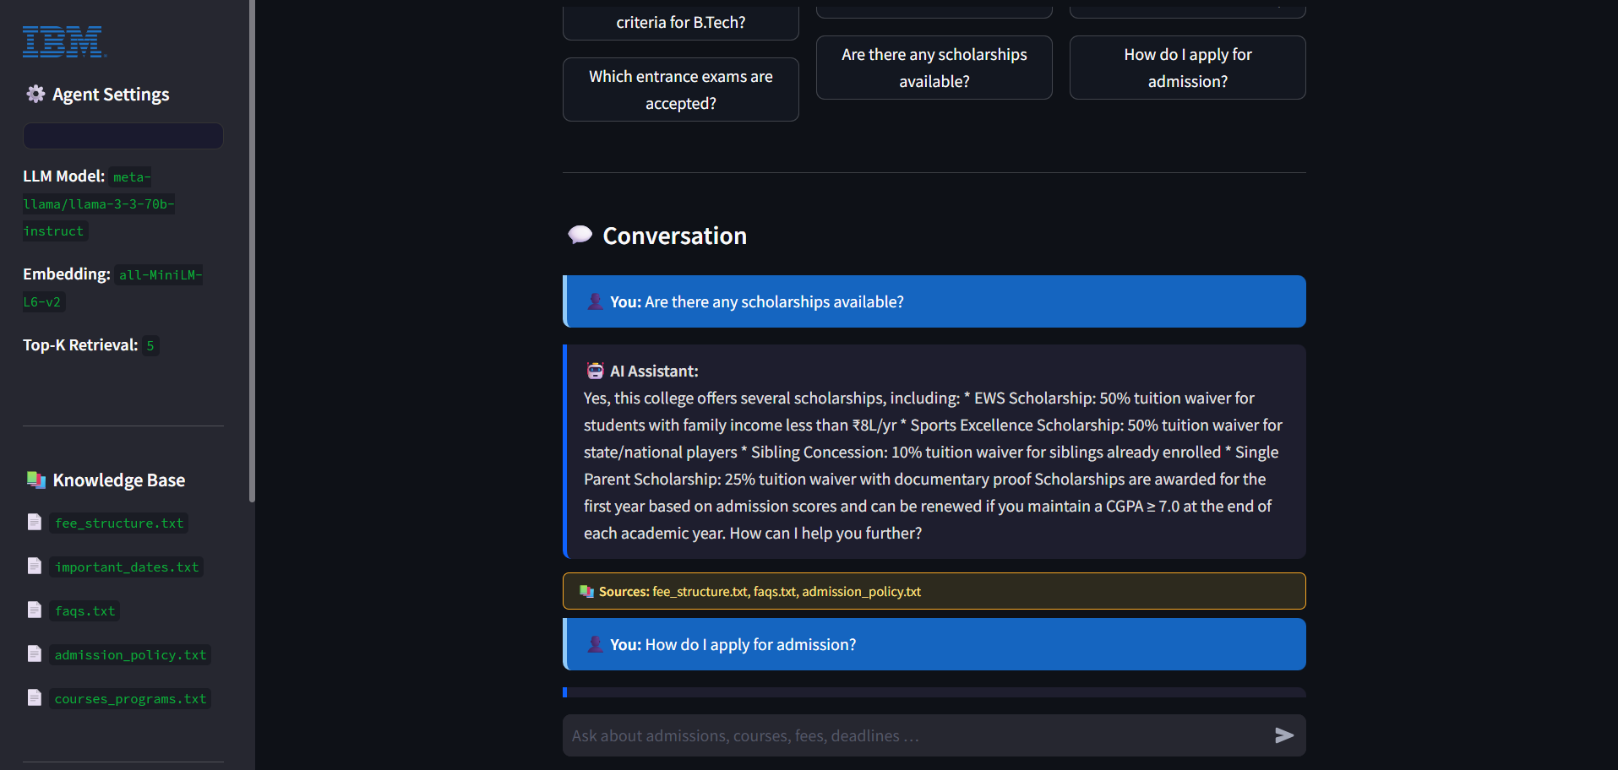
Langflow workflow -

Slide 8
Architecture blueprint
Student
Streamlit Web UI
Agent Orchestrator
Rag Engine
(Chroma db)
IBM Granite LLM
(watsonx.ai)
Knowledge Base
(.txt documents)
[Student] → [Streamlit Web UI] ↓ [Agent Orchestrator] ↙ ↘ [RAG Engine] [IBM Granite LLM] (ChromaDB) (watsonx.ai) ↓ [Knowledge Base] (.txt documents)

Slide 9

Role of Agentic AI in the solution
Role of Agentic AI in the College Admission Agent:-
Agentic AI enables the College Admission Agent to function as an intelligent, autonomous system rather than a simple keyword-based FAQ bot. Using IBM Granite models on IBM watsonx.ai, the agent retrieves relevant admission knowledge and generates precise, grounded responses without human intervention at each step.
Autonomous Retrieval and Reasoning – The RAG engine automatically finds the most relevant knowledge base chunks using semantic search (MMR). IBM Granite then reasons over these chunks to construct a factual, context-grounded answer.
Context Awareness – The agent maintains a 5-turn conversation memory, allowing it to understand follow-up questions such as 'What about the fee for that program?' without requiring the student to repeat context.
Goal-Driven Behaviour – A structured system prompt guides the agent to answer strictly from retrieved context, never hallucinate policies or fees, and redirect students to the admissions office when information is unavailable.
Knowledge Grounding and Transparency – Every answer cites its source documents (e.g. fee_structure.txt, faqs.txt), making agent transparent and accountable

Slide 10
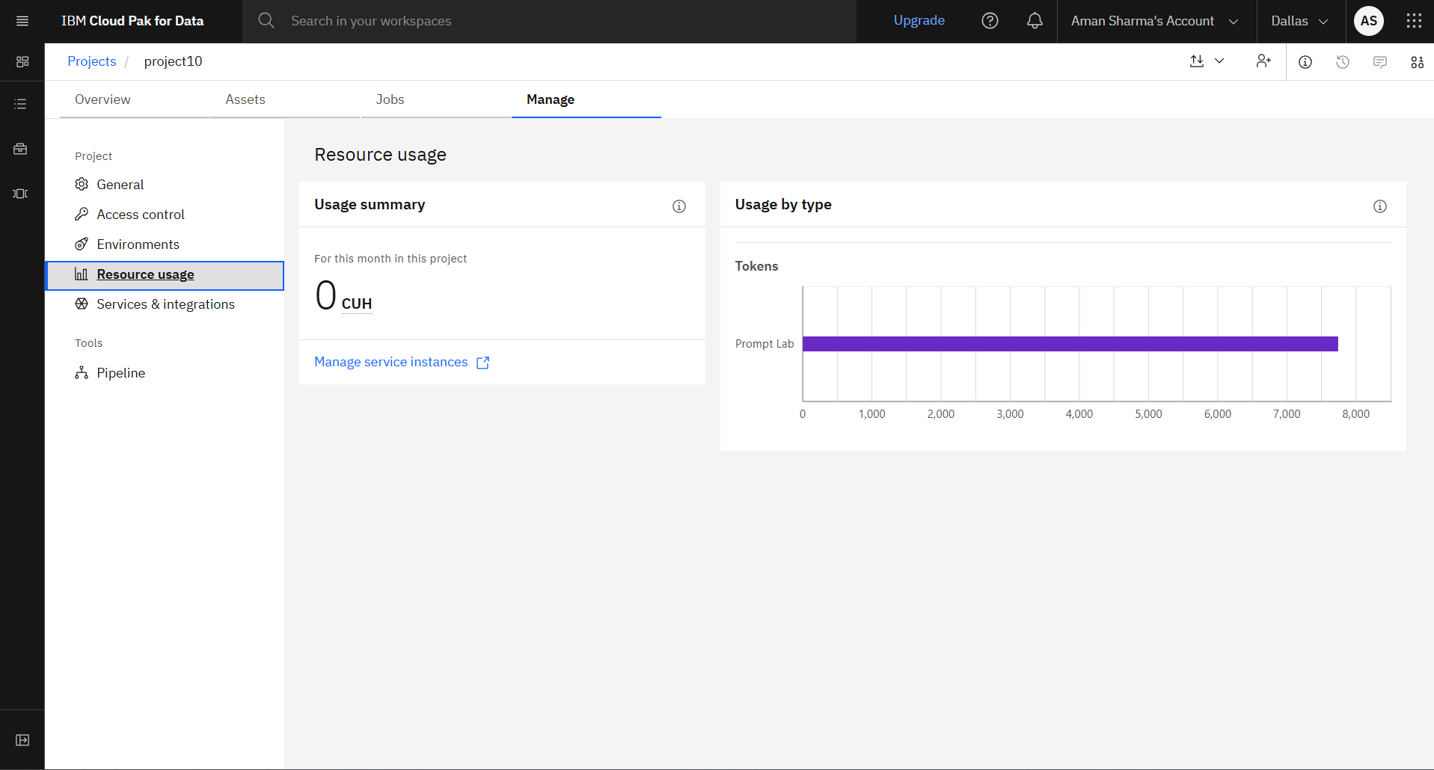
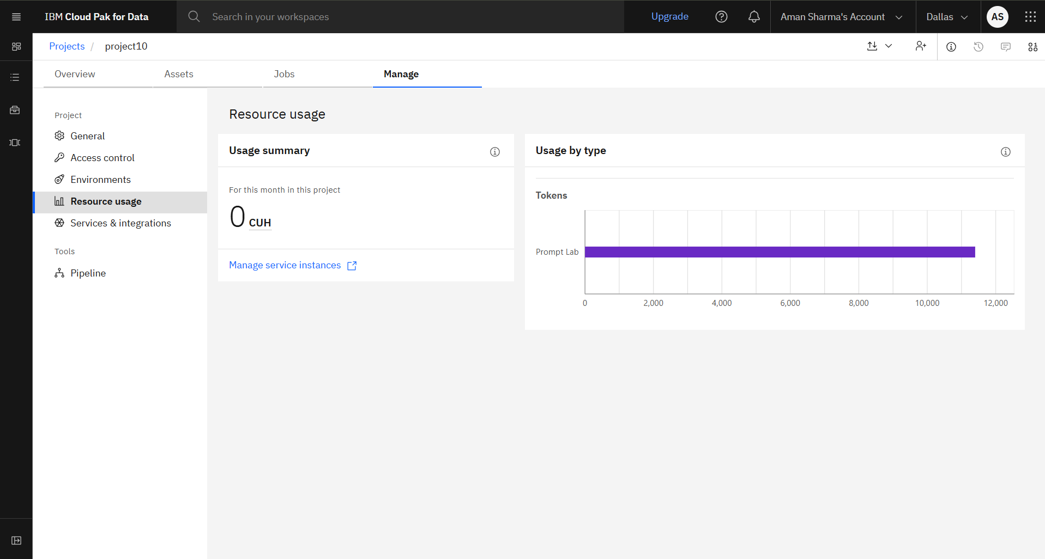
Token Usage
3000+ token are used
Before Prompt
After the Prompt
·
·
·

Slide 11
Novelty and Uniqueness
The College Admission Agent stands out by combining RAG, IBM Granite, and conversational memory into a single trustworthy, hallucination-free admission assistant.
Hallucination-Free Answers – Every answer is strictly grounded in retrieved knowledge base chunks. IBM Granite is explicitly instructed never to invent fees, dates, or policies — making every response factual and reliable.
Source Transparency – Every response cites the exact source document it used (e.g., fee_structure.txt, faqs.txt), making the agent fully transparent and accountable to students.
Conversational Memory – Maintains 5-turn conversation history, enabling natural multi-turn interactions and context-aware follow-up questions without repeating information.
Zero-Cost Local Embeddings – Sentence-transformers run entirely on local CPU with no external embedding API cost, making the solution economical and independent.
Live Knowledge Base Updates – Drop new .txt or .pdf documents into the knowledge base folder and rebuild in one click — no code changes required, making it easy to keep information current.
IBM watsonx.ai Governance – Built on IBM's enterprise AI platform ensuring secure, governed, and auditable model inference with full compliance support.
This makes the solution a trustworthy, transparent, and scalable digital admission counsellor.

Slide 12
Git Hub Link :-
https://github.com/amanvsharma251-hue/ibm_project.git
·
·
·

Slide 13
Future Scope
1. Real-Time Data Integration with University APIs
Connect the agent with live university portals and APIs to retrieve real-time merit list updates, seat availability, and application status. This will reduce manual document updates and keep the knowledge base up to date.
2. Multi-Institution Support
Extend the agent to support multiple colleges and universities, enabling students to compare admission criteria, fee structures, and placement statistics through a single conversation.
3. Voice-Enabled Multilingual Interface
Integrate speech-to-text and text-to-speech capabilities with support for multiple Indian languages, including Hindi, Tamil, and Bengali, making the assistant accessible to students from diverse linguistic backgrounds.
4. Personalized Admission Prediction
Integrate an AutoAI-based predictive model trained on historical admission data to estimate admission probabilities based on academic marks, entrance exam scores, category, and course preferences, providing personalized and data-driven guidance.
5. Integration with National Admission Portals
Integrate with national admission and counselling portals such as JoSAA, CSAB, and CAP to retrieve counselling round updates and help students navigate centralized admission processes efficiently.

Slide 14
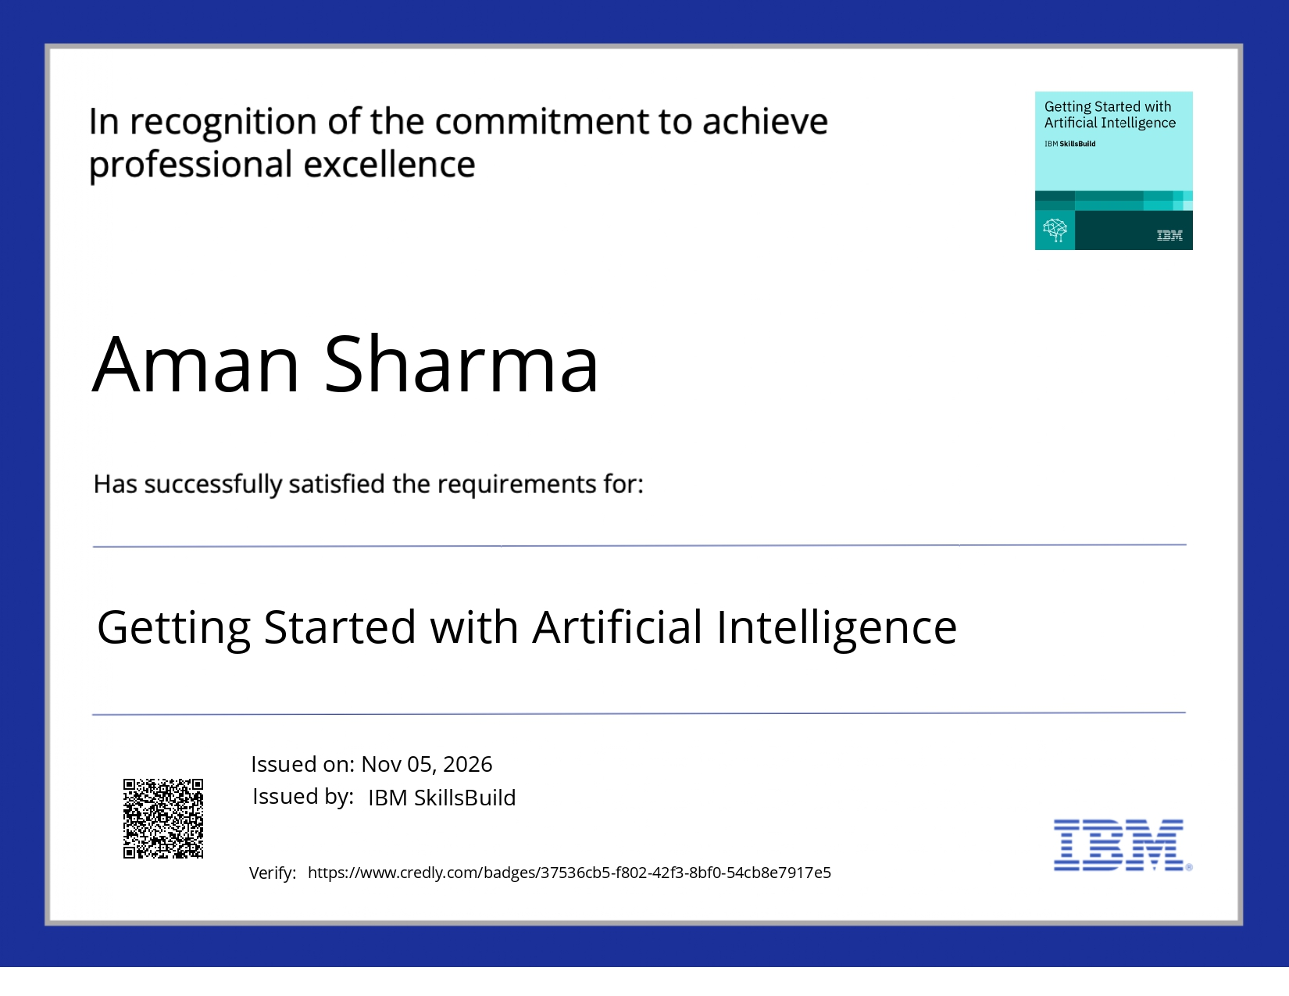
Certificates Earned:

Slide 15
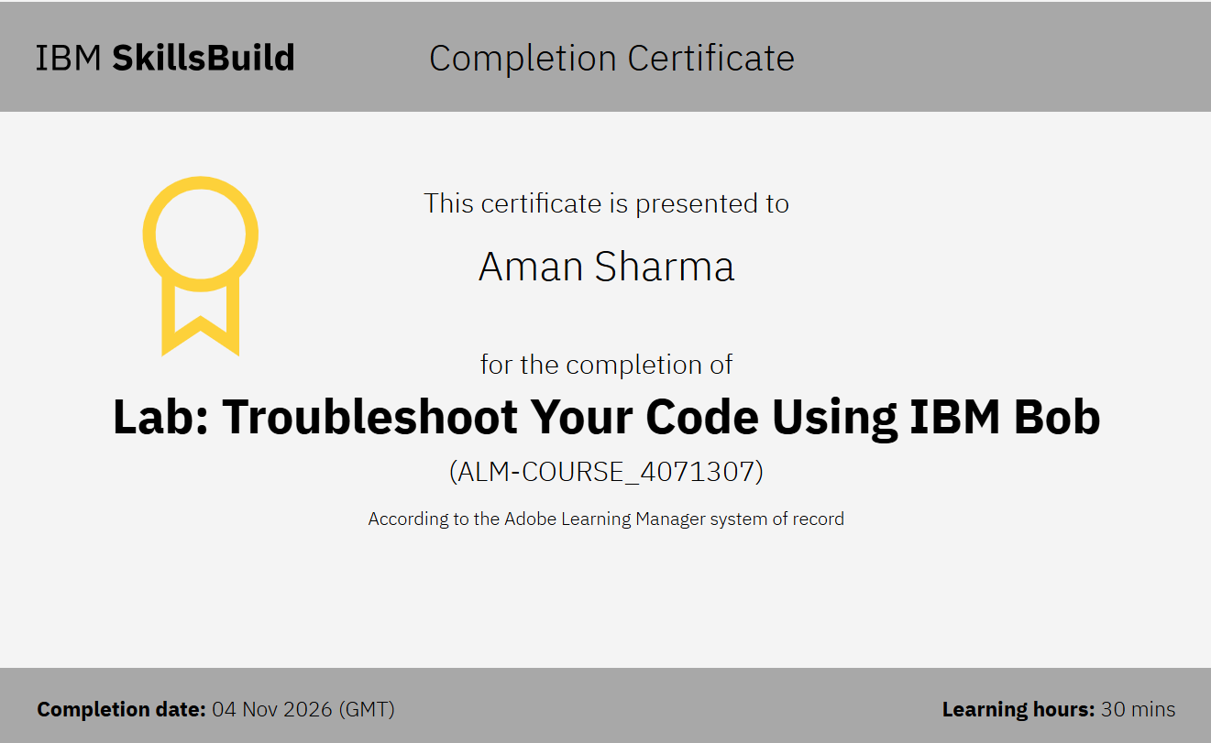
Certificates Earned:​

Slide 16


